Slide 1
KI i arbeidshverdagen min
Avdelingsmøte SAND, 22. oktober 2026
Guillermina Senn

Slide 2
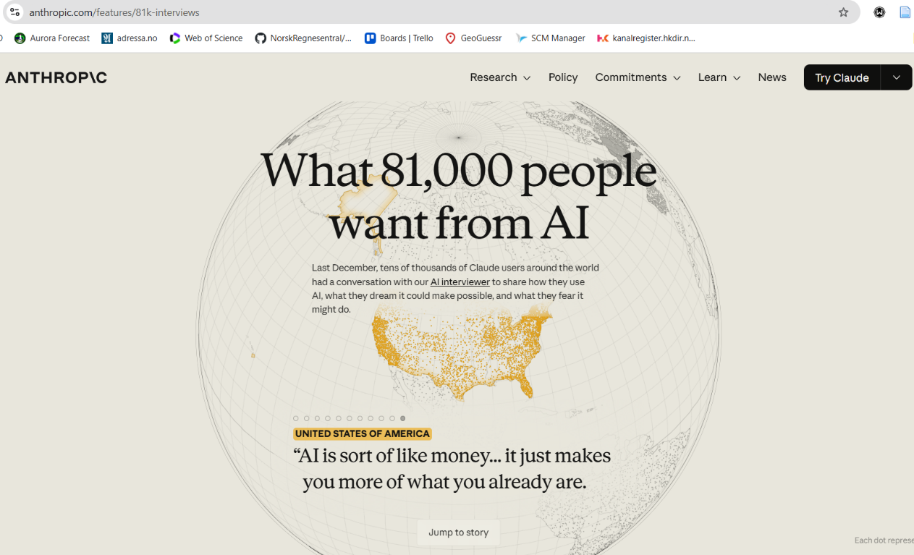
Hvorfor snakke om KI bruk
Notes:
If we are different, AI will amplify these differences. I want to show my setup and I am curious about other people’s setups because I suspect they can largely differ from mine.

Slide 3
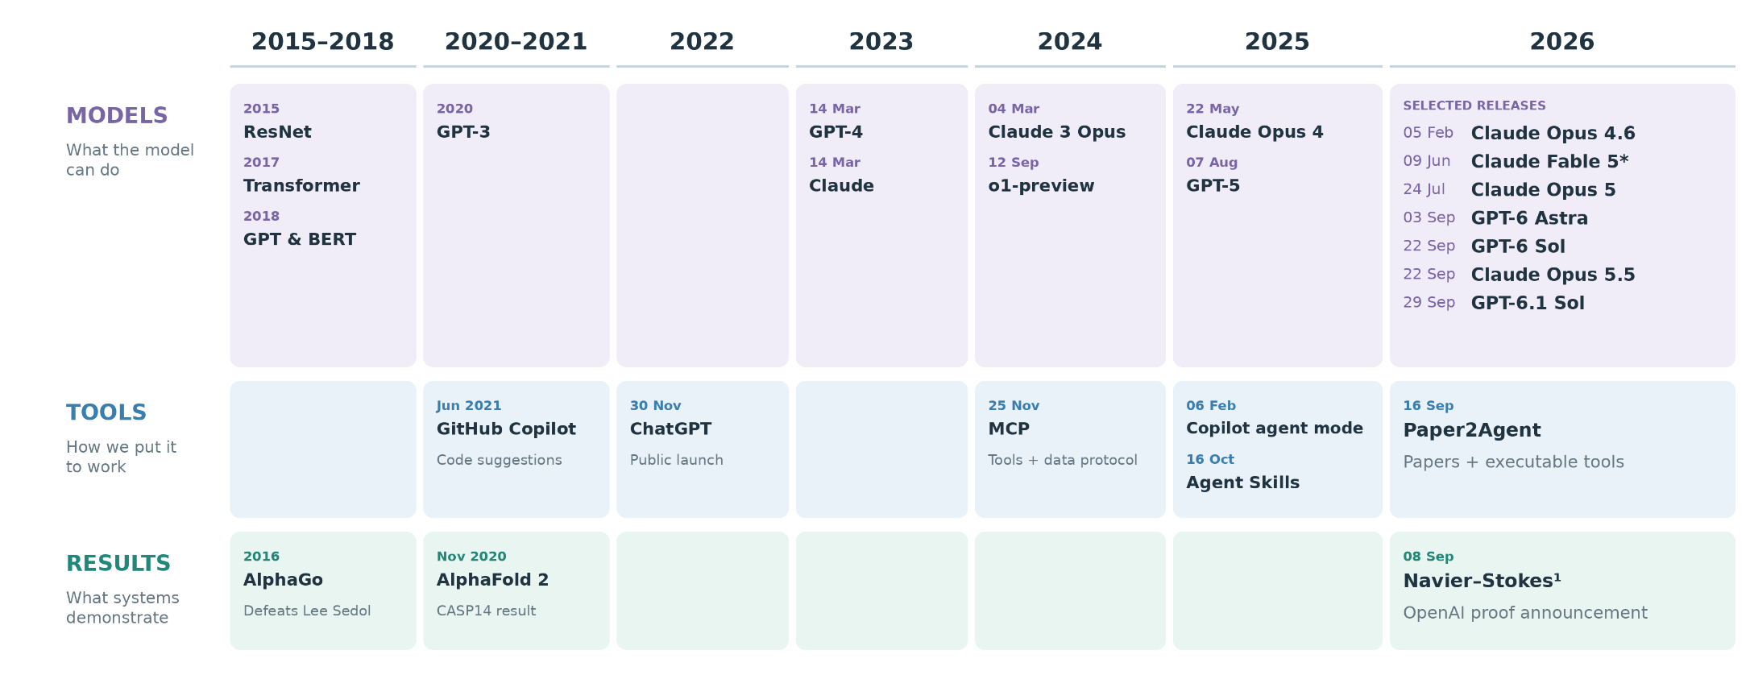
KI-tidslinje
(multimodal)

Slide 4
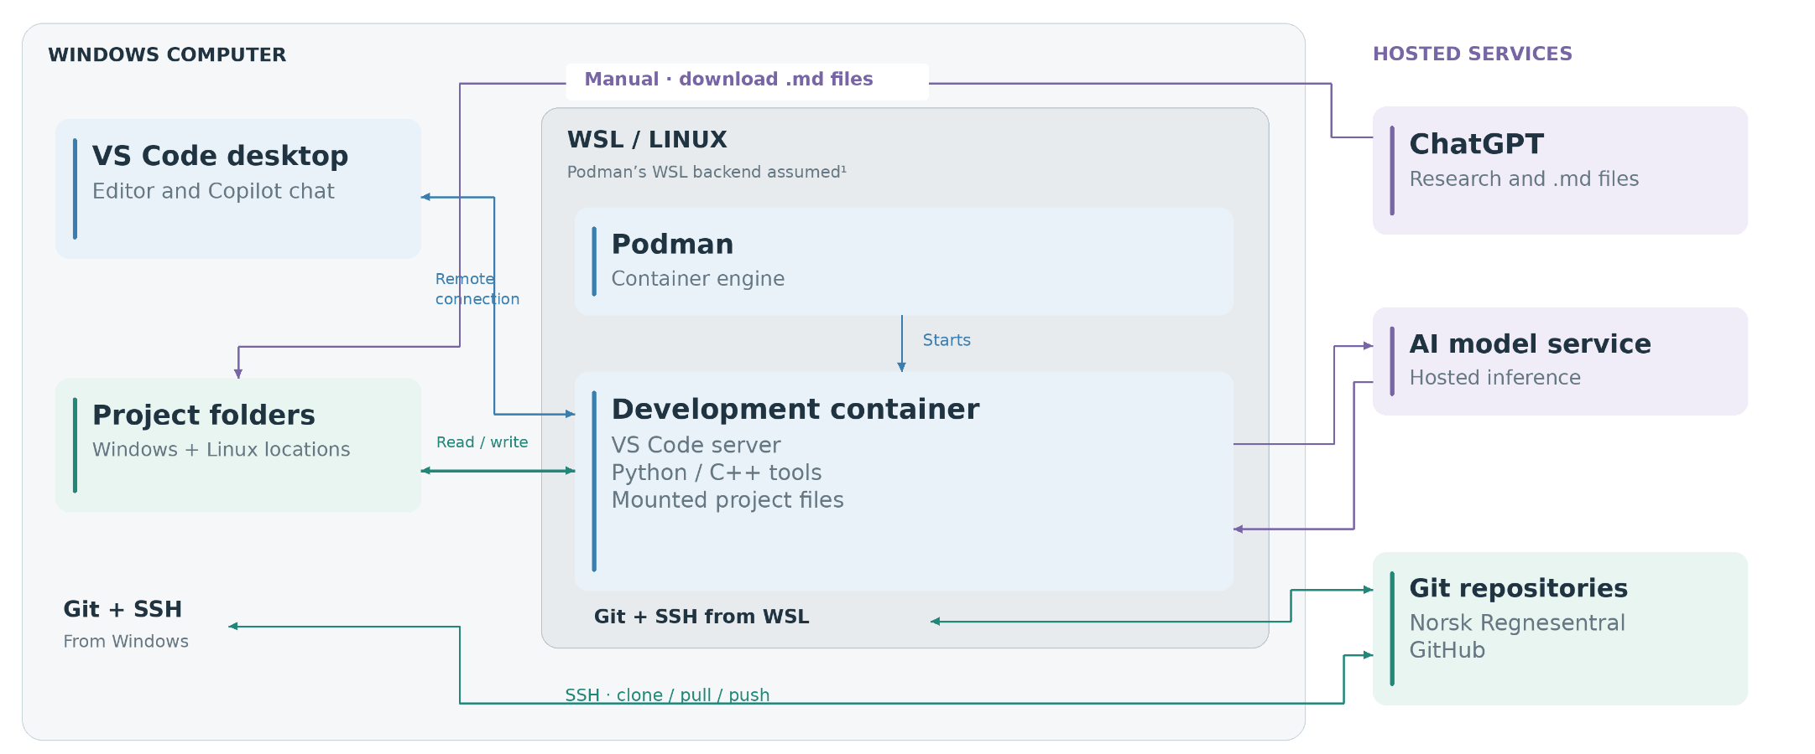
Arbeidsinnstillingene mine
Notes:
Windows VS Code interface + project files
│WSL / Ubuntu
Linux host environment + container launcher + SSH agent
│Development container
VS Code server + AI coding tools + Python/Rust + Git

Slide 5
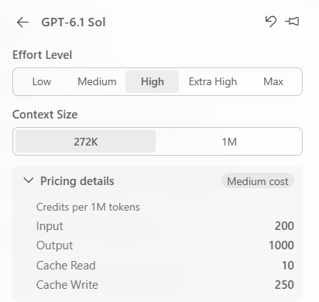
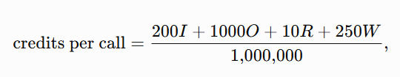
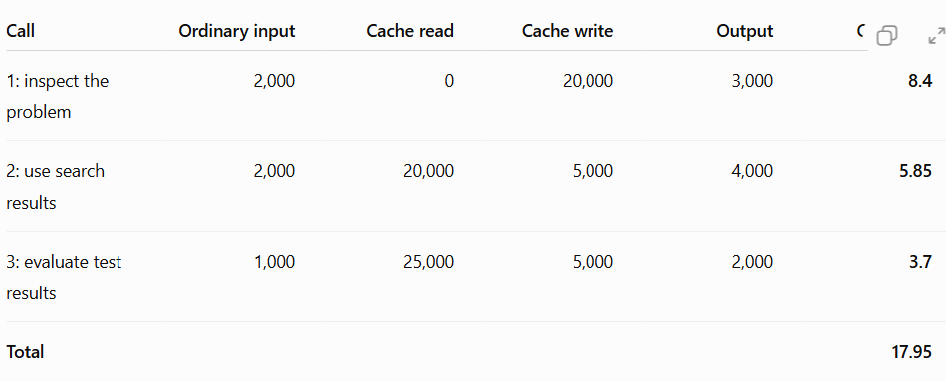
AI model services
Token-based monetization:

Slide 6
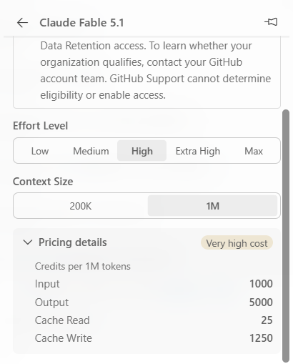
Optimal use of AI model services
Def: A solution to a programming task is optimal if it is simple, fast, and precise.
Idea: stronger model
Is it worth it?
5x

Slide 7
Next:
(how to not use Fable)
Some definitions needed first: context, model, agents

Slide 8
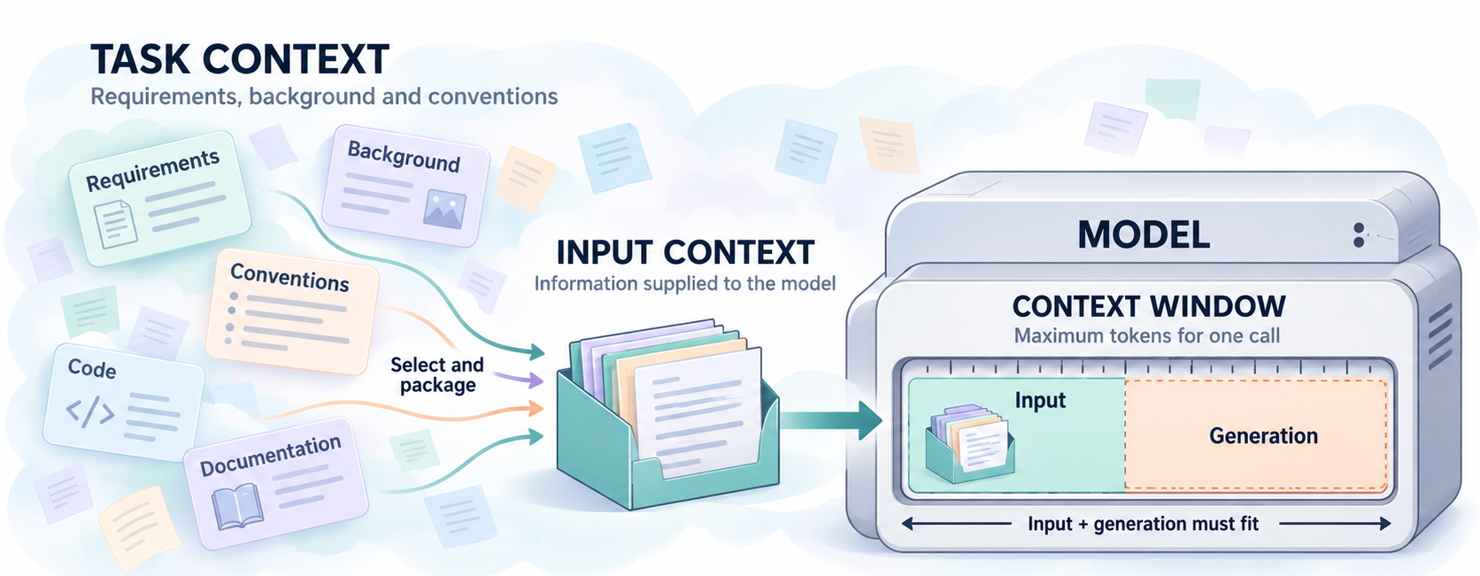
Three meanings of context
Notes:
Input context: Information supplied to model.
Context window [tokens]: Maximum sequence length for one call (input + generation)
Task context: Requirements, background, conventions.
How is context assembled in VS Code?
Hva hvis jeg ikke vil gjenta instruksjonene til agenten?

Slide 9
Models
Intelligence \approx model capability
Strong model:
Better training
Better reasoning
Better use of context
My claim:
Strong model + bad context less optimal than weaker model + careful context
More context != good context.

Slide 10
How I organize context
Give each type of information a clear home:
README.md — What the project is and where to start.
HOWTO.md — How to use it: practical workflows and examples.
AGENTS.md — Stable project context and working rules for AI agents.
Instructions folder — Focused rules.
Plans folder
Skills folder
This organization matches VS Code’s configuration.
Notes:
Better context resolves ambiguity and reduces the work the model must perform.

Slide 11
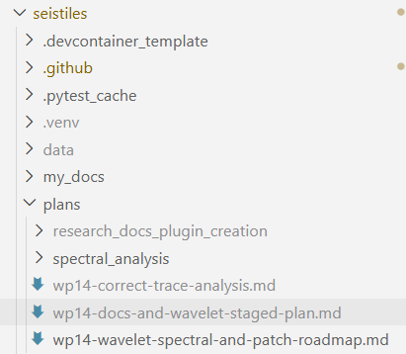
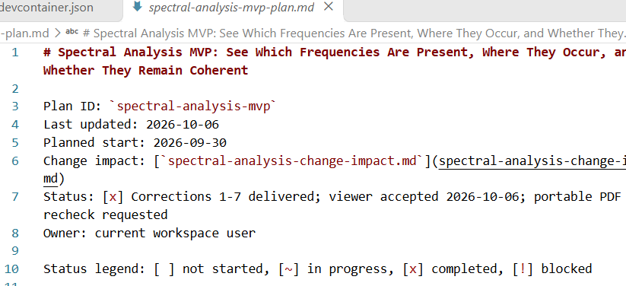
Plans
Def: living document that turns a goal into clear, ordered steps.
.md with date, stages and status
Notes:
Create plan with the best model you can.
Personally: GPT Sol/Astra 6 High for software or doc planning, Extra high for statistics
Execute plan with a cheaper model without falling back to 2023.
Personally: GPT Codex 5.3 Medium or High, Low only for basic basic. If it fails, improve to GPT Sol 6.1. Alternative is Auto in balance mode.
NOTE: Ask: GPT Sol 6 High for difficult math, Auto intelligence/balance otherwise.

Slide 12
Plans
Def: living document that turns a goal into clear, ordered steps.
Create with the best model you can afford.
Sol/Astra High for software
Extra-high for math
Implement with a cheaper model
Codex 5.3, 5.5
Auto (10% discount)
Fails? Change model
Notes:
Create plan with the best model you can.
Personally: GPT Sol/Astra 6 High for software or doc planning, Extra high for statistics
Execute plan with a cheaper model without falling back to 2023.
Personally: GPT Codex 5.3 Medium or High, Low only for basic basic. If it fails, improve to GPT Sol 6.1. Alternative is Auto in balance mode.
NOTE: Ask: GPT Sol 6 High for difficult math, Auto intelligence/balance otherwise.

Slide 13
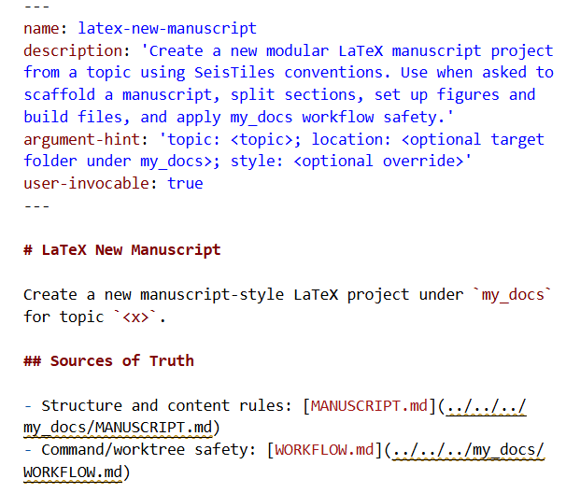
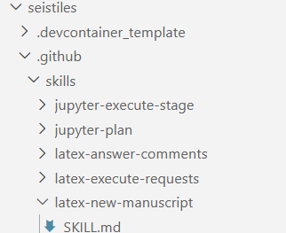
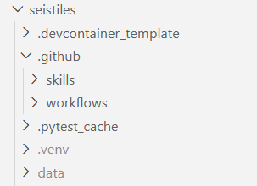
Skills
Def: Reusable package of task-specific instructions.
Invoke:
explicit with /<skill-name>
implicit (Copilot finds it).

Slide 14
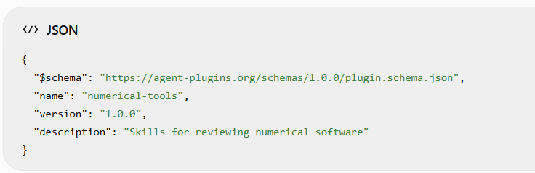
Plugins
Def: installable bundle of related customizations (skills, tools, custom agents)
Coordinated with a .json:
Chat: Install Plugin From Source in the Command Palette and supply its repository URL.
Available for all VS Code.

Slide 15
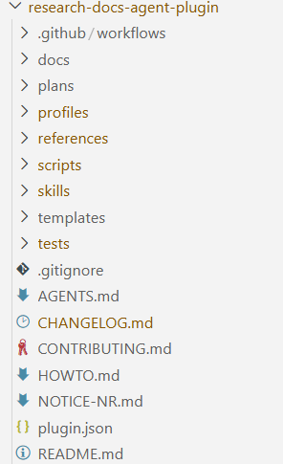
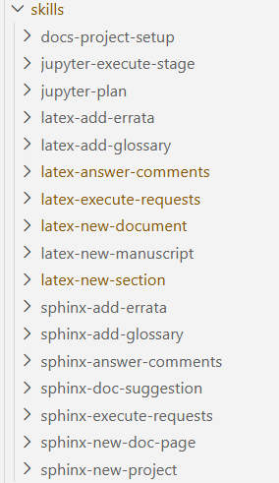
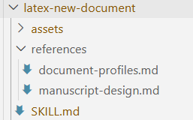
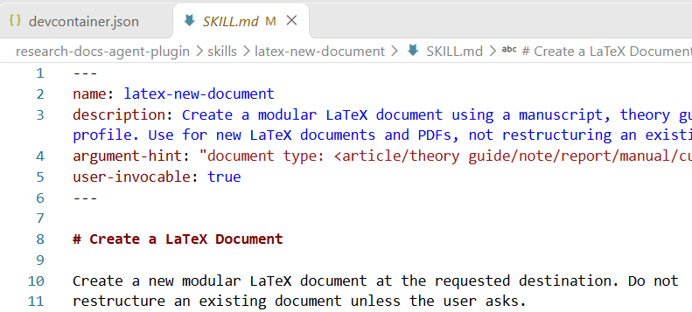
“research-docs” plugin

Slide 16
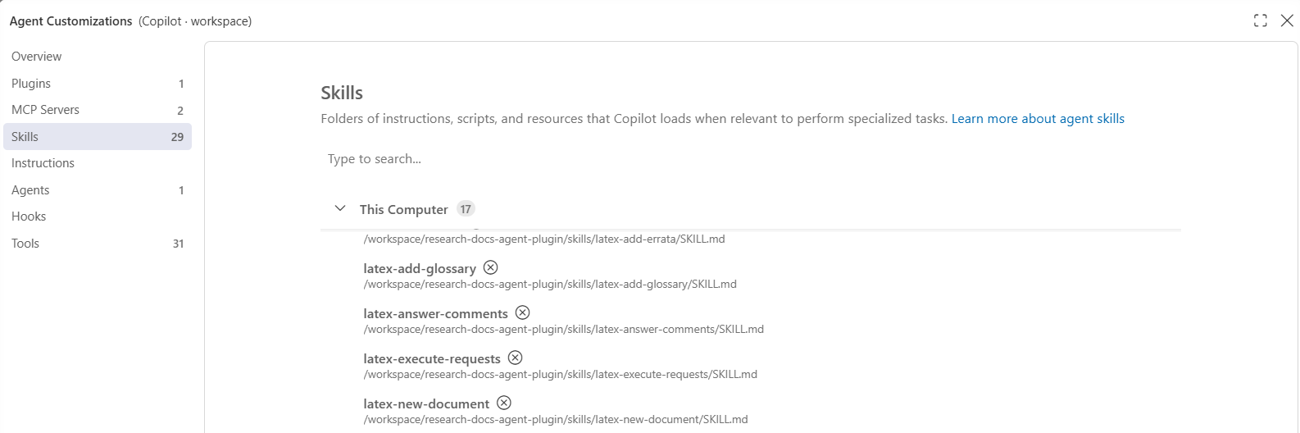
(Ctrl+Shift+P) Chat: Open Customizations.

Slide 17
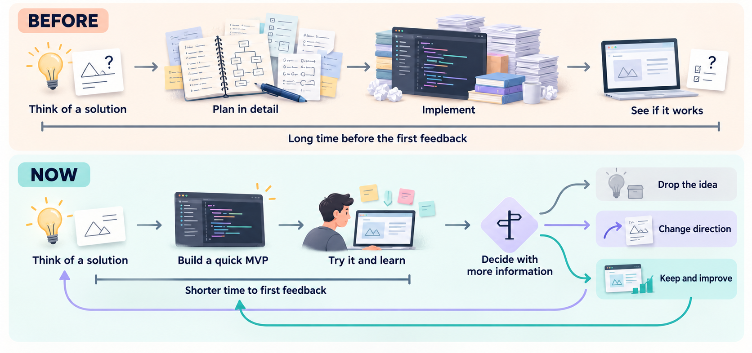
Is agentic coding the optimal way to go?
Notes:
I’ve moved from think, plan, execute, to plan, execute, think, refine
We have to look at this long term. I migth be lost now in the sea of information but if I had had this for the 2nd paper of my Phd, I would have known in a couple of weeks that it was a bad idea and that I should focus on something else. Same now I can create a mockup of what my idea will look like, test it, and discard it, or refine it. It has given us the ability of seeing the future. The price we pay is lower quality and precision in the beginning. I think software projects now might need two layers, one layer for building the mvp, and a second layer for building the final project.

Slide 18
References
https://code.visualstudio.com/docs/agents/best-practices
Notes:
Prompting:
Goal: Create a plan to implement and visualize spectral decomposition in SeisTiles. […]
Relevant context: codebase-guide, theory-guide, AGENTS.md
Constraints: Do not modify the existing visualization layer. […] Ask me questions if unsure.
Acceptance criteria: […]
Workflow:
Staged plan for complex work
After each stage, stop and human-review.

Slide 19
Agents
Def: AI agent is a system that pursues a goal by iteratively acting, observing, and deciding. Ex:
Def: Agent harness: System that manages the agents + context, execution, permissions, session state. Ex: GitHub Copilot
Be explicit with input context

