Slide 1
Homework Time!
Preview of Unit 1 Homework

Slide 2
Objectives
To organize and analyze data using Excel – specifically through:
Formulas
Conditional Formatting
Pivot Tables & Pivot Charts

Slide 3
Full Instructions & Data Set
Found in 01-Excel > Homework > Instructions > README.md
Data contained in StarterBook.xlsx

Slide 4
Background
$2B raised on Kickstarter, but not every project is a success
Only a third of projects are successful
Getting funded on Kickstarter requires meeting or exceeding the project’s initial goal
Many organizations analyze past data to discover “tricks” for finding success
For this week’s homework, you will organize and analyze a database of 4,000 past projects in order to uncover any hidden trends

Slide 5
Before You Begin
Create a new space called “excel-challenge”
Drop Box or Google Drive
Do not add homework this homework to an existing space (I.E. Prework folder!)
Store your excel workbooks in this new space, and make share you create a sharable link for submission

Slide 6
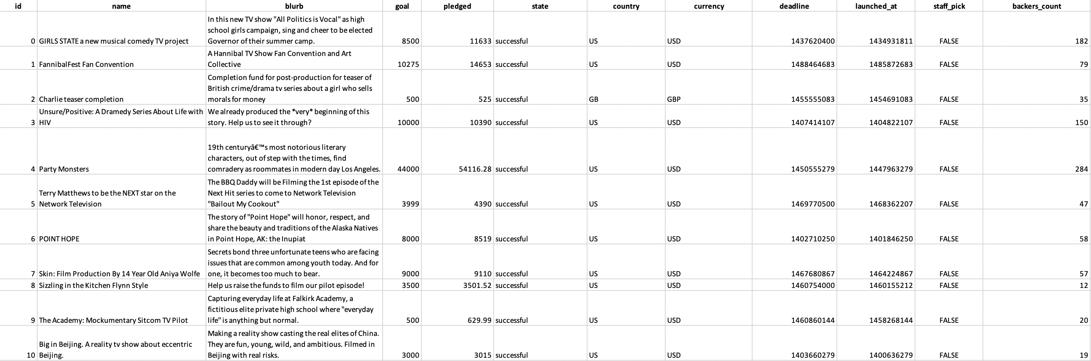
Starting Data

Slide 7
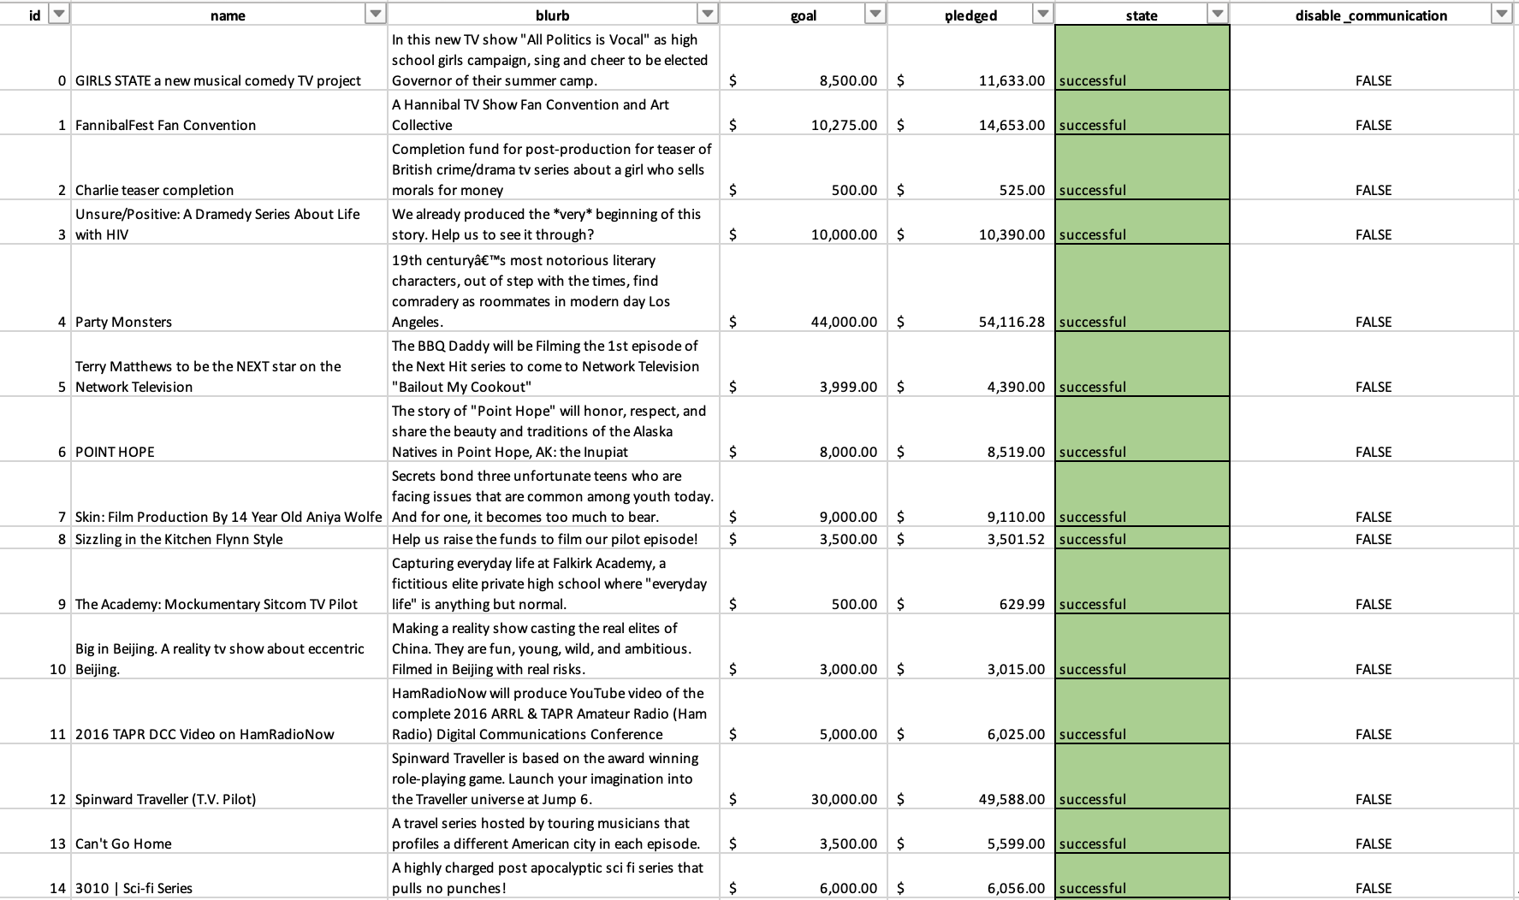
Conditional Formatting Example
In this case, we used conditional formatting to highlight each cell in green within the ‘state’ column if project was successful
In your homework, you will expand on this and include other colors to highlight whether the project failed, was canceled, or is currently live

Slide 8

Using Formulas Example
By using formulas, we created two new columns called Average Donation and Percent Funded
Manipulating and analyzing data with the help of formulas allows us tell a more powerful story

Slide 9
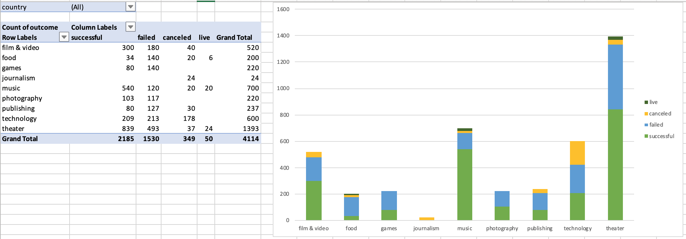
Pivot Table & Pivot Chart Examples

Slide 10
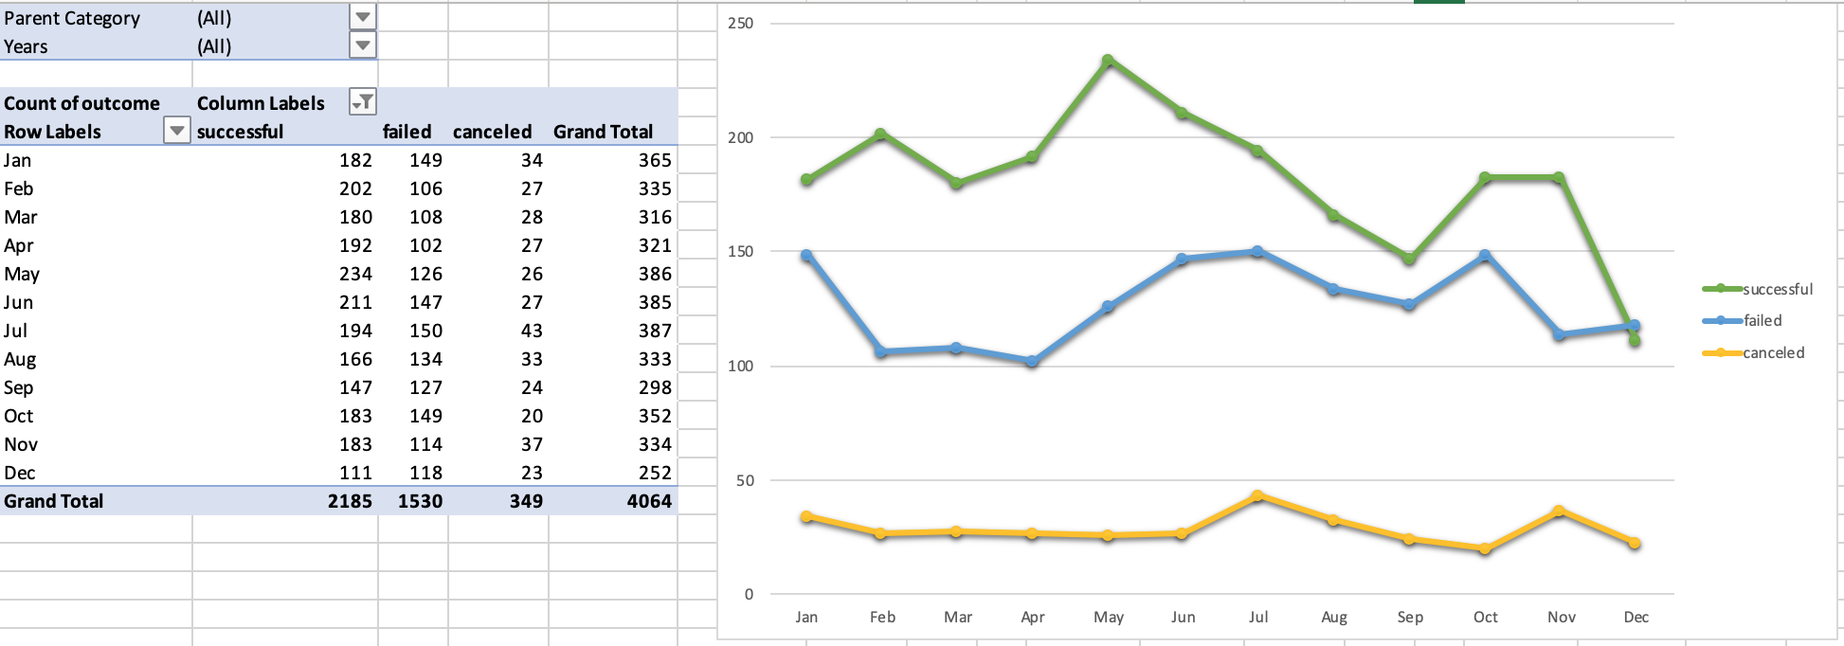
Pivot Table & Pivot Chart Example
To view more examples, navigate to Homework > Instructions > Images

Slide 11
Microsoft Word Report
Create a report in Microsoft Word document and answer the following:
1. Given the provided data, what are three conclusions we can draw about Kickstarter campaigns?
2. What are some limitations of this dataset?
3. What are some other possible tables and/or graphs that we could create?
Save this report and add it to your “excel-challenge” space

Slide 12
Bonus (Optional)
Part 1:
Find and graph the relationship between a goal’s amount and its chances at success, failure, or cancellation
Part 2 – Statistical Analysis:
Create your own summary statistics table

Slide 13
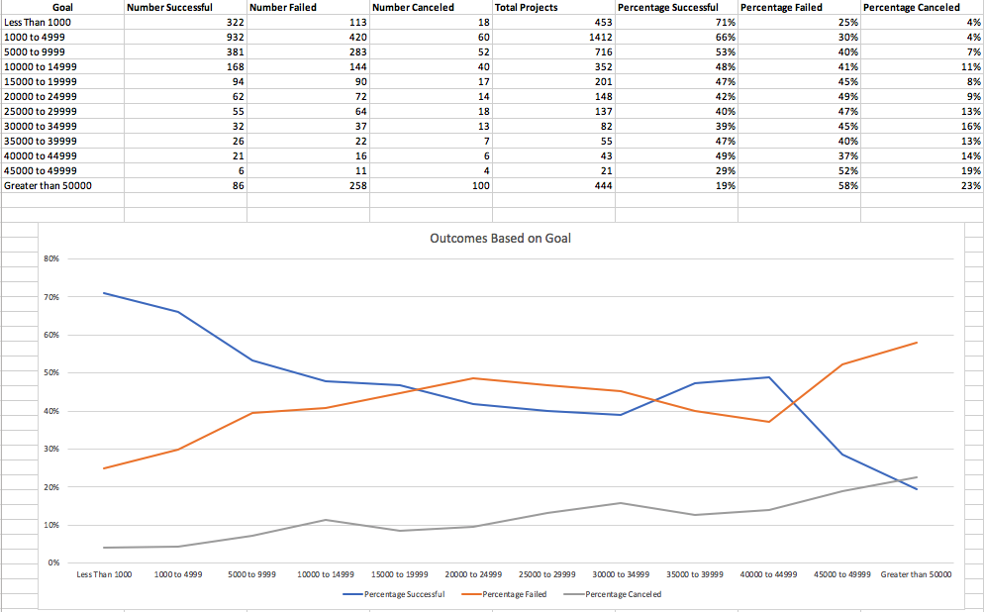
Bonus Example – Part 1

Slide 14
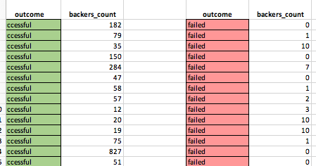
Bonus Example – Part 2

Slide 15
Submission
Upload the files to your Drop Box or Google Drive you created for this assignment
Submit link to bootcampspot.com
Make sure the link is sharable!

Slide 16

Questions?

