Slide 1
Homework Time!
Preview of Unit 3 Homework

Slide 2
Objectives
Practice using Git
Creating your first repository on GitHub
Cloning to your machine
Pushing your assignment to GitHub
Practice using Python for data analysis
Importing ‘csv’ file
Storing contents to variables
Looping
Calculations
Debugging!

Slide 3
Full Instructions & Data Set
Found in 03-Python > Homework > Instructions > README.md
Data contained in PyBank and PyPoll folders

Slide 4
Background
Python is widely used in mathematical and financial careers due to its ability to process and analyze large data sets
For Part 1 of the assignment, we will pretend we’re financial analysts and use Python to analyze financial records for a company.
For Part 2 of the assignment, we will use Python to analyze voting data to help a small, rural town modernize its vote counting process.

Slide 5
Before You Begin
Create a new repository in GitHub called “Python-Challenge”
Clone repository to your computer
Inside your local repository (computer), create two folders: ”PyBank” and “PyPoll”

Slide 6
PyBank Folder Structure
Inside of the PyBank folder, add the following:
New file called “main.py” – this will be your main script to run for each analysis
A folder named “Resources” with the CSV files you used
Make sure your main.py file has the correct path to these CSV files
A folder named “Analysis” that contains the text files that has results from your analysis

Slide 7
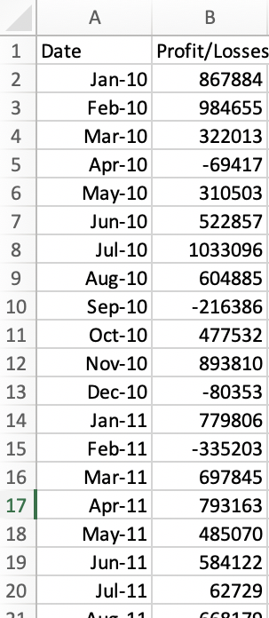
Preview of PyBank Instructions
Using the data to the left, use Python to calculate the following:
Total number of numbers included in dataset
Net total amount of “Profit/Losses” over entire period
Average of the changes in “Profit/Losses” over entire period
Greatest increase in profits (date & amount) over entire period
Greatest decrease in losses (date & amount over entire period)

Slide 8
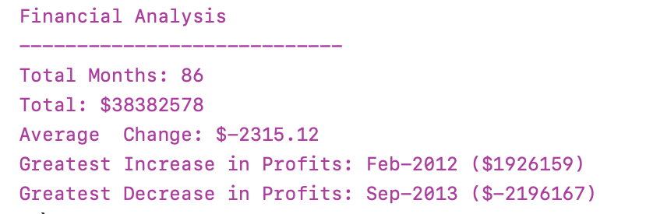
Example of PyBank Analysis
Your analysis should look similar to the one below

Slide 9
PyBank Reminders
Your final script should do the following:
Print the analysis to the terminal
Export a text file with the results

Slide 10
PyPoll Folder Structure
Inside of the PyPoll folder, add the following:
New file called “main.py” – this will be your main script to run for each analysis
A folder named “Resources” with the CSV files you used
Make sure your main.py file has the correct path to these CSV files
A folder named “Analysis” that contains the text files that has results from your analysis

Slide 11
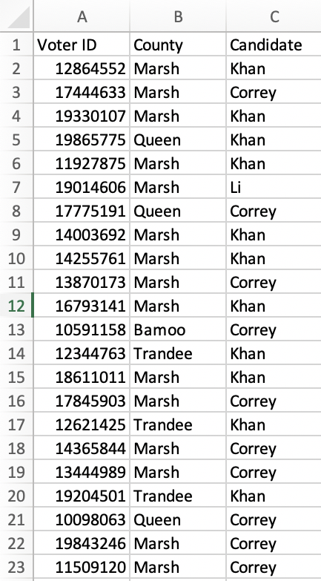
Preview of PyPoll Instructions
Using the data to the left, use Python to calculate the following:
Total number of votes cast
Complete list of candidates who received votes
Percentage of votes each candidate won
Total number of votes each candidate won
The winner of the election based on popular vote

Slide 12
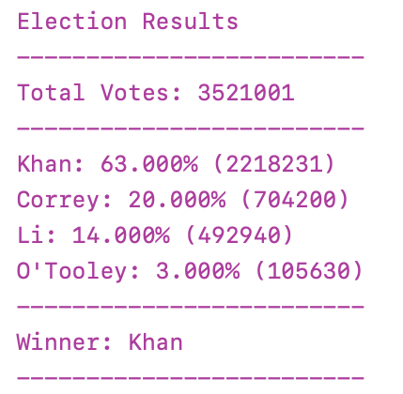
Example of PyPoll Analysis
Your analysis should look similar to the one below

Slide 13
PyPoll Reminders
Your final script should do the following:
Print the analysis to the terminal
Export a text file with the results

Slide 14
Considerations
Try to break down your tasks into smaller, more manageable objectives
Accomplish one – then move onto the next
Helps with debugging and building confidence!
Start early!
Challenge yourself to identify specific questions before reaching out for help
Get comfortable with Google!

Slide 15
Submission
Commit and push changes to GitHub repository
Example of how to do this:
Open up terminal or GitBash
Cd foldername
Git add .
// Adds all changes so you’re ready for commit
Git commit –m “message”
// Commits changes - use a meaningful message
Git push
You’re done!

Slide 16

Questions?

