Slide 1

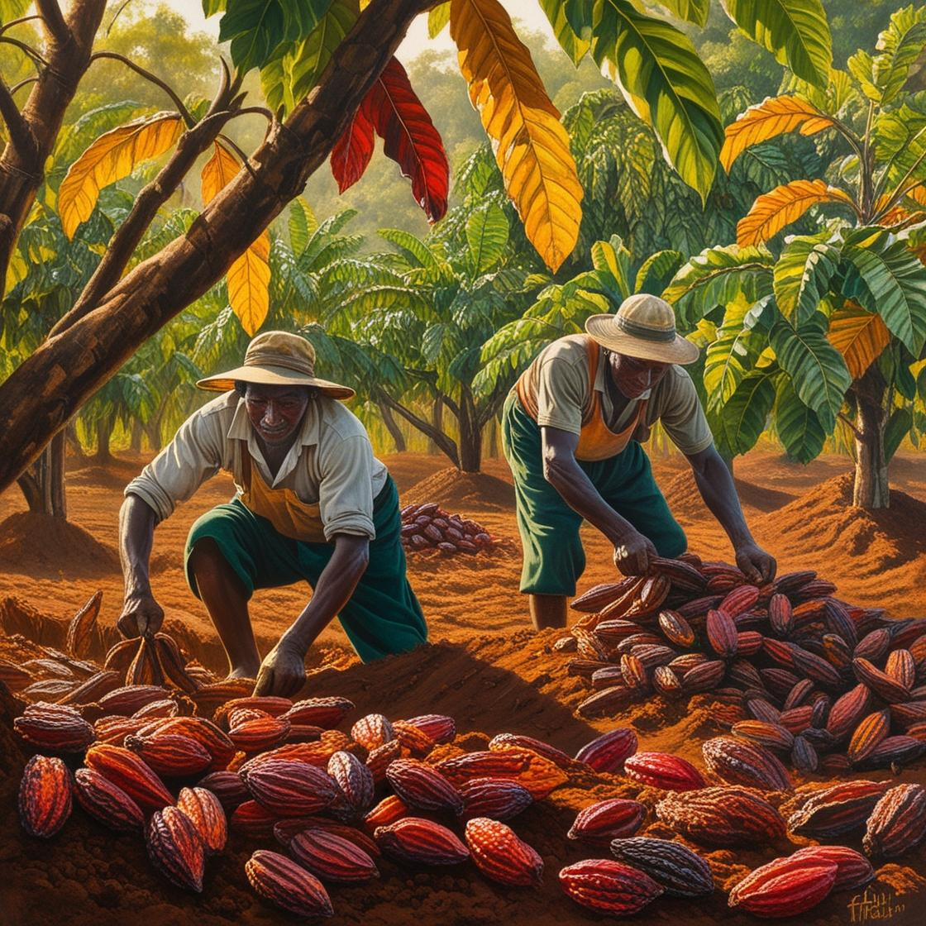
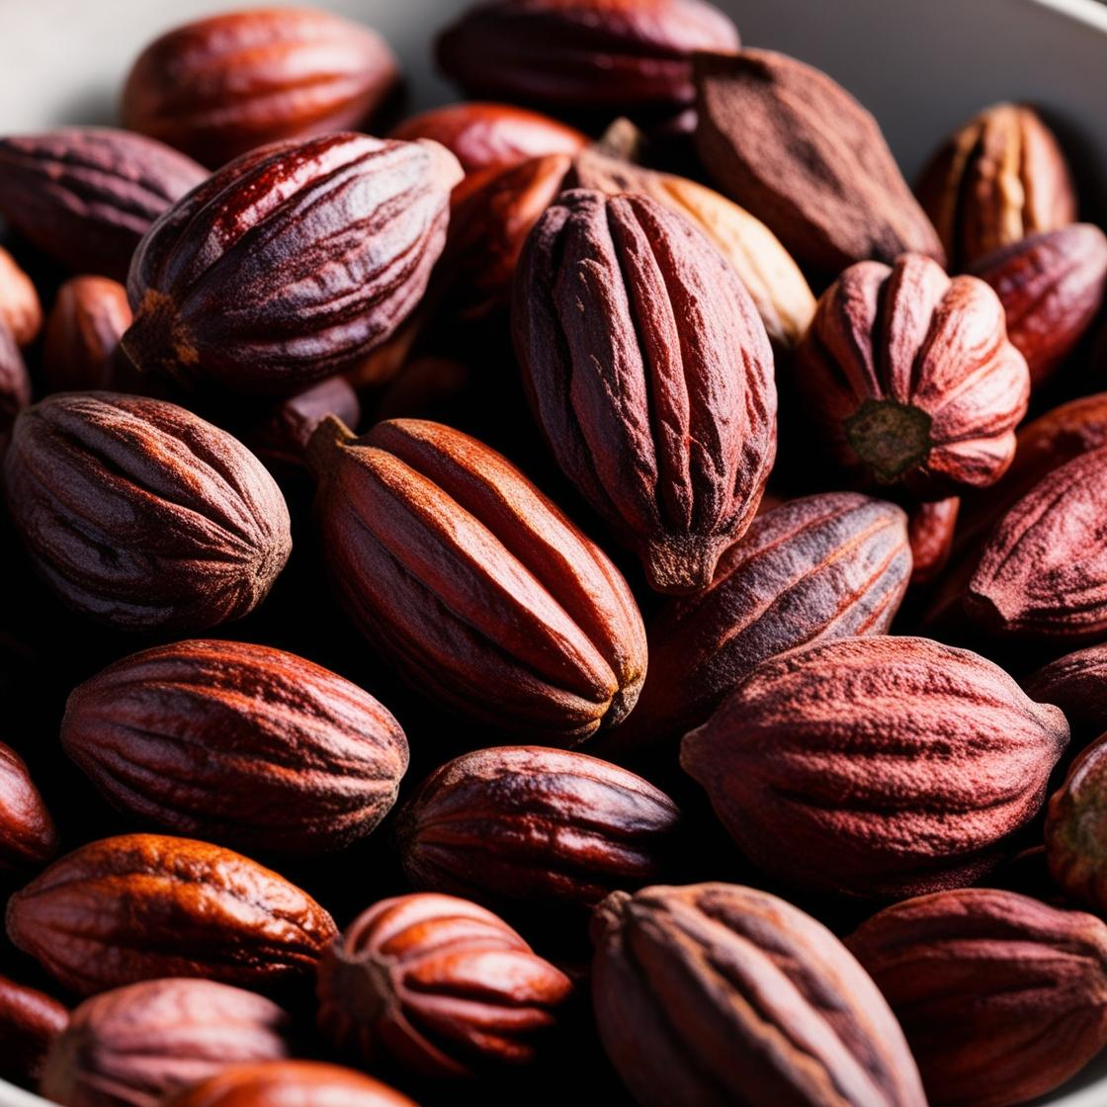
Inputs
Production process
Outputs
Land
Labor
Trees

