Slide 1
Detection of planes in cuboids from RGBD images of packing scenes – 3/3
Guillermo Camacho
Computer Vision – Course Project
Universidade Federal Rural de Pernambuco (UFRPE)
PGIA7346
Video: https://youtu.be/Oj56ktWGSHs

Slide 2
Agenda
Introduction
Basic Concepts
The Dataset
Methodology
Results
Conclusions
References

Slide 3
1. Introduction

Slide 4
Purpose
Design an algorithm that can extract visible top-planes of a box in an RGBD image acquired from a packing scene:
Scenes composed of multiple boxes distributed over an area
Response in Real Time

Slide 5
Algorithms to detect Planes from Point Clouds
Plane Detection
RANSAC
MSAC (Mathworks, 2020)
RANSAC_SAC (PCL, 2020)
Hough Transform
(Vera, 2018)

Slide 6
2. Basic Concepts

Slide 7

Basic Concepts
Basic Concepts
Point Clouds
Plane Model
RANSAC
ICP

Slide 8
3. The Data Set

Slide 9
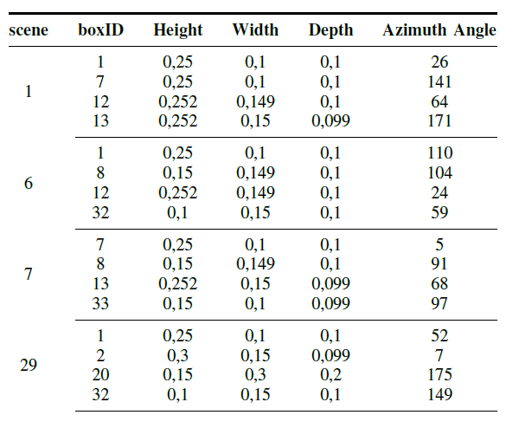
Dataset from (Celis and Almeciga, 2019)
Point clouds acquired by Microsoft Kinect v2 sensor
Annotations suitable to the problems of detection of boxes
36 Scenes
Each scene was sampled from a single point of view
Four samples by scene
Requires Transformation to camera frame
Notes:
Single point of view at each scene
Raw depth-map was not stored (512x424). A colored 3D point cloud was stored (1080x1920x3). This was computed with a proprietary function (pcfromkinect)

Slide 10
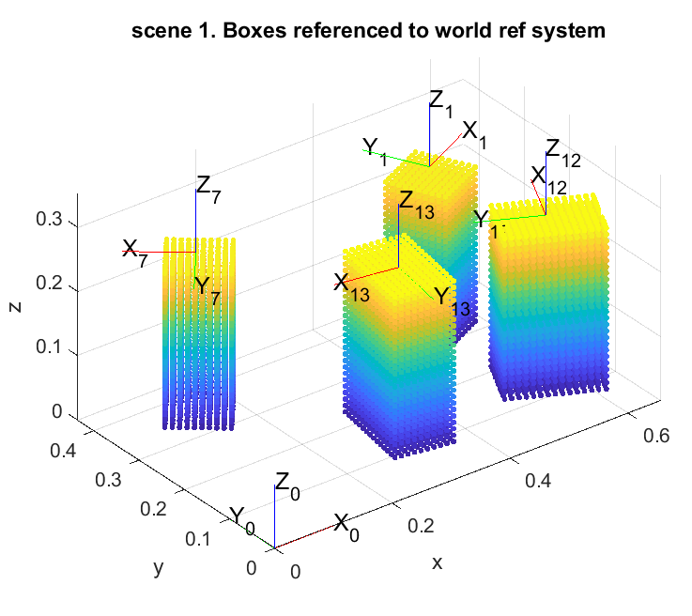
Dataset from (Celis and Almeciga, 2019)
Notes:
Single point of view at each scene
Raw depth-map was not stored (512x424). A colored 3D point cloud was stored (1080x1920x3). This was computed with a proprietary function (pcfromkinect)

Slide 11
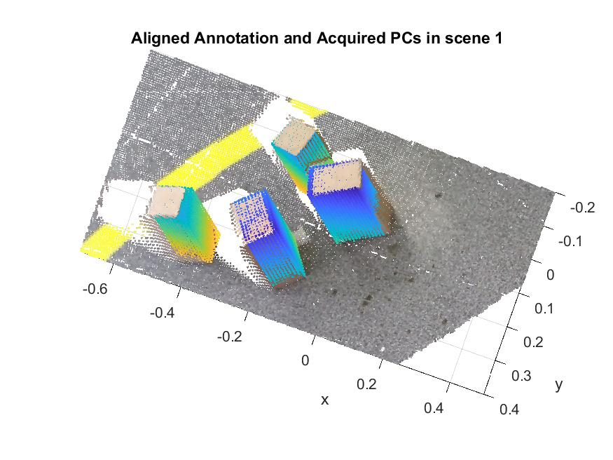
Aligned Annotation with Camera view

Slide 12
4. Methodology

Slide 13
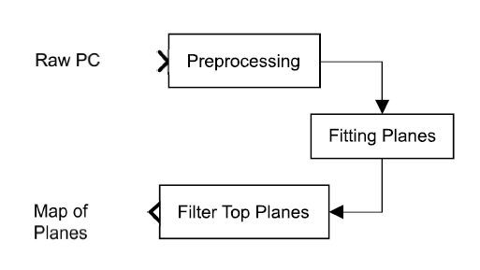
Pipeline to resolve the extraction of planes and assessment of algorithm
Notes:
Example in scene 1
altura, largura e comprimento

Slide 14
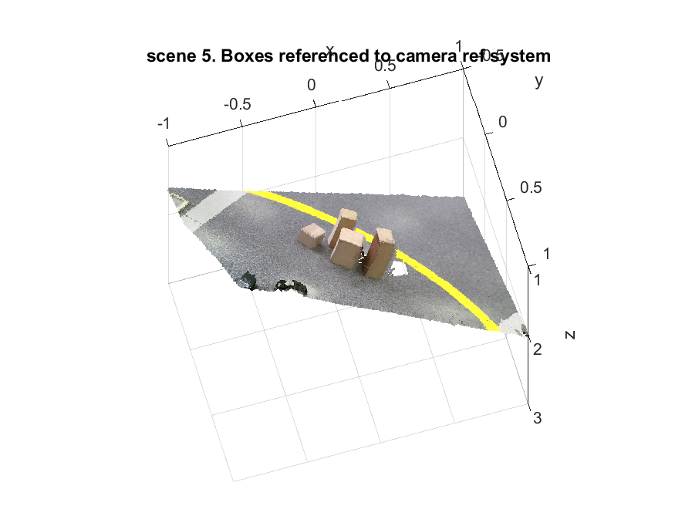
1. Preprocessing
Merge of available samples at each scene
Denoise of the merged point cloud
Extraction of a region of interest ROI

Slide 15
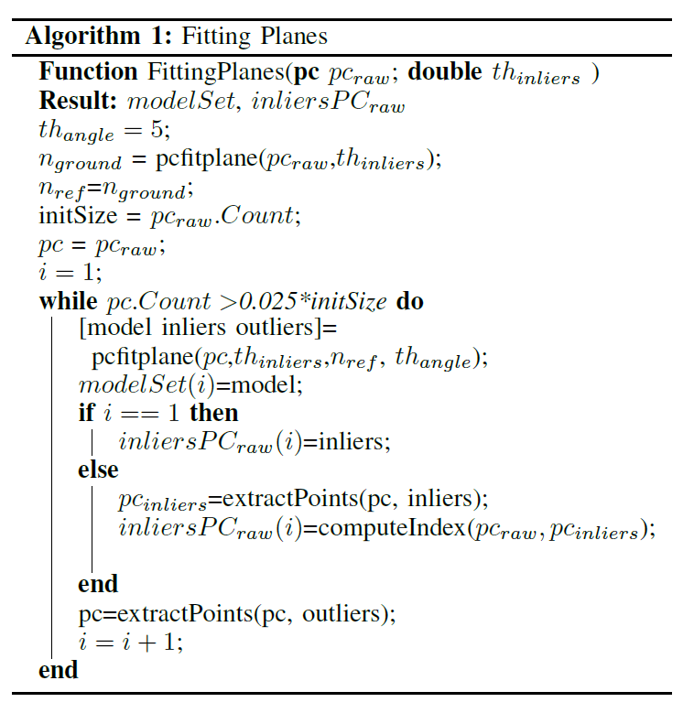
2. Fitting of planes

Slide 16
3. Filter top planes
Filter ground plane and its duplicates
Remove planes with area major than a threshold
Remove planes with area minor than a treshold
Remove planes that are not parallel or perpendicular to ground plane.
Split planes with area major than the maximal areaexpected in the scene.
3. Selection of planes which compose a box
Mean Shift-based plane division

Slide 17
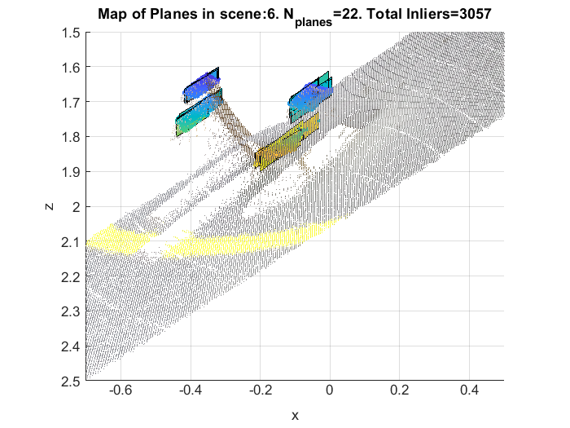
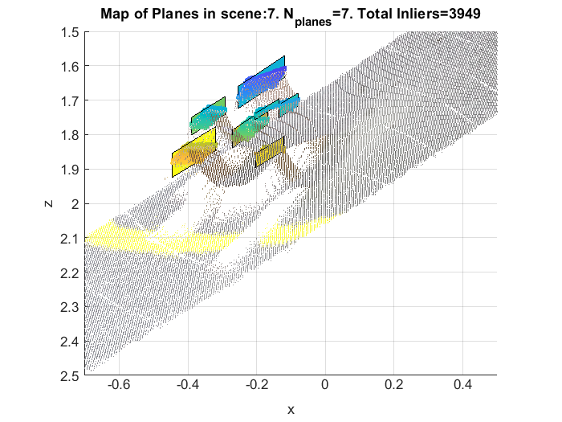


Sample of Outputs

Slide 18
5 Results

Slide 19
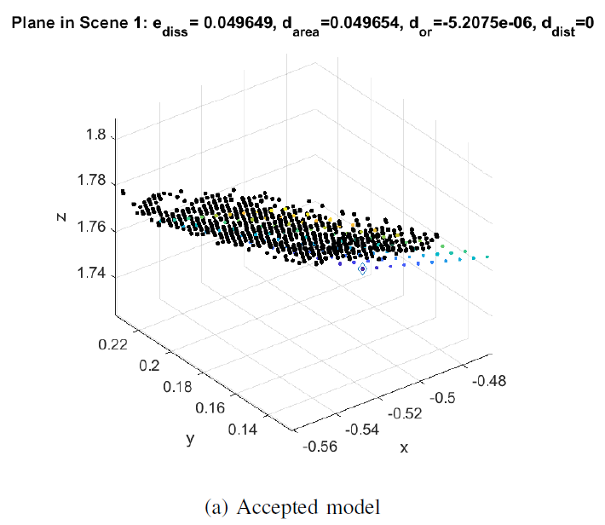

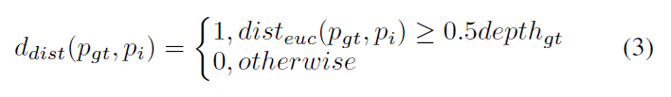
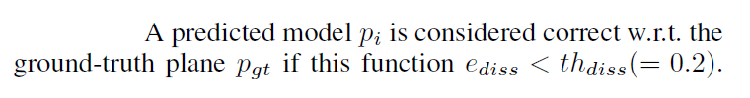
Dissimilitude function

Slide 20
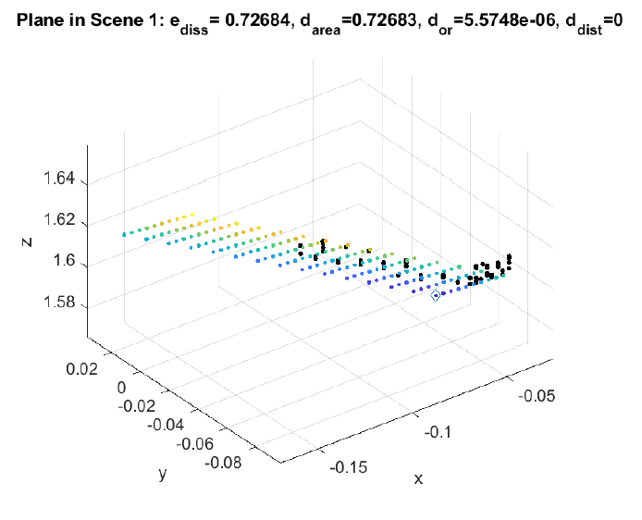
Dissimilitude function

Slide 21
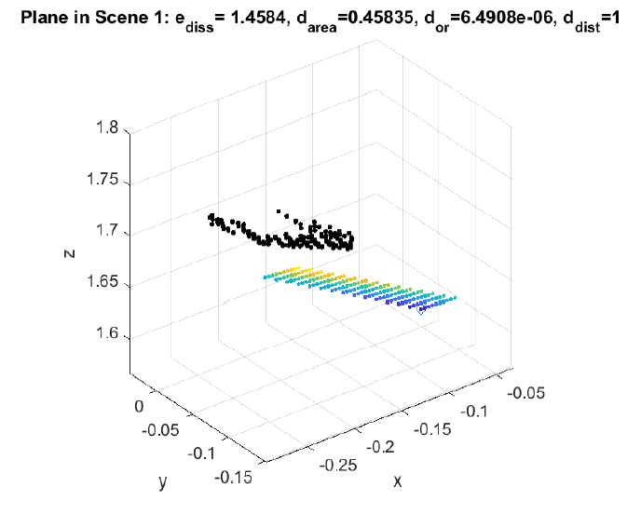
Dissimilitude function

Slide 22
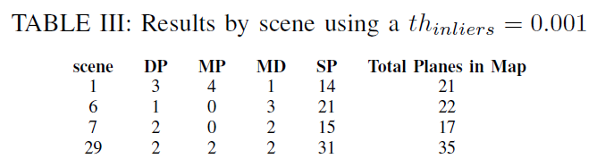
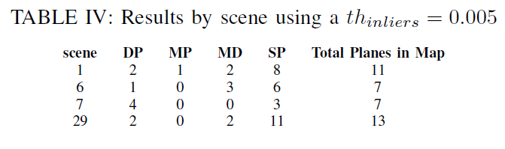
Results
-DP: existing planes detected
-MP: number of existing planes that were detected multiple times
-MD: number of missing planes
-SP: number of spurious planes detected
Notes:
-DP: existing planes detected
-MD: number of existing planes that were detected multiple times – MD,
-MP: number of missing planes
-SP: number of spurious planes detected

Slide 24
6. Conclusions

Slide 25
6.1 Conclusions
The main contribution of the paper is an algorithm that can detect an average of 50% of the top-planes in the assessed scenes combined with a high number of spurious planes
Additional contributions are:
(1) a dissimilarity index between planes which shows consistency with the results obtained,
(2) a framework useful to perform the detection of planes and assessment of the algorithms
Notes:
ICP algorithm: Given two clouds of points (a reference and a source), the algorithm finds 3D correspondences between the point clouds and tries to determine the transla-
tion and rotation matrices whose application to the source can lead to the best match on the reference in terms of minimum distance
https://www.researchgate.net/publication/290477323_A_Modified_Iterative_Closest_Point_Algorithm_for_3D_Point_Cloud_Registration

Slide 26
6.2 Future Works
The Fitting-Plans process currently used is based entirely on the MSAC algorithm available in Matlab. This process have shown high computational cost (aprox 2.5 min by scene) and requires a more efficient implementation. One candidate is the efficient RANSAC algorithm presented in (Schnabel, 2007).
The independent processes of Fitting-Plans and Filtering-Top-Plans prevent the inliers of a filtered plane from being used in another plane. One possible solution is to integrate these processes and reprocess the inliers of the filtered plans.

Slide 27
6.2 Future Works
The Mean Shift-based plane division stage can be improved using techniques that use information from the neighborhood of the point cloud.
These techniques can identify discontinuities such as those expected at the edges and use these detections to activate clustering criteria. A proposal like these is presented in (Hemmat, 2015)
These techniques can restrict the candidate planes to those formed by connected components on the surface (Schnabel, 2007)

Slide 28
6.2 Future Works
The filtering process can use the information on normal of points to reject planes like those highlighted in the figure
Define a threshold angle between
The normal of the plane
The average normal of the inliers in the plane

Slide 29
6.2 Future Works
The detection of ground normal it works cause the clutter in the scene is low. For high clutter in the scene we must use a robust method. One candidate is the gravity estimation algorithm presented in (Gupta et. al, 2013) and used in (Gupta et. al, 2015)

Slide 30
6.2 Future Works
Explore the definition of a plane that is not extended over infinity: plane’s bounding polygon
Explore the definition of similitude function between planes. A good seed is on (Vera, 2018) and (Yang et. al, 2016) section IV-C.
Finally, we expect to implement experiments over the whole dataset to conclude about the performance of the algorithm under different distances between camera and objects and different points of view
Technical works
Compute the rest of transformation matrix: From pose 2 to pose 9
Save the normal of points in the output of preprocessing stage
Add descriptor of box-ID to the ground-truth plane. This can be done from computeGTPlanes folder
Extract the rest of planes: perpendicular to ground
Consider the necessity of build ground-truth planes with just the visible part of the plane

Slide 31


Framework
Notes:
Al realizar el cálculo de la matriz de transformación en la pose d2/right, se obtienen errores muy altos (*). Estos pueden estar relacionados con: (1) la relación de puntos entre las entradas al bloque de estimación de T (**), (2) la aparición de puntos que no corresponden al plano superior de caja en el archive cameraFrame.ply.
El punto 1 se puede resolver generando un mayor volumen de datos (x10)
El punto 2 se puede resolver implementando un filtro basado en la normal de los puntos de pc_{raw}
(*)
scene score
3 0.0108722
20 0.00102094*
21 0.00932959
0.00141454
(**)
Loaded PC ground truth from a PLY file, with Width: 650 Height: 1
Loaded PC from kinect; PLY file, with Width: 6866 Height: 1
-----------------------------------------------Datos de salida para la transformación de d3/right que funcionó muy bn
Loaded PC ground truth from a PLY file, with Width: 500 Height: 1
Loaded PC from kinect; PLY file, with Width: 3473 Height: 1
Loaded files in 9.3962 ms
Applied 100 ICP iteration(s) in 614.704 ms
ICP has converged, score is 2.57108e-05
ICP transformation 100 : cloud_icp -> cloud_gt
Rotation matrix :
| 0.662 -0.568 -0.489 |
R = | -0.748 -0.539 -0.387 |
| -0.044 0.622 -0.782 |
Translation vector :
t = < -0.278, 0.575, 1.746 >
saved translation matrix on disk in path ..\..\data\boxAndSceneFeatures\s1_R_matrix.txt
saved aligned ply on disk with name gtTopCameraFrame_alfa.ply
C:\Users\guill\Documents\Investigacion GAC\UnisalleRGBDBoxes\project2020\vs\projectVision_2020\x64\Debug\projectVision_2020.exe (process 22688) exited with code 0.
Press any key to close this window . . .

Slide 32
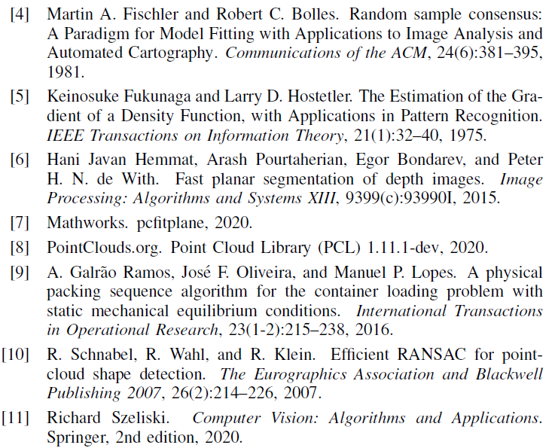
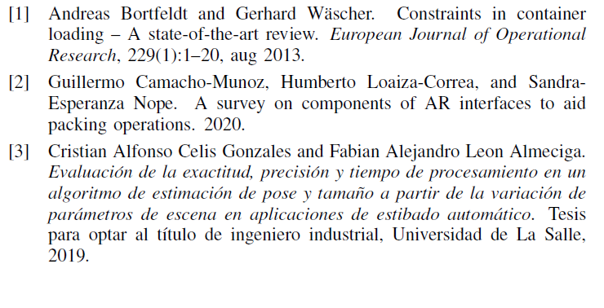
7. References

Slide 33
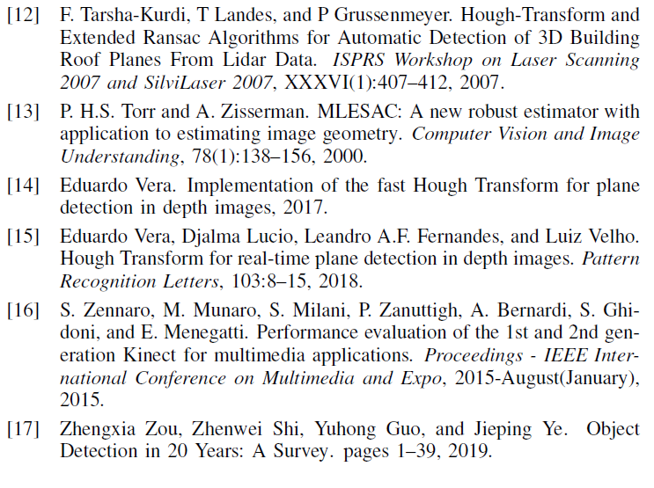
7 References

Slide 34
[1] S. Yang, Y. Song, M. Kaess, and S. Scherer, “Pop-up SLAM: Semantic monocular plane SLAM for low-texture environments,” IEEE Int. Conf. Intell. Robot. Syst., vol. 2016-November, pp. 1222–1229, 2016.

