Slide 1
Information retrieval – CS-5364
Homework #3
By
Guillermo rodriguez

Slide 2
Data Set
Data was provided by way of an Enron email archive
Data was extracted from:
http://www2.aueb.gr/users/ion/data/enron-spam/
Given the requirements set forth only the first data repository named ‘Enron1’ was utilized.
Data classes included Spam, Not Spam, and Other

Slide 3
Strategy
Use the Python programming language
Create a common class with methods to tokenize, stem, and lemmatize the data set
Utilize the same common class for the nieve-bayes specific attribute components required
Create a class to create the scatter plot of probabilities
Use Python libraries for needed functionality

Slide 4
Code repository
The code was commited to github and may be accessed via the URL:
https://github.com/guillermorodriguez/nieve-bayes
You may clone the repository locally with git by using the command:
git clone https://github.com/guillermorodriguez/nieve-bayes.git
The repository is accessible to anybody to view, add or modify
The individual dependencies used via Python have been documented in the header of each file

Slide 5
Algorithm
Tokenize data set
Create Feature Sets
Calculate p(cj)
Apply Laplace Smoothing to Calculate P(Wi|c)
Calculate posterior probability

Slide 6
Tokenization
def tokenization(self, data): result = {} for _word in data.split(' '): _word = _word.strip() if _word.encode(‘utf-8’) in result: result[_word.encode(‘utf-9’)] += 1 else: result[_word.encode(‘utf-9’)] = 1 return result

Slide 7
Feature set
The feature set for each document type spam, not spam, and other were determined by taking the 10% of the first data elements in the pair for each such as.
_spam_token_test = _statistics.tokenization(' '.join(spam[:cutoff]))

Slide 8
P(Cj)
Each class was tallied such that
P(spam) = spam documents / total documents = 0.290698
P(not spam) = not spam documents / total documents = 0.267442
P(other) = other documents / total documents = 0.441860

Slide 9
Laplace smoothing – P(w|c)
def probabilityOfValueInClass(self, data):
result = {}
class_count_total = 0
for value in data.values():
class_count_total += value
for key, value in data.items():
result[key] = ( value + 1 ) / ( class_count_total + len(self.vocabulary))
return result
Sample Data:
Spam:
'skin',0.001102
'medical',0.001102
Not Spam:
'christmas',0.001195
'Subject:',0.001195
Other:
'dated',0.001184
'the',0.001184
'thru',0.001184

Slide 10
Posterior Probability
def posteriorProbability(self, data, class_probability, spam, not_spam, other):
result = {}
for key, value in data.items():
denominator = 0
if key in spam:
denominator += spam[key]
if key in not_spam:
denominator += not_spam[key]
if key in other:
denominator += other[key]
denominator /= ( sum(spam.values()) + sum(not_spam.values()) + sum(other.values()) )
if denominator == 0:
denominator = 1
result[key] = ( value * class_probability ) / denominator
return result

Slide 11
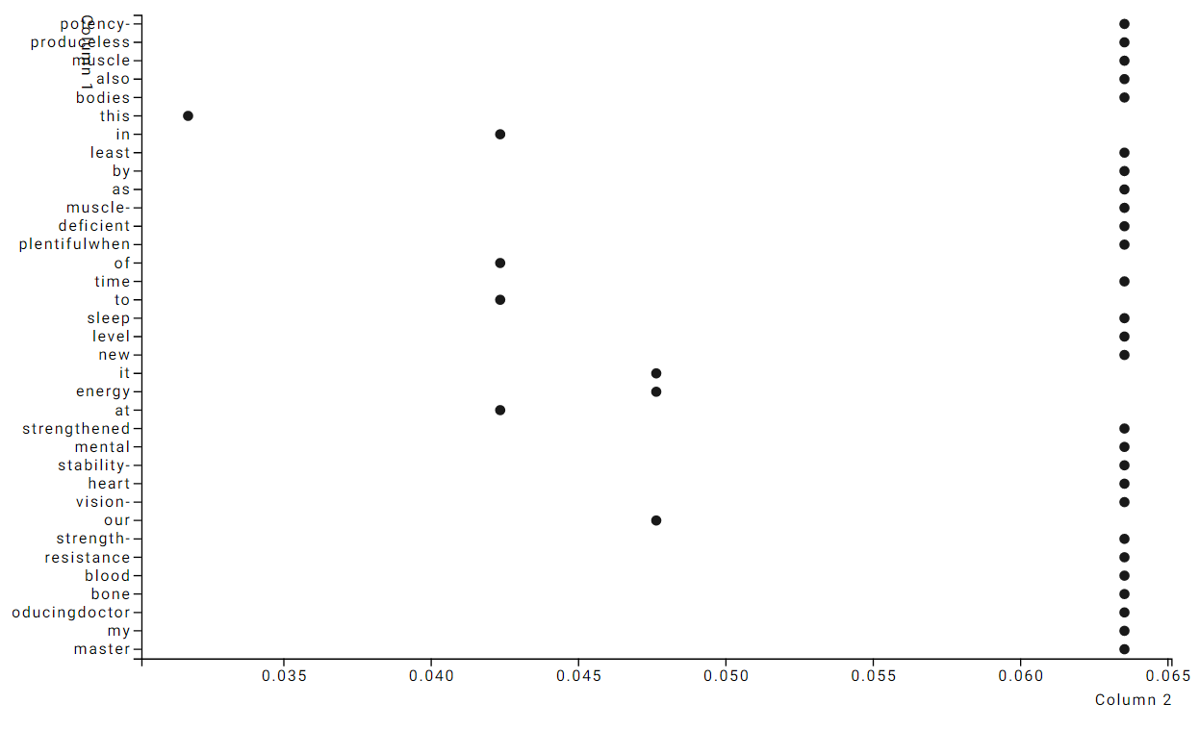
Visualization of nieve-bayes results

Slide 12
Classifier performance
def performance(self, true_positive, false_positive, false_negative):
precision = true_positive / ( true_positive + false_positive )
recall = true_positive / ( true_positive + false_negative )
f_measure = 2 * precision * recall / ( precision + recall )
return precision, recall, f_measure

Slide 13
Takeaways
Naïve-Bayes is a relatively simple algorithm to incorporate that can yield adequate results for a data set.
Python lends itself well to supervised learning tasks such as Naïve-Bayes algorithms.
With the adoption of built in libraries and a programming construct such as Python it is possible to create small, but scalable solutions for information retrieval tasks.

Slide 14
Ending
Code is available for your use with no guarantees
Please direct all questions to me via email at gui_rod_dallas@hotmail.com

