Slide 1

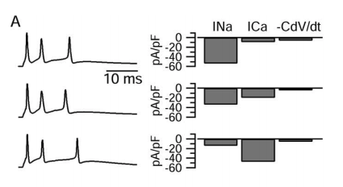





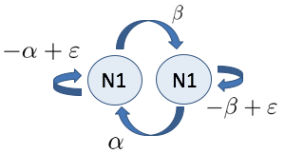
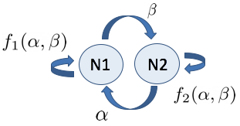
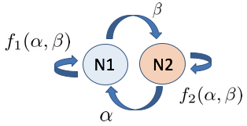
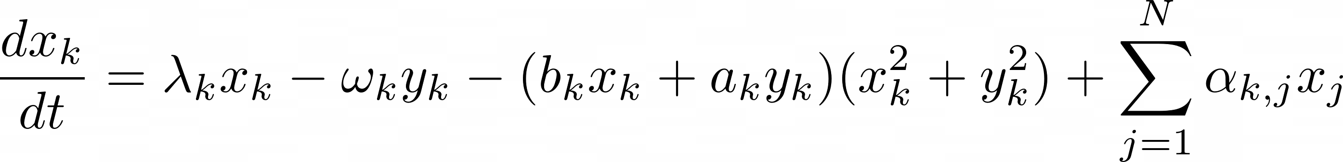
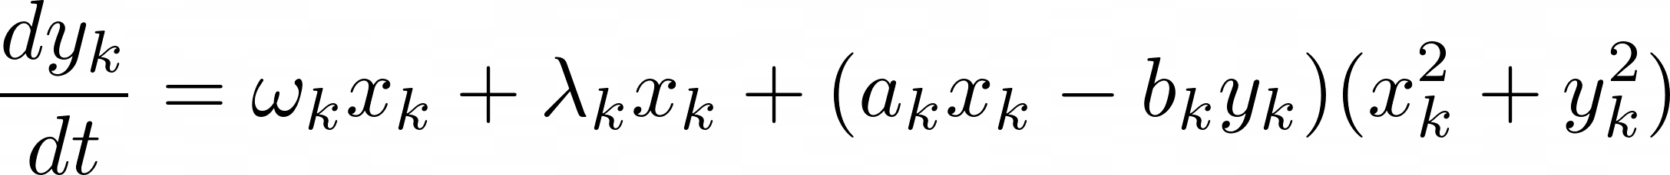
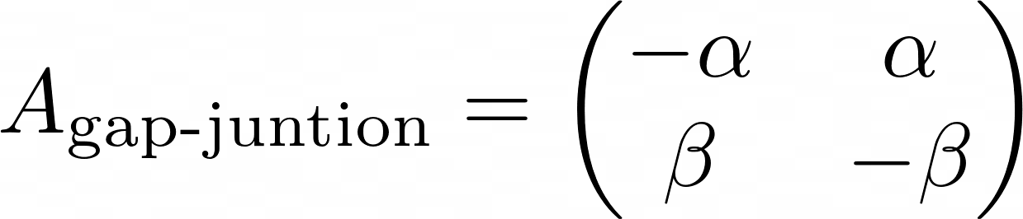

Neural oscillations level sets for activity constancy:
from single neurons to networks
Guillermo Villanueva
Universitat Politècnica de Catalunya
Abstract
Introduction
Neural oscillatory patterns can be characterized by a number of attributes, whose value is determined by the interplay of the participating currents. Experimental and theoretical work has shown that multiple combinations of parameters can generate patterns with the same attributes [1-4]. This endows neurons and networks with flexibility to adapt to changing environments and is substrate for homeostatic regulation [4].
At the same time, it presents modelers with the phenomenon of unidentifiability in parameter estimation. Attribute level sets (LSs) in parameter are manifolds on parameter space for which a given attribute is constant. Whether and under what circumstances the attribute LSs for individual neurons are conserved in the networks in which they are embedded and what additional network level sets emerge is not well understood.
In this work we describe a canonical (C-) model for oscillations LSs for single cells. Under certain conditions, the LSs for individual C-cells are preserved in networks of C-cells. Moreover new LSs emerge in these networks. We characterize them for both homogeneous and heterogeneous networks, where individual cells are identical or not.
Degeneracy in Biological Systems
Parameter Estimation Unidentifiability
The Activity-dependent homeostatic regulation (ADHR) mechanism constitute a negative feedback system through which neurons are able to restore their properties and compensate changes due to perturbations. It allows neurons to maintain their so-called target activity level.
Neuronal activity properties need to be constrained in order to achieve the target activity level of any ADHR. Usually, these constraints result in regions on parameter space which generate a desired neuron behavior. When characterized by certain attributes, attribute LSs can represent these regions.
Neuronal parameter optimization is the process of identifying sets of parameters that lead to a desired electrical activity pattern in a given neuron or neuronal network model that is not fully determined by experimental data.
Structural degeneracy (of a given parameter model) refers to the situations where multiple sets of parameters values can produce the same observable output, therefore making the inverse problem ill-posed. It is only based on the inherent structure of a given model
The idea a given that target activity level can be achieved with different parameter combinations and that almost identical activity can arise from different intrinsic properties has both experimental and theoretical evidence [1,5].
Figure 1. Similar neuron activity, From [5]
If we create ground truth (fake) data using a particular set of parameters values, it is not clear (¿?) how to retrieve the biophysical parameter values used.
Figure 2. Degeneracy scheme for the neuron model
Results
Conclusions
Attribute Level Set Preservation
Newly Emerged Network Level Sets
Gap junctions do not preserve LSs on type-II heterogeneous networks (cells belong to different amplitude LS). However a readjust in self-connectivities guarantees LSs preservation.
Several LSs have been computed (1,2-dimensional LSs on 1,2,3 or 4-dimensional parameter spaces).
The type of network (homogeneous or heterogeneous) and the model structure does affect predictions in [3].
*Prediction in [3]: If a particular homeostatic
The self-connected cell do not preserve LSs.
Type-I and type-II heterogeneous (cells belong to different individual amplitude LSs) two-cell networks preserve individual LSs on two-dimmensional manifolds on parameter space.
Gap junctions preserve LSs in type-I heterogeneous networks (cells belong to the same amplitude and frequency LS)
The self-connected cell
Homogeneous Networks
Type-I Heterogeneous Networks
Type-II Heterogeneous Networks
2-dimensional total-degenerated LSs on the intrinsic parameter space (Figure 11)
Methods
The mathematical oscillator (C-model) used to represent the behavior of a neuron is given by
It is a type of the so-called Lambda-Omega systems with a single limit circle in which degeneracy is easily characterized. Amplitude and frequency LSs are given by
The general form of the linear connectivity networks of Lambda-Omega systems are
where is the connectivity matrix
2-dimensional total-degenerated LSs on connectivity parameter space.
Neuron model
Figure 3.
Figure 4.
Figure 5.
mechanism maintain m independent characteristics (or attributes) of neuronal activity, then at least m parameters must be changed as a response to a perturbation in one parameter of the system.
1-dimensional total-degenerated LSs on
connectivity parameter space (Figure 9)
1-dimensional total-degenerated LSs on each cell’s intrinsic parameter space.
1-dimensional total-degenerated LSs on the connectivity parameter space. (Figure 10)
Future Work
How related are model symmetries with the preservation of LSs? How closely related are homeostatic mechanisms (LSs) at the neuron and network level? What do we exactly mean by a network LS? How could one develop methods for the disambiguation of degeneracy? Robust, non model-dependent algorithms to compute LSs?
Figure 6.
Figure 7.
Figure 8.
Network model
Figure 9.
Figure 10.
Figure 11.
Contact Information
References
Guillermo Villanueva
Universitat Politècnica de Catalunya
Email: guillermovillanuevabenito@gmail.com
[1] Prinz, A. A., Bucher, D. and Marder, E. Similar network activity from disparate circuit parameters. Nat Rev Neurosci, 7:1345-1352 (2004)
[2] Rotstein, H. G., Olarinre, M. and Golowasch, J. Dynamic compensation mechanism gives rise to period and duty cycle level sets in oscillatory neuronal models. J Neurophysiol, 116:2431-2452 (2016).
[3] Olypher, A. V. and Calabrese, R. L. Using constraints on neural activity to reveal compensatory changes in neuronal parameters. J Neurophysiol, 98:3749-3758 (2007).
[4] Olypher, A. V. and Prinz, A. A. Geometry and dynamics of activity-dependent homeostatic regulation in neurons. J Comp Neurosci, 28:361-374 (2010).
[5] Swensen AM, Bean BP. Robustness of burst firing in dissociated purkinje neurons with acute or long-term reductions in sodium conductance. J Neurosci. 2005 Apr 6;25(14):3509-20.

