Slide 1
OMPHALOS / RESEARCH UPDATE
ACE, control and the cost of a proof
Omphalos / Delphyne / miniF2F in Rocq
−55.5%
+3 / 40
38 / 40
spending
Luna ACE increment
Terra during learning
Accepted bounded-control trade-off; 28 → 25 validation solves.
Matched development comparison; encouraging, p = 0.25.
Training generation; later frozen evaluation uses a different controller.
Thesis contribution: economical, verifiable search through Delphyne.
Main question: which improvements survive the entire path to a checked proof?
Strong control result; modest ACE signal; concrete explanations for lost opportunity.
Delphyne · Development evidence · 13 September 2026
01
Notes:
Open with the three numbers. They belong to different comparisons. Never present 38/40 as validation performance. This is a complete reading deck; use the rehearsal route for a shorter talk.

Slide 2
OMPHALOS / READING GUIDE
The questions this update answers
Is ACE implemented?
Did it improve coverage?
Yes: Generator, Reflector, Curator and persistent playbook.
Local additions: batched Reducer, checked evidence and budget controls.
Luna: 24 → 27/40 in the matched validation comparison.
Uncertain: three gains; too little evidence for a supported general gain.
Does a stronger model unlock ACE?
What is worth retaining?
Terra solves more without a book.
ACE increment stays small: +0 with Luna’s book, +1 with its own.
Budget trade-offs and reliable evidence.
Failed candidates stay optional; common controller limitations remain.
Separate implementation fidelity, local correctness, coverage and economic value.
Delphyne · Development evidence · 13 September 2026
02
Notes:
Use these questions as a map. Each is answered visibly later; no claim depends on speaker notes or a live file visit.

Slide 3
OMPHALOS / IMPLEMENTATION
Our ACE loop, in one slide
01
Generator
02
Rocq feedback
03
Reflector
Propose a proof
using the current book
→
Execute and check
what actually happened
→
Diagnose the attempt;
propose useful lessons
04
Curator
05
Reducer
06
Merge + store
Propose structured
playbook changes
→
Select / combine
batched proposals
→
Deterministic update;
hash the next book
Training: the book evolves between batches; no model weights are updated.
Evaluation: the selected book is frozen; each proof has its own resource allowance.
Delphyne: strategies describe choices; policies choose models, search and spending.
The Reducer is a local batching component; the deterministic merge owns the stored state.
Delphyne · Development evidence · 13 September 2026
03
Notes:
The advisor knows ACE. Spend at most 45 seconds here. Emphasize the local Reducer and the separation between the evolving book and frozen inference.

Slide 4
OMPHALOS / IMPLEMENTATION / NAVIGATION
Where each ACE element lives in the code
ACE element
Delphyne strategy / query
File to open · then search symbol
Generator
prove_theorem_ace / ProposeProofScriptACE
prove_ace.py
Reflector
reflect_on_trajectory / ReflectOnTrajectory
prove_ace.py
Curator
curate_playbook / CuratePlaybook
prove_ace.py
Reducer
aggregate_curation_deltas / AggregateCurationDeltas
prove_ace.py
Book + merge
Playbook / merge / refine; PlaybookStore.put
ace/ace_playbook.py; ace/ace_store.py
Driver
execute / ACEAdaptStepConfig
experiments/ace/ace_adaptation.py
All paths are relative to examples/omphalos; search by symbol because active code can move lines.
Delphyne · Development evidence · 13 September 2026
04
Notes:
Optional visit 1: prove_ace.py; compare the four strategies and their policy functions. Visit 2: ace/ace_playbook.py merge; then ace/ace_store.py PlaybookStore.put. Mapping describes the measured architecture, not unbenchmarked work in the other session.

Slide 5
OMPHALOS / MEASUREMENT
What counts as a solve—and what is capped?
Setting
Dollar allowance / problem
Requests / verifier
Interpretation
Historical X / Luna
$0.10
32 requests
Older post-crossing stopping
Bounded / Luna
$0.10
64 / 300 seconds
Conservative pre-request admission
Bounded / Terra
$1.00
64 / 300 seconds
Same controller; recorded tariffs ×10
Terra training Generator
$1.00 nominal
32 requests
Evolving book; older stopping rule
Qualified solve: verifier success within the stated cost rule.
Bill includes failures; book preparation is separate.
40 problems per X partition; validation is reused development data.
A nominal allowance, a request reservation and the eventual bill are different quantities.
Delphyne · Development evidence · 13 September 2026
05
Notes:
Do not conflate the original canonical $0.05 setting with X experiments. The slide deliberately gives the settings behind the principal comparisons. testX and protected challenge outcomes remain excluded.

Slide 6
OMPHALOS / COMPLETE DEVELOPMENT HISTORY
Development cycles 1/4 · replication and X3
Cycle / change
Observed development result
Conclusion / disposition
Initial replication
ACE = baseline: 32/40 cells; $0.5058 vs $0.4446
No coverage gain; 20 original validation problems × 2 seeds.
Initial ablations / definitions
No-Reflector changes book composition; definitions fix 1/8 cells
No context-collapse replication at this scale; preserve the input fix.
X v2: offline / online
Offline 54/80 = baseline; cold online 56/80; warm 50/80
Warm start does not reliably improve results.
X3: batched evidence
X3 57/80 vs baseline 54/80
Modest gain; one-epoch book becomes the reference.
Reflection / rewriting / epochs
No-Reflector 57/80; monolithic 55/80; X3 3 epochs 53/80
More reflection / training is not reliably better.
For X rows, 80 cells = the same 40 validationX problems at two replicate identifiers.
Delphyne · Development evidence · 13 September 2026
06
Notes:
These are development reconstructions, not independent repeated confirmations. Early incomplete top-k, no-Reflector and online archives are not scored as complete panels. All later X counts use their explicitly named versions; v2 three epochs scored 50/80.

Slide 7
OMPHALOS / COMPLETE DEVELOPMENT HISTORY
Development cycles 2/4 · better advice and delivery
Cycle / change
Observed development result
Conclusion / disposition
X4: cited-only credit
55/80 vs X3 57/80
Better bookkeeping; citations do not establish causal usefulness.
Stronger writers / v5
Terra writers 55/80; v5 53/80
More capable writing and richer failure evidence do not beat X3.
Rendering v2 vs v3
Cost effect changes sign across v5 and X3 books
Rendering effect depends on the book.
Hints on error / x6 repairs
Triggered 53/80; repairs 56 raw / 55 qualified
Some repairs help locally; no reliable large coverage gain.
Stall stopping: k = 4
26/40, $0.7943 vs 27/40, $0.8870
Spend less with one fewer solve; live and offline estimates differ.
Deterministic digest table
51/80 vs X3 rendering 2 56/80
Simple summaries lose coverage; effect uncertain.
Advice can be correct, cheaper to send, or more traceable without completing more theorems.
Delphyne · Development evidence · 13 September 2026
07
Notes:
The stronger-writer treatment still uses Luna as Generator. The later all-Terra training chain is different. x6 has one raw success above the retrospective $0.10 qualification threshold. Old cost exports do not necessarily contain every retry receipt.

Slide 8
OMPHALOS / COMPLETE DEVELOPMENT HISTORY
Development cycles 3/4 · control and local checks
Cycle / change
Observed development result
Conclusion / disposition
Review development stage
X3 57/80; repair books 55 / 54 raw; baseline 52/80
Repair books do not beat X3; protected stages excluded.
Bounded money + focused
25/40 vs 28/40; spending −55.5%
Accepted trade-off; original no-loss gate failed.
Control-cycle follow-up
28/40, $1.0253 vs 25/40, $0.6780
Coverage bought back at higher cost; Pareto gate failed.
Polish / downshift / recovery
53/80 each; candidate bill +5.55%
No benchmark win; keep optional.
Applicability / checked change
Adaptive 2/12 useful vs fixed 3/12; checked change 1→2/6
Local correctness helps; full-theorem gains unestablished.
Local reasoning-effort probes
Terra low/medium/high 4/6 each; Luna high/xhigh 5/6
More reasoning is not monotonic; check the right local operation.
Local episodes, theorem cells and campaign bills have different denominators.
Delphyne · Development evidence · 13 September 2026
08
Notes:
Applicability primary screen stopped; no full train/validation benchmark followed. Checked-change correctness improved 3/6 to 6/6. The control-cycle archived source has reconstruction limitations; do not quietly rerun it as the same experiment.

Slide 9
OMPHALOS / COMPLETE DEVELOPMENT HISTORY
Development cycles 4/4 · coverage and attribution
Cycle / change
Observed development result
Conclusion / disposition
Model / writer-effort suite
Pilot 18/24 vs 17/24; full contenders 19 / 24 vs 27/40
Promising pilot did not become a coverage upgrade.
Structured mechanisms
Effort arm 43/80 vs 53/80; S/C/R have 51 parse failures
No promotion; parser confounds mechanism interpretation.
Fixed-book demos / exploration
D/E validation 26 / 25 vs 27/40
No coverage gain; unchanged book.
Four isolated coverage arms
D2/E2/S/H 25 / 24 / 25 / 25 vs 27/40
All cost more on validation; retain the reference.
Attribution / capacity
Own-book increment: Luna +3, Terra +1; training Terra 38/40
Solver strength exceeds demonstrated ACE increment.
13 Sep: resource completion
Small cap 26/40; continuation 23/40 vs 27/40
Both cost more; no follow-up selected, no promotion.
Completed cycles are preserved as evidence; the latest losing variants are not the new default.
Delphyne · Development evidence · 13 September 2026
09
Notes:
The September 13 row is a completed snapshot, not a report on the other active session. Costs and controller details appear later. The ledger and archival scores are left unchanged.

Slide 10
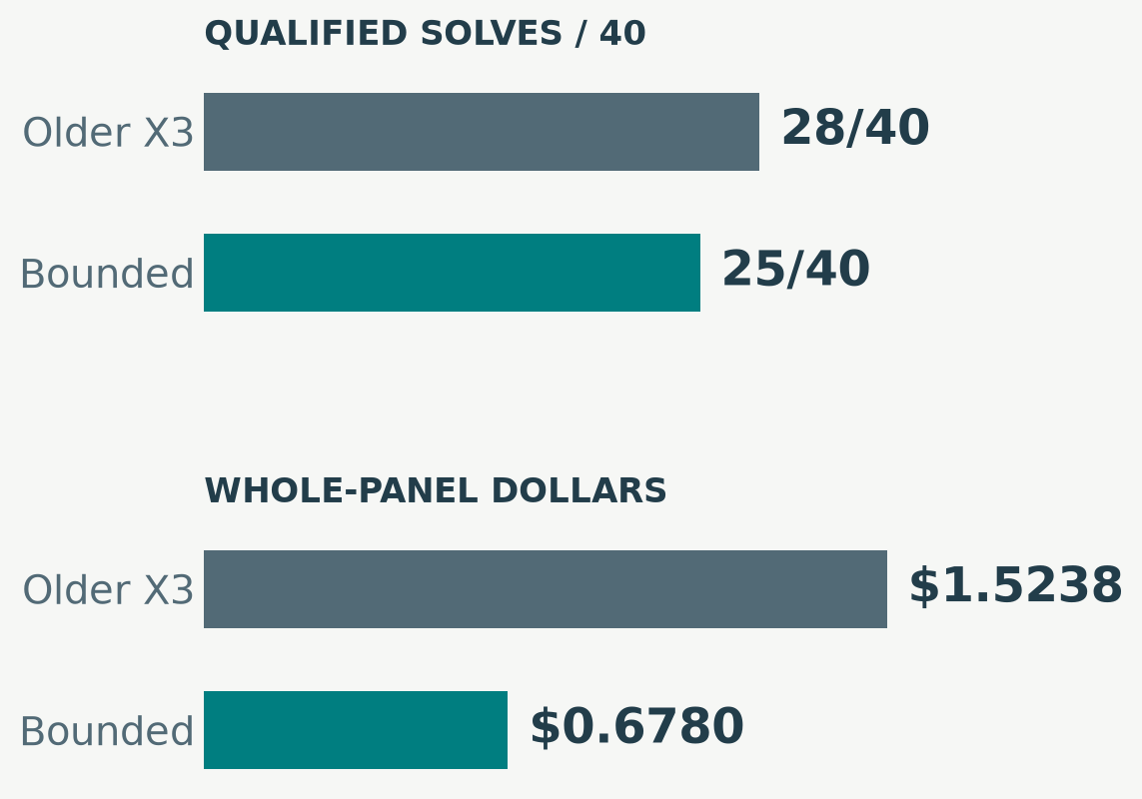
OMPHALOS / CONTROL RESULT
The strongest result is a budget trade-off
Coverage: 28 → 25 / 40.
Bill: $1.5238 → $0.6780; 55.5% less.
Cost per solve: $0.0544 → $0.0271.
Accepted: three fewer solves for lower cost; no-loss gate failed.
Both use a nominal $0.10/problem allowance; the controller changes what gets admitted.
Delphyne · Development evidence · 13 September 2026
10
Notes:
The comparator is the older review X3 seed-0 run, not the latest 27/40 flagship. Total cost includes failed attempts. Categorical bars show measured alternatives; there is no interpolated budget-response curve.

Slide 11
OMPHALOS / ATTRIBUTION
A changed baseline explains part of the confusion
Program
trainX
validationX
Validation bill
Earlier / no book
33/40
27/40
$0.8870
Bounded / no book
28/40
24/40
$0.7765
Bounded / Luna book
28/40
27/40
$0.6672
Earlier → current no book: five training and three validation solves lost.
Current no book → ACE: three validation solves recovered.
Current ACE vs earlier program: same validation count; bill 24.8% lower.
All use Luna and $0.10/problem; controller, feedback and runtime lineage still differ.
Delphyne · Development evidence · 13 September 2026
11
Notes:
The first arrow is a historical program comparison, not a paired single-feature ablation. The second is the intended book intervention within the bounded program, still subject to historical/provider conditions. File: experiments/campaigns/ace_attribution_20260912/LINEAGE.md.

Slide 12
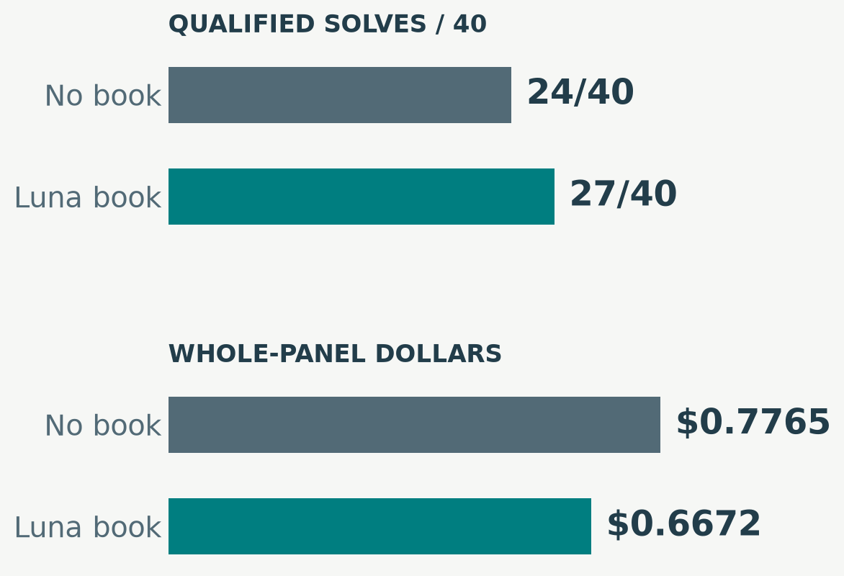
OMPHALOS / MATCHED ACE RESULT
Luna’s book helps here—but the signal is small
Question: does this book help the bounded solver?
Observed: 24 → 27/40; three gains, no losses.
Economics: $0.7765 → $0.6672; bill −14.1%.
Uncertain: paired p = 0.25.
Luna / medium / $0.10 per problem / 64 requests / 300 verifier seconds.
Delphyne · Development evidence · 13 September 2026
12
Notes:
Do not say ACE is proved effective, proved ineffective, or equivalent. The whole-panel count is more informative than a count of cherry-picked repaired cases. Cache economics are separated later.

Slide 13
OMPHALOS / LUNA / TERRA EXPERIMENT
The full crossover separates solver from book
No book
Luna book
Terra book
Luna solver
24 / 40
27 / 40
24 / 40
$0.10 cap
$0.7765
$0.6672
$0.7342
Terra solver
29 / 40
29 / 40
30 / 40
$1.00 cap
$6.6106
$6.8523
$6.4513
Same Luna book: +3 solves for Luna, +0 for Terra.
Terra-written book: no gain for Luna; +1 for Terra.
Own-book Terra: 9.67× the bill for three more validation solves.
Each cell is 40 validationX problems; costs include failures and exclude book preparation.
Delphyne · Development evidence · 13 September 2026
13
Notes:
Rows are solver models, columns are frozen books. Luna cap $0.10; Terra $1.00. Same-book interaction −7.5 percentage points, paired p=0.375. Own-Terra book increment p=1.0. Reused records do not become independent theorems.

Slide 14
OMPHALOS / INTERPRETATION
What the Luna / Terra experiment changes
Stronger solver: yes, more coverage
Stronger writer: no clear unlock
Without ACE: Terra 29/40; Luna 24/40.
Cost matters: Terra uses a $1.00 cap and recorded tariffs ×10.
Luna + Terra book: 24/40, matching no book.
Terra + own book: only 29 → 30/40.
Training success vs book usefulness
Next inference to test
Generator: Terra 38/40; Luna 33/40.
Transfer still needs valid, relevant advice that the solver uses.
Target exposed bottlenecks in evidence or completion.
Larger models and more writing do not guarantee an ACE gain.
The study does not establish that model scale unlocks ACE; an intrinsic model ceiling also remains unproven.
Delphyne · Development evidence · 13 September 2026
14
Notes:
Avoid a categorical statement that Terra cannot benefit. The same-book interaction has p=0.375 and the own-Terra difference p=1.0. Small gains and the study design limit conclusions.

Slide 15
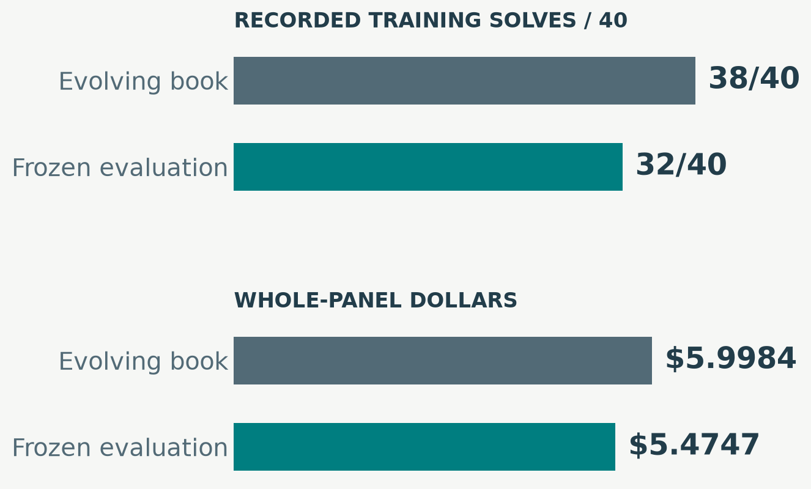
OMPHALOS / THE 38/40 RESULT
Yes: Terra achieved 38/40 during book creation
38/40 on trainX: the book evolved between batches.
Generator bill: $5.9984 for all 40 tasks.
Full preparation: $8.0992, including writers and embeddings.
Frozen book: trainX 32/40; validationX 30/40.
38 → 32 compares two training executions; 30/40 is a different partition, not another measured decline.
Delphyne · Development evidence · 13 September 2026
15
Notes:
Terra is used for all four generative roles. One shuffled pass, four-problem batches, final book 26 bullets / 2426 estimated tokens. The two training-generation misses were algebra_amgm_sum1toneqn_prod1tonleq1 and imo_1967_p3. Source: training_evolution.json and training_accounting.json in ace_attribution_20260912.

Slide 16
OMPHALOS / CONTROLLER AND CONTEXT
Why did 38 become 32? What we know—and do not
Known change · request admission
Known change · context
Training: 32 requests; stop after a budget crossing.
Evaluation: up to 64; reservations can deny the next call.
Training: evolving book; older proof loop.
Evaluation: frozen book; focused queries and bounded verifier feedback.
Known issue · completion is fragile
Unknown · the causal breakdown
Unfinished progress: time limits, parsing and final submission matter.
More nominal requests do not guarantee useful admitted work.
Different sampled trajectories: this is not a paired controller ablation.
Six net solves lost ≠ six proven reservation failures.
The gap motivates diagnosis; it does not show that the finished book destroyed six proofs.
Delphyne · Development evidence · 13 September 2026
16
Notes:
Same nominal Terra generator allowance $1.00, different stopping semantics. Do not assign a numerical share of the six-solve gap to the controller, compression or sampling without a matched intervention.

Slide 17
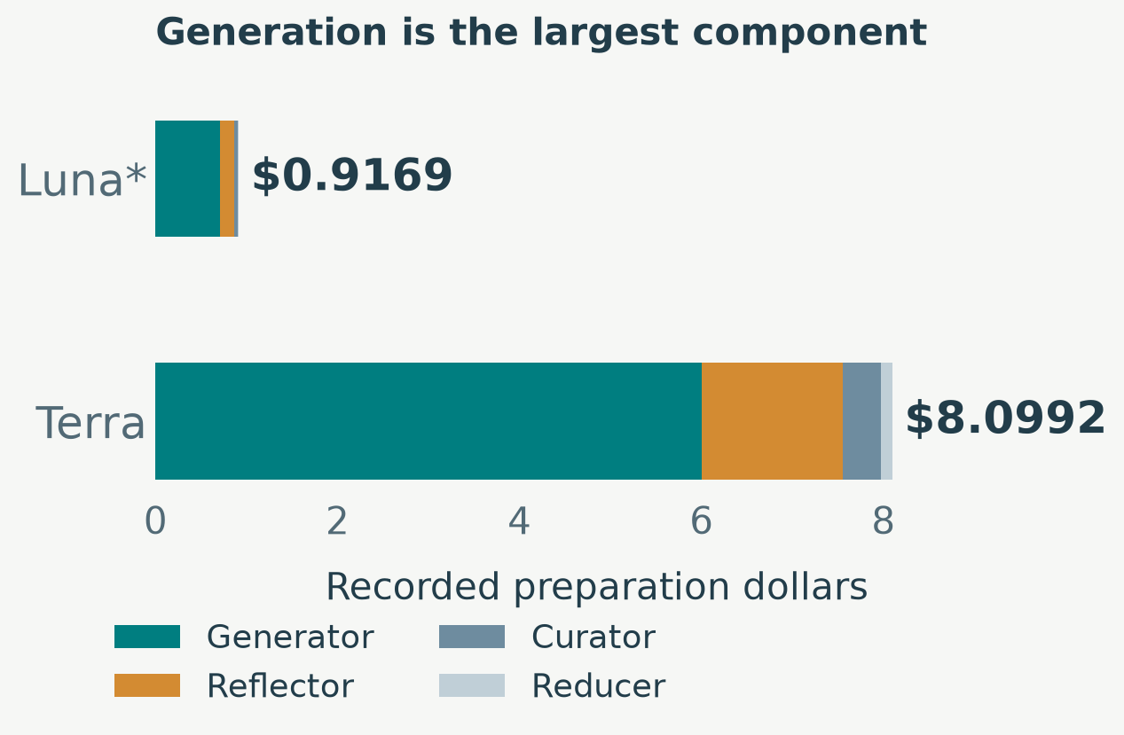
OMPHALOS / ECONOMICS / PREPARATION
Creating a book is a real up-front expense
Luna: ≥ $0.9169; historical embeddings unknown.
Terra: $8.0992; 8.83× Luna’s known cost.
26 bullets each; below the 4,000-token guard.
Payback requires useful lessons to survive reduction.
Preparation and inference are separate bills; generation is the largest preparation component.
Delphyne · Development evidence · 13 September 2026
17
Notes:
The bars are additive costs, not a learning curve. Luna final size 2103 estimated tokens; Terra 2426. Breakeven uses assumed future workloads and belongs in the backup question.

Slide 18
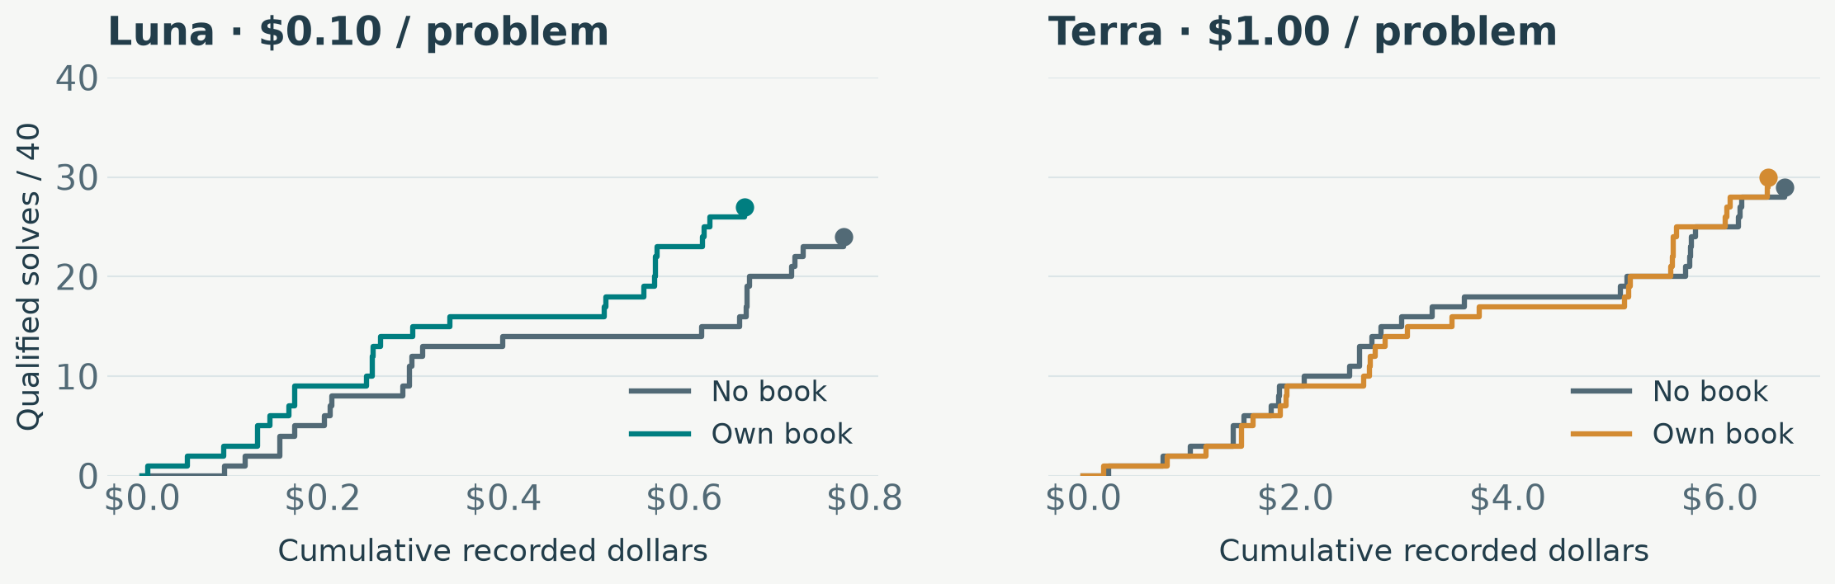
OMPHALOS / ECONOMICS / WHOLE PANEL
Spent versus solved: the actual recorded staircase
Right without up: money spent without a solve. Up: a qualified proof.
Fixed task order; all 40 costs. Accounting paths, not simulated smaller-cap runs.
Luna endpoints: 24 / $0.7765 vs 27 / $0.6672. Terra: 29 / $6.6106 vs 30 / $6.4513.
Delphyne · Development evidence · 13 September 2026
18
Notes:
Two model-specific dollar scales avoid squeezing Luna into an unreadable sliver. Step plots preserve discrete solve increments. Do not smooth these observations or imply the task order is an optimized execution policy.

Slide 19
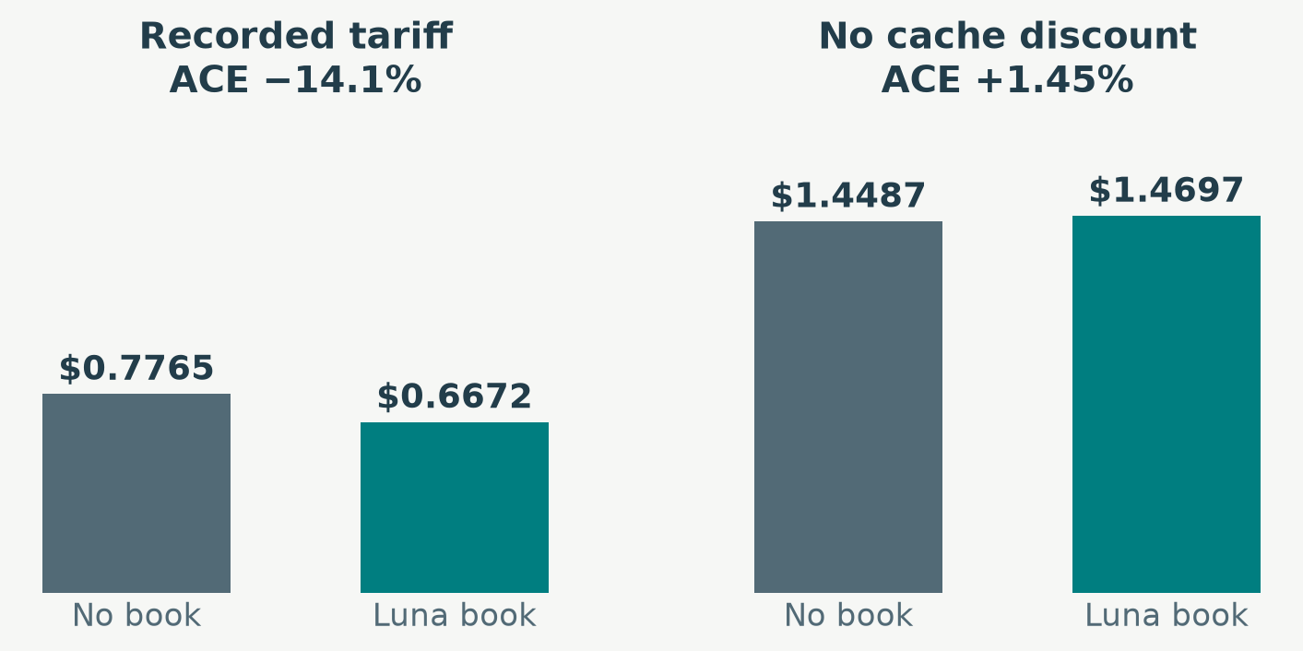
OMPHALOS / ECONOMICS / SENSITIVITY
Cache discounts change the economic conclusion
Observed Luna bill: ACE saves 14.1%.
No cache discount: the same tokens cost 1.45% more with ACE.
Cached share: 64.6% → 75.9%; token use rises slightly.
Terra: own-book uncached sensitivity is +8.51%.
The saving is real at the observed tariff; it cannot all be attributed to less computation.
Delphyne · Development evidence · 13 September 2026
19
Notes:
This counterfactual reprices the same trajectories; it does not rerun the models or change admission behavior. Bar pairs deliberately replace straight-line trajectories between unrelated price scenarios.

Slide 20
OMPHALOS / MISTAKES AND LESSONS
Four failure mechanisms behind weak transfer
1 · The wrong successful ending
2 · Invalid syntax in a valid idea
Accepted ending: nia. Missing from the last proposed script.
Risk: teach a different action from the one that closed the proof.
Reducer: valid assert becomes rejected have syntax around Rle_0_sqr.
Name lookup is insufficient: verify the snippet in its source context.
3 · A mechanism that never arrives
4 · Shorter context, longer search
51 parse failures; 33 duplicates.
Concatenated final messages break parsing; evaluate the fix separately.
Compaction: repeated tool calls; sometimes no proof submission.
Local savings can lose useful memory and completion opportunity.
Capture → validate → retain → expose → use → finish. A failure anywhere can erase the benefit.
Delphyne · Development evidence · 13 September 2026
20
Notes:
Terminal witness: amc12_2000_p6. The missing-text flag alone does not prove every affected training lesson was wrong. Syntax acceptance is not full theorem success; exposure is not causal attribution.

Slide 21
OMPHALOS / EXACT CONTINUATIONS
More allowance recovered Terra proofs, then stalled
Original allowance
2× money
Also 2× requests / time
Luna · no ACE
4 / 8
4 / 8
4 / 8
Luna · book*
3 / 8
3 / 8
3 / 8
Terra · no ACE
4 / 8
6 / 8
6 / 8
Terra · book*
3 / 8
7 / 8
7 / 8
Caps: Luna $0.10 → $0.20 → $0.20; Terra $1 → $2 → $2. *Corrected own-book context.
Same paid prefixes: eight selected trainX problems; no fresh restarts.
Extra money: Luna unchanged; Terra gains +2 / +4 solves.
Then no extra solves: 11 residual paths face money denial; one carries an API failure.
The final plateau is not evidence of an unrestricted model-capability ceiling.
Delphyne · Development evidence · 13 September 2026
21
Notes:
C = no ACE; E = corrected own-book context. Level 0 caps Luna $0.10 / Terra $1.00. Level 1 doubles money to $0.20 / $2.00 while retaining 64 requests / 300s. Level 2 retains that money and gives 128 requests / 600s. Costs in backups include each prefix once.

Slide 22
OMPHALOS / LATEST COMPLETED CYCLE
13 September: the first completion fixes did not win
Treatment
trainX
validationX
Validation bill
Historical reference
28/40
27/40
$0.6672
A · output cap 4,096
30/40
26/40
$1.1281
B · corrected continuation
25/40
23/40
$0.7379
A exposed more search, but did not improve validation economics.
Both gates failed: no selected follow-up; neither becomes the default.
Cost: $3.6136 of a $30 ceiling; Luna / medium / $0.10 per problem.
A reduces the response cap from 32,768 to 4,096 tokens. Completed cycle; ongoing code work is unscored.
Delphyne · Development evidence · 13 September 2026
22
Notes:
These are historical seed-0 controls and fresh candidate trajectories. Validation is reused development data. The frozen book is unchanged. Output cap is a model-response limit including reasoning, not the final visible proof length.

Slide 23
OMPHALOS / RESEARCH DISCIPLINE
Are failed ideas inherited by later experiments?
Stored in Git
Activated by configuration
Keep results, costs, books and candidate code.
A research commit does not establish a solver improvement.
Opt-in: compaction, exploration, repair and continuation.
The next control retains the reference; losing flags stay off.
What really is inherited
Remaining protection to strengthen
The accepted controller and its cost / coverage compromise.
Shared code changes can affect several configurations.
One explicit reference constructor; preserve prompt identity.
Separate archive, fix and promotion; check shared behavior.
Optional treatments are isolated by switches; shared-code behavior still deserves regression checks.
Delphyne · Development evidence · 13 September 2026
23
Notes:
This is an assessment of inspected configuration and history, not a proof of complete behavioral equivalence. Raw BoundedConfig defaults differ from the reference’s explicit admission=False / restart=False settings. No code is changed by preparing this presentation.

Slide 24
OMPHALOS / DISCUSSION
The thesis claim and the advisor decisions
Claim supported by the work
Claim that stays open
ACE in Delphyne: explicit artifacts and verifier feedback.
Useful cost / coverage control; concrete failure diagnoses.
A general, reproducible ACE coverage gain.
An intrinsic Luna ceiling or a general stronger-writer advantage.
Where further work earns its cost
Decisions for the meeting
Faithful, executable evidence.
Local progress must become an accepted proof within the full budget.
Which cost / coverage trade-off serves the thesis?
What evidence is still needed? Use trainX / validationX; testX stays closed.
Evaluate improvements by completed proofs and the whole bill, with mechanism exposure recorded.
Delphyne · Development evidence · 13 September 2026
24
Notes:
Close with decisions, not a promise that the active code work will succeed. The original $30 proposal has begun; the completed first cycle is already included. No new budget or experiment is requested by this deck.

Slide 25
OMPHALOS / BACKUP / EXACT VALUES
What are the exact crossover costs and caps?
Solver
Book
Solves
Panel bill
Bill / solve
Luna
None
24/40
$0.776512
$0.032355
Luna
Luna
27/40
$0.667228
$0.024712
Luna
Terra
24/40
$0.734194
$0.030591
Terra
None
29/40
$6.610626
$0.227953
Terra
Luna
29/40
$6.852274
$0.236285
Terra
Terra
30/40
$6.451344
$0.215045
One row = 40 validationX problems. Recorded inference spending includes failures.
Preparation excluded; historical controls reused; not 240 independent theorems.
Luna / medium / $0.10 cap; Terra / medium / $1.00 cap; 64 requests and 300 verifier seconds.
Delphyne · Development evidence · 13 September 2026
B01
Notes:
Exact source: report/ace_retrospective/data/crossover.csv. Own-book p-values: Luna 0.25; Terra 1.0. The full crossover tests solver/book combinations, not a general scaling law.

Slide 26
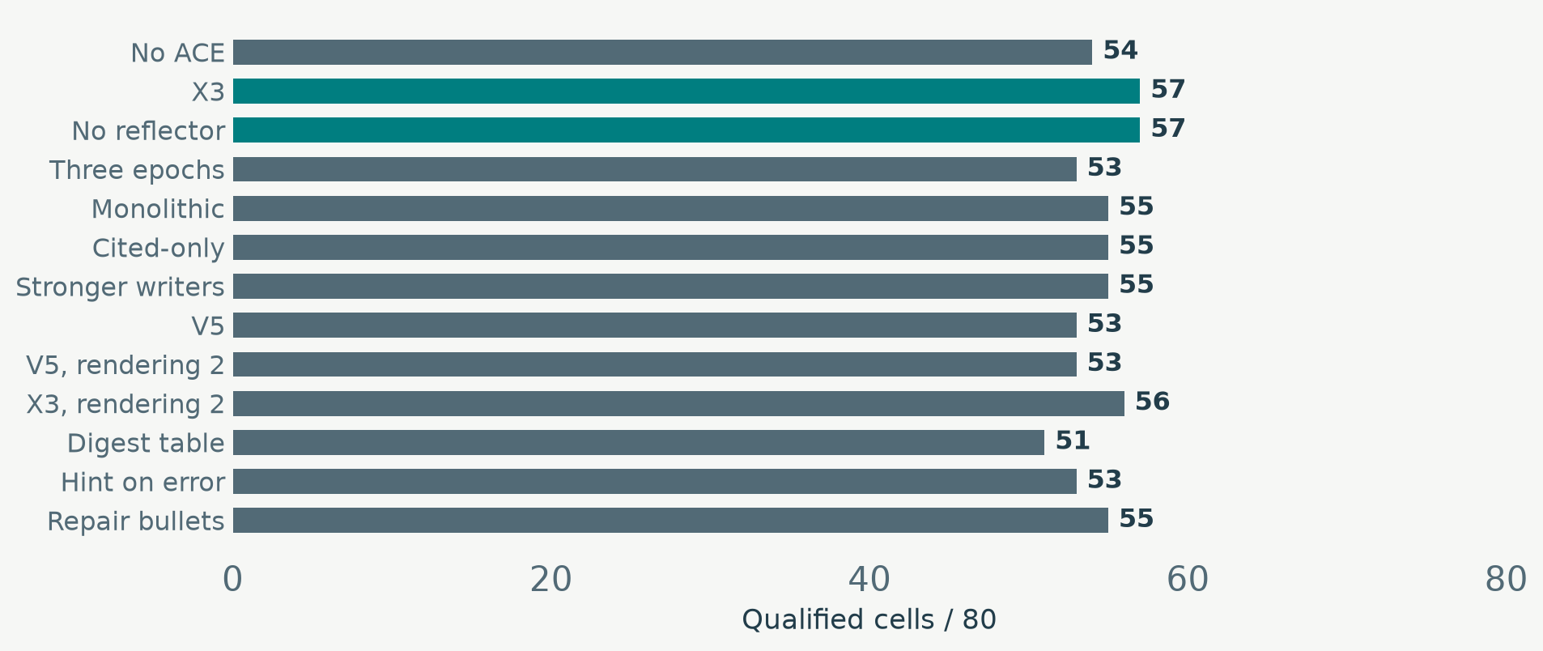
OMPHALOS / BACKUP / HISTORICAL COMPARISON
Which historical books improved coverage?
X3 and no-Reflector: 57/80 versus no ACE 54/80; differences remain modest.
Repair bullets: 56 raw successes; 55 qualify under the retrospective cost rule.
Two replicate identifiers on 40 validationX problems; separate books and delivery methods.
Delphyne · Development evidence · 13 September 2026
B02
Notes:
Directly labeled horizontal bars show categorical treatments. Bills were repriced from tokens at the audited snapshot; they are not guaranteed complete historical retry receipts. Incomplete arms are excluded, not silently counted as full panels.

Slide 27
OMPHALOS / BACKUP / ADMISSION SEMANTICS
How can a run stop while money remains?
$0.085742
$0.086368
DENIED
Remaining balance
Required reservation
$0.000626 over balance
Reserve input and maximum output charges before dispatch.
Bound above balance → deny. The hypothetical actual bill is unknown.
A smaller cap also constrains reasoning; the 4,096-token trial did not win.
Unused money is not automatically spendable; looser admission must still respect financial protection.
Delphyne · Development evidence · 13 September 2026
B03
Notes:
Illustrative recorded continuation: remaining $0.085742, next reservation $0.086368. This is $0.000626 over the balance. File: runtime/campaign_budget.py, CampaignResponsesModel.estimate_budget and Ledger.reserve. Do not make all reservations unsafe just to admit more calls.

Slide 28
OMPHALOS / BACKUP / AMORTIZATION
When would preparing the book pay for itself?
Quantity
Luna
Terra
Known preparation bill
≥ $0.9169
$8.0992
Inference saving / 40 tasks
$0.1093
$0.1593
Conditional break-even workload
≈ 336 tasks
≈ 2,034 tasks
Assumptions: unchanged task mix, coverage, prices, cache reuse and usefulness.
Denominator: future attempted problems; unsuccessful attempts also count.
Not included: engineering / assistant costs; Luna’s missing historical embeddings.
This is arithmetic under fixed assumptions, not a prediction of external generalization.
Delphyne · Development evidence · 13 September 2026
B04
Notes:
Break-even = known preparation cost divided by observed per-attempt inference saving. Values are rounded upward to whole attempted tasks. No extrapolated straight-line chart is needed to convey these conditional figures.

Slide 29
OMPHALOS / BACKUP / EVIDENCE
Which evidence should an ACE lesson retain?
Proposal and execution
The concrete witness
The exact submitted script and the prefix actually executed.
Accepted terminal proof, including automatic assistance such as nia.
amc12_2000_p6: final_check.success = true.
nia. accepted; missing from proposal. The proof succeeded.
From source to lesson
From lesson to benefit
Context, bindings and checked snippet attached to the lesson.
Preserve valid syntax through reflection, curation and reduction.
Show delivery and use in the later operation.
Then measure full proofs and total spending; local validity is insufficient.
File to inspect: report/ace_retrospective/data/creator_terminal_evidence.json, entry 0.
Delphyne · Development evidence · 13 September 2026
B05
Notes:
Other fields and full paths are in rehearsal_excerpts.md. Seven of 33 source successes have a missing terminal-tactic text flag; this is not seven established identical causal errors.

Slide 30
OMPHALOS / BACKUP / MEASUREMENT RULES
Why is +3 solves not yet a supported gain?
What the three gains say
What counts as evidence
3 gains, 0 losses: paired exact p = 0.25.
No proof of a general effect; also no proof that ACE has zero value.
All expected cells; platform failures retained in the denominator.
Whole-panel costs, including failed attempts, retries and known liabilities.
What is independent
What permits a practical decision
Cluster related theorem families and repeated seeds.
validationX is reused development data; selection is not confirmation.
Support: two-sided p < 0.10; 90% intervals.
Expansion, trade-off and promotion are separate decisions; preserve gates.
Do not buy extra seeds merely to cross a significance threshold; testX stays closed.
Delphyne · Development evidence · 13 September 2026
B06
Notes:
Five independent all-favorable discordances give exact two-sided p=0.0625. This is a minimum for attainable significance, not a power calculation. Small samples and historical controls warrant restrained interpretation.

Slide 31
OMPHALOS / BACKUP / NAVIGATION
Which files should I rehearse before presenting?
Question
File · relative to examples/omphalos
Search / inspect
How is ACE wired?
prove_ace.py
prove_theorem_ace; ReflectOnTrajectory
How is the book stored?
ace/ace_playbook.py; ace/ace_store.py
merge; refine; PlaybookStore.put
Where is 38/40?
experiments/campaigns/ace_attribution_20260912/RESULTS.md
Playbook creation; Generator solves
What stopped a call?
runtime/campaign_budget.py
estimate_budget; Ledger.reserve
Terminal witness?
report/ace_retrospective/data/creator_terminal_evidence.json
entry 0; final_check; last_tactic
Read-only rehearsal; no experiment launch, partition loader or live model call is needed.
Delphyne · Development evidence · 13 September 2026
B07
Notes:
A short presentation route and file checklist are in advisor_rehearsal.md / advisor_rehearsal.pdf. The older rehearsal_notes files describe the previous sixteen-slide deck.

