Slide 1
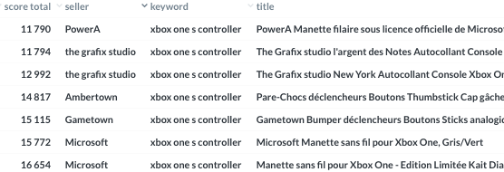




Slide 2
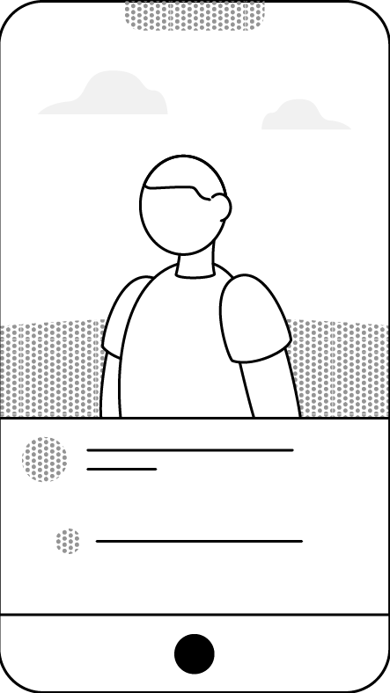
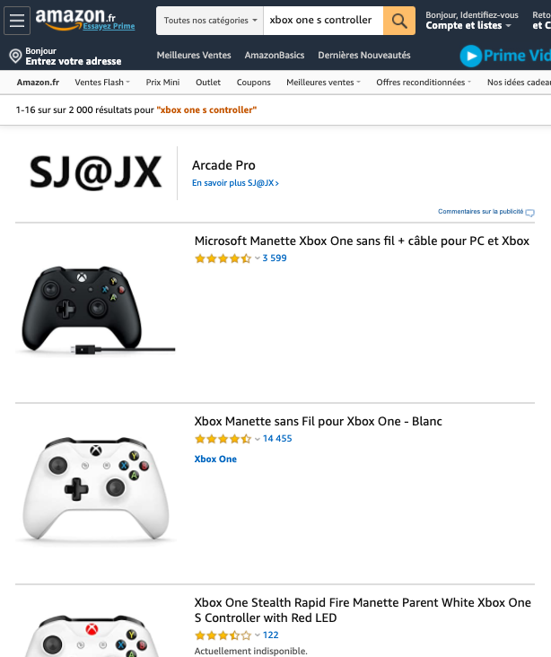

Slide 3

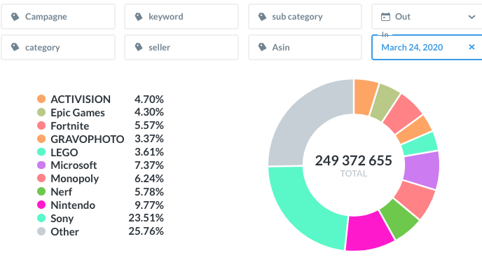

Share of voice
Sponsored product
Sponsored product
Sponsored products
Headline products

Slide 4
Sponsored product
Sponsored product
Sponsored products
Headline products

