Slide 1
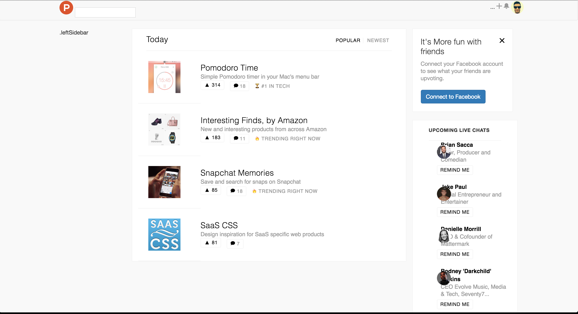
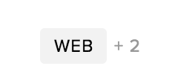
C
Overall am I in the right direction? Is it time to use Sass? How do I better organize/think about my CSS?
A – self explanatory, can’t get it to work
B – ProductHunt has a div like the one bellow here [1]. Can’t figure out how to position it. Should I redo this entire center container using a 2/10 col grid?
C – Need to align center. Was having difficulty but should be a Google search away.
D – I’ve got responsive design coded in a hacky way. Need help with next steps. TOP PRIORITY
B
A
[1].

