Slide 1

Spider-Man: Homecoming Sight Mask

Slide 2
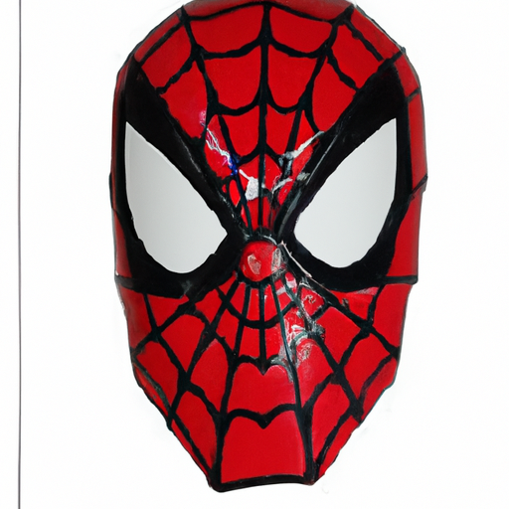
Product Image
Product Name: Spider-Man: Homecoming Sight Mask
Department: Toys and Games
Target Audience: Gender: both Age: 5-13
Main Features: Moving eye feature, fits most sizes, Spider-Man: Homecoming design.
Source: GPT 4

Slide 3
Ads Strategy Copy for four important moments in online campaigns to increase sales of the selected product
Cold Public 1
Cold Public 2
Discover the Ultimate Spider-Man Experience! Transform into your favorite superhero with the Spider-Man: Homecoming Spider Sight Mask. Featuring movie-inspired details and moving eyes that react to your mouth movements, this mask is perfect for imaginative play. Don't just watch Spider-Man, BE Spider-Man. Shop now!
Ready to swing into action? The Spider-Man: Homecoming Spider Sight Mask awaits you! With a flexible band to fit all sizes, this mask brings Spidey's adventures to life. Activate the moving eyes with a simple mouth movement and embrace your inner hero. Join the web-slinging fun today!
Remarketing
Abandoned Cart
Still thinking about stepping into Spider-Man's shoes? The Spider Sight Mask from Spider-Man: Homecoming is the perfect addition to your superhero collection. With eye movement you control, it's as close as you can get to having Spidey's powers. Don't miss out, swing back and complete your purchase now!
You're one step away from completing your superhero transformation! The Spider-Man: Homecoming Spider Sight Mask is still waiting for you. Don't let it slip away – come back to finish your checkout and bring home the excitement of becoming Spider-Man with a mask that's as dynamic as you are.
Source: GPT 4

Slide 4
Thanks for attention

