Slide 1

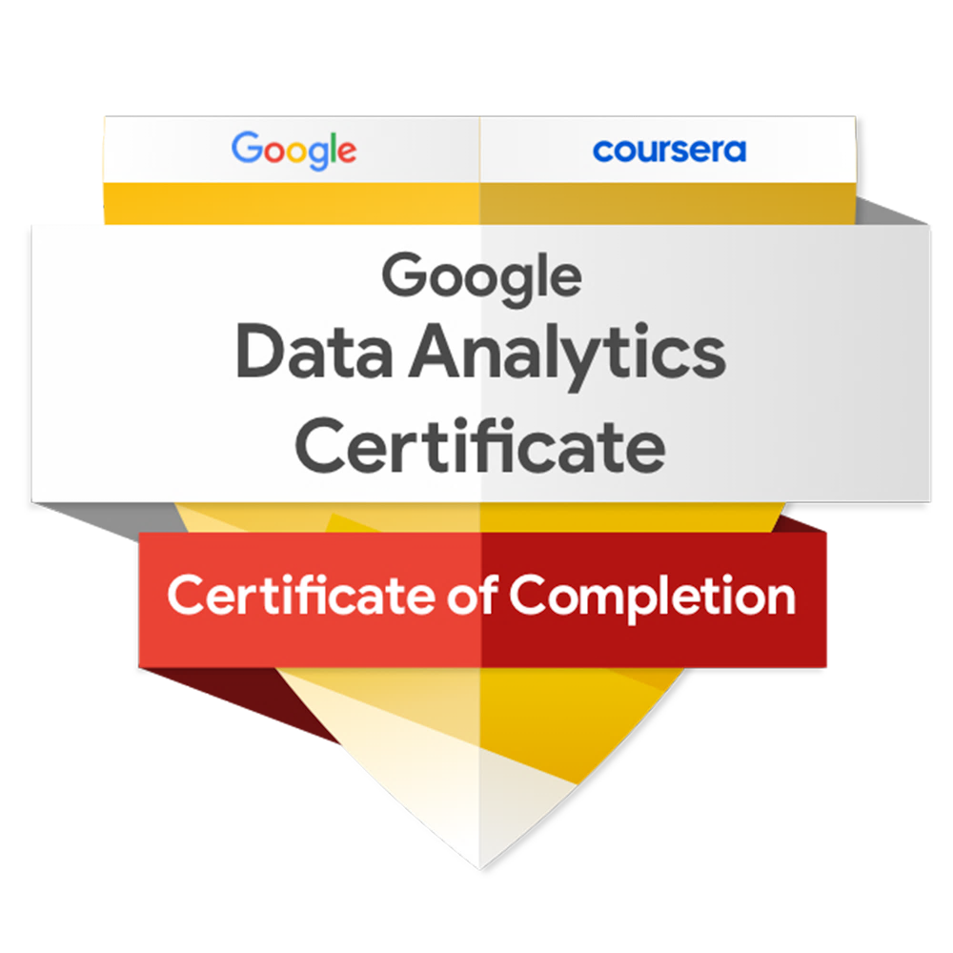
Cyclistic
Design strategies to convert casual users into annual members of Cyclistic. The final capstone project for obtaining the Google Data Analysis Certification.

