Slide 1





Spring Security y JWT
3
6
@jcabelloc
Youtube
Juan Cabello

Slide 2
Spring Security y JWT
Proyecto Base (Sin seguridad)
Spring Security / Arquitectura / Filtros
Configuración Básica con Autorización
Uso de UserDetailsService y Conf. Autorizaciones
Autenticación Personalizada y Generación de Token JWT
Uso de JWT (Bearer Token) en los requests

Slide 3
Proyecto Base(Sin Seguridad)
API REST de tipo "Hola Peru"
SSJ1

Slide 4
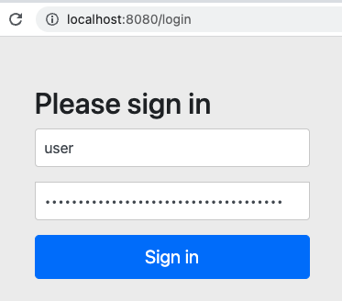
Spring Security
Spring security provee Autenticación, Autorización y Protección contra ataques comunes.
<dependency>
<groupId>org.springframework.boot</groupId>
<artifactId>spring-boot-starter-security</artifactId>
</dependency>
Spring crea por defecto: User con password aleatorio, Form login, Basic Auth, un SecurityFilterChain, y mucho más
SSJ2

Slide 5
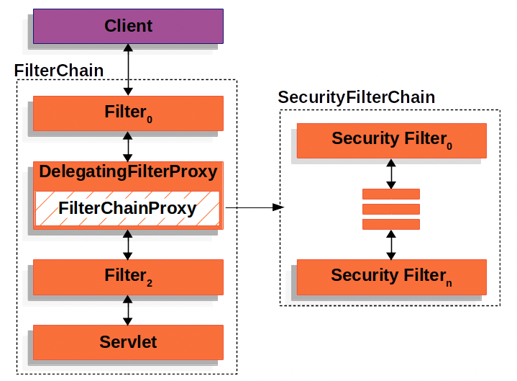
Spring Security - Arquitectura
...
CorsFilter
...
UsernamePasswordAuthenticationFilter
...
BasicAuthenticationFilter
...
FilterSecurityInterceptor(AuthorizationFilter)
...
SSJ2

Slide 6
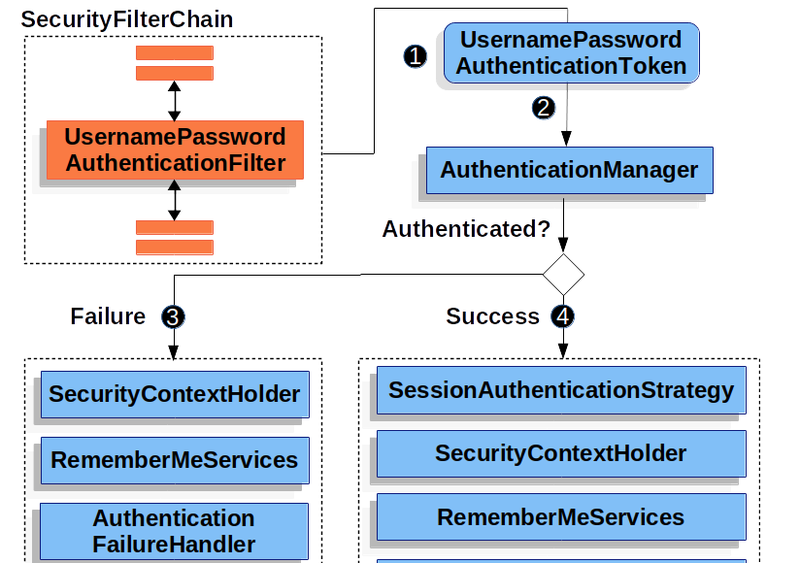
Autenticación con Form Login
SSJ2
Notes:
Spring Security’s HTTP Basic Authentication support in is enabled by default. However, as soon as any servlet based configuration is provided, HTTP Basic must be explicitly provided.

Slide 7
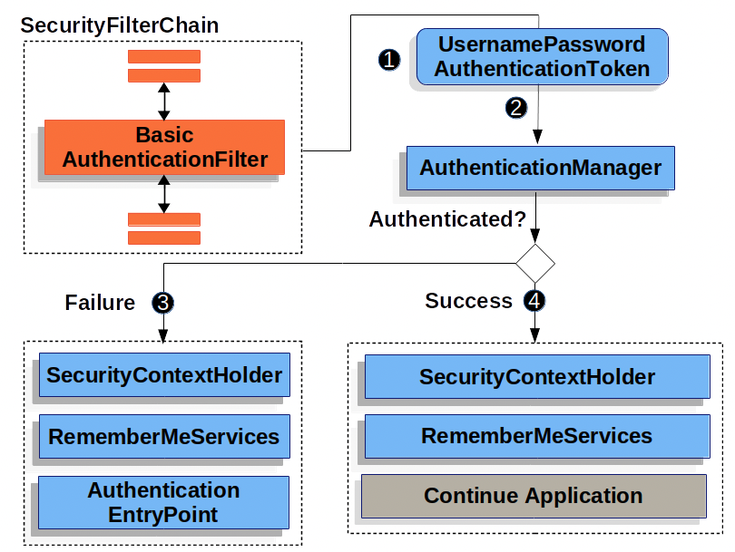
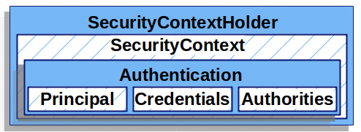
Autenticación Básica
SSJ2
Notes:
Spring Security’s HTTP Basic Authentication support in is enabled by default. However, as soon as any servlet based configuration is provided, HTTP Basic must be explicitly provided.

Slide 8
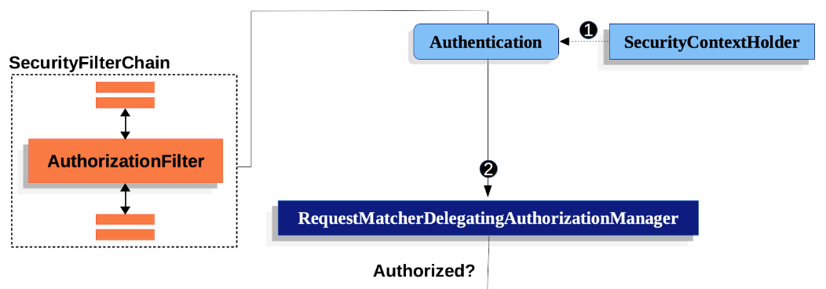
Autorizacion(Control de Acceso)
@Bean SecurityFilterChain web(HttpSecurity http) throws Exception {
http
.authorizeHttpRequests((authorize) -> authorize
.anyRequest().authenticated()
);
return http.build();
}
Configuración equivalente al "default" =>
SSJ3
Notes:
Spring Security’s HTTP Basic Authentication support in is enabled by default. However, as soon as any servlet based configuration is provided, HTTP Basic must be explicitly provided.

Slide 9
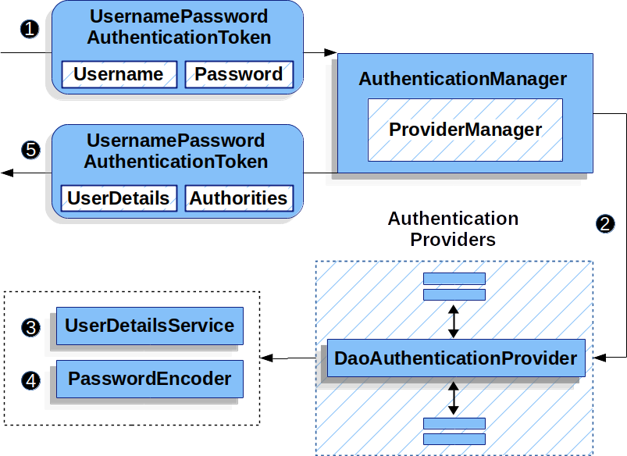
Configuración de Spring Security
Uso de UserDetailsService para obtener información del usuario
Configuración de Autorizaciones(público, privado, roles)
SSJ4
Notes:
If you need to check if it is an anonymousUser then you can check whether Authentication object is AnonymousAuthenticationToken instance or not.

Slide 10
Configuración de Spring Security con JWT
Autenticación y Generación de Token JWT
SSJ5
Notes:
If you need to check if it is an anonymousUser then you can check whether Authentication object is AnonymousAuthenticationToken instance or not.

Slide 11
Configuración de Spring Security con JWT
Uso de Token JWT para llamar a APIs REST
SSJ6
Notes:
If you need to check if it is an anonymousUser then you can check whether Authentication object is AnonymousAuthenticationToken instance or not.

Slide 12
Referencias
https://docs.spring.io/spring-security/reference/index.html
https://jwt.io/
https://www.toptal.com/spring/spring-security-tutorial
https://www.toptal.com/java/rest-security-with-jwt-spring-security-and-java
https://www.javainuse.com/spring/boot-jwt
https://www.baeldung.com/spring-security-csrf

