Slide 1
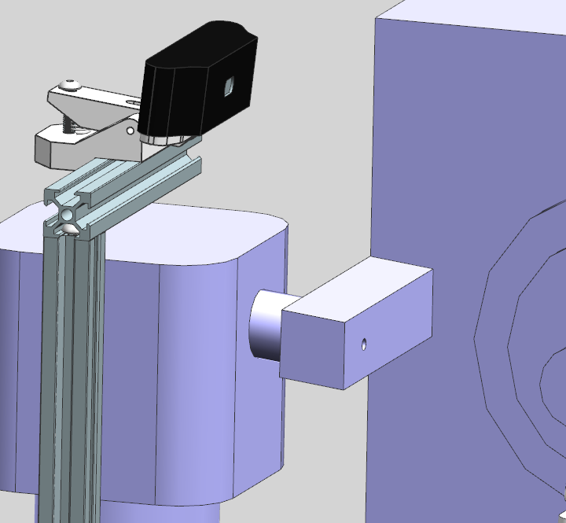

Slide 3
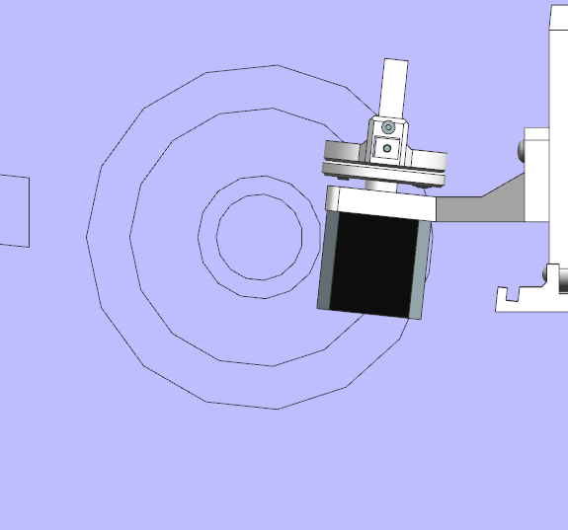
SAFETY GAP

Slide 4
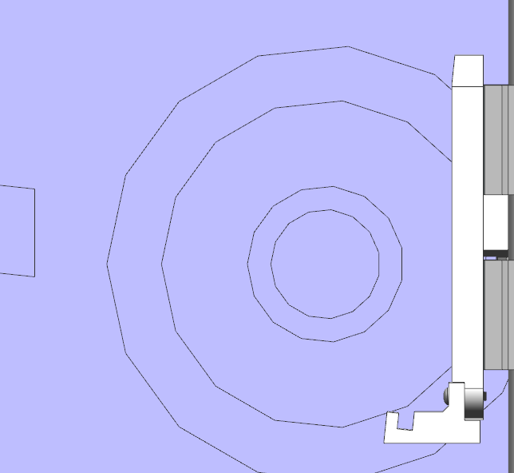
SAFETY GAP

Slide 5
Z
X

