Slide 1
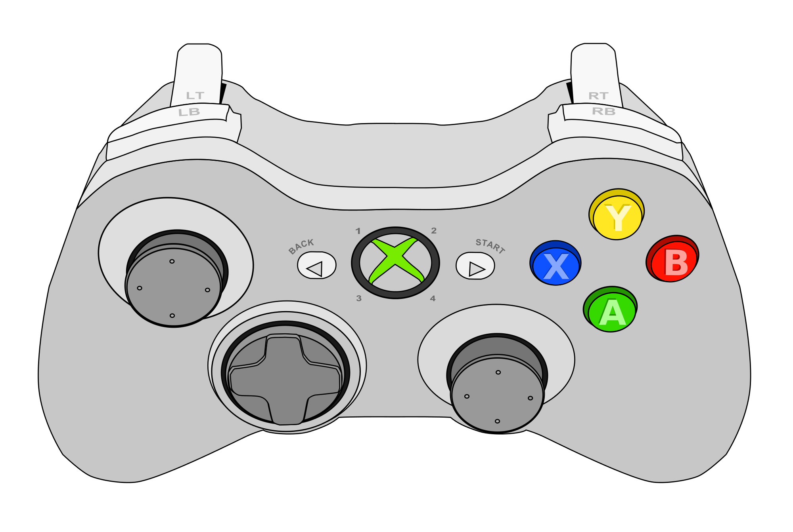
???
Shoot
Change Character (previous)
Map
Pause Menu
Change Character (next)
Special Attack
Throw/Discard Item/Object
Character Movement
Generic Action
Use Item
(yourself)
Take/Grab Item/Object
Open Doors
Rotate Character
Use Item
(other characters)
Attack (punch)

Slide 2
Aim
Shoot/Throw Object
Change Character (previous)
Map
Pause Menu
Change Character (next)
Special Attack
Discard Item
Character Movement
Generic Action
Use Item
(yourself)
Take/Grab Item/Object
Open Doors
Rotate Character
Use Item
(other characters)
Attack (punch)

