Slide 1
Nand2Tetris Project 01 (Part 02)
Guilherme Quadros da Silva

Slide 2

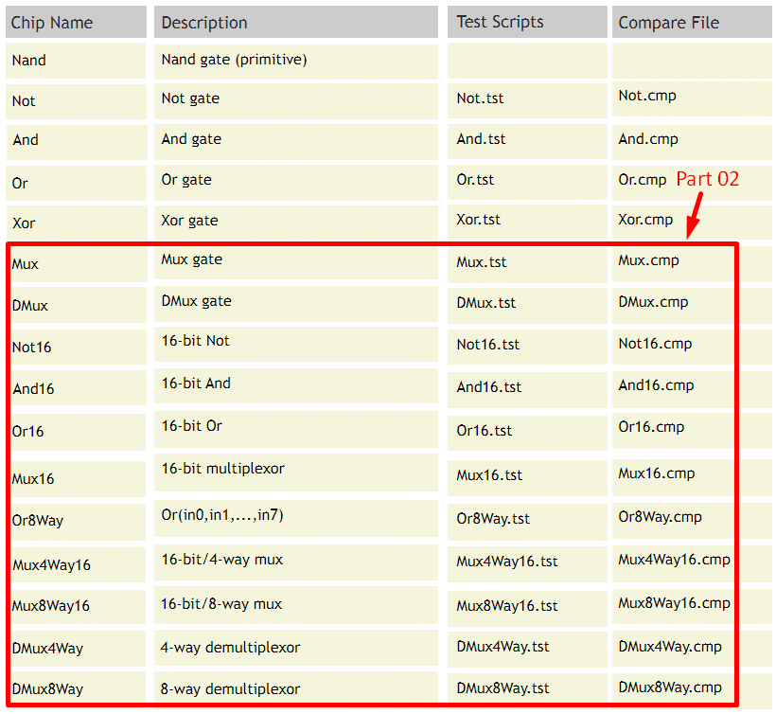

Resources
List of Chips:
www.nand2tetris.org/project01
Gate Design tool:
https://logic.ly/dem

Slide 3
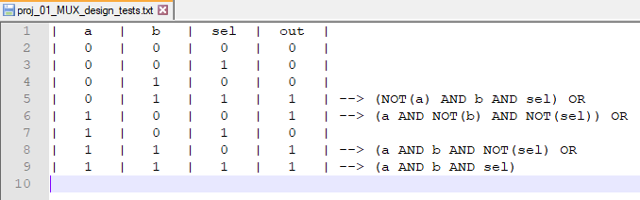

Mux gate design TRUTH TABLE TEST

Slide 4
Mux gate design
https://logic.ly/demo

Slide 5
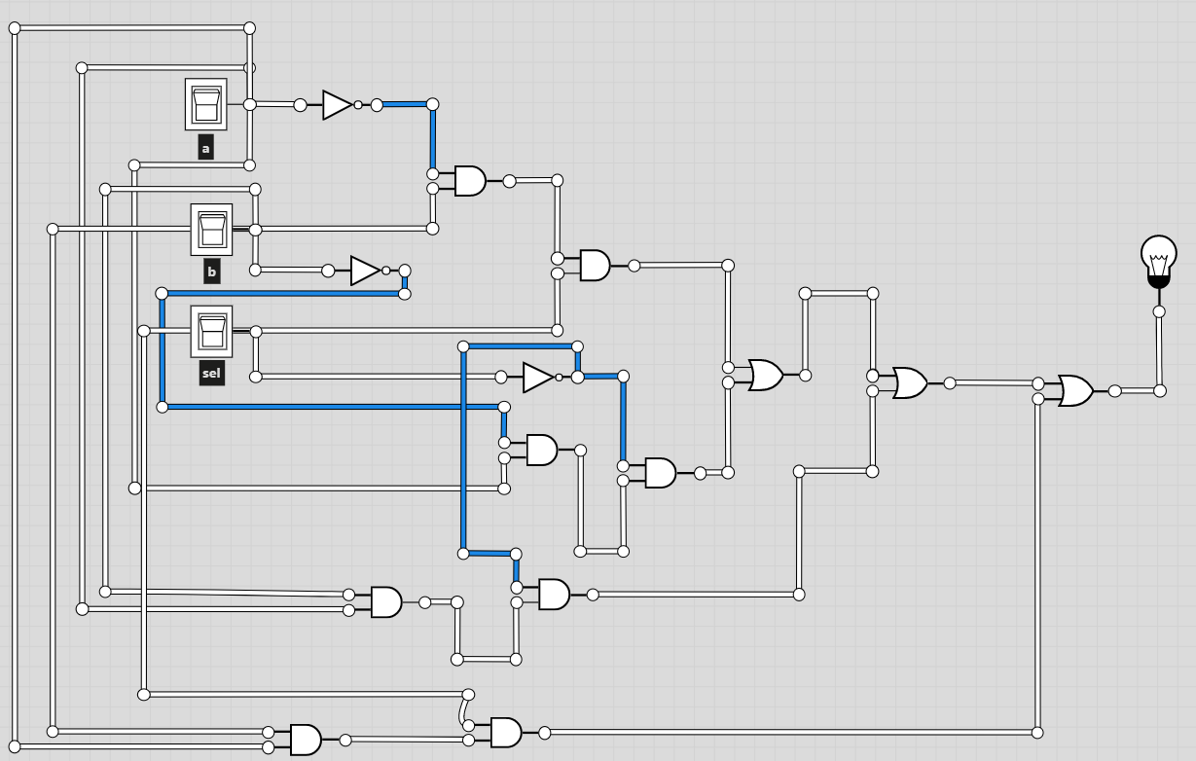

Slide 6
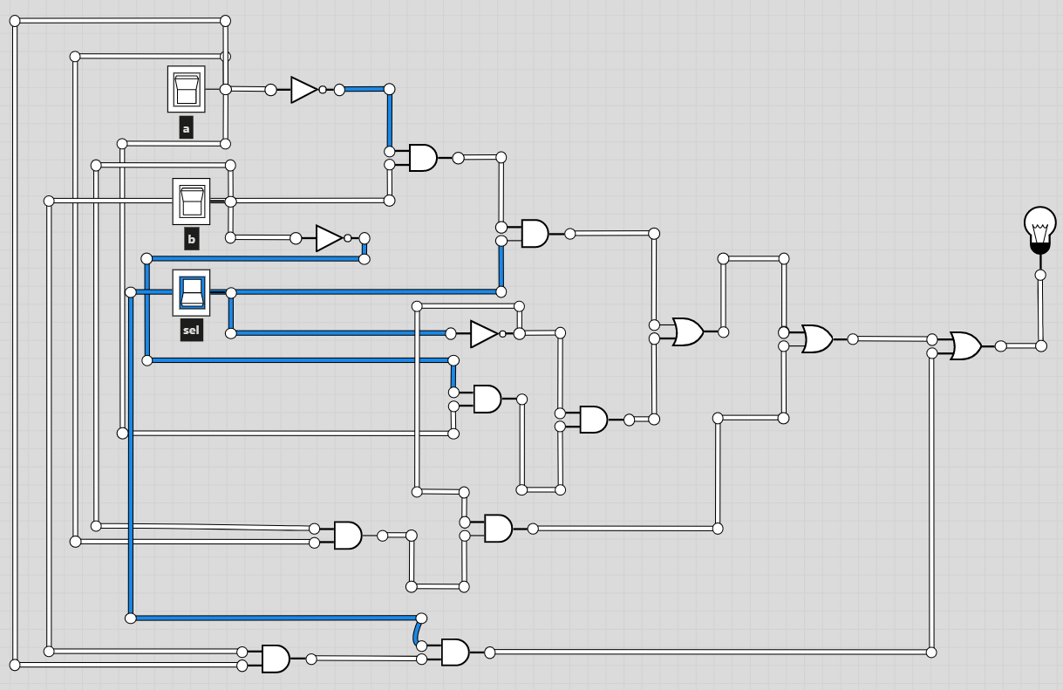

Slide 7
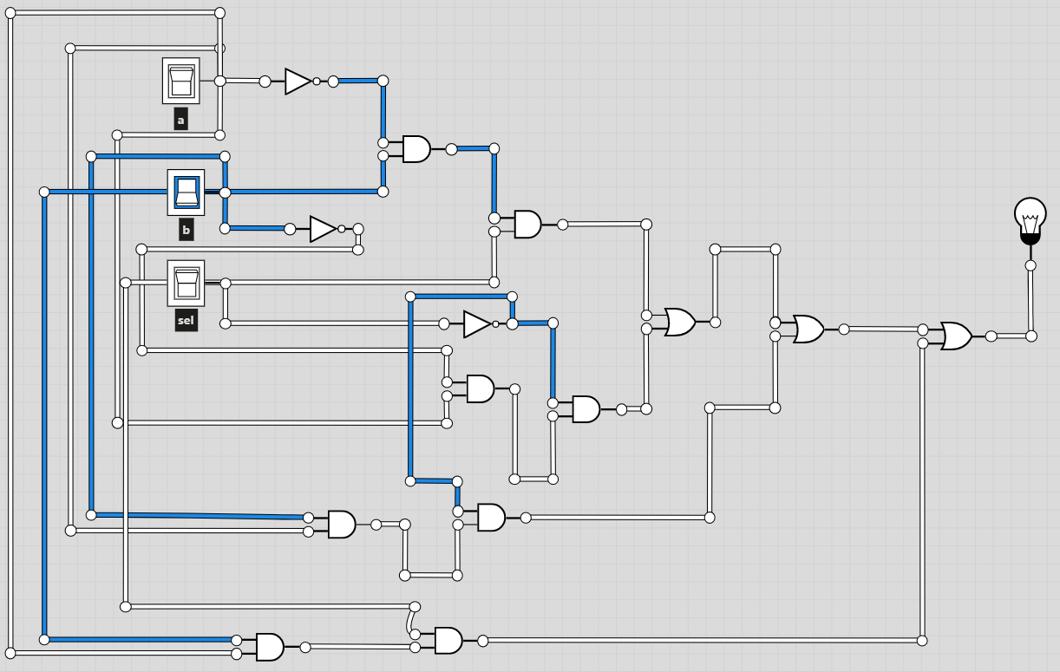

Slide 8
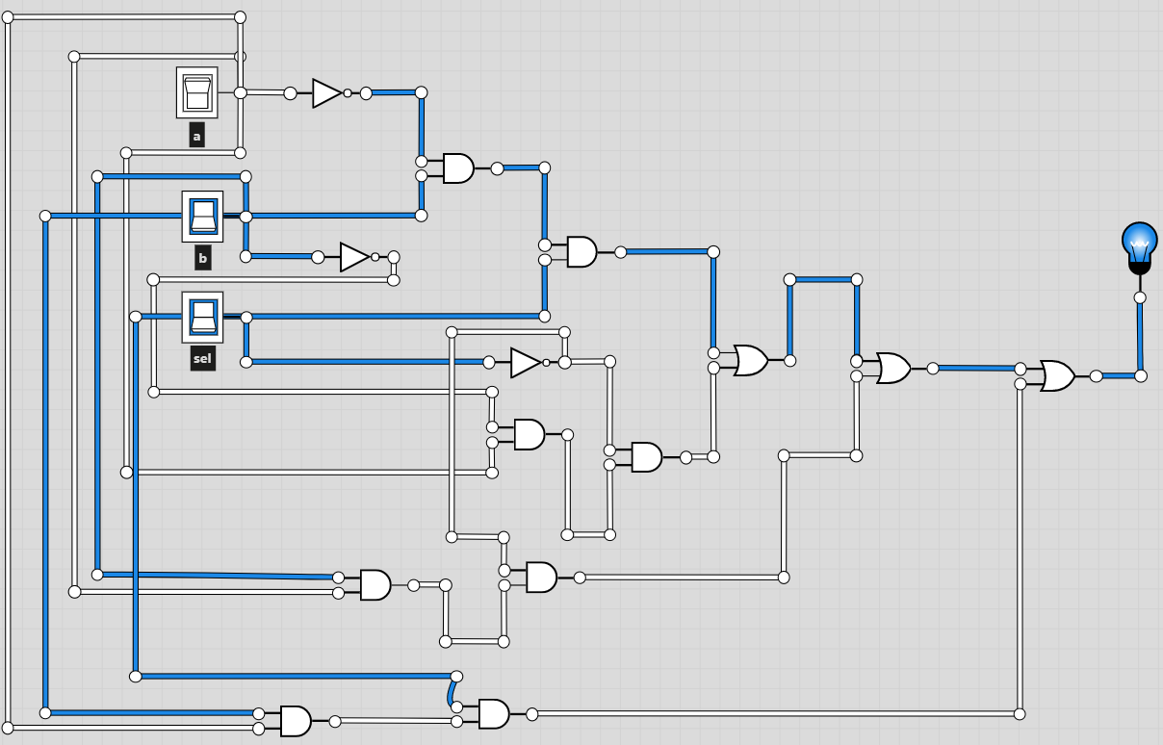

Slide 9
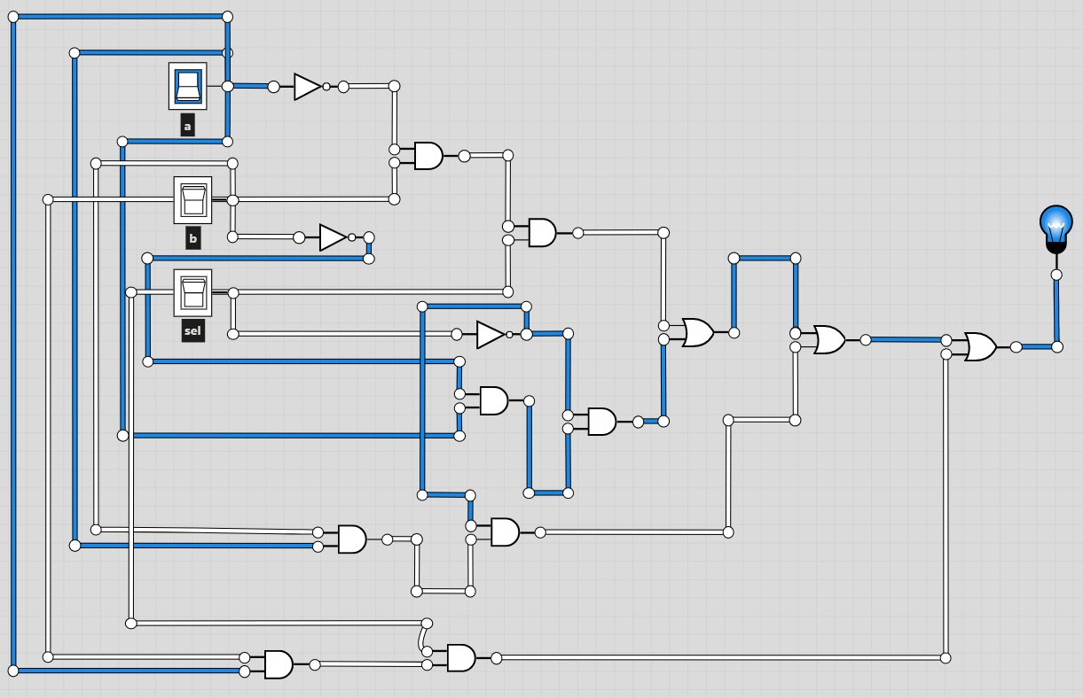

Slide 10
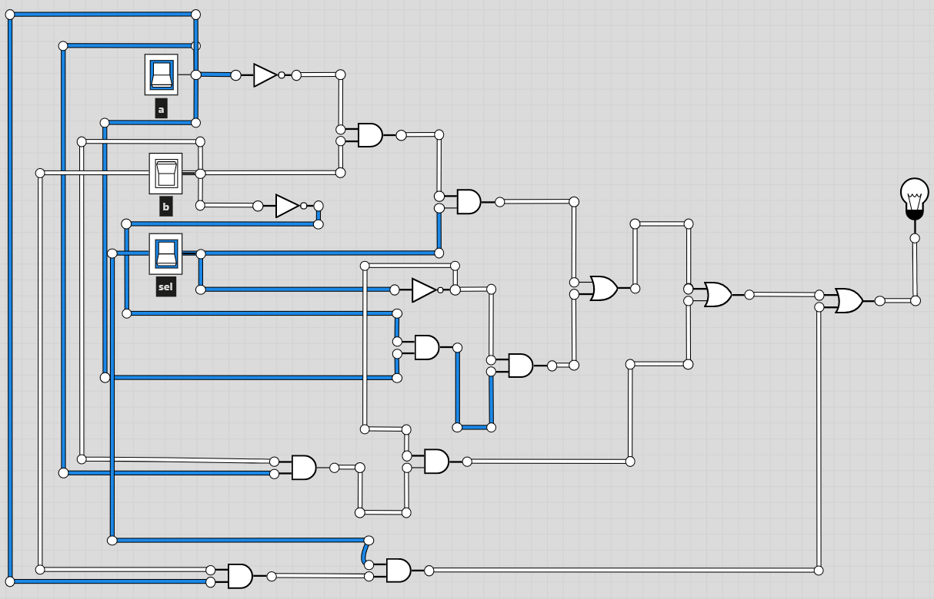

Slide 11
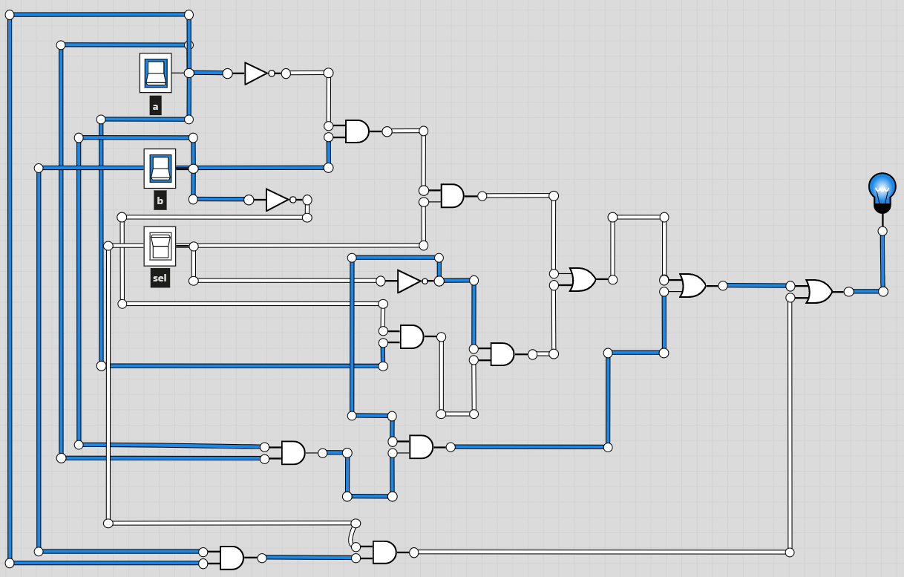

Slide 12
