Slide 1
Nand2Tetris Project 01
Guilherme Quadros da Silva

Slide 2

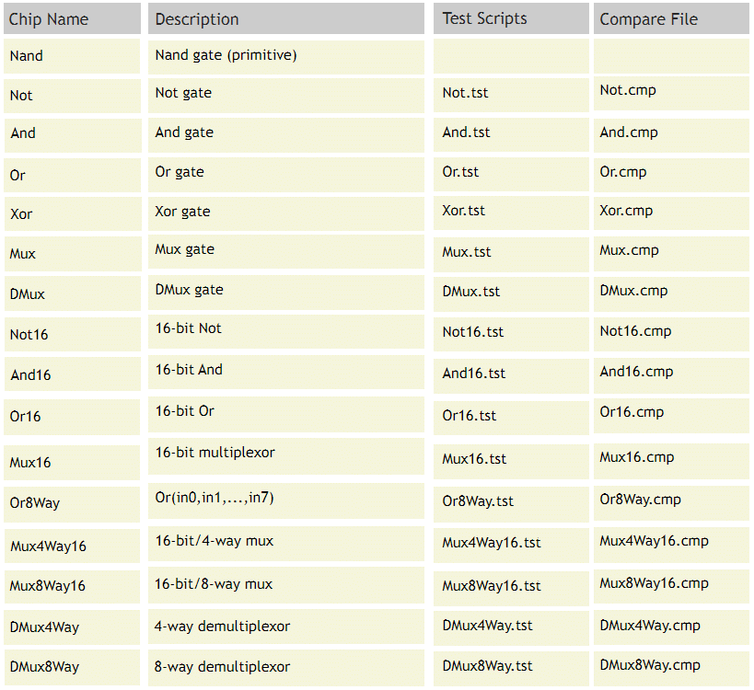

Resources
List of Chips:
www.nand2tetris.org/project01
Gate Design tool:
https://logic.ly/dem

Slide 3
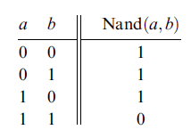

Not gate
Not Truth Table
Nand Truth Table

Slide 4
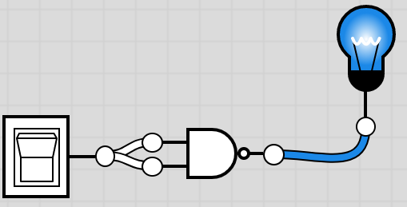
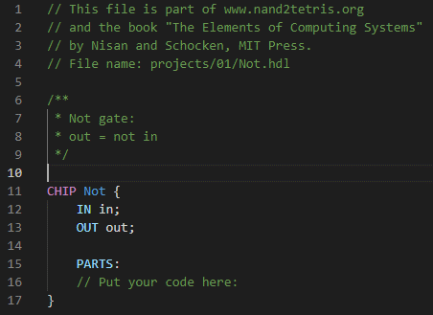
Not gate design
a=in | b=in | out=out
0 | 0 | 1
1 | 1 | 0

Slide 5
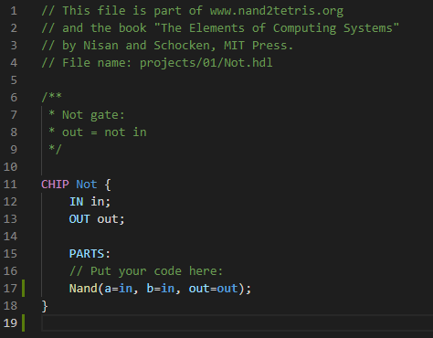

Not gate VHDL CODE

Slide 6
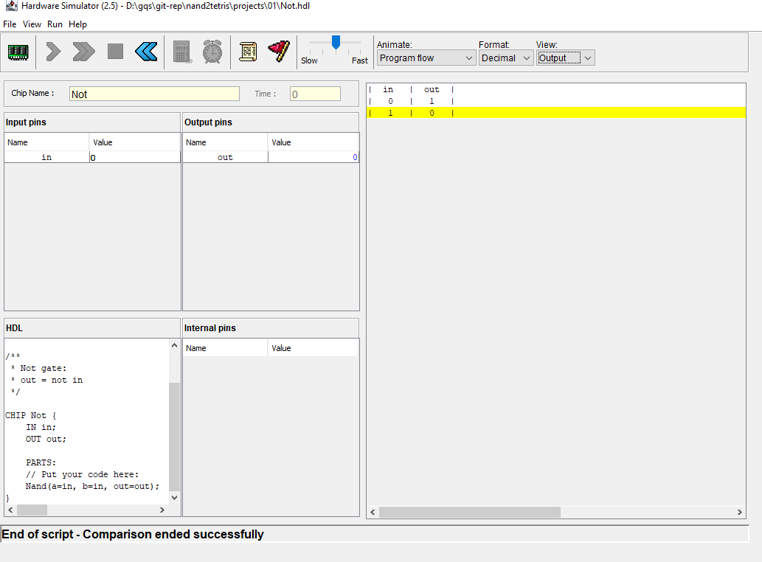
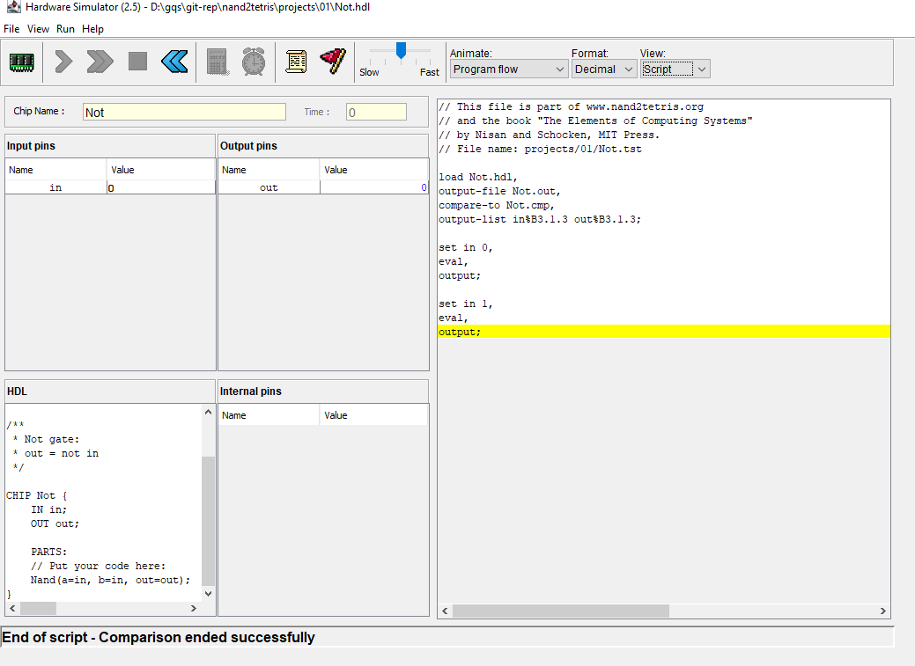
Test results

Slide 7
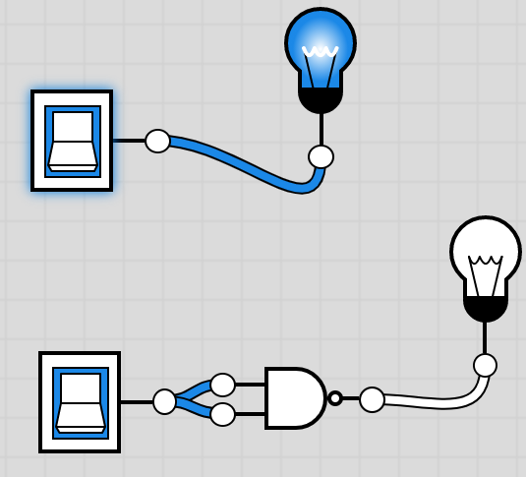
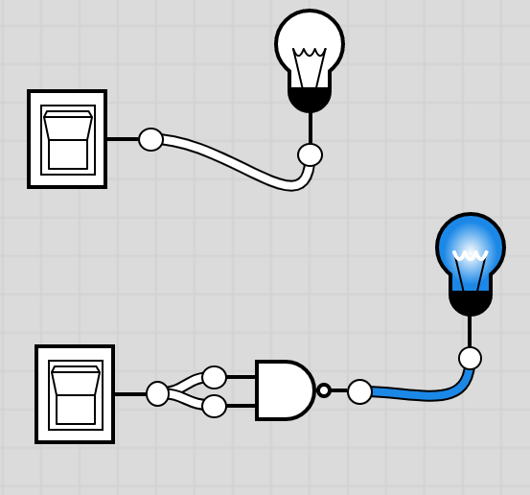
https://logic.ly/demo

