Slide 1
Nand2Tetris Project 01
Guilherme Quadros da Silva

Slide 2

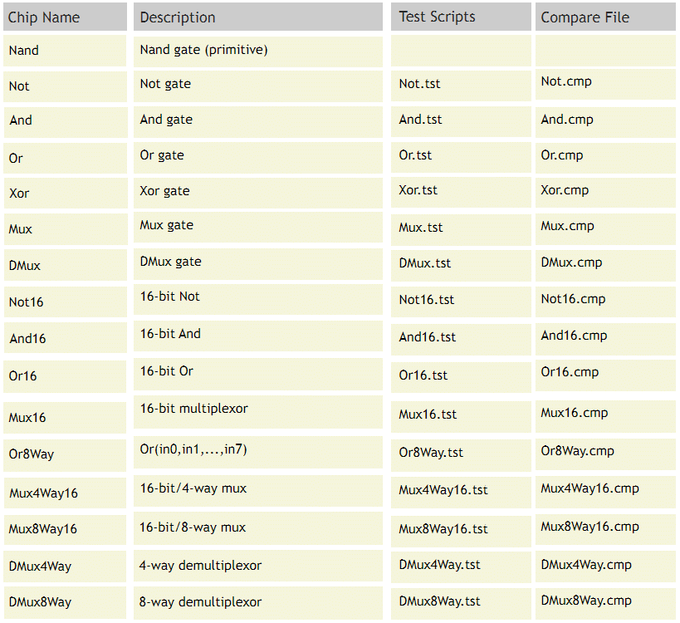

Resources
List of Chips:
www.nand2tetris.org/project01
Gate Design tool:
https://logic.ly/dem

Slide 3
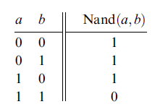

Not gate
Not Truth Table
Nand Truth Table

Slide 4
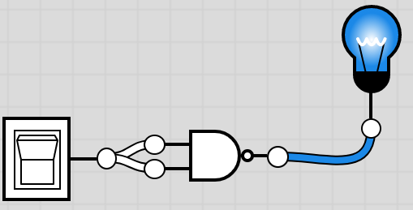
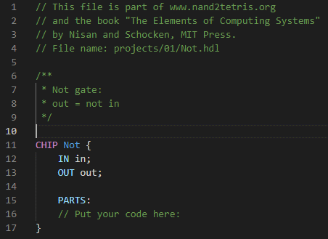
Not gate design
a=in | b=in | out=out [Nand]
0 | 0 | 1
1 | 1 | 0

Slide 5
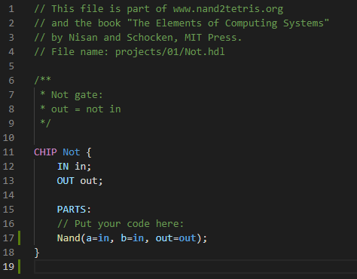

Not gate HDL CODE

Slide 6
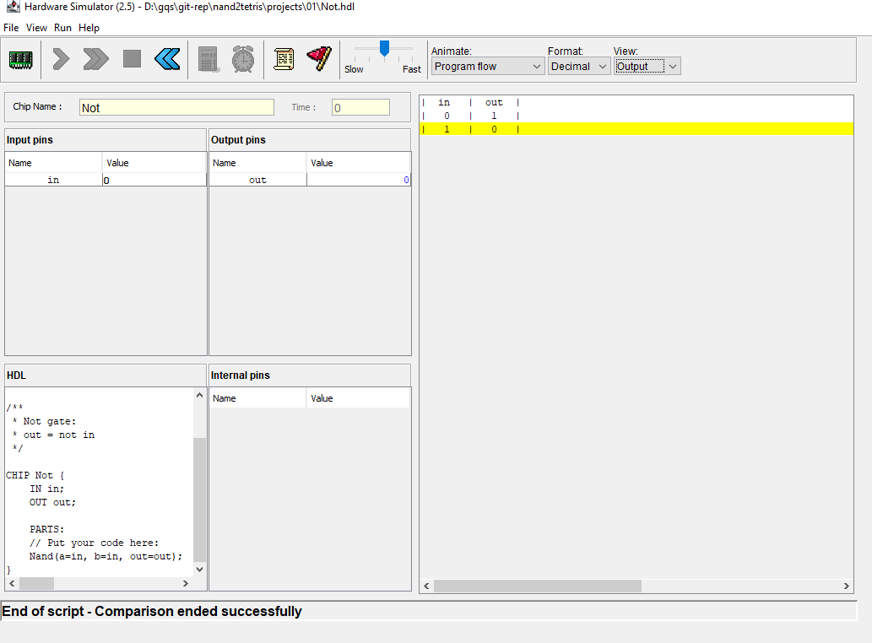
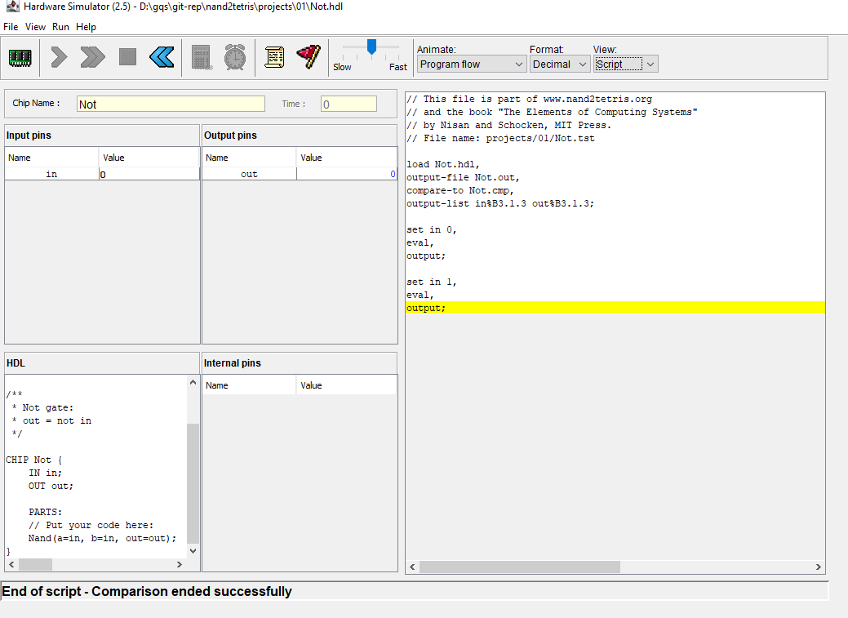
NOT Test results

Slide 7
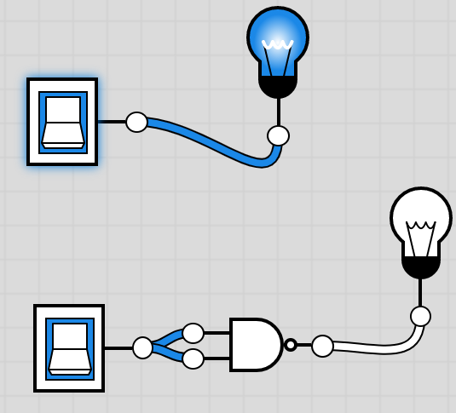
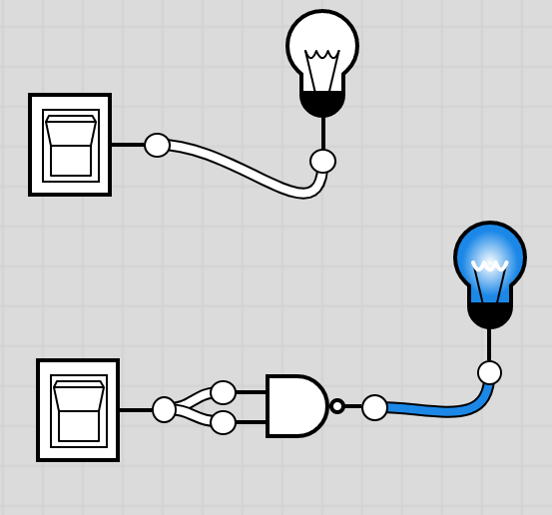
https://logic.ly/demo

Slide 8
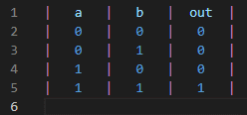
And gate
And Truth Table
Nand Truth Table
Not Truth Table

Slide 9
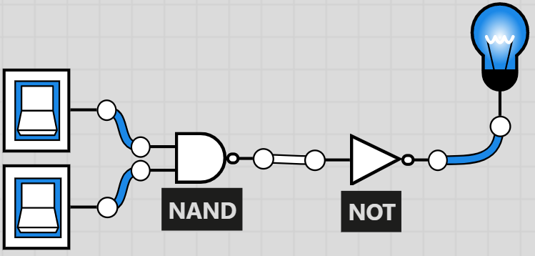
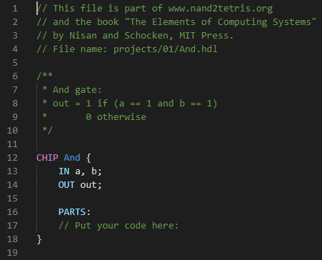
And gate design
a=a | b=b | out=nandOut [Nand]
0 | 0 | 1
0 | 1 | 1
1 | 0 | 1
1 | 1 | 0
Not Truth Table
in=nandOut | out=out [Not]
1 | 0
1 | 0
1 | 0
0 | 1

Slide 10
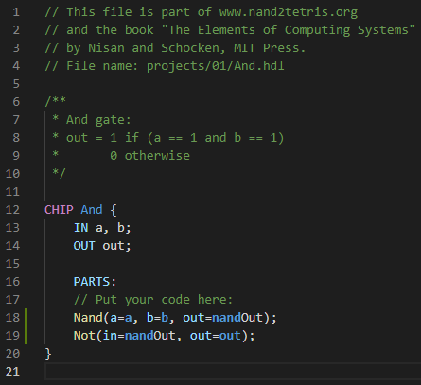
And gate HDL CODE

Slide 11
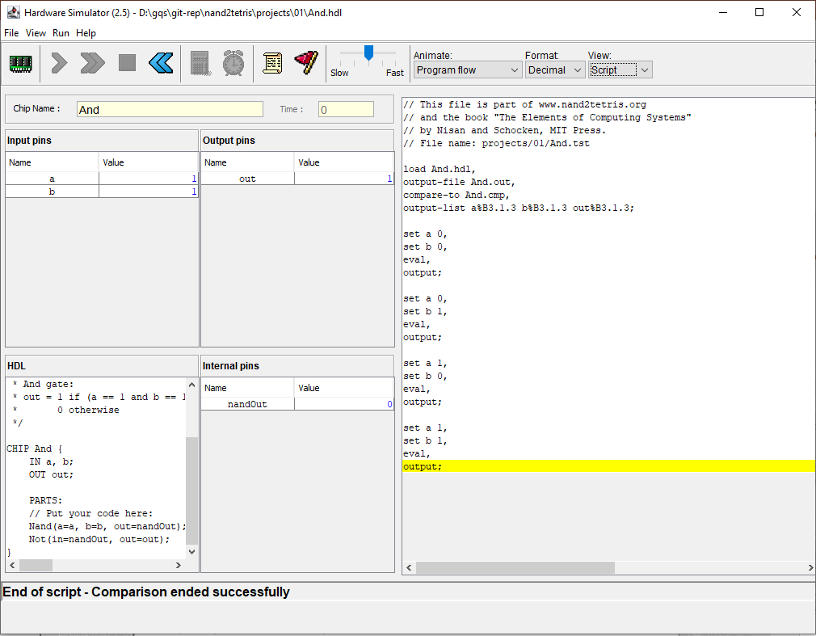
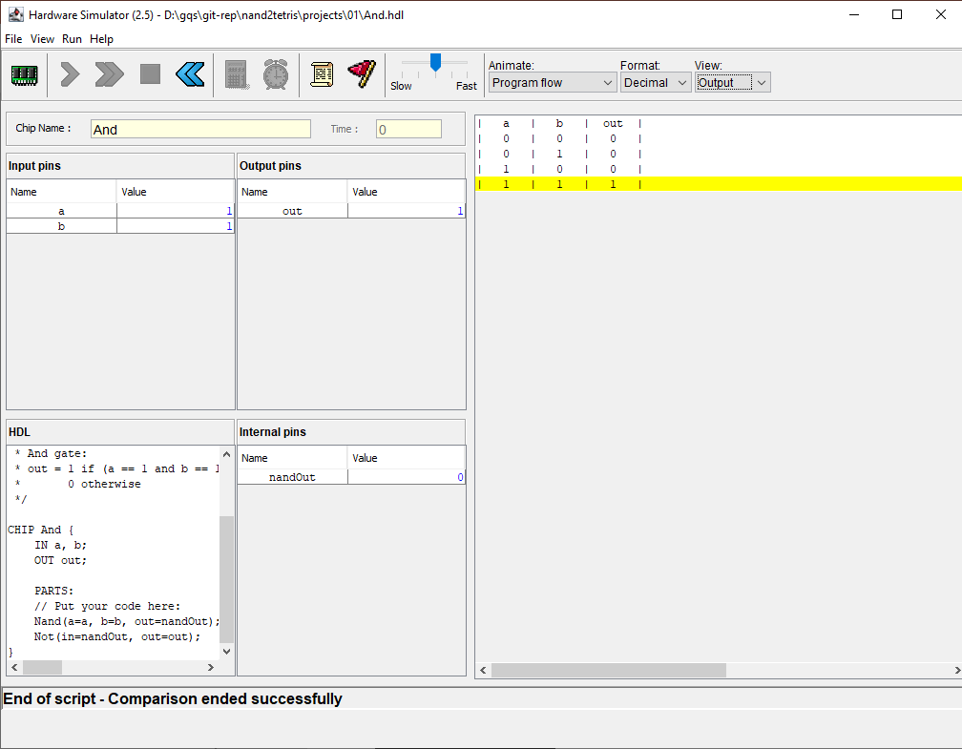
And Test results

Slide 12
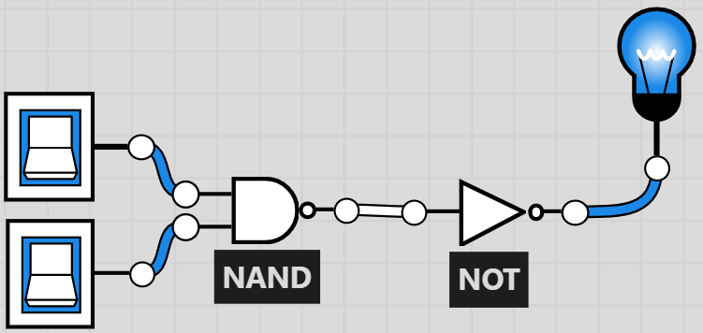
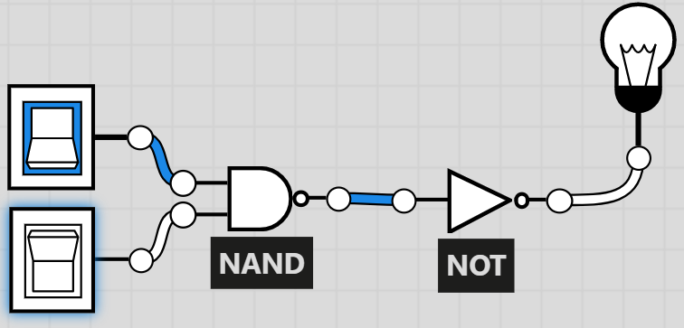
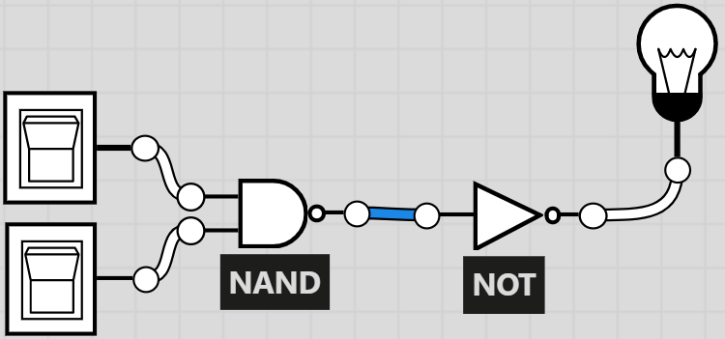
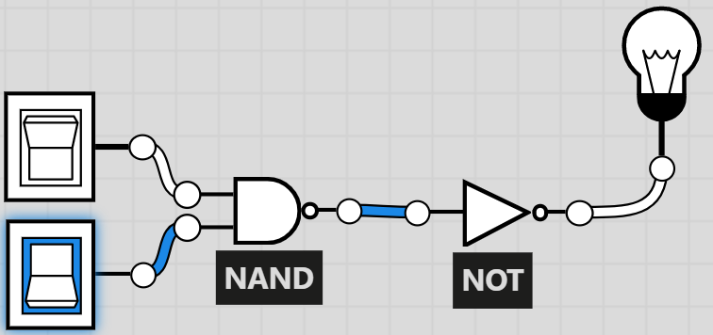
https://logic.ly/demo

Slide 13
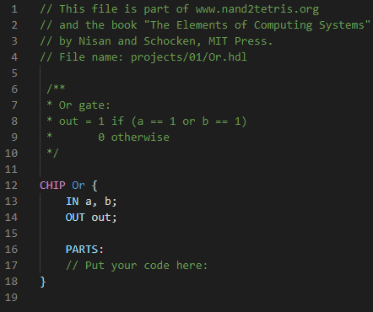
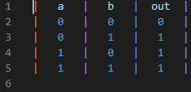
Or gate
Or Truth Table

Slide 14


Or gate Design

Slide 15
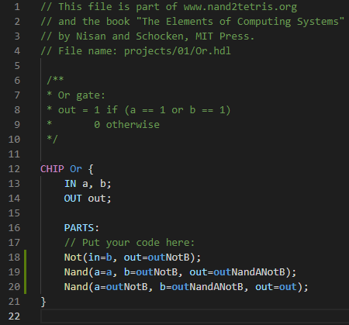
Or gate HDL CODE

Slide 16
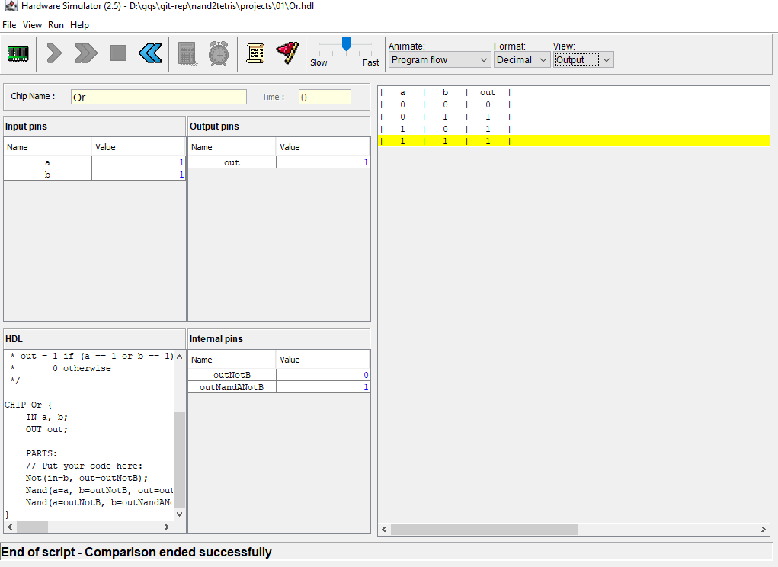
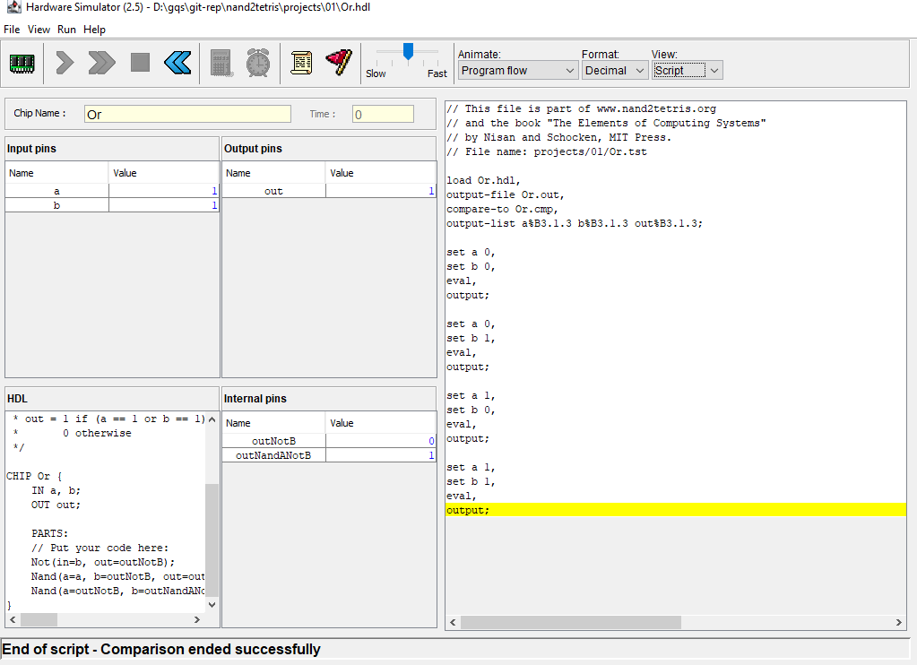
Or Test results

Slide 17

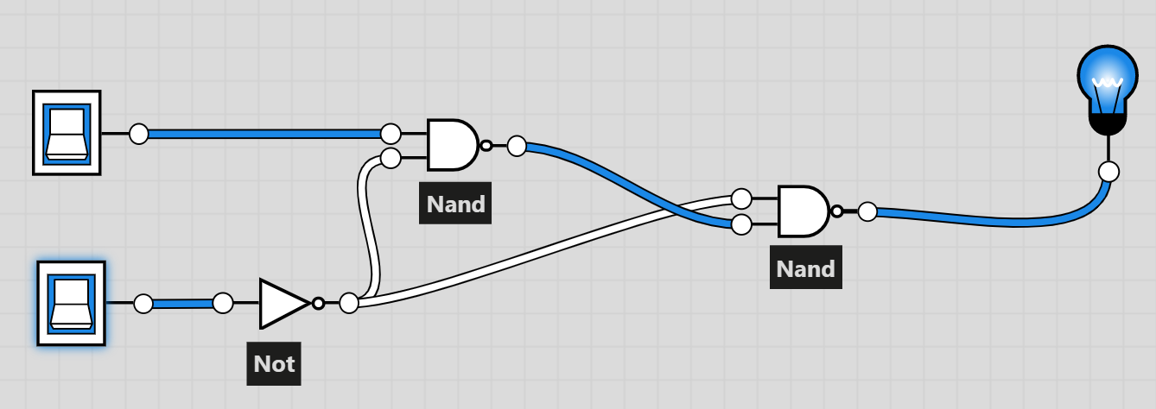


https://logic.ly/demo

Slide 18
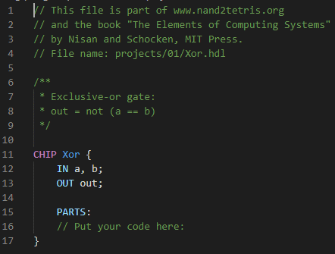
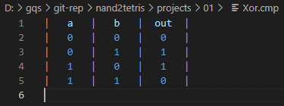
XOr gate

Slide 19
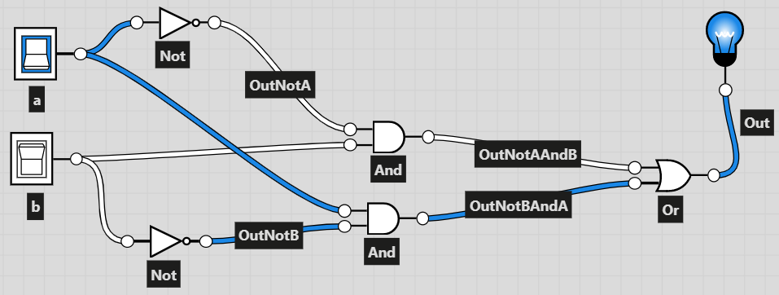
XOr gate Design

Slide 20
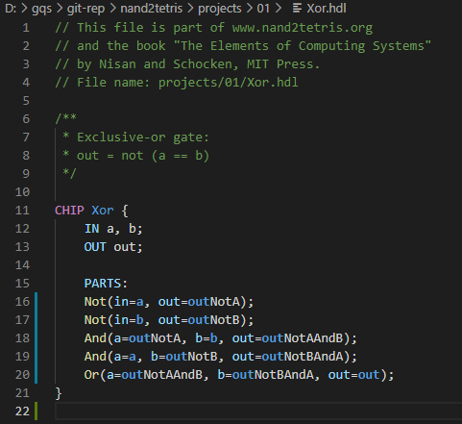
XOr gate HDL CODE

Slide 21
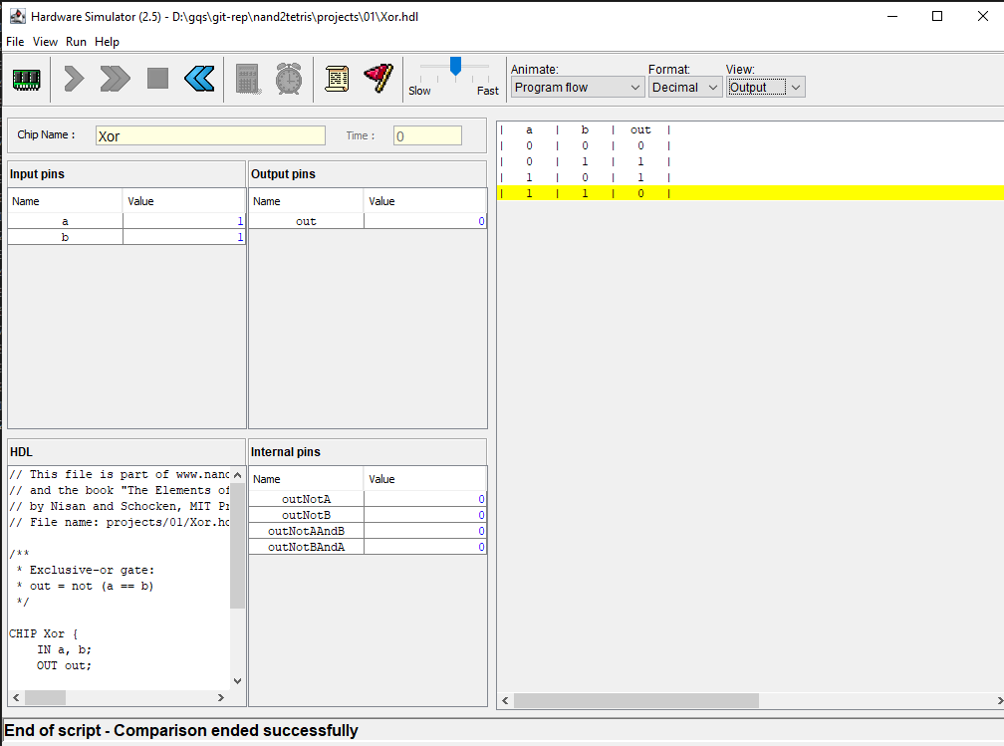
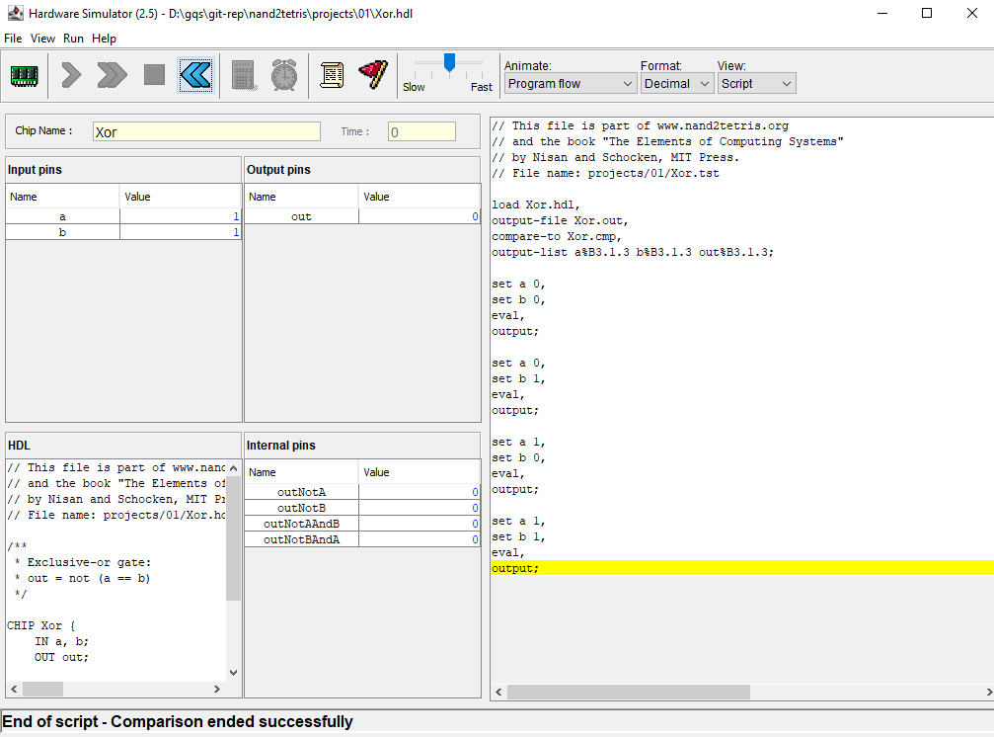
XOr Test results

Slide 22
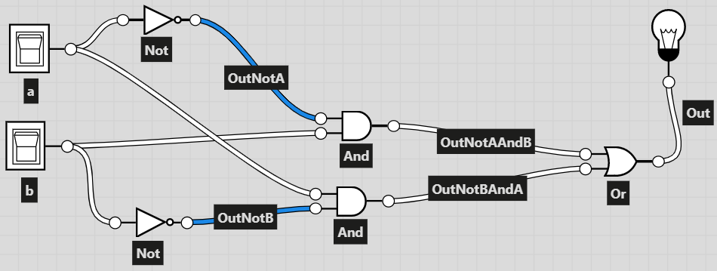
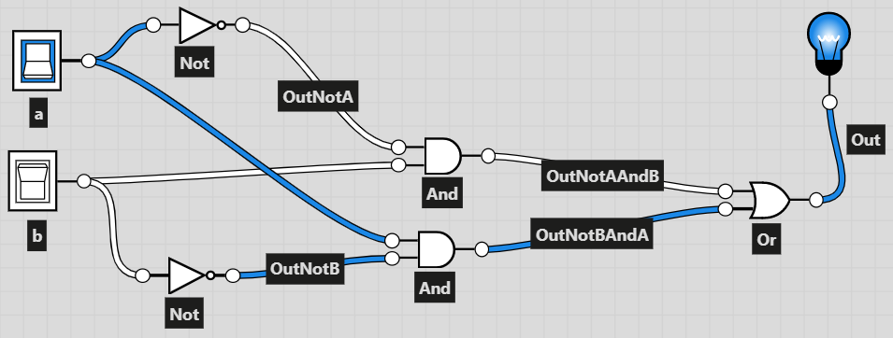
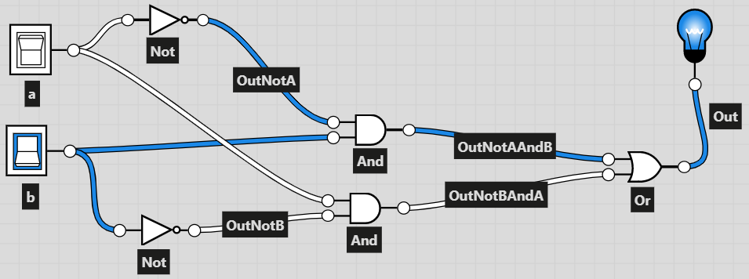
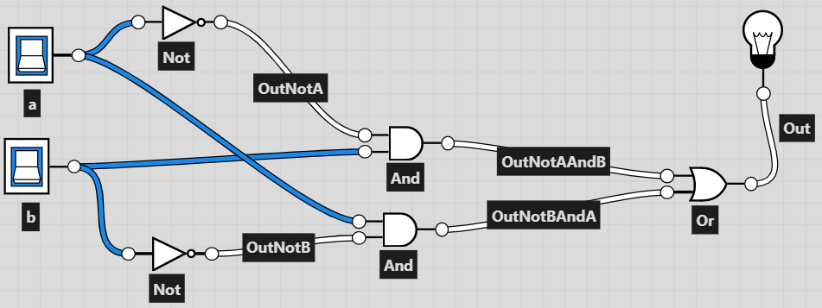
https://logic.ly/demo

Slide 23




XOr gate v2 Design

Slide 24
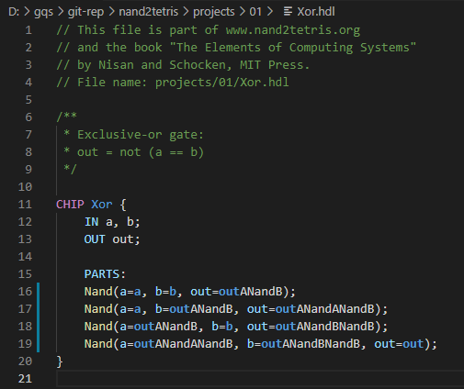
XOr gate V2 HDL CODE

Slide 25
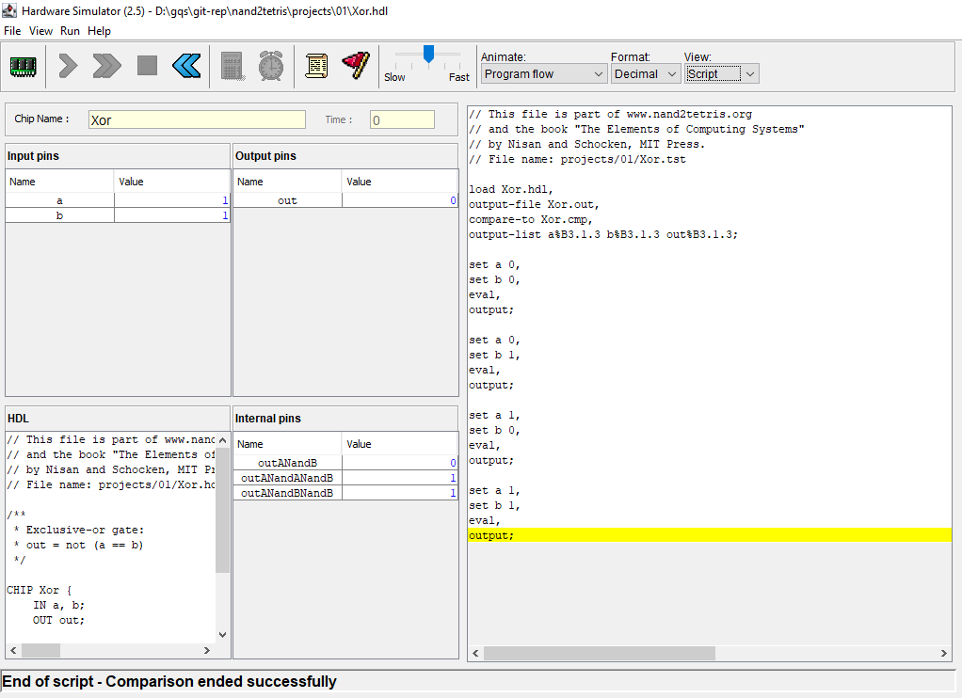
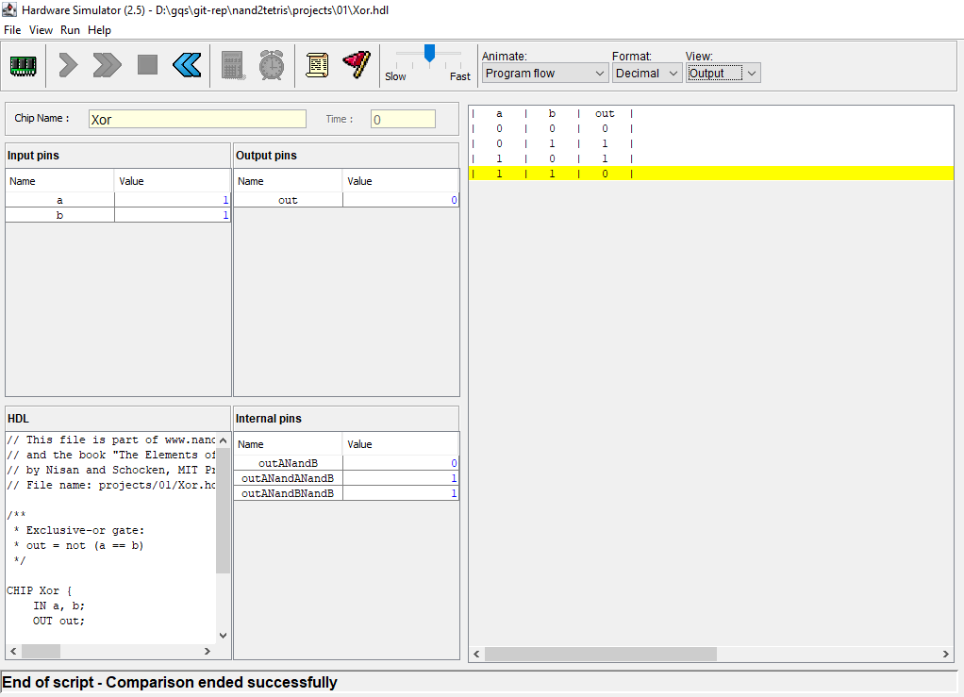
XOr V2 Test results

