Slide 2
Clients Section
A tabular paginated listing of clients.
With search options
Options to link GMR & DFM – (in a popup)
Add/change doctors image, logo – (in a popup, with crop support)
Options to viewadd custom reviews
Auto generate HOF banners
Auto-delete HOF banners

Slide 3


Clients Section
Search
ID | Name & URL | User Image | User Logo | Linkages | Actions
 |  |  |  | DFM GMR | [Reviews] [Auto generated banners] [Auto Delete Banners]
 |  | <<View>> | <<View>> | GMR +
 |  | <<View>> | <<upload>> | GMR +
 |  |  |  | +
 |  |  |  | +
 |  |  |  | +
 |  |  |  | +
User image, user logo can be displayed but if all are to be loaded at page load, it would affect loaded time. Therefore it is suggested to have an option to view images by on demand. If there is no image added an <<upload>> link can be shown. For images uploaded already, by clicking on image it is possible to show the upload popup.

Slide 4
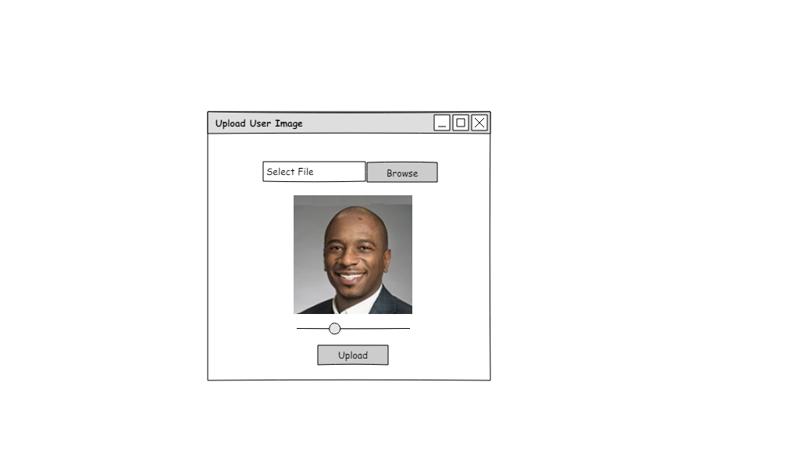

Clients Section >> User Image Upload
<<Client name >>
User Image upload with image preview and cropping facilities.

Slide 5
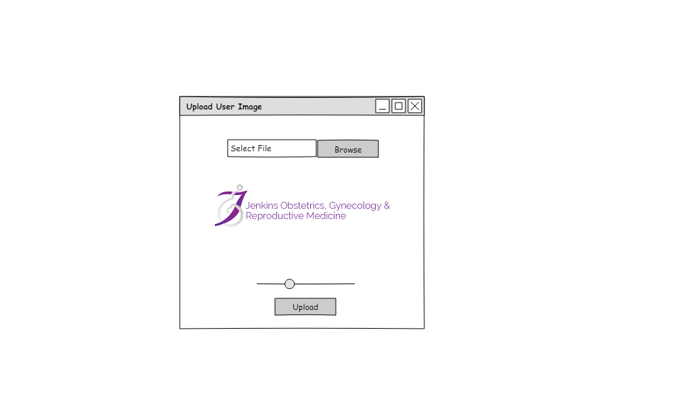
Clients Section >> User Logo Upload
<<Client name >>
User Logo upload with image preview and cropping facilities.

Slide 6
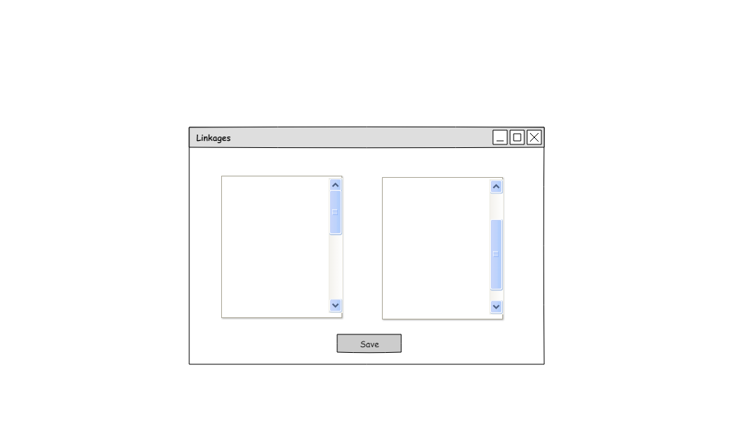
Clients Section >> Linkages
<<Client name >>
GMR Profile List
DFM Profile List
A popup with two listings of GMR profile and DFM profiles allowing users to select linkages between client record , GMR profile and DFM profile

Slide 7
Clients Section >> Reviews
<<Client name >>
Add Custom Review
ID | Provider | Rating | Review | Created Date | Actions
 |  |  |  |  | [Banners] [DFM details]
A tabular listing of reviews for the relevant client with options to view Banners and details and DFM Details.

Slide 8
Clients Section >> Reviews >> Banners
Add Banner
Auto-generate Banners
Delete all banners
ID | Provider | Rating | Review | Created Date | Actions
 |  |  |  |  | [View] [Download] [Edit] [Delete] [DFM]
Banner creation process will be same as existing method. In addition to that it is suggested to have support for URL shortening and QR code inclusions.

Slide 9
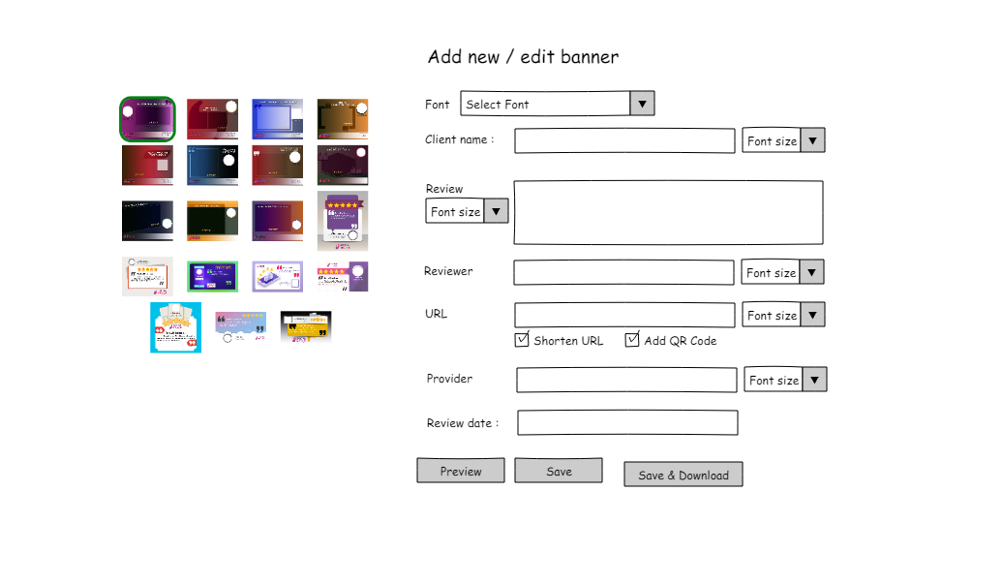
Clients Section >> Reviews >> Banners
Banner creation process will be same as existing method. In addition to that it is suggested to have support for URL shortening and QR code inclusions.

Slide 10
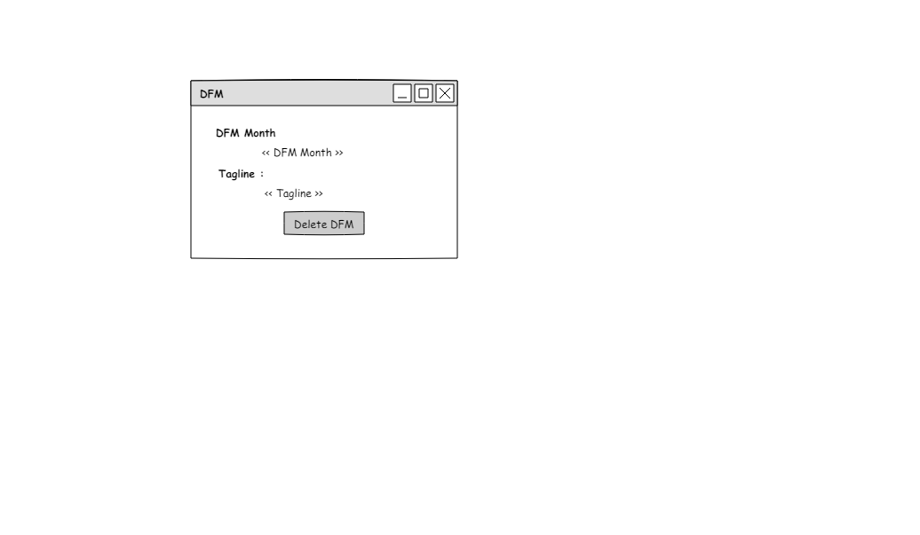
Clients Section >> Reviews >> DFM
A popup containing DFM information and facility remove DFM dependency.

Slide 11
Clients Section >> Reviews >> Banners
<<Client name >> - Banners for Review <<Review Id>>

