Slide 1
SDC HACKATHON 2026 · DOMAIN 1 · AIVERSECITY FUTURE-READY WORKFORCE
FutureReady MY
Turn your CV into explainable career matches, an honest view of how AI is changing those jobs, and a study pathway of real courses.
1
2
3
4
5
6
Six stages, one synthetic user, one live session
Team XH-Cat
Yip Gui Rong (leader) · Multimedia University
SDG 4.4 relevant skills · SDG 8.6 youth in work, education or training
Live: https://futures.grong.my
Notes:
Presenter A. Hello judges, we are team XH-Cat. FutureReady MY helps Malaysian students and young workers answer one question: I have these skills; which future roles fit me, and what should I learn first? Everything you will see is live at futures.grong.my, with a made-up user.

Slide 2
Students choose courses and jobs blind to how AI changes them
10.2%
56% / 26%
600,000+
youth unemployment (ages 15-24)
use AI at work vs have formal AI training
workers need reskilling within 3 to 5 years
OpenDOSM lfs_month_youth, June 2026
Hays Asia Salary Guide 2025, quoted in the SDC Domain 1 brief
MOSTI, quoted in the SDC Domain 1 brief
The facts exist, but they are scattered. The national occupation list (eMASCO), job-ad data (DOSM), skill levels (O*NET), AI-exposure research (ILO, Anthropic Economic Index) and accredited courses all sit on different sites. A student cannot join them into one answer. Generic advice or a chatbot that guesses is what they get today.
Notes:
Presenter A. The problem: youth unemployment is 10.2 percent; more than half of professionals use AI but only a quarter are trained; 600,000 workers need reskilling. The official data exists but is scattered. Our first users are diploma and foundation students; next are career centres and HR teams.

Slide 3
One confirmed profile, four tools, every number sourced
Your confirmed profile
Future Skills Radar
Career matching
How AI touches the tasks of your own jobs, research momentum, and AI news for your field every 3 hours.
1,812 Malaysian eMASCO roles. Skill Match, AI touch and Overall match, explained line by line.
From a PDF or Word CV, or a short 5-part form
Rules reader + DeepSeek suggest; each AI item must quote the CV word for word
You confirm every item before it counts
English, Bahasa Melayu, 中文
Study pathway
Organisation view
Skills to build, biggest gap first, each with an exact, checked course page; accredited programmes.
Career centres and HR teams see a group's skill gaps and plan target roles.
AI reads and finds. Arithmetic on official data decides. The user confirms.
Notes:
Presenter A. One profile, confirmed by the user, feeds four tools. The rule we kept everywhere: AI helps read and find, official data and plain arithmetic decide, and the user confirms. No language model ever produces a match score.

Slide 4
The final demo journey: six stages, all live
1
Tell us about yourself
2
Future Skills Radar
3
Get matched
Upload a CV or fill the form. Every suggestion is checked and confirmed; the confirmed profile drives all results. Nothing is pre-filled.
Observed AI use on your jobs' tasks, ILO exposure, research momentum by AI topic, AI news. Source and date on each; datasets are rebuilt by pipeline scripts and news refreshes every 3 hours.
Roles in groups, sorted by Overall match. "You meet X of Y needed levels" for every role, plus the exact skills gap and what would raise it.
4
Follow a pathway
5
See the SDG contribution
6
Compare futures
Tick roles, get skills to build in order, biggest gap first (+8 points), each with an exact HRD Corp e-LATiH or Coursera page, checked 31 Oct.
Every role is tagged to an SDG goal that links to the UN page, labelled "team draft, not yet reviewed" or approved. Filter roles by SDG.
Moderate AI (observed today) vs Rapid AI (ILO full exposure). Roles move between groups, labelled ESTIMATE. The Skill Match never changes.
Notes:
Presenter A. This is the judges' six-stage journey, and where each stage lives in our app. Presenter B will now run all six with one made-up user, Aina, a diploma holder in IT working in IT support.

Slide 5
LIVE DEMO
futures.grong.my
One synthetic user: Aina Binti Ahmad, Diploma in IT, IT Support Executive (made-up CV)
1
2
3
4
5
6
Upload CV, confirm
Radar: AI on your tasks
Career matching
Plan study pathway
SDG tags and filter
Moderate → Rapid AI
If the network fails: the same app runs on this laptop (npm start), and backup screenshots of every stage follow at the end of this deck.
Notes:
Presenter B drives the demo (about 5 minutes); see submission/live-demo/demo-script.md. If the site does not open on campus Wi-Fi, use the phone hotspot or the local copy, or jump to the backup slides.

Slide 6
Must-haves: what you see live, and what is not there yet
Feature | Shown live in FutureReady
Skills profile intake | Skills read from the uploaded synthetic CV or form, confirmed by the user, and sent to matching (never stored). Change a skill and the matches change.
AI-trend signal layer | Anthropic Economic Index (release 2026-06-26), ILO WP140 (2025), OpenAlex (fetched 2026-10-30), DOSM job ads, AI news every 3 hours. Name and date on screen; when the job-ad trend changes, roles move between groups. Not yet: a declining-skills list on the Radar page.
Future-role matching | Skill Match = levels met ÷ levels needed on O*NET skills and knowledge (importance ≥ 3), shown as "you meet X of Y needed levels". Skills gap listed per role; Overall match formula shown.
Reskilling pathway | Ordered steps (biggest gap first, in points of Skill Match), exact e-LATiH (HRD Corp), Coursera and other course pages, each checked on a date. Not yet: course time estimates, because no course site gives a sourced duration.
SDG mapping | Every role carries an SDG tag with its reason link and review label; SDG filter on matching. Not yet: the separate "path contribution" panel (removed 1 Nov while it was reworked).
Handling uncertainty | Moderate vs Rapid AI scenarios move roles between groups (hundreds of roles move for the demo user); ESTIMATE and PROVISIONAL labels; "Not enough evidence yet" group.
Notes:
Presenter A or B. The six must-haves, as they appear live. We say plainly what is not there yet: the pathway has no time per course because the course sites give no sourced duration, and the separate SDG path-contribution panel is not in this build; every role is still tagged.

Slide 7
How we stop it inventing a job, a course or a number
✓
Roles only from official lists
✓
No language model in matching
1,812 roles from eMASCO (MOHR). eMASCO → ISCO-08 → SOC → O*NET through official code tables. A broken chain shows "not available", never a guess.
Skill Match is arithmetic on O*NET levels: basic 2, good 4, expert 6. Overall = Skill Match × (1 − AI touch) + AI know-how × AI touch.
✓
AI must show its evidence
✓
Real courses, checked dates
DeepSeek CV items are kept only if they quote the CV word for word, tagged "Found by AI", and confirmed by the user. 16 synthetic CVs: precision 1.0, skill recall 0.89.
Every course is a team-picked real page with the date it was checked. The server refuses to start with a bad pick.
✓
Uncertainty is labelled
✓
Data kept current, with dates
CALCULATED, ESTIMATE and PROVISIONAL labels; two AI scenarios; "Not assessed yet" skills mark a match provisional.
Each dataset shows its snapshot date and is rebuilt by pipeline scripts with SHA-256 manifests. AI news refreshes every 3 hours under hard caps.
Notes:
Presenter B. The judges' questions: where does this come from, is it real, why this score. Roles only from eMASCO; matching is arithmetic; AI must quote its evidence; courses are real pages with checked dates; uncertainty is labelled; and every dataset carries its date and is rebuilt by scripts, with AI news every 3 hours.

Slide 8
One Node app, official data, AI only where it helps
Browser
Cloudflare
Node.js 24 + Express 5
SQLite
Plain JavaScript ES modules, pdf.js, three.js intro. EN / BM / 中文. Guest data stays in the browser.
DNS, HTTPS and a Tunnel to the team's computer. Free. No open router ports.
REST API: /api/cv, /api/matching, /api/pathway, /api/radar, /api/news, /api/org, /api/auth.
Accounts, saved profiles, organisations (node:sqlite; same interface as Cloudflare D1).
Shared logic + bundled official data
DeepSeek (paid, capped)
Matching, Radar, pathway and news rules run in both server and browser.
O*NET 31.0 · eMASCO (MASCO 2020) · ISCO-08 / SOC crosswalks · ISCED-F 2013 + CIP · ILO WP140 · Anthropic Economic Index · OpenAlex · DOSM job ads · UN SDG targets. SHA-256 manifests, rebuilt by Python pipeline scripts.
deepseek-flash reads each CV next to the rules reader (JSON mode, word-for-word check).
DeepSeek Search finds AI news for 10 study fields every 3 hours; deepseek-flash keeps or drops each result.
Caps: 10 per run, 80 per 24 hours, counted before each call. Career matching uses no language model.
Notes:
Presenter B. One Node and Express app behind a Cloudflare Tunnel. Logic shared by browser and server. Official datasets with hashes. DeepSeek in three guarded places only. Quality: 1,765 Vitest tests and 49 Python tests, test-first, with a build record in the repository.

Slide 9
Impact and feasibility, in numbers
PHASE 1 KPI: PATHWAY STEPS WITH AN EXACT, CHECKED COURSE PAGE
Running cost
About US$4-6 a month for AI news, plus about US$0.002-0.004 per CV read. Hosting on a free Cloudflare Tunnel.
Privacy (PDPA)
The profile sent for matching is used for one answer and never stored or logged. Guests stay in the browser. A PDPA cross-border review comes before real CVs.
Reach
Free for students in 3 languages. Organisation view for career centres, TVET colleges and HR teams as the paid model.
31 of 38 skills (82%, 24 Oct) → all 68 O*NET skill and knowledge items (100%, 125 course picks checked 31 Oct). Accredited programmes for 99 of 124 fields of study.
Honest about results
The student pilot (20+ students, target 70% finish in under 10 minutes) has not run yet, so we claim no result.
Notes:
Presenter A. Against our Phase 1 baseline: exact course pages went from 82 percent to 100 percent, above the 90 percent target. Cost is a few dollars a month. Privacy: the matching profile is never stored or logged. We have not run the student pilot yet, so we claim no pilot result.

Slide 10
What changed since the preliminary round, and why
Preliminary | Final | Why
Embedding similarity (bge-m3) | Arithmetic on official O*NET levels | Every match can be explained on screen
38 app skills, 82% with a course page | 68 O*NET items, 100% with a checked page | Pathway and Skill Match use the same items
Rules-only CV reading | Rules + DeepSeek with a word-for-word check | Rules alone missed items; 0 wrong items on 16 CVs
Optional news tagging | DeepSeek Search every 3 hours + relevance check | The first run kept preprints and homework pages
Skill fit only | Overall match with AI know-how (UNESCO 2024 framework) | Where AI touches a job, AI skills matter
Students only | Organisation view for HR and career centres | A paid model that keeps the student app free
Replit + React/Vite | Cloudflare Tunnel + SQLite, plain ES modules | No paid cloud database, no build step
Full change log: submission/SDC2026_XH-Cat_PRD.docx (section 4).
Notes:
Presenter A. The biggest change: we dropped embedding similarity for arithmetic on official levels, so every number can be explained. The full change log is in our updated PRD.

Slide 11
Know which skills carry over, and what to learn next.
Explainable · sourced · free for students · live today
Try it: https://futures.grong.my
Code: https://github.com/guirong0109/XH-Cat_MyFuture
Team XH-Cat · Questions welcome, from both of us
Notes:
Presenter A closes. Both teammates take questions. See submission/live-demo/qa-prep.md.

Slide 12
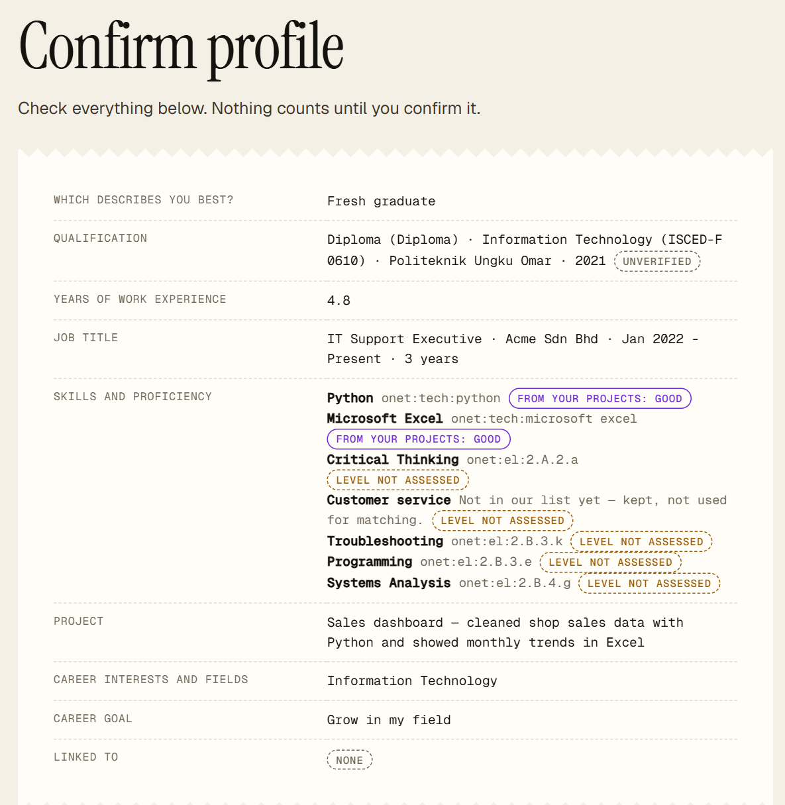
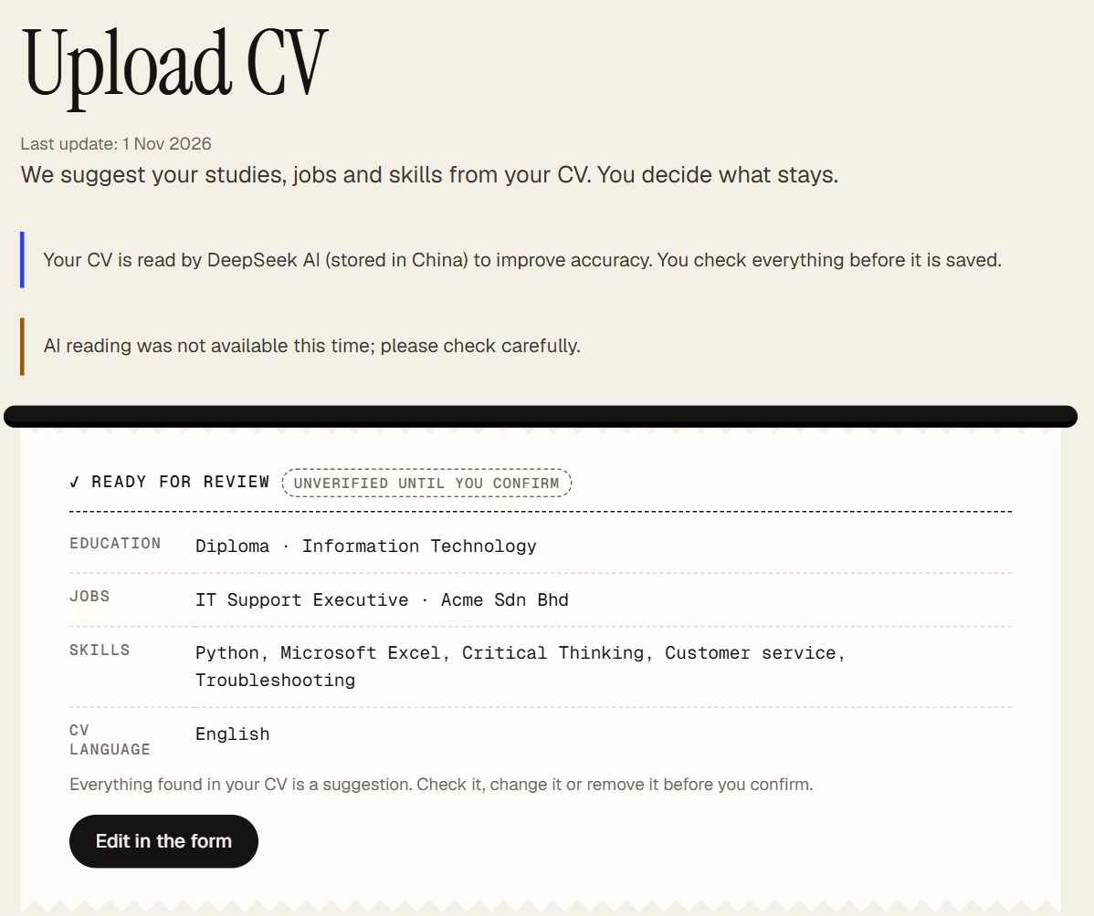
Stage 1 · Tell us about yourself
1
BACKUP · captured from the app on 1 Nov 2026 with the synthetic CV
Aina's CV (DOCX) is read; studies, job and skills are suggested.
"Unverified until you confirm": nothing counts until Aina checks it.
Skills map to O*NET codes; "Customer service" is kept but not used for matching.
The confirmed profile is what matching uses.
Notes:
Backup for stage 1: upload, review, confirm.

Slide 13
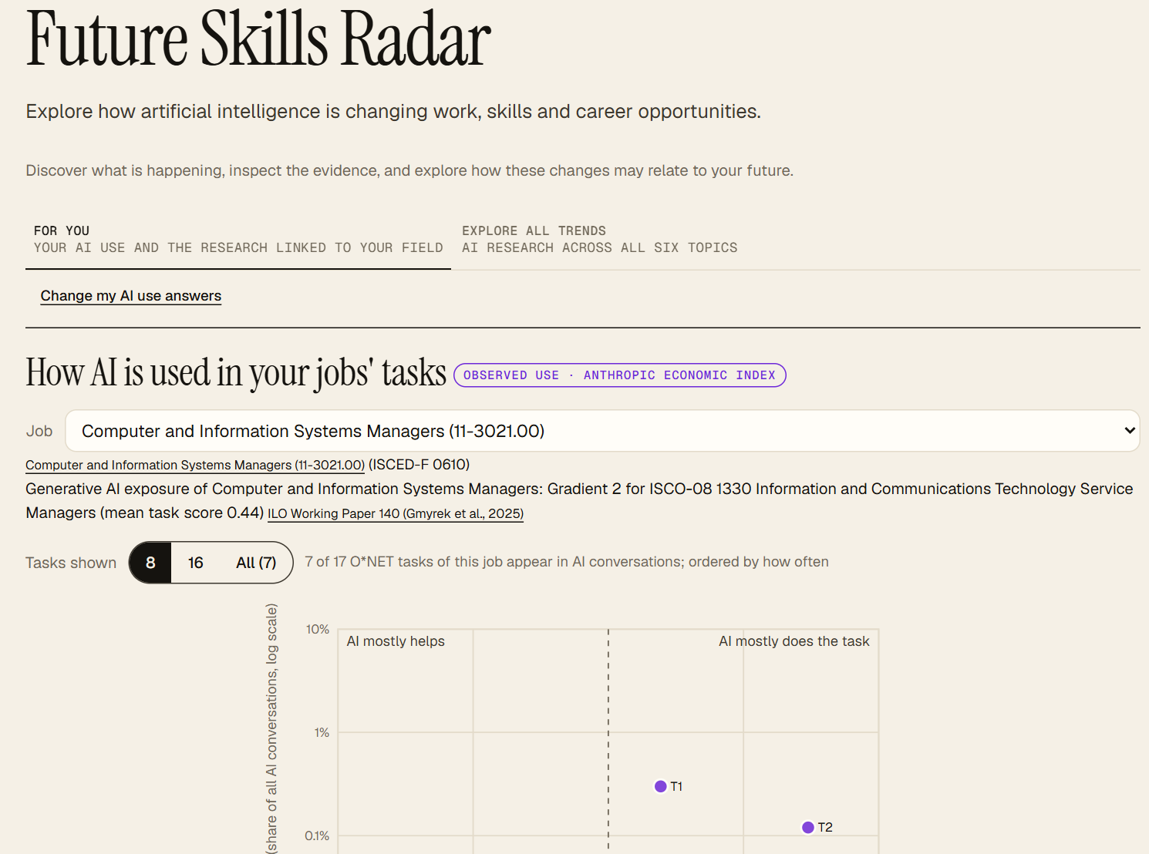
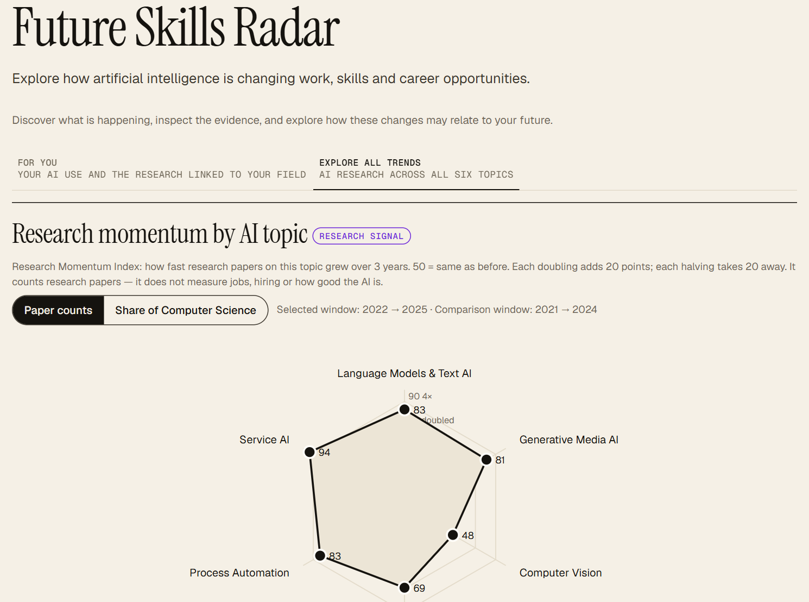
Stage 2 · Future Skills Radar
2
BACKUP · captured from the app on 1 Nov 2026 with the synthetic CV
For you: how AI is used on the tasks of Aina's jobs (Anthropic Economic Index, release 2026-06-26).
ILO WP140 exposure gradient for the same job.
Explore all trends: research momentum by AI topic (OpenAlex), with years and source.
AI news for the field refreshes every 3 hours on the live site.
Notes:
Backup for stage 2.

Slide 14
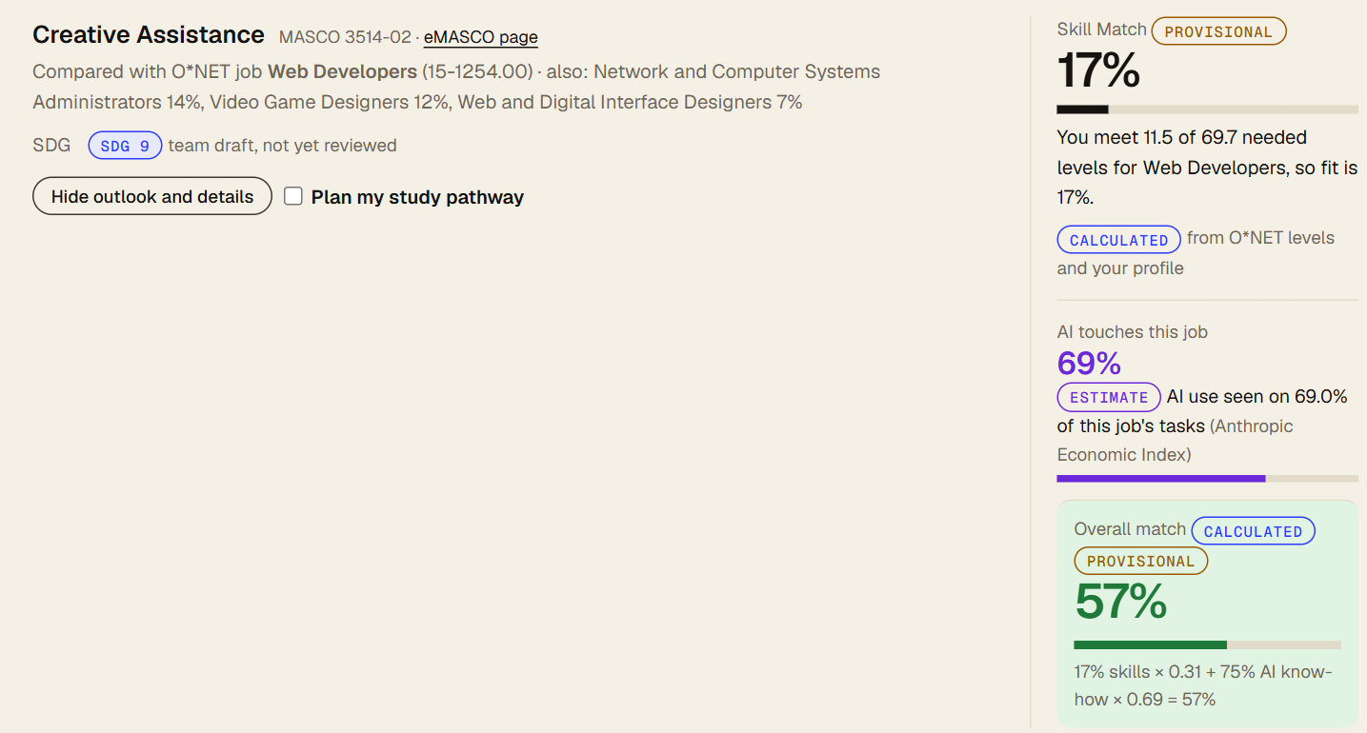
Stage 3 · Get matched
3
BACKUP · captured from the app on 1 Nov 2026 with the synthetic CV
"You meet 11.5 of 69.7 needed levels for Web Developers, so fit is 17%."
AI touches this job: 69% (ESTIMATE, Anthropic Economic Index).
Overall: 17% × 0.31 + 75% AI know-how × 0.69 = 57%.
PROVISIONAL because 4 skills are "Not assessed yet"; setting levels can change it.
Notes:
Backup for stage 3.

Slide 15
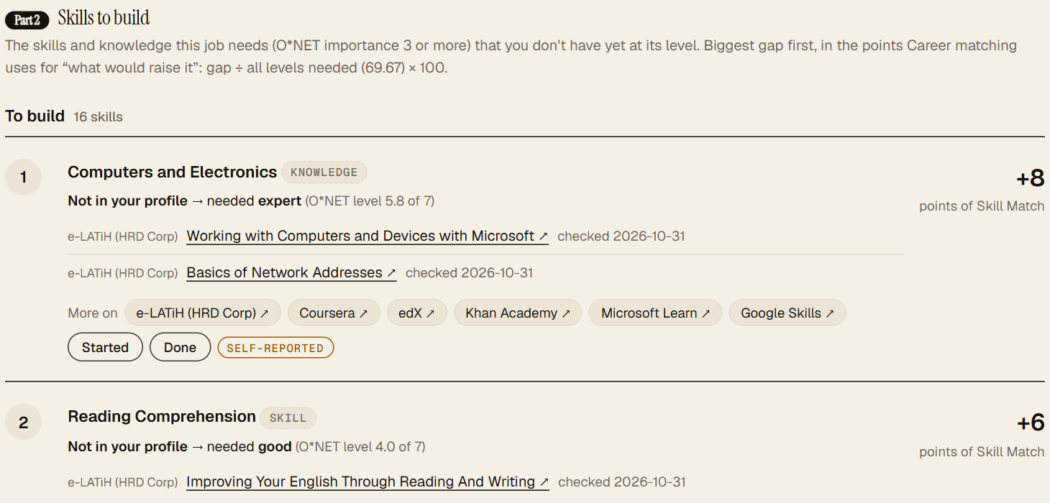
Stage 4 · Follow a pathway
4
BACKUP · captured from the app on 1 Nov 2026 with the synthetic CV
Skills to build, biggest gap first, in points of Skill Match (+8, +6 ...).
Each step links an exact course page: e-LATiH (HRD Corp), Coursera, checked 2026-10-31.
Started / Done tracking, self-reported.
Above it: accredited Malaysian programmes (MQA) for the fields that lead to the role.
Notes:
Backup for stage 4.

Slide 16
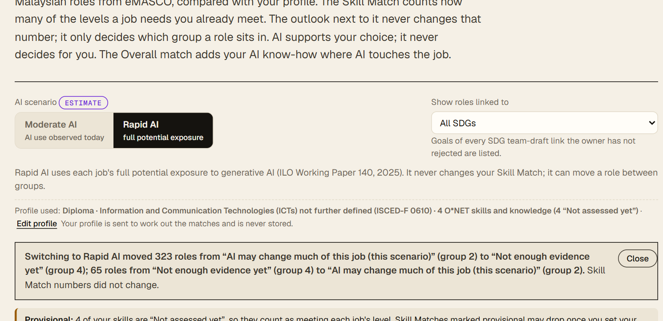
Stages 5 and 6 · SDG tags and Compare futures
6
BACKUP · captured from the app on 1 Nov 2026 with the synthetic CV
Switching Moderate AI → Rapid AI moved 323 roles out of group 2 and 65 roles into it.
"Skill Match numbers did not change." The scenario is labelled ESTIMATE.
Every role card carries an SDG tag (e.g. SDG 9) linking to the UN goal page, labelled "team draft, not yet reviewed".
"Show roles linked to" filters matches by SDG.
Notes:
Backup for stages 5 and 6.

