Slide 1

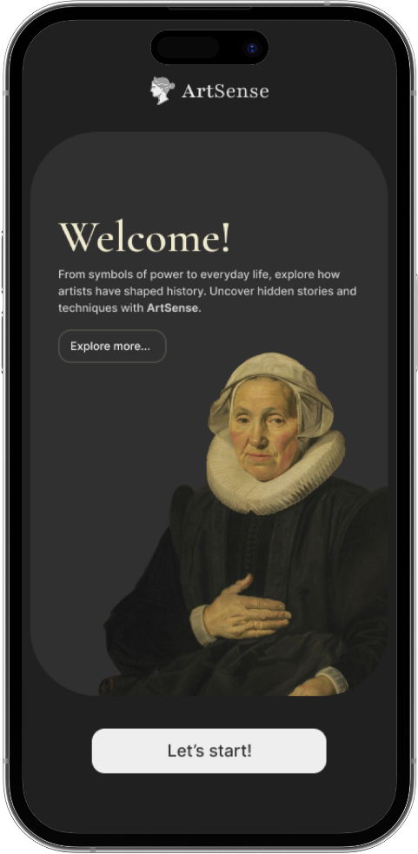

ArtSense
Your AI-powered guide to art, history, and hidden stories.
Discover the Past, Guided by the Future.
ShiftAPPens 2025

Slide 2


ArtSense
1. Problem
2. Solution
3. Technologies
4. Demo
5. Conclusion
1

Slide 3

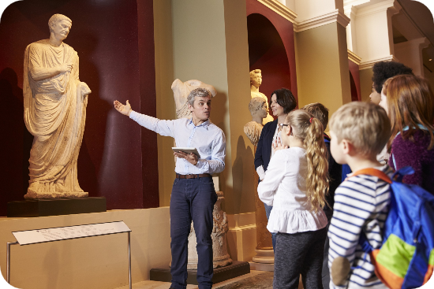
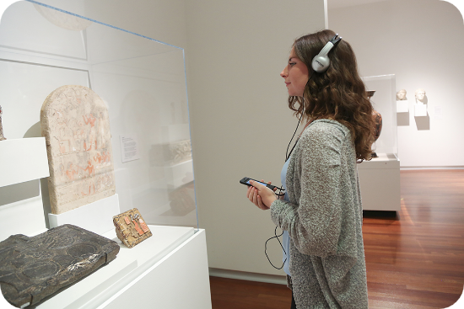

How Small Museums handle this?
ArtSense
Problem:
Guided Tour
Audio Guide
2

Slide 4

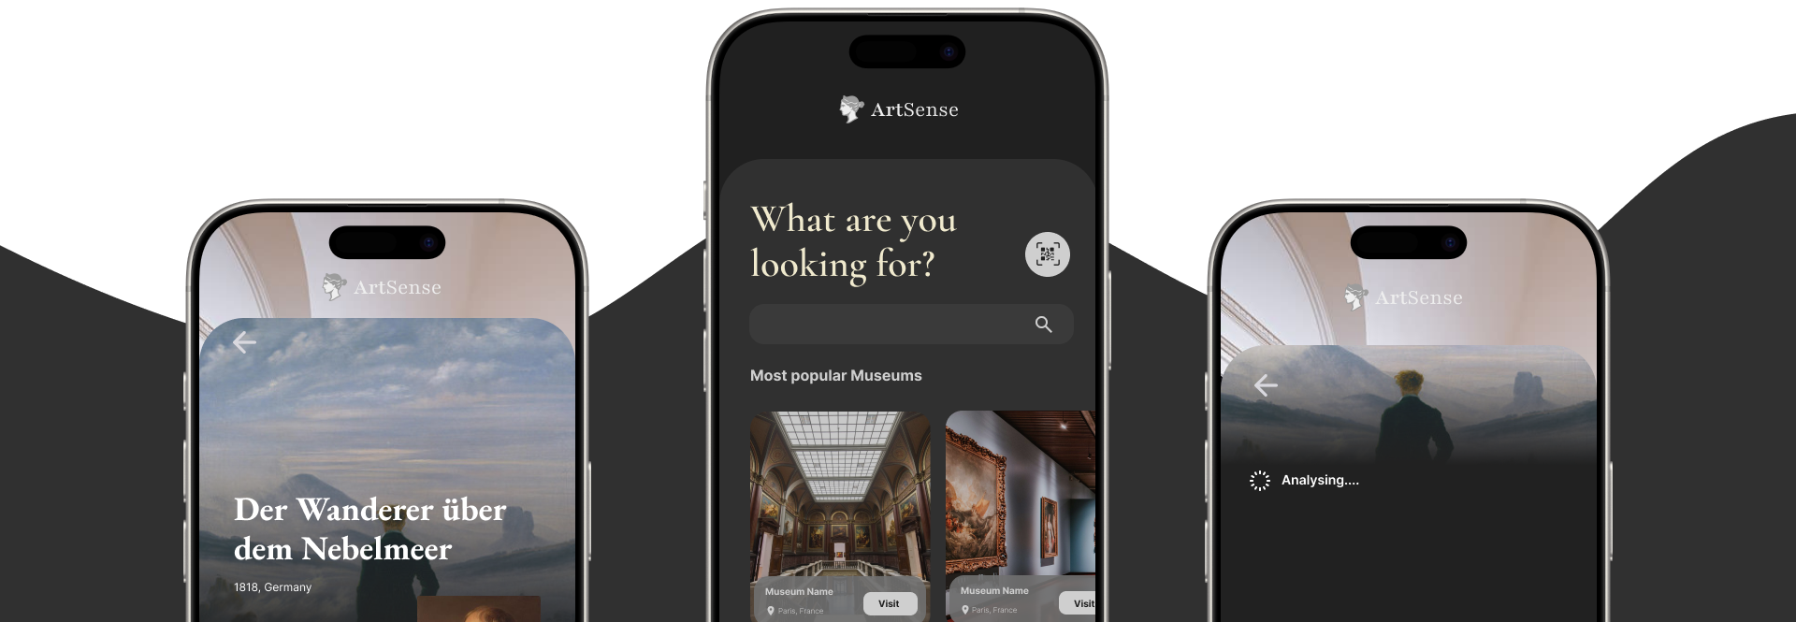
ArtSense
3

Slide 5








ArtSense
4. LLM
2. Front-end
3. Back-end
1. Prototype
4

Slide 6
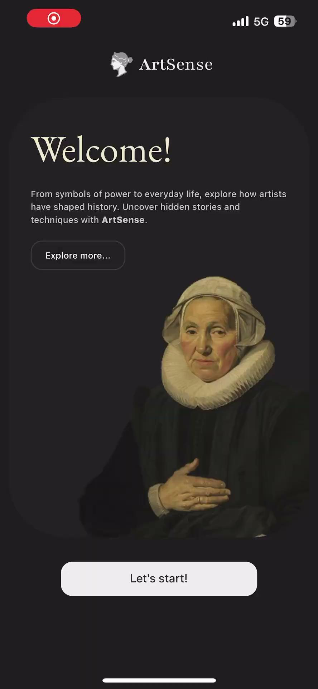
ArtSense
Demo
5

Slide 7
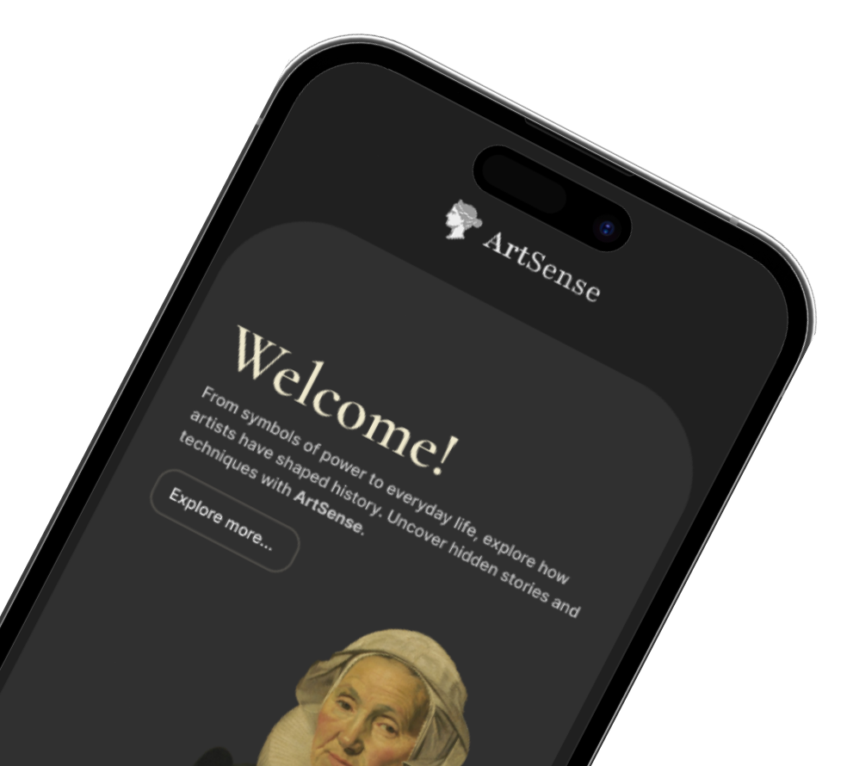
ArtSense
Thank you for your attention!
Any questions?
6

