Slide 1
Phishing
From problem to solution

Slide 2
What is Phishing?

Slide 3
Fraudulent emails, text messages, phone calls or web sites designed to trick users into downloading malware, sharing sensitive information or personal data;
Identity theft, credit card fraud, ransomware attacks, data breaches, and huge financial losses for individuals and corporations;
Social engineering, the practice of deceiving, pressuring or manipulating people into sending information or assets to the wrong people.

Slide 4
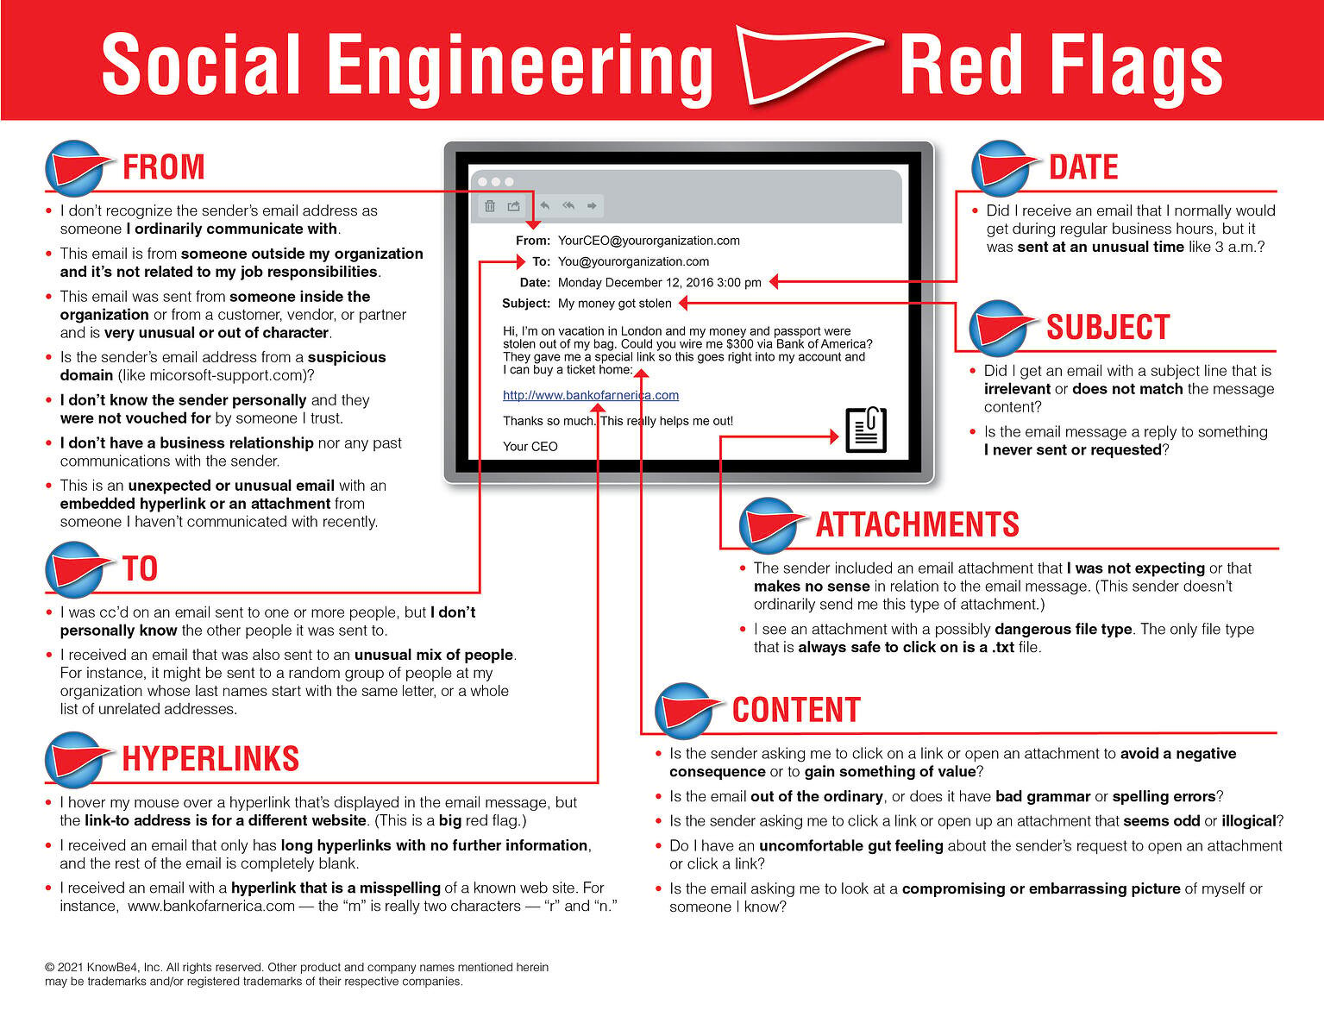

Slide 5
Types of Phishing

Slide 6
Email phishing: theft of confidential information through an email that appears to be from a legitimate organization. It is not a targeted attack and can be conducted en masse;
Spear phishing: a highly-targeted, well-researched attack generally focused at business executives, public personas and other lucrative targets. Criminals who do this will already have some information about the victim;
Whaling: more targeted than the spear, taking aim at high-level executives. Tends to be a lot subtler. Tricks such as fake links and malicious URLs aren’t helpful in this instance;

Slide 7
Smishing: sending malicious short links to smartphone users, often disguised as account notices or prize notifications;
Vishing: malicious call that pretends to be from helpdesk, a government agency, or another organization and tries to extract personal information;
Angler phishing: fake URLs, cloned websites, posts and instant messaging can all be used to persuade people to disclose sensitive information or download malware. Criminals can use the data that people willingly post on social media to create highly targeted attacks.

Slide 8
Examples of Phishing

Slide 9
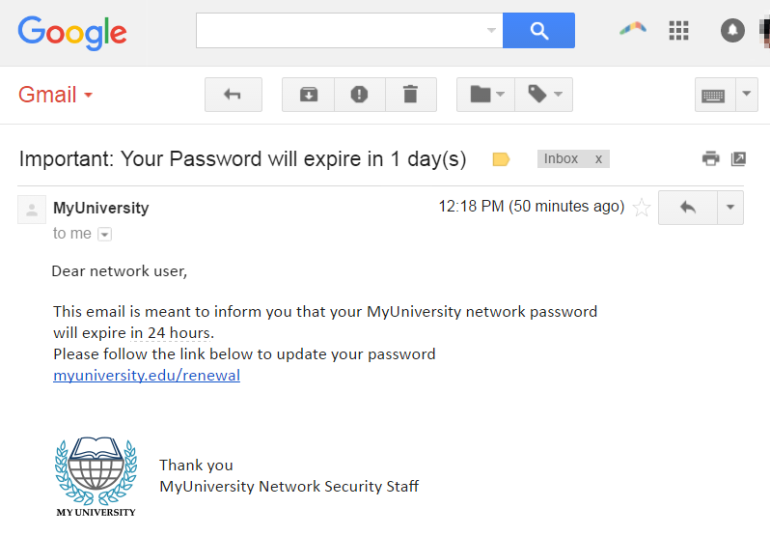
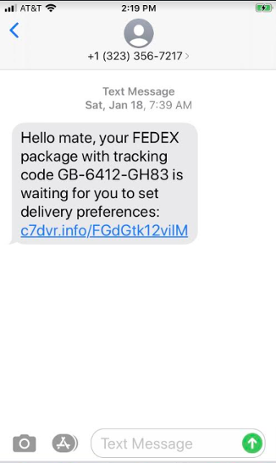
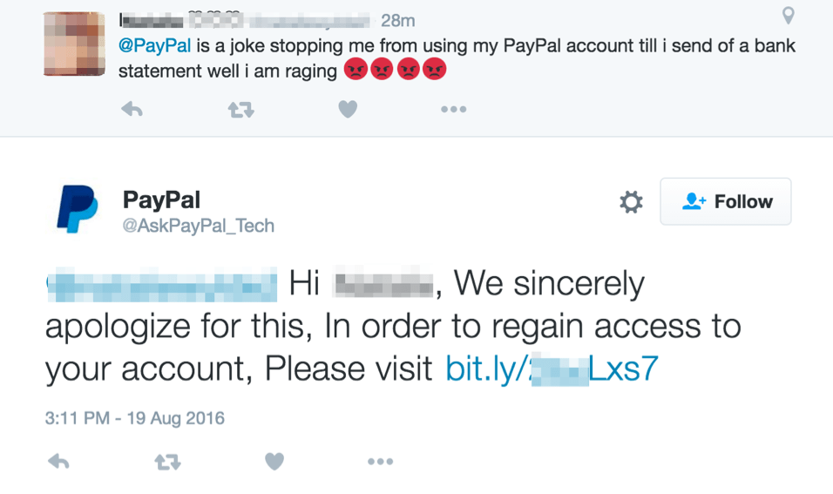

Slide 10
Heaven Systems Problem

Slide 11
The main problem pointed out by the company was the growing number of phishing emails, which were crowding employees' inboxes, thus triggering a relative drop in productivity, problems with email communication within the company and distrust of employees regarding the data transition.
In addition, all issues related to this issue were passed on to the IT team, causing them to waste a lot of time to resolve these issues, creating a drop in productivity in the IT team as well.

Slide 12
Ways to prevent Phishing

Slide 13
Security awareness about this type of attack: raising awareness of the signs and dangers of phishing attacks, employees will be able to identify them and report it to can take timely steps to contain the incident;
Spam filters or secure email gateways to block deceptive emails: monitoring incoming emails for unwanted or fraudulent content, once identified, they prevent them from ever reaching an employee’s inbox;
Make use of endpoint monitoring and protection: monitoring endpoints for security threats and implement rapid remediation and response on compromised devices against endpoint attacks;

Slide 14
Conduct phishing attack tests: simulated phishing attack testing can help security teams evaluate the effectiveness of security awareness training programs, and help end users better understand attacks;
Limit user access to high-value systems and data: restricting access to systems and data can help protect sensitive data from leakage, using the principle of least privilege and only give access to users who absolutely need it;
Rotate passwords regularly: prevent an attacker from gaining unlimited access, prevent ongoing attacks and lock out potential attackers regularly rotating the passwords.

Slide 15
Heaven Systems Solution

Slide 16
Among all the options presented, in a general analysis, it was decided that the extreme importance in the initial identification of a phishing attack is the main key for the reduction of the overload of the IT area and the decrease of productivity in the initial sector.
Employees must be aware of the possibility of any phishing attack within the company, and prepared to act appropriately when faced with one. In addition, with the already use of a system to detect Spear-Phishing, IT professionals must receive sufficient training to deal with problems and reports that are generated by the software itself.
Constant training and extensive simulations in all areas of the company are efficient ways to balance the performance and productivity of both in relation to possible attacks.

Slide 17
https://www.ibm.com/topics/phishing
https://www.itgovernance.eu/blog/en/the-5-most-common-types-of-phishing-attack
https://ovic.vic.gov.au/privacy/resources-for-organisations/phishing-attacks-and-how-to-protect-against-them/
https://www.lepide.com/blog/10-ways-to-prevent-phishing-attacks/

