Slide 1
Builder Session: Enhanced Developer Operations With Container Insights
Builder SessioN
John Jackson (ECS Developer)

Slide 2
Agenda
What is Elastic Container Service (ECS)?
What is Container Insights?
What Metrics do we provide?
How do Metrics get propagated to CloudWatch?
What can we do with these Metrics?
Demo
Q&A

Slide 3
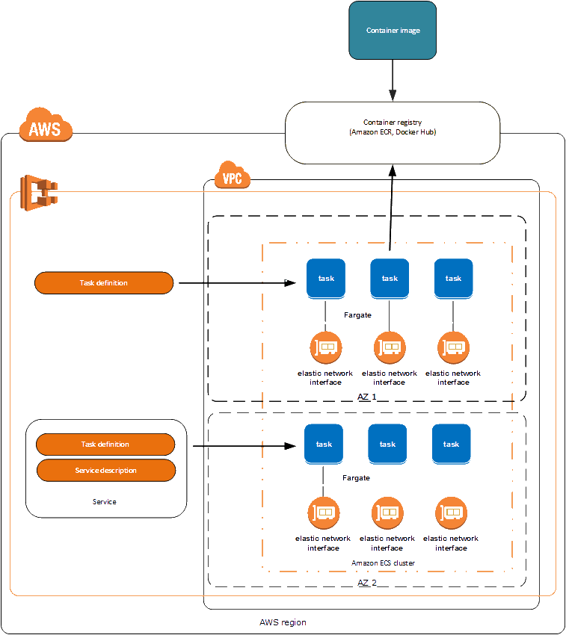
Elastic Container Service (ECS)
Highly scalable and performance-optimized container orchestration service that supports Docker container workloads.
Provides a variety of resource constructs to make this process simple and maintainable.
Containers can be launched on Fargate to remove the burden of managing infrastructure through serverless containers.

Slide 4
Elastic Container Service (ECS)
Task: Basic primitive comprised of several related containers running together on the same infrastructure.
Task Definition: The configuration for launching a Task on targeted infrastructure.
Service: A configuration defining how ECS can schedule and maintain tasks on targeted infrastructure.
Cluster: A logical grouping of Tasks, Services and EC2 instances to use as target infrastructure.
ECS Agent: A container run on your infrastructure to communicate with ECS and manage your containers.

Slide 5
Container Insights
Container Insights collects, aggregates, and summarizes metrics and logs from your containerized workloads.
Opt-in on a Cluster for all of the Tasks run in that Cluster.
Provides in-depth logging of metric data for each Task and Container running in your Cluster.
Provides live metrics based on a number of the logs emitted in your Cluster.
Logs emitted by Container Insights can be further queried for post analysis and to set up new tooling.
This data is gathered from Docker Stats via the ECS Agent. Then, it is ingested, processed and published through ECS’s backend infrastructure providing a simple opt-in experience.

Slide 6
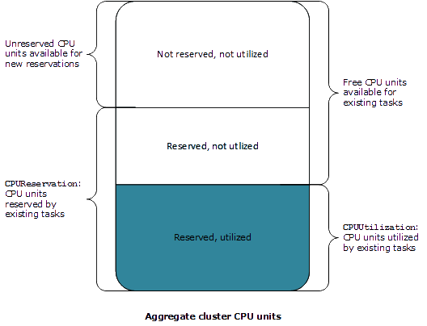
Metrics - ECS and Container Insights
ECS (Cluster and Service)
CPU and Memory Utilization Percentage
CPU, GPU and Memory Reservation Percentage
ECS/Container Insights (Cluster, Service and Task Definition)
CPU and Memory Utilized Stats
CPU and Memory Reserved Stats
Storage and Network Stats
Service Metrics from DescribeServices
Cluster Metrics from DescribeClusters
Not Reserved,
Not Utilized
Reserved,
Not Utilized
Reserved,
Utilized

Slide 7
Enhancing Developer Operations?
Container Insights provides a variety of new data to analyze performance trends and implement new tooling which can enable automation of developer workflows.
What is possible with Container Insights?
Dive deep into your infrastructure through detailed structured logs and metrics.
Alarm and scale automatically on new data points like network utilization, storage utilization, service state and cluster state.
Reduce risk by implementing tooling to respond to unexpected performance changes.
Save money by implementing tooling to determine the right size for tasks.
Reduce operations effort and response time by implementing tooling to resize your TaskDefinition on-demand.

Slide 8
Demo: Consumer Service
https://github.com/guitar80ep/BuilderSession

Slide 9
Questions?
Additional questions? Contact jjacksa@amazon.com

