Slide 1


How You in HEP can benefit from Functional Programming
Jonas Rembser
28.11.2018
1st LLR Student and Postdoc Seminar

Slide 2
Contents
What is Functional Programming (FP)
Relation between the FP and High Energy Physics communities
FP in C++ and Python for your everyday work
FP-inspired techniques in data analysis
Some easy FP paradigms to improve your code

Slide 3
Introduction
Who of you has heard about Functional Programming before?
Tell me what you think of this Python code:
Tell me what you think of this C++ code:
x = 4
print(x)
x = 5
print(x)
int n = 10;
for(int i = 0; i < n; ++i)
{
std::cout << i << " ";
}
std::cout << std::endl;

Slide 4
Introduction
Who of you has heard about Functional Programming before?
Tell me what you think of this Python code:
Tell me what you think of this C++ code:
Lies, lies lies! You can't trust the "definition" of variables!
x = 4
print(x)
x = 5
print(x)
int n = 10;
for(int i = 0; i < n; ++i)
{
std::cout << i << " ";
}
std::cout << std::endl;

Slide 5
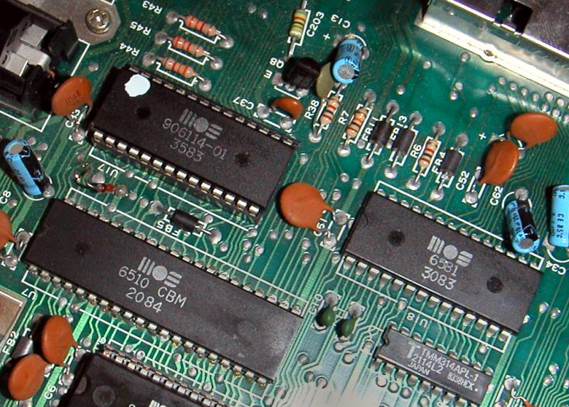
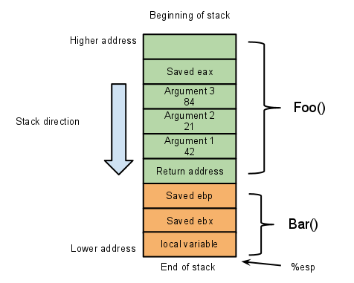
But why do we lie so much?
A historical sketch of programming:
From machine code to assembly
From assembly to e.g. Fortran or C
We got used to variables standing for a location in memory…
...not as short-hands for values as in mathematics!
What is the next level of abstraction?

Slide 6
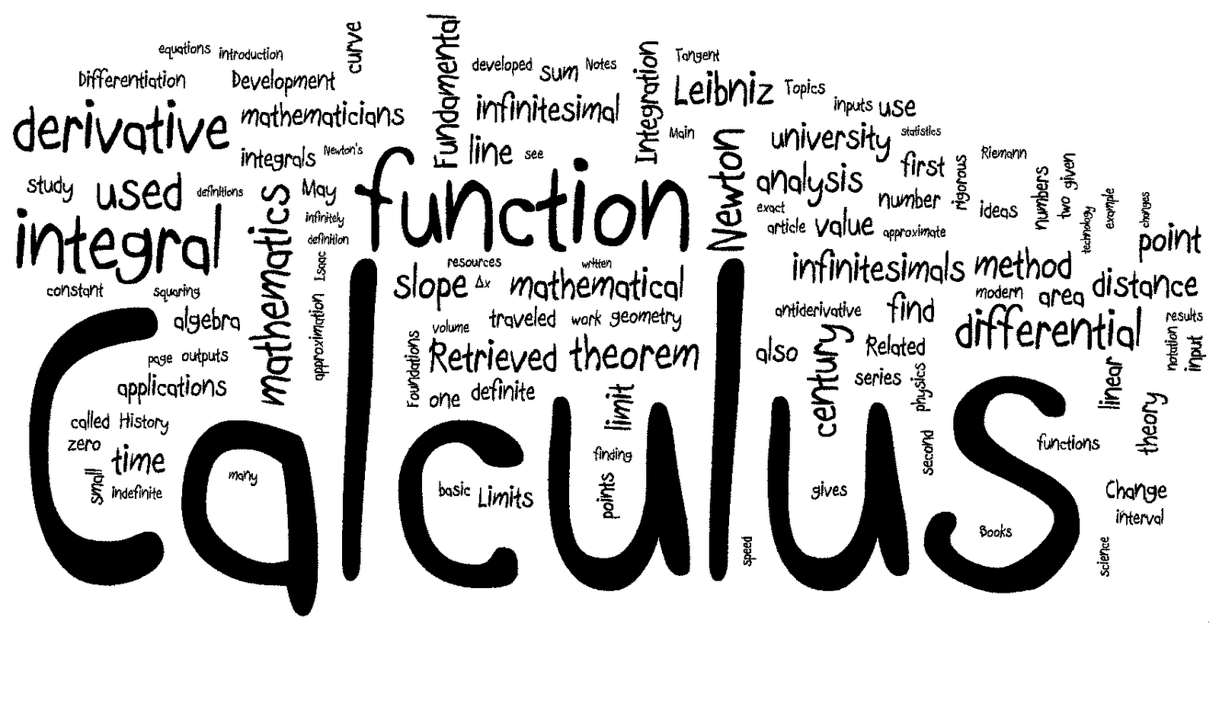
Functional Programming
Treat computation as the evaluation of mathematical functions
Avoid changing-state and mutable data
Higher level of abstraction requires very smart compilers

Slide 7
The Lambda Calculus
Lambda calculus: a formal system for expression computation based on functions as a universal model of computation
Very interesting research topic that plays an important role in FP
Syntax | Name | Description
x | Variable | A character or string representing a parameter or mathematical/logical value
(λx.M) | Abstraction | Function definition (M is a lambda term). The variable x becomes bound in the expression.
(M N) | Application | Applying a function to an argument. M and N are lambda terms.
Operation | Name | Description
(λx.M[x]) → (λy.M[y]) | α-conversion | Renaming the bound (formal) variables in the expression. Used to avoid name collisions.
((λx.M) E) → (M[x:=E]) | β-reduction | Replacing the bound variable with the argument expression in the body of the abstraction

Slide 8
Why was I showing this?
Consider trivial expression (λx.x)
In Python it would be
That should look familiar! Lambda functions are now part of many languages so you can create unnamed "throw-away" functions
Example:
We just saw another FP concept: Higher-order functions!
is a function that takes a function as an argument
Now you know why it's called "lambda function" in Python.
But why "lambda calculus in the first place?
Recursive problem… which is a good keyword
lambda x: x
map(lambda x: x**2, [1,2,3])
map

Slide 9
Recursion in Lambda Calculus
How to implement recursion?
Not possible to refer to the definition of a function in a function body!
What we need is some higher-order function to apply on a function to call it recursively:
fix f = f ( fix f ), and therefore fix f = f ( f ( … f ( fix f ) … )).
This fixed-point combinator can be implemented in lambda Calculus by Haskell Curry's Y combinator:
Y = λf.( λx.f (x x) )( λx.f ( x x ) )

Slide 10

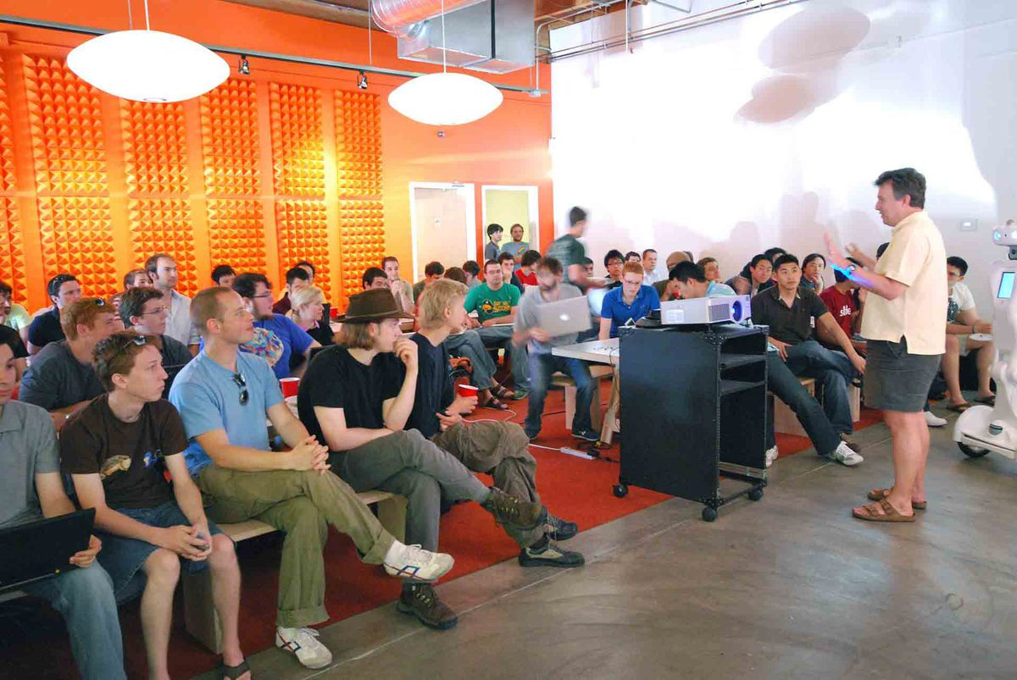
Why was I showing this again?
The US company Y Combinator is arguably the most famous startup incubator in silicon valley
It invested in Dropbox, Airbnb, Reddit, Docker, etc.
If FP concepts inspire trendy company names now, we are definitely up to something!

Slide 11
Functional Programming Languages
The most famous one is Haskell, which sticks close to the typed lambda calculus. These are the strong points of the language:
  Purity:
  functions have no side-effects and outputs only depends on inputs
  Strong typing:
  all variable types must be known at compile-time and no implicit casting,
  which results in most bugs being caught at compile time and enables powerful static code analysis
  Elegance:
  code often reads like a high-level algorithm description
  Laziness:
  nothing is evaluated until it has to be evaluated
In particular the first two bullet-points result in fewer bugs than you'd normally get in e.g. C++ and Python
I will not go deeper in the topic of FP languages and will explain how to use these concepts in C++ or Python instead

Slide 12


Functional Programming in the Real World
Some companies use pure FP languages like Haskell or Ocaml
(the latter developed by INRIA)
Mostly in silicon valley, startup scene, fin-tech sector and France
Companies like FP languages for:
  Robustness
  Scalability
  Rapid development times (once you get the hang of it)
  Readability of code
  It attracts high quality nerds

Slide 13
Functional Programming in High Energy Physics
Google searches:
  physics+"object oriented programming"
  2 Million results
  physics+"functional programing"
  7000 results
  Conclusion: we definitely didn't jump on that bandwagon…
High energy physics has an important Fortran legacy
  Fortran: as un-functional as it gets. Variables all have to be declared in the beginning and then you mutate them heavily!
  Many people still write code like this today
Fortunately, we use a lot of C++ and Python, which now took over many concepts from PF for example:
  Powerful type systems (C++)
  Lambda functions and higher-order functions (both)
  Mutable variables can be avoided without loosing much speed thanks to
  powerful optimizers in moders compilers (C++)

Slide 14
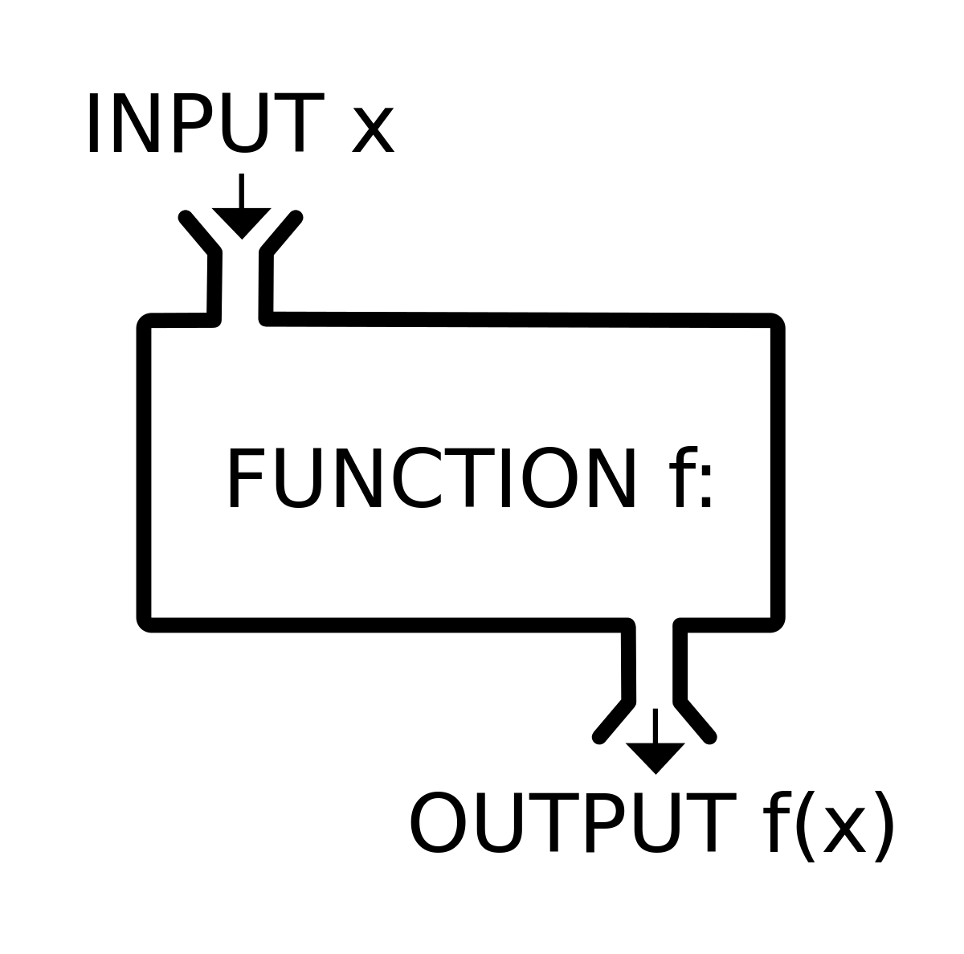
What you can take from FP to write better code Today
Stick to pure functions as much as possible.
  A pure functions output only depends on the input (not on some external state) and has no "side effects" (implicit effects on external state)
Ensure that your variables have well-defined types
  In Python you can't really do that
  In C++ that means avoid , casts,
  and violations of the Liskov Substitution principle
Try to find elegant, abstract solutions to your problems
with powerful higher-level functions and define your own
  In C++ that means get familiar with function pointers
  In Python that means use libraries with a high level of functional abstraction like Pandas or sklearn
Don't be afraid of avoiding mutable data
  Don't try to mutate variables to "make your program more efficient"
  Infest your C++ code with
nullptr
void*
const

Slide 15
Making a case for Pure Functions
Typical C++ HEP coding pattern on the right
Often huge "god classes" which have a lot of member variables that get mutated all over the place
That's dangerous because information may "leak over" to other event because you didn't reset a variable for example
You can never be sure what the actual inputs and outputs of a function are without reading it's body
Don't be that guy
class MyAnalyzer() {
public:
MyAnalyzer(Configuration config);
run(Event iEvent); // for event loop
private:
// Some functions that do
// something to the class members.
// Real inputs and outputs NOT CLEAR!
void selectElectrons(float cut);
void makeSuperClusters(bool keepBrems);
bool fitTrack(int nHits);
// Metric shit-ton of variables
// which all get mutated in
// the class member functions
// (hidded side effects...)
int iEvent_;
float pt_;
float eta_;
float phi_;
// ..
// ..
};

Slide 16
Making a case for Type Safety
Branch
Very nice negative example is the ROOT TTree's method:
Problem is the void pointer. Type of address is instead specified as argument, e.g.:
What if you later change the type of in the code from "Float_t" to "Double_t" and forget to change "F" to "D"?
The compiler won't complain and you'll get garbage in your tree
Why not using the compiler and type system as your ally to detect bugs early? Missed opportunity here!
TBranch * TTree::Branch ( const char * name,
void * address,
const char * leaflist,
Int_t bufsize = 32000 );
Float_t mass;
tree→Branch("mass", &mass, "mass/F");
mass

Slide 17
C++ case study: filling a TTree
#include "TFile.h"
#include "TRandom.h"
#include "TFile.h"
#include "Ttree.h"
#include <vector>
#include <cmath>
class MySimulator {
public:
MySimulator() {
tree_ = new TTree("tree", "tree");
tree_->Branch("n" , &nElectrons_, "n/i");
tree_->Branch("eta" , &etaVec_);
tree_->Branch("phi" , &phiVec_);
tree_->Branch("pt" , &ptVec_);
rng_ = new TRandom(); // random number generator
}
~MySimulator() {
tree_->Write();
delete rng_;
}
void simulate(int iEvent) {
etaVec_.clear(); // don't forget to clear vectors at each event
phiVec_.clear();
ptVec_.clear();
nElectrons_ = 4 + rng_->Integer(4); // how many electrons?
for(int iElectron = 0; iElectron < nElectrons_; ++iElectron) {
phiVec_.push_back( rng_->Uniform() * 2.*M_PI - M_PI );
etaVec_.push_back( rng_->Uniform() * 5.0 - 2.5 );
ptVec_ .push_back( rng_->Exp(10.) + 20. );
}
tree_->Fill(); // fill the TTree with event information
}
private:
TTree* tree_;
TRandom* rng_;
unsigned int nElectrons_; // variables for TTree branches
std::vector<float> etaVec_;
std::vector<float> phiVec_;
std::vector<float> ptVec_;
};
int main() {
int nEvents = 10000; // number of events to simulate
TFile* file = TFile::Open("data.root", "RECREATE");
MySimulator simulator{};
for(int iEvent = 0; iEvent < nEvents; ++iEvent) {
simulator.simulate(iEvent);
}
delete file;
}
Let's try to find the "non-FP" parts together:

Slide 18
C++ case study: filling a TTree
#include "TFile.h"
#include "TRandom.h"
#include "TFile.h"
#include "Ttree.h"
#include <vector>
#include <cmath>
class MySimulator {
public:
MySimulator() {
tree_ = new TTree("tree", "tree");
tree_->Branch("n" , &nElectrons_, "n/i");
tree_->Branch("eta" , &etaVec_);
tree_->Branch("phi" , &phiVec_);
tree_->Branch("pt" , &ptVec_);
rng_ = new TRandom(); // random number generator
}
~MySimulator() {
tree_->Write();
delete rng_;
}
void simulate(int iEvent) {
etaVec_.clear(); // don't forget to clear vectors at each event
phiVec_.clear();
ptVec_.clear();
nElectrons_ = 4 + rng_->Integer(4); // how many electrons?
for(int iElectron = 0; iElectron < nElectrons_; ++iElectron) {
phiVec_.push_back( rng_->Uniform() * 2.*M_PI - M_PI );
etaVec_.push_back( rng_->Uniform() * 5.0 - 2.5 );
ptVec_ .push_back( rng_->Exp(10.) + 20. );
}
tree_->Fill(); // fill the TTree with event information
}
private:
TTree* tree_;
TRandom* rng_;
unsigned int nElectrons_; // variables for TTree branches
std::vector<float> etaVec_;
std::vector<float> phiVec_;
std::vector<float> ptVec_;
};
int main() {
int nEvents = 10000; // number of events to simulate
TFile* file = TFile::Open("data.root", "RECREATE");
MySimulator simulator{};
for(int iEvent = 0; iEvent < nEvents; ++iEvent) {
simulator.simulate(iEvent);
}
delete file;
}
Let's try to find the "non-FP" parts together:
  One mutated variable per tree branch
  Impure TTree::Fill() and TTree::Write() functions
  Mutated TRandom
  Vectors mutated all over the place:
    std::vector<T>::clear()
    std::vector<T>::push_back()

Slide 19
The STree – a wrapper around TTree
#ifndef __S_TREE__
#define __S_TREE__
#include "TTree.h"
#include <mutex>
template<class T>
void addTreeBranch(TTree* tree, const char* name, T& variable) {
tree->Branch(name, &variable);
}
#define TYPES_WITH_SUFFIX \
X(char , "/B") X(unsigned char , "/b") \
X(short , "/S") X(unsigned short, "/s") \
X(int , "/I") X(unsigned int , "/i") \
X(long , "/L") X(unsigned long , "/l") \
X(float , "/F") X(double , "/D") \
X(char * , "/C") X(bool , "/O")
#define X(Type, suffix) \
template<> \
void addTreeBranch<Type>(TTree* tree, \
const char* name, Type& variable) { \
tree->Branch(name, &variable, \
(std::string(name) + suffix).c_str()); \
}
TYPES_WITH_SUFFIX
#undef X
#undef TYPES_WITH_SUFFIX
template <typename T>
class STree {
Public:
STree(const char* name, const char* title)
: tree_(new TTree(name, title))
{ init(); }
void init();
void write() const { tree_->Write(); }
void print() const { tree_->Print(); }
void fill(T && structure) const {
std::lock_guard<std::mutex> lock {mutex_};
structure_ = std::move(structure);
tree_->Fill();
}
private:
template<class S>
void addBranch(const char* name, S foo) {
addTreeBranch(tree_, name, structure_.*foo);
}
TTree * tree_;
mutable T structure_;
mutable std::mutex mutex_;
};
#endif
Let's first make a function to add branches of the correct type by matching the type of the variable
Let's create a wrapper around TTree which provides a fill function that does not depend on the external state but takes the branch variables as inputs
To use this class, one has to define the tree structure as a struct in C++. Type checking of branches is done at compile time and we avert bugs
Put lock_guard in write function to make possible multithreaded filling

Slide 20
Defining the tree structure
#ifndef __EVENT_TREE__
#define __EVENT_TREE__
#include "Stree.h"
struct EventRecord {
unsigned int nElectrons;
std::vector<float> etaVec;
std::vector<float> phiVec;
std::vector<float> ptVec;
};
template<>
void STree<EventRecord>::init() {
addBranch("n" , &EventRecord::nElectrons);
addBranch("eta" , &EventRecord::etaVec);
addBranch("phi" , &EventRecord::phiVec);
addBranch("pt" , &EventRecord::ptVec);
}
using EventTree = STree<EventRecord>;
# endif
Next, we have to define the tree structure and corresponding STree<T>::init() function for this structure
  You might of course also write a preprocessor macro that does both at once

Slide 21
Our final FP solution
#include "TFile.h"
#include "TRandom.h"
#include "EventTree.h"
#include <vector>
#include <cmath>
class MySimulator {
public:
MySimulator() : tree_("tree", "tree") {}
~MySimulator() { tree_.write(); }
void simulate(int iEvent) const
{
// how many electrons?
const unsigned int nElectrons {4 + rng_.Integer(4)};
std::vector<float> etaVec(nElectrons);
std::vector<float> phiVec(nElectrons);
std::vector<float> ptVec(nElectrons);
for (auto& x : etaVec) x = rng_.Uniform() * 5.0 - 2.5;
for (auto& x : phiVec) x = rng_.Uniform() * 2.*M_PI - M_PI;
for (auto& x : ptVec) x = rng_.Exp(10.) + 20.;
tree_.fill({ .nElectrons = nElectrons,
.etaVec = etaVec,
.phiVec = phiVec,
.ptVec = ptVec });
}
private:
EventTree tree_;
mutable TRandom rng_;
};
int main()
{
const int nEvents {10000}; // number of events to simulate
TFile file {"data.root", "RECREATE"};
MySimulator simulator{};
for(int iEvent = 0; iEvent < nEvents; ++iEvent)
simulator.simulate(iEvent);
}
Impure part now mostly moved out to other files
fill function now much more explicit as it was before
Code is easier to read now: a look at the fill function call is enough to get the general idea
No type-related bugs possible with the STree wrapper
On the downside about
10 % slower
Speed loss can be mitigated by simulating in multiple threads, which would not have been possible before

Slide 22
Our final FP solution
(multi-threaded)
#include "TFile.h"
#include "TRandom.h"
#include "EventTree.h"
#include <vector>
#include <cmath>
class MySimulator {
public:
MySimulator() : tree_("tree", "tree") {}
~MySimulator() { tree_.write(); }
void simulate(int iEvent) const
{
// how many electrons?
const unsigned int nElectrons {4 + rng_.Integer(4)};
std::vector<float> etaVec(nElectrons);
std::vector<float> phiVec(nElectrons);
std::vector<float> ptVec(nElectrons);
for (auto& x : etaVec) x = rng_.Uniform() * 5.0 - 2.5;
for (auto& x : phiVec) x = rng_.Uniform() * 2.*M_PI - M_PI;
for (auto& x : ptVec) x = rng_.Exp(10.) + 20.;
tree_.fill({ .nElectrons = nElectrons,
.etaVec = etaVec,
.phiVec = phiVec,
.ptVec = ptVec });
}
private:
EventTree tree_;
mutable TRandom rng_;
};
int main()
{
const int nEvents {10000}; // number of events to simulate
const int nThreads {8};
TFile file {"data.root", "RECREATE"};
MySimulator simulator{};
auto simulateEvents = [&]() {
for(int iEvent = 0; iEvent < nEvents/nThreads; ++iEvent)
simulator.simulate(iEvent);
};
std::vector<std::thread> threads;
for(int i = 0; i < nThreads; ++i) threads.emplace_back(simulateEvents);
for(auto& thread : threads) thread.join();
}
Easy to speed up your analysis by factor n if you kept your use of mutable data under control
Downside: the order of events is now not deterministic anymore, which makes the random numbers not deterministic

Slide 23
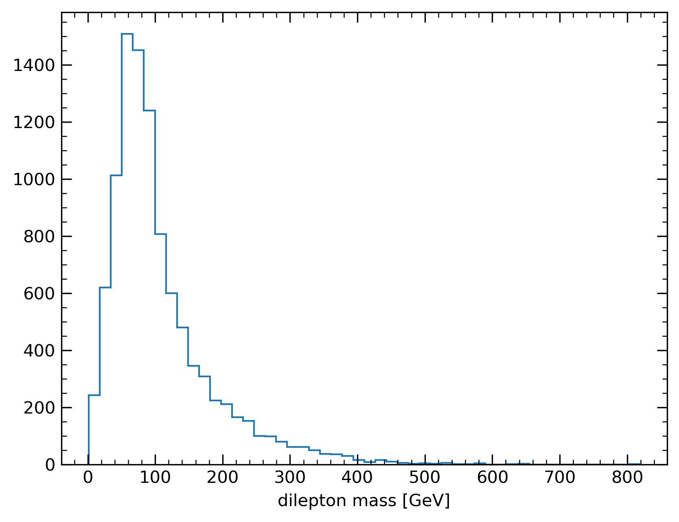
Making Plot with Python
import uproot
import numpy as np
import matplotlib.pyplot as plt
import pandas as pd
df = uproot.open("data.root")["tree"].pandas.df()
def get_mass(leptons):
leps = leptons.sort_values("pt")[-2:]
pt_prod = leps["pt"].prod()
eta_diff = leps["eta"].diff().iloc[1]
phi_diff = leps["phi"].diff().iloc[1]
return np.sqrt(2*pt_prod*(np.cosh(eta_diff)-np.cos(phi_diff)))
mass = df.groupby("entry").apply(get_mass).values
plt.figure()
plt.hist(mass, bins=50, histtype='step')
plt.xlabel("dilepton mass [GeV]")
plt.savefig("dilepton_mass.png")
The split-apply-combine idiom is a nice example of how higher-oder functions can abstact away event loops
In Pandas:
  Split step is done by df.groupby
  apply is the higher-order function
  Combination step is implicit in apply
Pandas provides a very high level of abstaction and is fast enough for datasets with thousands of rows
Pandas disencourages mutable data, but you can still do it with the argument
inplace=True

Slide 24
Conclusions
Functional programming is the natural next level of abstraction in the evolution of programming languages
Functional programming languages like Haskell or OCaml (while not being mainstream yet) have significantly inspired the mainstream languages to implement features originating from FP
These new aspects of C++ and Python can help Physicists write more bug-free and readable code, saving time for everyone
Three most important lessons:
  Write pure functions
  The compiler and type-system is your friend
  Avoid mutating variables if possible
  Use higher-level functions
Sticking to these rules results in code that can be easily parallelized

