Slide 1

RetailMyMeds
Pharmacy Qualification System
.
Built for Arica Collins | February 2026
Kevin McCarron + Matthew Scott

Slide 2
The Problem We Solve
$39.50
41,775
22,019
Avg loss per GLP-1 fill on gov payers
Pharmacies in targeting database
Active pharmacies scored for outreach
Independent pharmacies lose money on every GLP-1 prescription. Most don't know how much.

Slide 3
What We Built
Qualification Scorecard
State Outreach Lists
2-min form. Personalized grade (A-D), financial projections, downloadable PDF.
Top 10 states, outbound-ready CSVs. 12 columns, sorted by priority.
Targeting Database
Quick Estimate
41,775 pharmacies, 5 federal sources. Scored, graded, segmented.
4-field version. Instant ROI verdict for cold outreach or events.
Wix Velo Integration
Scoring API
Ready-to-deploy code for retailmymeds.com.
Live backend. Scores, PDFs, email delivery in real time.

Slide 4
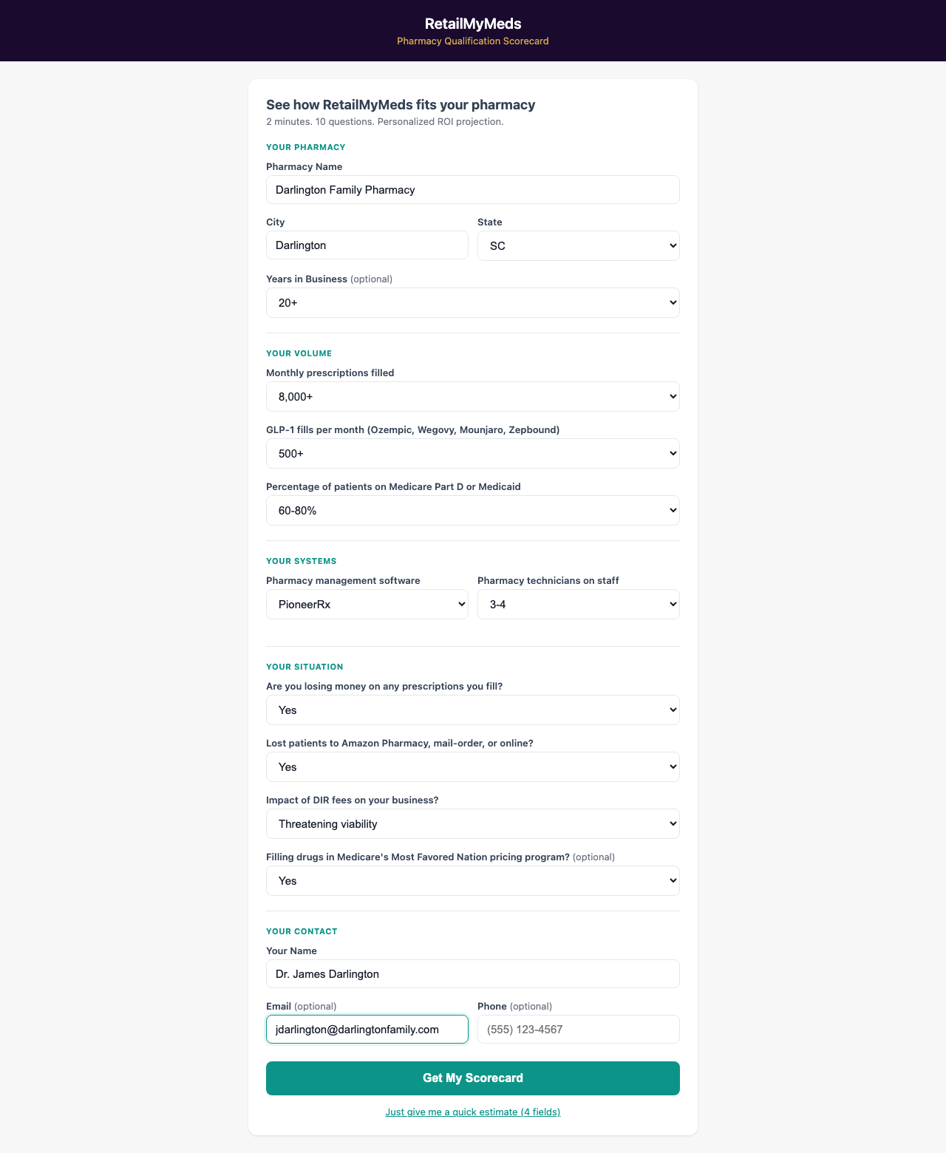
The Qualification Form
2 minutes. 10 questions. Personalized ROI.
A pharmacy owner answers 10 questions about volume, systems, and situation.
Four sections: pharmacy info, Rx volume, technology, and current pain points.
Works on desktop and mobile. No login required.

Slide 5
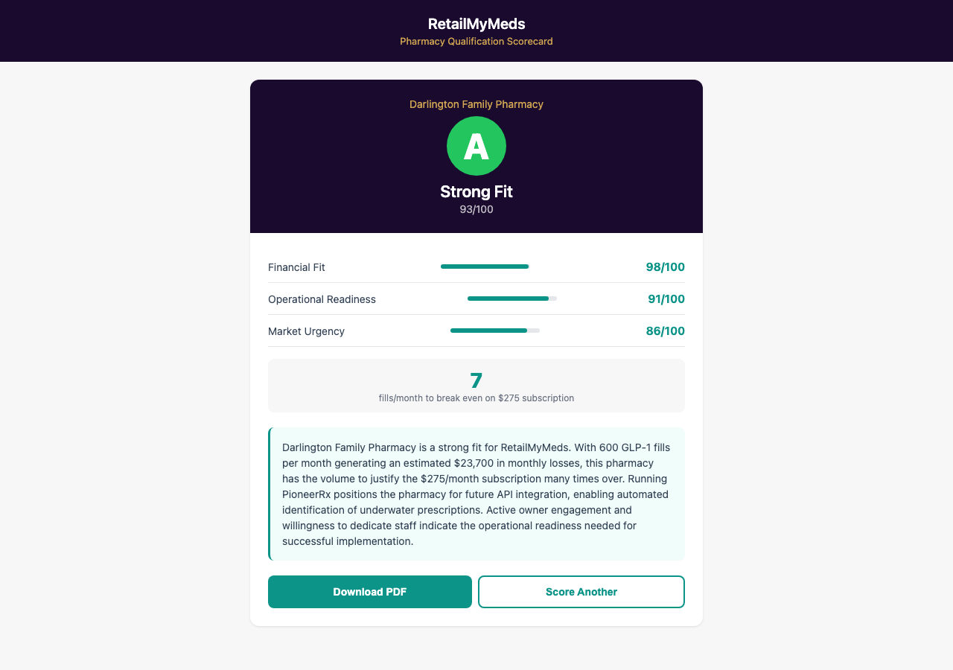
Instant Scorecard Results
Grade, dimensions, recommendation, PDF -- all in seconds.
Letter grade (A-D) with composite score out of 100.
Three dimensions: Financial Fit (45%), Operational Readiness (30%), Market Urgency (25%).
This example: Grade A, 93/100
Breakeven: just 7 fills/month
Est. loss: $23,700/month

Slide 6
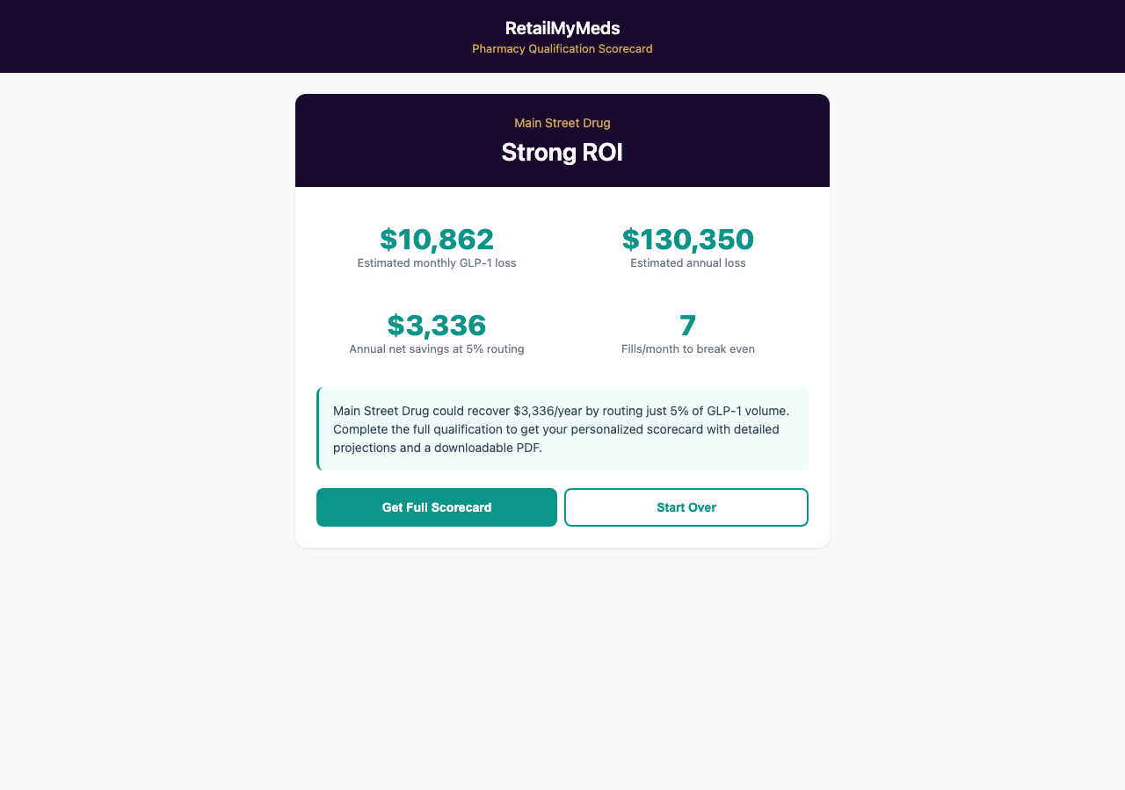
Quick Estimate (4 Fields)
Low-friction entry point for cold outreach.
Only 4 fields: name, state, Rx volume, GLP-1 fills. Instant ROI verdict.
Use cases
Trade shows and conferences
Cold call follow-ups
Email campaign landing pages
Social media lead capture

Slide 7
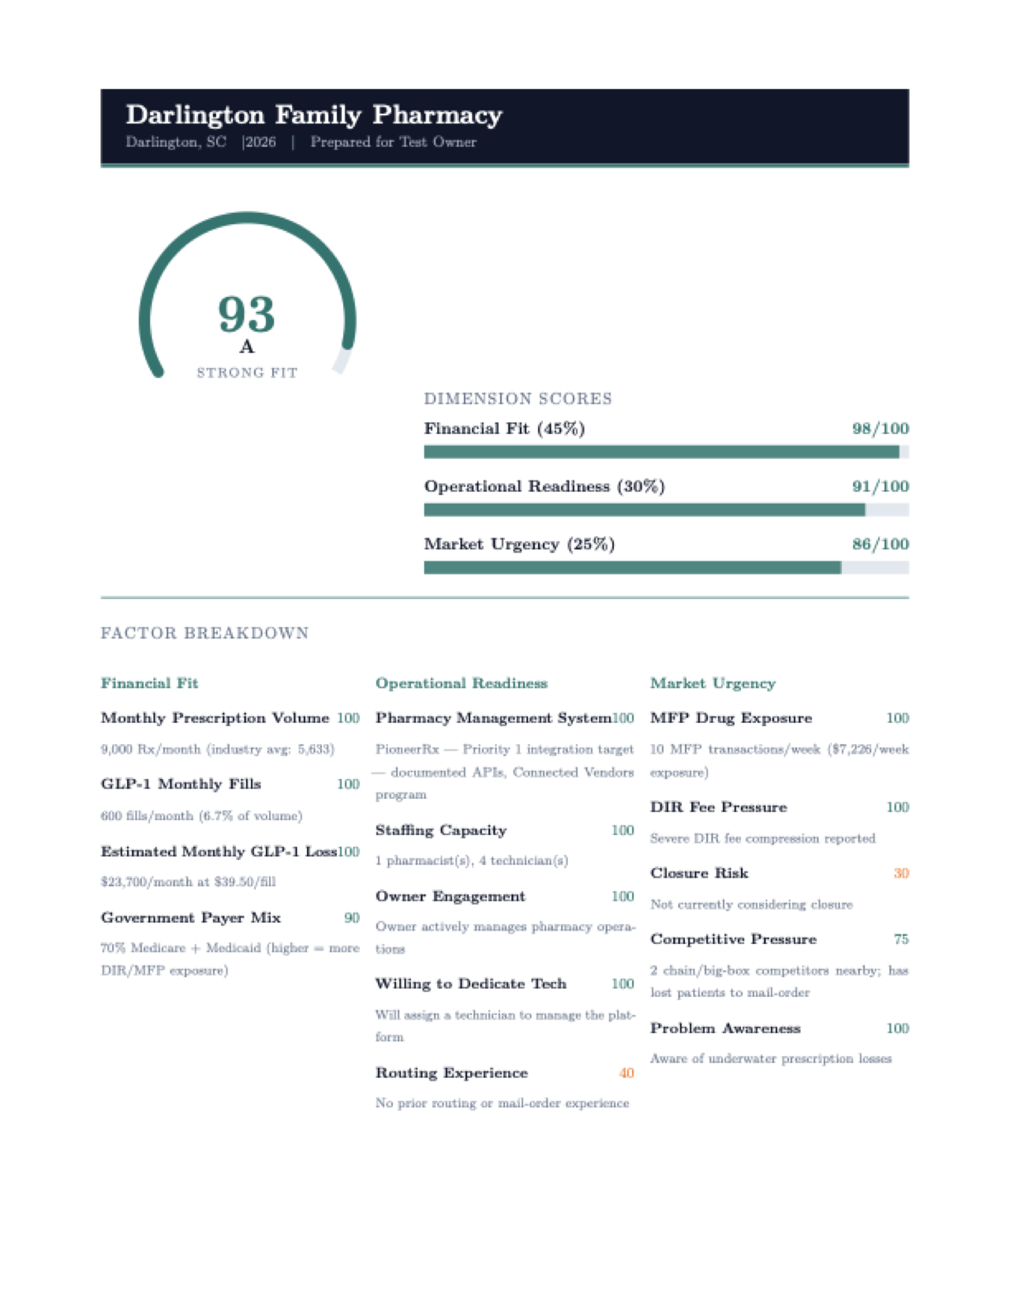
Downloadable PDF Scorecard
Personalized document each pharmacy can share internally.
Full score breakdown, every sub-score, and written recommendation.
Generated server-side via LaTeX. Every PDF unique to that pharmacy.
3 pages per scorecard
Factor breakdown included
ROI projections at 3 scenarios
Can be emailed automatically

Slide 8
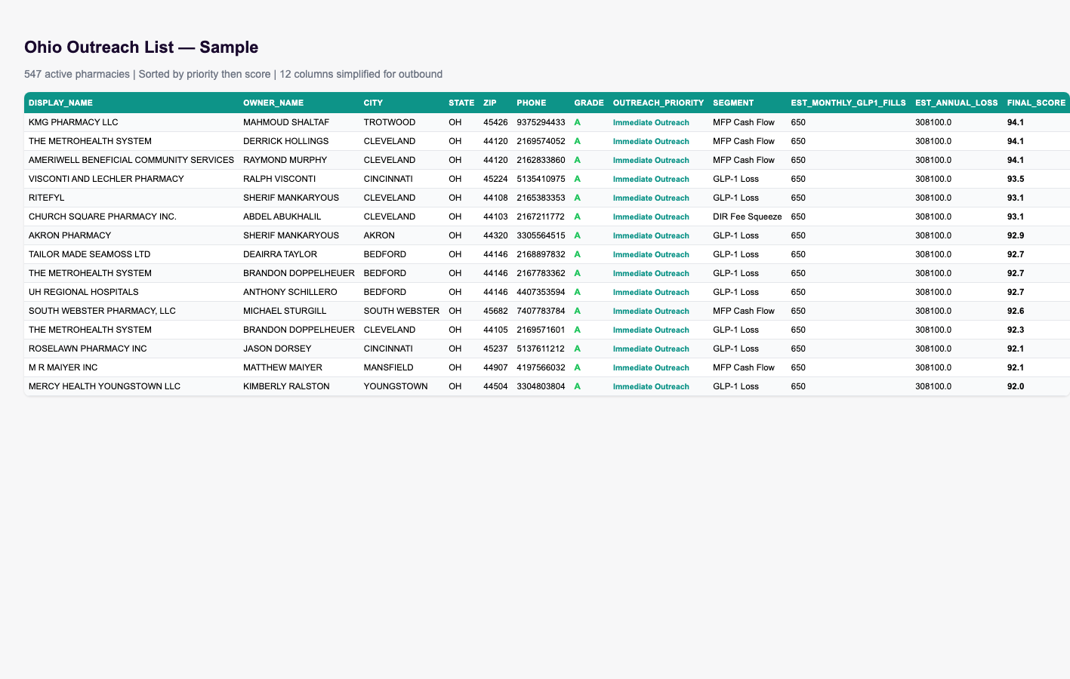
State Outreach Lists
Pre-built, priority-sorted CSVs for outbound workflow.
10
12
5,922
12,817
State files ready
Columns per row
Immediate Outreach
Top 10 states total

Slide 9
Two Paths, One Engine
Outbound (Arica)
Inbound (Website)
You already have the lists.
Kevin integrates the form.
State CSVs with 12 columns
Form on retailmymeds.com
Sorted by priority + score
Pharmacy self-qualifies in 2 min
5,922 Immediate Outreach
PDF emailed automatically
Quick Estimate for cold calls
Lead captured with score + grade
Full scorecard for warm leads
Velo code ready for Kevin

Slide 10
Questions for You
.
How are you currently qualifying pharmacies?
Which states are you operating in right now?
What does your outreach workflow look like today?
What format would be most useful for your team?
Everything shown today is live and ready to use.

