Slide 1
Software Architecture with Visual Frameworks
Paul Tarvydas
Norm Sanford

Slide 2
Agenda
Brief visual overview
Description of basic units
Causality
Some Features: Test Jigs, Checking “integration” early, Simulation
Conclusion

Slide 3
Brief Visual Overview

Slide 4
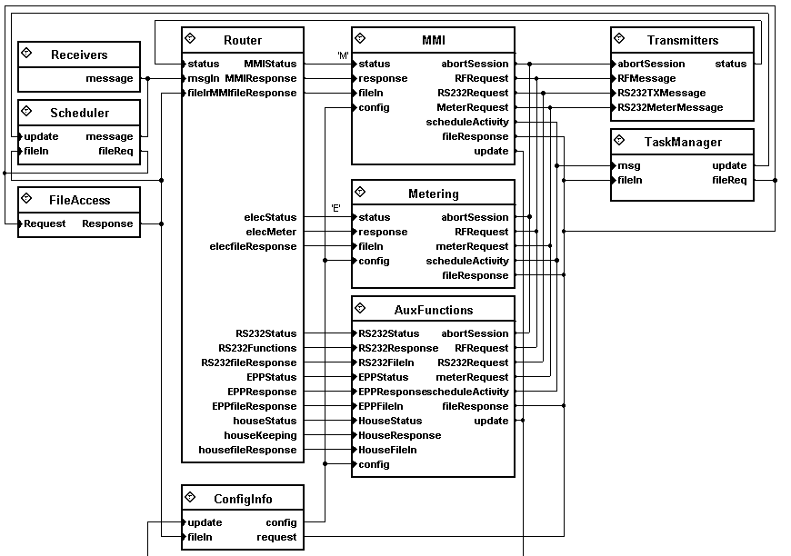
Sample from an actual project (smart electricity meter)
Top level arch.
Schematic
Parts
Wires

Slide 5
Hierarchical
Composition
Drill down into “Transmitters” part ...

Slide 6
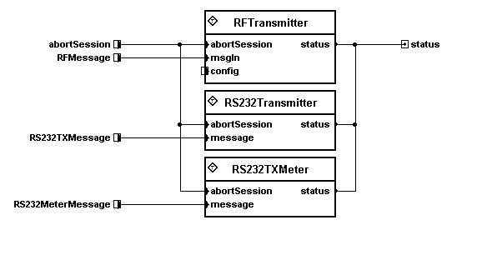
Contents of “Transmitters” Part
Contains another schematic
Input / output ports connect to input / output pins of enclosing part “shell”
Drill down into “RS232Transmitter” ...

Slide 7
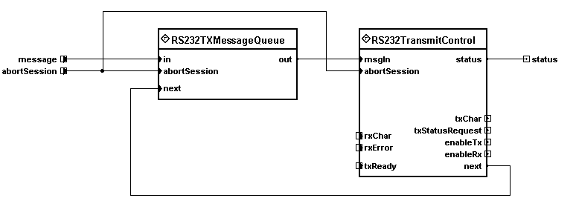
Contents of “RS232Transmitter”
Another schematic (4th level)
Less and less functionality (i.e. closer to implementation details)
Drill into “RS232TXMessageQueue” ...

Slide 8
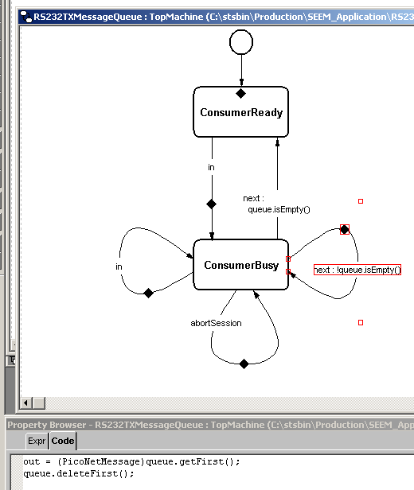
“RS232TXMessageQueue”
“Leaf node”
State machine
Transitions labeled by input pin
Optional guarded transition expression
Entry / exit code
Transition code
States can be hierarchical (not shown)
Text code typically consists of small snippets
Code runs to completion
Reactive

Slide 9
Description of Basic Units

Slide 10
Basic Units
Parts
Schematics
Events
Hierarchical State Machines

Slide 11
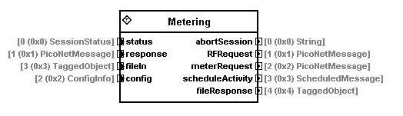
Parts
Instantiable object (no inheritance)
Input pins
Output pins
Pins have names and types
Generates (“sources”) events
Accepts & processes (“sinks”) events

Slide 12
Parts …
Fundamental unit of encapsulation
Fundamental unit of concurrency
Asynchronous - every part is like an ultra-light weight process (one stack, interrupt-like, no priorities, no preemption)
One input queue, one output queue
“Run to completion”
Pluggable, independently downloadable

Slide 13
Parts Can Contain...
Other parts, i.e. a schematic (no recursion)
Hierarchical state machines (diagrams, annotated with text code snippets)
“native” code
  e.g. C code with appropriate part “API”
  native code parts also have input & output pins

Slide 14
Schematics
Fundamental unit of architecture
Fundamental unit of composition
Hierarchical
A schematic encapsulates one set of parts and their interconnections (wires)

Slide 15
Events
Fundamental unit of inter-part communication
May contain scalar or composite data

Slide 16
Event Flow
Uni-directional flow (output to input)
No call / return protocol implied
Asynchronous event send -
  once a part sends an event to its output pin, it “loses track” of the event
  details of event delivery are unknown to sender
Events may be delivered to 1, > 1, or 0 other parts (depending on wiring)

Slide 17
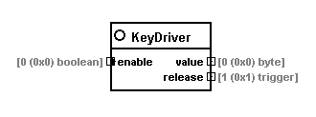
Event Generation
System sits idle until an event arrives from “outside”
“Driver parts” are the source of the external events that drive the system
Driver parts can be placed anywhere in the system (e.g. at top level, or at lowest levels - simply a matter of style)

Slide 18
Driver Parts
Embedded system driver parts field interrupts
Workstation (e.g. Windows): field callbacks
Driver parts typically perform the smallest unit of work possible, e.g. receive one byte, transmit one byte
Remainder of “driver” coding handled using diagrams - schematics and parts

Slide 19
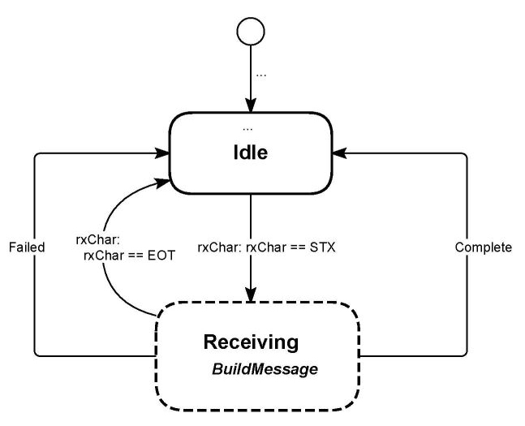
Hierarchical State Machines
“Software architecture” in VF: two halves
  specifying relationships between parts in terms of composition and communication
  specifying the behaviour of individual parts
To specify part behaviour, we use hierarchical state diagrams

Slide 20
Hierarchical State Machines
A visual language that compiles to code.
Natural way to express behaviour of parts that handle events.
Features of hierarchical state machines:
  functional abstraction
  “top down” exception handling

Slide 21
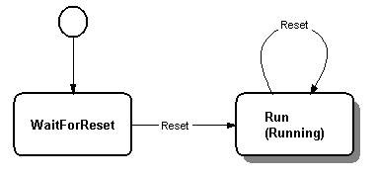
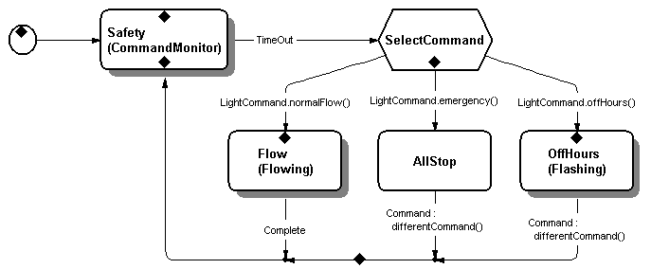
Top Down Exception Handling
If a reset event arrives, the machine will reset to its initial state
No reference to reset event
anywhere
else inside
the machine

Slide 22
Causality

Slide 23
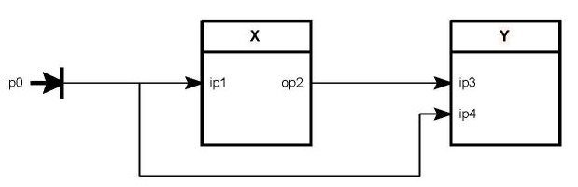
Causality
Notion of “b was caused by a”
Simple example schematic
Input event on input pin of X (ip1) causes output event on pin op2
In what order does Y see the events?

Slide 24
Call / Return Implementation
b
a
Two events, a and b
Diagram implies that b was caused by a
Event a calls ip1, then ip4 ; but ip1 calls ip3
Y sees b followed by a even though b was caused by a

Slide 25
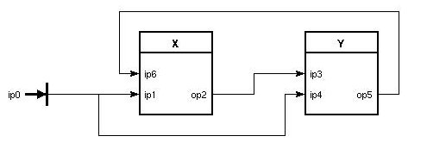
Causality
b
a
c
(specify calling order to repair previous example)
Call / return always fails to preserve causality in this example.
a causes b, a causes c ; Y should see a,b ; X should see a,c

Slide 26
Causality - Event Semantics
b
a
a is deposited, atomically, on input queues of X and Y
regardless of which part processes its inputs first, Y always sees a followed by b

Slide 27
Causality
Important for “intuitive” visualization
Can be achieved by using “event semantics” instead of “call / return” semantics
Event semantics => causality => meaningful, unambiguous diagrams
Event semantics “works” in the way that people (even non-programmers) “think”

Slide 28
Some Features of This Technique

Slide 29
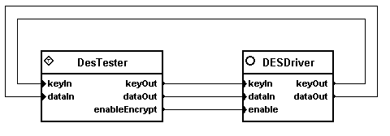
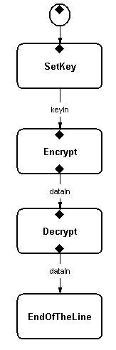
Test Jigs
Lift part from main architecture, put into test jig
Encapsulation - behaviour of parts (e.g. DESDriver) is independent of the schematics in which they appear

Slide 30
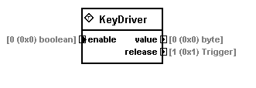
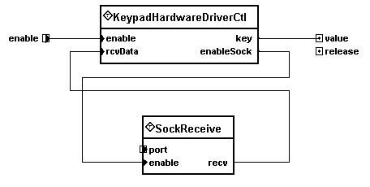
Testing by Simulation
Real Driver
Simulated Driver
Replace driver part(s) with pin-compatible simulator parts
Schematics “don’t care” about the implementations of particular parts

Slide 31
Early Integration
Complete the architectural hierarchy and compile / check it before parts are fully implemented

Slide 32
Conclusion

Slide 33
Conclusion
We’ve shown one way to visually express software architecture
We treat the problem of “software architecture” as a “language / compiler” problem instead of as a “modeling” problem

Slide 34
Conclusion
Architecture - no need for:
  call / return at architectural level
  inheritance at architectural level
  recursion at architectural level
  scheduling (priorities, preemption)
Visual Frameworks notation is “more like” notations used by Engineers and Architects - i.e. schematics and blueprints

Slide 35
tarvydas@visualframeworksinc.com

Slide 36
Random notes
VF is a “system of communicating state machines”
VF is a “system of communicating device drivers” (single stack semantics)

