Slide 1
Software Architecture Using Fine-grained Event-driven Reactive Components
www.visualframeworksinc.com
Paul Tarvydas
Norm Sanford
© Visual Frameworks Inc.

Slide 2
Why?
To solve a problem
(a) develop a notation to express the problem domain
(b) express solutions to specific problems using the notation
e.g. Physics (Feynman diagrams), Engineering (blueprints), etc.

Slide 3
Why?
Anti-Events
call-return
e.g. Java, etc.
Sensors
Events
Events
Event
Architecture
Actuators
Events
Events

Slide 4
Why?
event-based
programming
language
e.g. VF
Sensors
Events
Events
Events
Event
Architecture
Actuators
Events
Events
Events

Slide 5
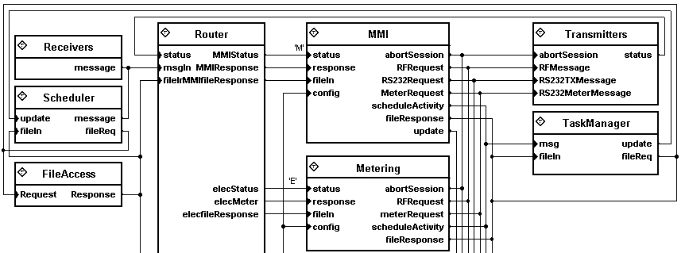
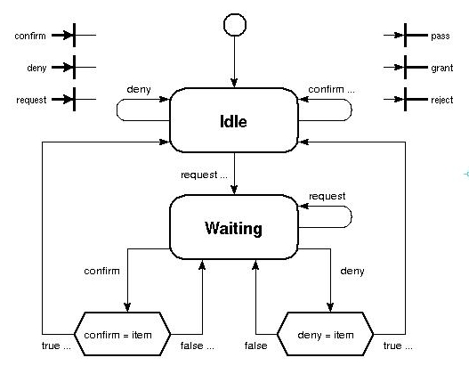
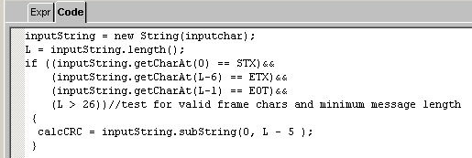
Visual Frameworks™
Diagrams for Asynchronous
Components
+ Diagrams for Control Flow
+ Text Snippets

Slide 6
Overview
VF = event-based programming language.
How we arrived at the event-driven paradigm starting with bare hardware.
Experience ⇒ it is practical to use the event-driven paradigm to construct common software applications, including operating systems (RTOS)
Distribution and visualization of architecture falls out naturally.

Slide 7
View from 10,000 feet (3.048km)
Many leaf components contain only a few lines of code.
e.g. POS terminal spec = 600 pages, implementation = 200-300 asynchronous components (running on 8051 8-bit cpu)
Smallest = 8-bit 8051, 13K RAM, multiple 32K code pages ; Largest to date = workstation app with 20,000 instances (“threads”)

Slide 8
View from 10,000 Feet
Faster reaction times than with “processes” - more efficient use of available parallelism
Visual, semantically complete, compilable diagrams (⇒ Engineering)
Routing / connections determined at compile time (parts pluggable into compiled schematics)
Real industrial products / projects (5-10 over about 15 years)

Slide 9
Motivation
Size – 8-bit machines, 13K-64K RAM
8051, Z80, ARM, Windows®
Speed – classical 'context switch' was too slow
Wished to replace ad hoc 'driver' code with a more-structured approach
The preferred approach - i.e. 100’s of small processes - was too expensive using RTOS.

Slide 10
Traditional RTOS
Full preemption ⇒ separate stack for each process (RAM size problem)
Choice: handle device interrupts as ad-hoc code in “driver”, or, perform full context switch to waken a process (speed problem)
Synchronization, concurrency issues between processes ⇒ critical regions, monitors, etc.
Translation of hardware events to call/return paradigm ⇒ complications

Slide 11
Event-Driven “RTOS” and Apps
Replace “call-return” by one-way event sends
Every software unit = state machine (event reactor)
System of communicating state machines.
All software units “run to completion”
One stack - stack-based preemption only

Slide 12
Experience - Overview
A number of iterations (about 5 major rev’s)
Practical to build “apps” and “RTOS” using 100’s of units (each akin to a “process”), even on 8-bit memory-limited CPU’s
This method supports causality.
Causality ⇒ understandability, visualization, encapsulation, distribution
⇒ “simpler” than traditional RTOS methods

Slide 13
Ver. 1- Harel-like State Machines
Constructed multi-cpu system for process control (68000’s)
Used textual state language based on Harel hierarchical state machines and concurrency
Hierarchical state machines = “good”
Implied concurrency = “not so good” (global analysis, implied synchronization of cpu’s)
Inspiration for event kernel

Slide 14
Ver. 2 - Event Kernel
Separated concurrency from state machines
Small event-send kernel, e.g. API contained few calls, e.g. send(to, data), exitDriver(), exitComponent()
Software unit = busy flag + input queue + output queue + reactor code (+ static variables)
Event = tag+data, tag+pointer-to-data

Slide 15
Ver. 2 - Event Kernel (b)
“Thread” = hardware interrupt
More than one active thread possible
Threads “blocked” (turned back) by busy flag
Driver code extremely “simple” - read port, reset, send(), exitDriver()
Very simplistic, yet, preserves causality!
Inspiration for H/W-like “pins” and “events”

Slide 16
Ver. 3. Visual Schematics
Hierarchical schematics of multi-pin parts containing (1) other schematics or (2) C code
Kernel extensions for multiple pins & hierarchy

Slide 17
Ver. 4. VM, SM, Download
Replaced “C” by hierarchical state machines, a V.M. and a “snippet” compiler (e.g. expressions on transitions, entry, exit code)
Stopped trying to express “everything” as parts
Simple kernel + event api + typed pins ⇒ downloadable parts, in-field remote upgrade
Many applications built this way ⇒ lots of experiments, experience with event architectures

Slide 18
Ver. 5. Portability, Visual Compiler
Portable kernel (“C”), Mega-128, ARM, Windows®. Same application on all cpu’s, plug in different drivers to change cpu’s
Visual compiler - scanner = drawn primitives (“tokens”) to factbase (simple, atomic relations), parser = prolog inferencer generates new higher-level facts, semantics = prolog inferencer of high-level facts
“Emacs-like” diagram editor (point + mark)

Slide 19
Distributed Systems / Patterns
Distributed debugging
Downloadable parts
Distributed application - communication hierarchy - protocol parts sent events “down” to driver parts and v.v.
Patterns

Slide 20
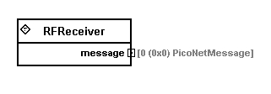
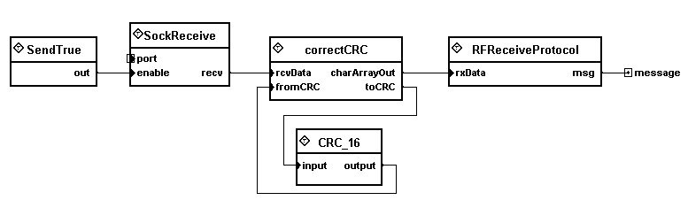
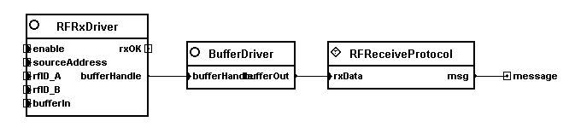
Distributed Debugging
Part Outline
Simulated Part
Real Part

Slide 21
Downloadable Parts
Bug fix, functionality upgrade, function change
Download “code” parts ⇒ change code
Download “schematic” parts ⇒ change wiring between parts
Download “schematic” parts ⇒ change architecture without changing code

Slide 22
Distributed Applications
Distributed apps used proprietary protocols
Protocols written as “routine” part of O/S code.
Smart electricity meter
Elec.
App
Keyboard
& Display
Protocol
Driver
Host
Download
App
.
.
.

Slide 23
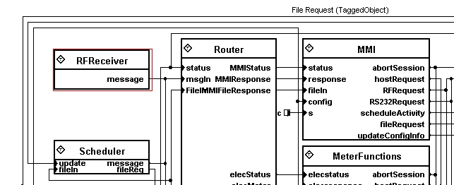
Protocol (1)
Protocol Hierarchy - Top Level

Slide 24
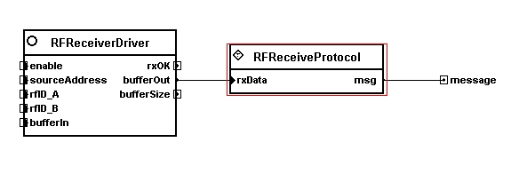
Protocol (2)
Protocol Hierarchy - Second (inner) Level
RFReceiverDriver (left) implemented in C as a “driver”
Protocol (right) is a hierarchical schematic

Slide 25
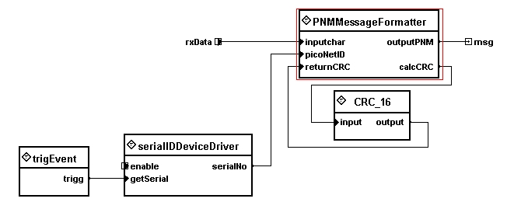
Protocol (3)
Protocol Hierarchy - Third (inner) Level

Slide 26
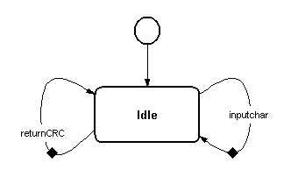
Protocol (4)
Protocol Hierarchy - Fourth (leaf) Level

Slide 27
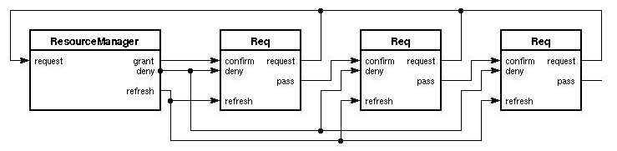
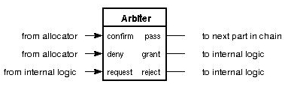
Daisy Chain Pattern
“Borrowed” from H/W design
Like “priority”, “token ring” or “super” hierarchy
Every requester
contains an
Arbiter instance

Slide 28
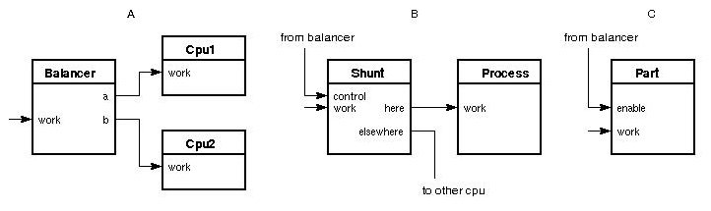
Patterns
Patterns encountered that would be applicable to load balancing
(A) Multiplexer
(B) Shunt
(C) Enable / Disable

Slide 29
Questions
www.visualframeworksinc.com
tarvydas@visualframeworksinc.com

