Slide 1
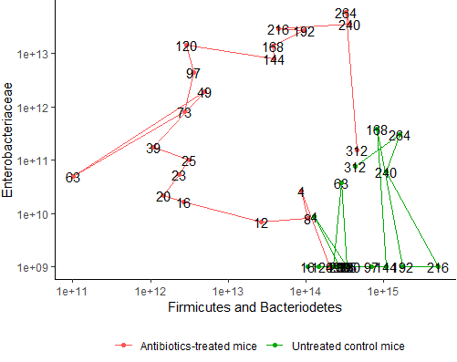

Slide 2
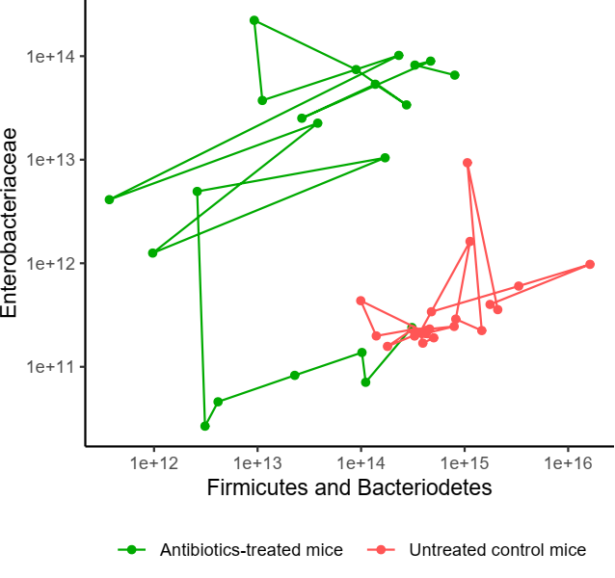
Day 5
End of abx.
Day 13
End of expt.
Day 1
Day 0
Start of abx.

Slide 3
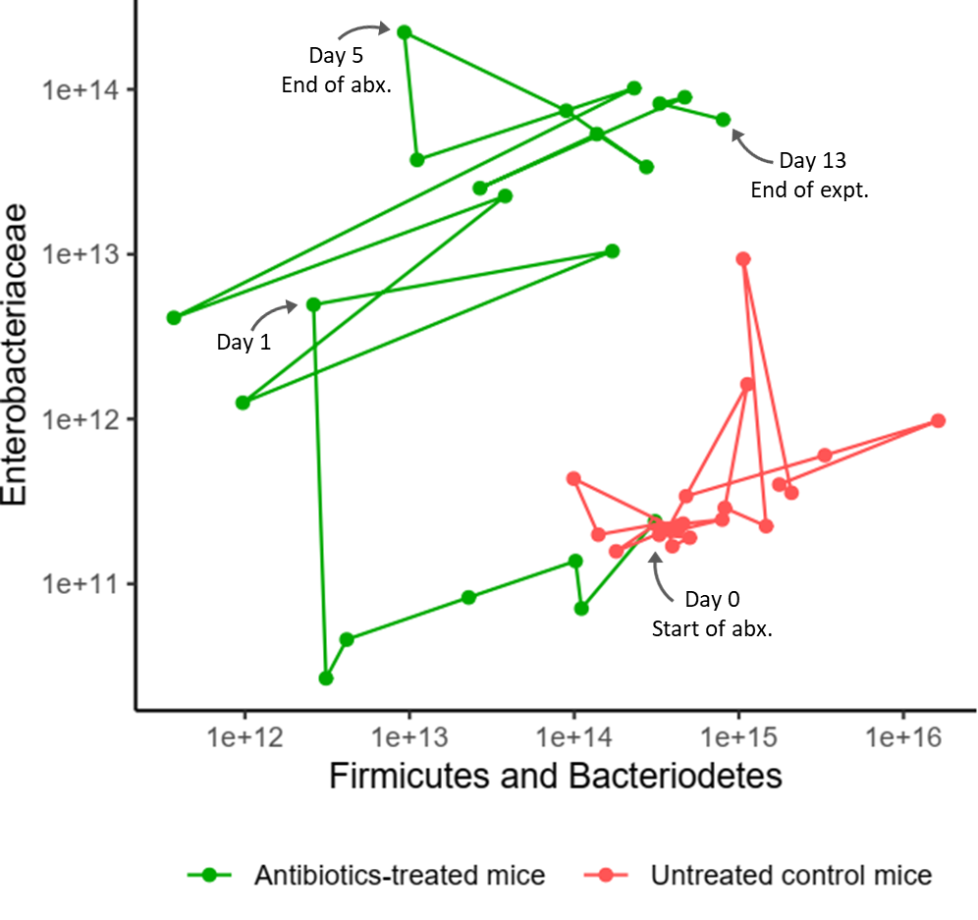
Hearst castle

Slide 4
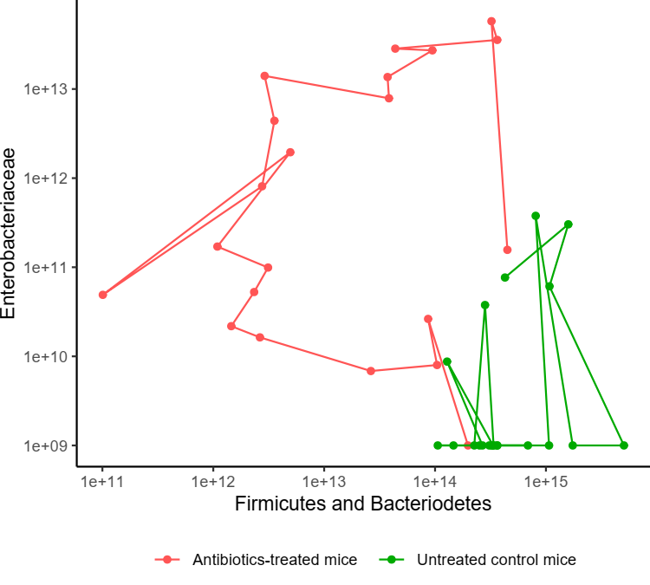
Day 5
End of abx.
Day 1
Day 13
End of expt.
Day 0
Start of abx.

Slide 5
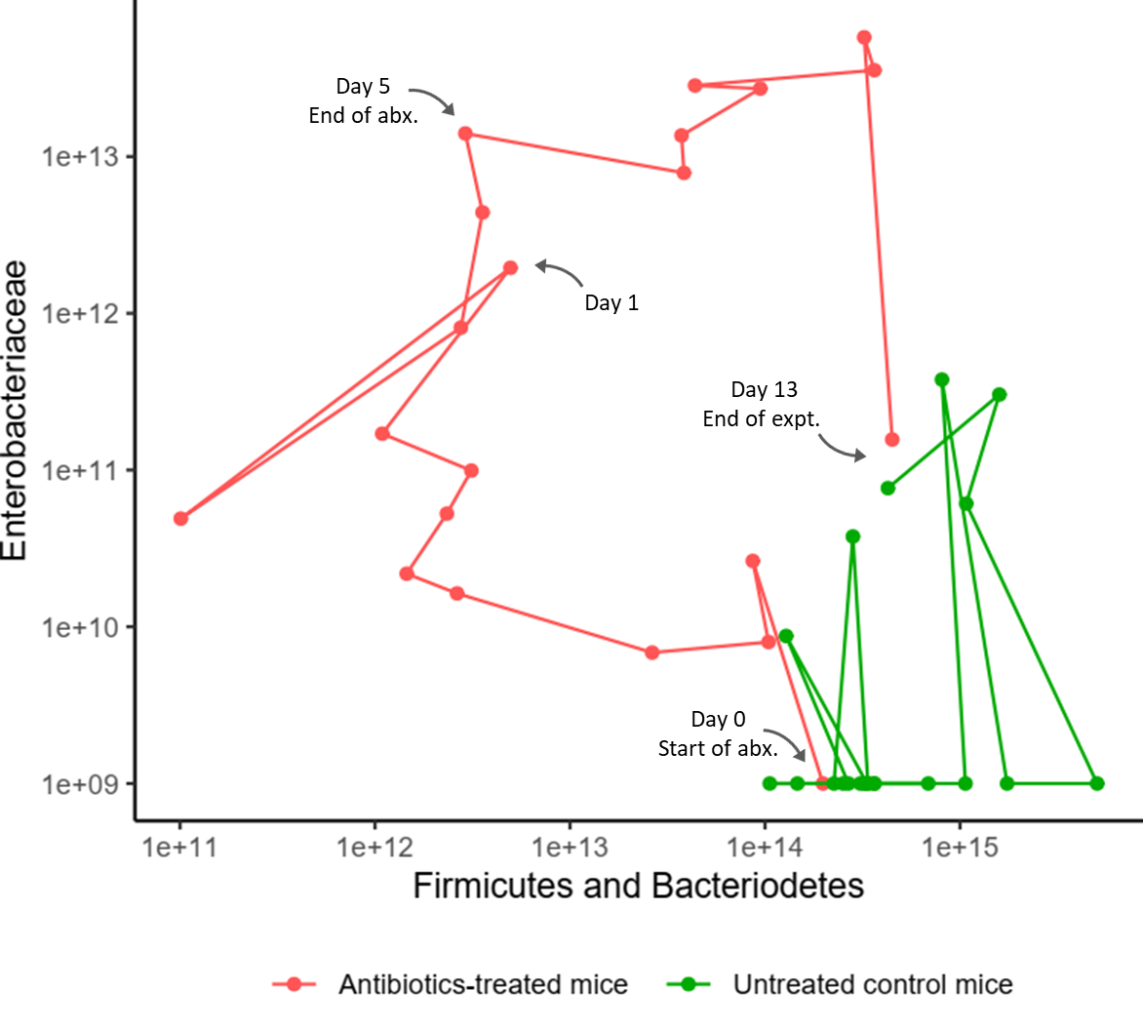

Slide 6
264h
120h
End of abx.
216h
168h
49h
73h
25h
312h
4h
20h
12h
0h
Start of abx.

Slide 7
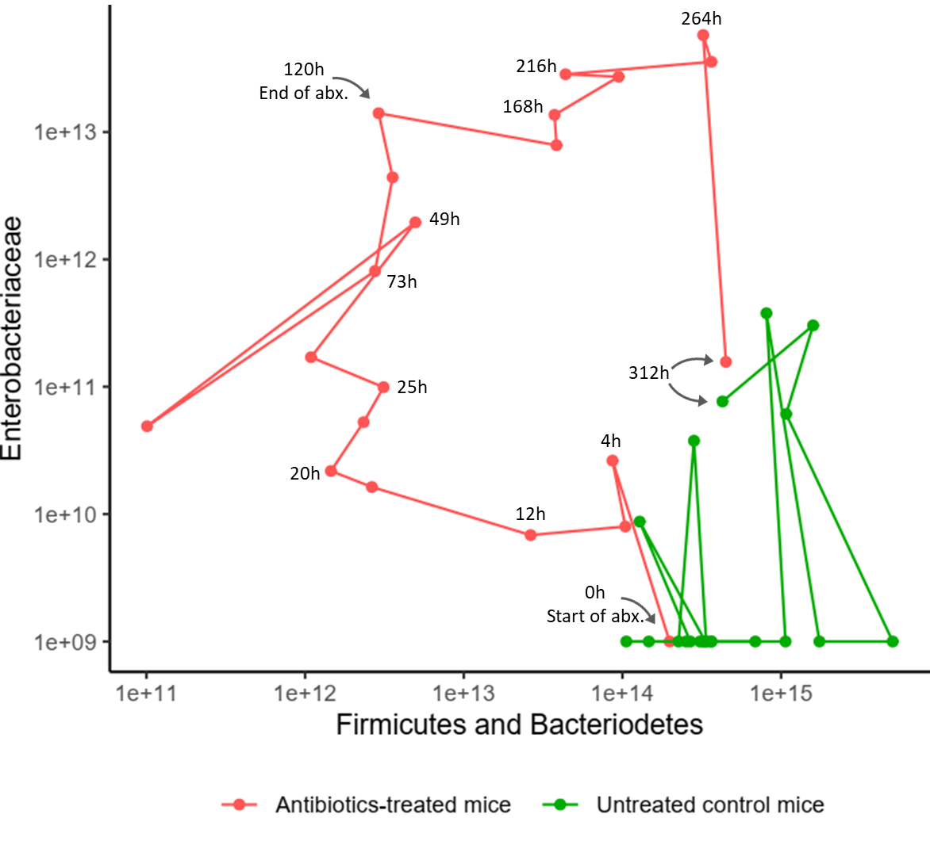

Slide 8
Day 11
Day 9
Day 10
Day 5
End of abx.
Day 8
Day 7
Day 6
Day 4
Day 1
Day 3
Day 13
End of expt.
Day 2
Day 0
Start of abx.

Slide 9
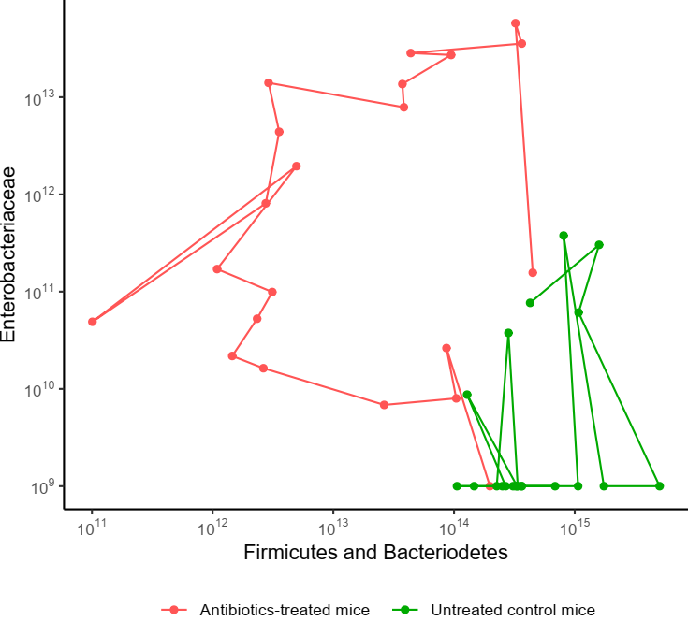
Day 11
Day 9
Day 5
End of abx.
Day 2
Day 13
End of expt.
Day 1
Hour 12
Hour 0
Start of abx.

Slide 10
