Slide 1
When do activation readers reveal more than the prompt?
MATS 12 · NEEL NANDA STREAM · EXPLORATION PHASE · 30 OCTOBER 2026
decodable
a linear probe can read it
causal here
the answer depends on it at this token and layer
Reporting gaps, causal read-site effects, and the limits of natural answer tracking.
Working hypothesis—not an established mechanism: a readout can be text-explainable and activation-sensitive without faithfully stating the subject's own changing state.
Guiv Farmanfarmaian · Suraj Prasad
stated
the reader's text says it
Our 3 main measurements

Slide 2
OUR CLAIMS & CREDENCES
What we believe, and what could change our minds
Two observations are substantially firmer than our proposed explanations.
95%
OBSERVATION
Structural state can survive yet go unreported.
E100/E113; S22/S25 · Challenge: human-validated naming and independent decoding.
90%
OBSERVATION
At the tested read token, causal effects rise late.
E126 and unsteered E137 · Challenge: earlier-site effects on new tasks; registered natural rule failed.
60%
HYPOTHESIS
Many successful readouts are explainable from prompt context.
S06, E140; E107b/E116 pull against · Challenge: verified model-private tracking beyond matched text-only.
55%
HYPOTHESIS
Training and output conventions help explain the silence.
S29/S30; E139 remains mixed · Challenge: reward-only ablation or interface-matched SFT/RL study.
Provisional subjective credences—not statistical confidence intervals. Guiv and Suraj should agree on these numbers before submission.
DECISIVE STANDARD · A reader tracks a causally verified subject-private state better than a matched text-only predictor.
Sources: G-E100/E113/E126/E137/E140/E107b/E116; S-06/S22/S25/S29/S30; see claim ledger and appendix.

Slide 3
BEFORE THE SPRINT
What existed and what we kept
Exploration
Sprint
Readers replicated: NLA FVE 0.761; WorkspaceBench 12 of 12 inside our CIs
The J-space survival test can't separate in-J from non-J features
Only col (characters since newline) is cleanly non-J; no reader reads it
Confirmatory run pre-registered, never run
Kept: the replication, best-of-11-layers, centred pushes, z against random directions
Kept: WorkspaceBench measures re-solving the prompt (next slide)
23 Oct: Neel asked what one method finds that another can't
That question, per concept, became the sprint

Slide 4
An activation reader turns one residual vector into text
THE APPARATUS
decodable
causal here
stated
3 Inject h into a reader that shares Qwen's weights
1 Prompt into Qwen3.6-27B
4 Text
Archived question: The capital
of Peru is
End of archived question.
Current question: The capital
of France is
Oracle Lens · reads block 44
short continuations of a prompt
replaces a marker token's input embedding
e[marker] ← 16000 · h / ‖h‖
2 Residual output of one block, one token
block 40
block 42 NLA reads
NLA · reads block 42
a paragraph explaining the activation
block 44 Oracle reads
adds after its block 1, RL-trained so a critic can rebuild h
block 52
h₁[marker] ← h₁ + ‖h₁‖ · h / ‖h‖
block 60
h
block L output = hidden_states[L+1]
Read site Chat banks read the assistant-onset token, the last prompt token before Qwen would generate. Transfer chains (E133, E137) have no chat template and read the raw final " by". Never the first generated token.
Readers: Oracle Lens and NLA adapters on the same Qwen3.6-27B backbone · core/readers.py and read-site conventions in guivff/activation-readers @ c60fa970 (appendix A3)

Slide 5
Three questions about every state: decodable, causal here, stated
HOW WE GRADE A READER
decodable
causal here
stated
Decodable
Causal here
Stated
Can a linear probe read it from the activation?
Does Qwen's answer depend on it at this token and layer?
Does the reader's text say it?
held-out probe
patch the activation, watch the answer's logit difference
blind judge; a YES must quote the readout
AUROC
R
k / n
0.5 chance · 1.0 perfect
0 no effect · 1 full effect
missing readouts reported
judge-free
judge-free
judged
Rule A state can be decodable without being causal here, and causal without being stated. These are never drawn on a shared axis; each later slide names its unit.
Judge: blind LLM judge, a YES must quote the readout · human audited later

Slide 6
Readouts often look like a prompt of this kind, rebuilt and answered
WHAT THE READERS ACTUALLY WRITE
decodable
causal here
stated
Prompt to Qwen
Oracle Lens readout
NLA readout
What is the opposite of 'hot'? (Answer in Spanish, one word.)
- Frío
- Frío
- Frío (This is the single most common Spanish word for "cold" and the most direct translation)
Q&A format pattern: structured question-and-answer pair in English, now delivering a Spanish-language direct answer. … requiring the single Spanish word (e.g., "Frío") as the completion.
lang-02A
Both state the answer, and the NLA names the answer language.
Eva carries the rope and Jonas carries the lantern. Who carries the lantern? Name only.
- Alice
-
John
*(Note: The answer is strictly the name of the person who sleeps, as requested by …
Q&A format with strict answer-only instruction signals the model must provide just the name "Alex" as the direct answer to "Who sits first." …
own-02A
Neither names Jonas or Eva. Both rebuild a prompt of this kind (a name-only question) and answer that.
Selected examples Two readouts picked to show the two styles, not rates; the rates are on the following slides. Excerpts shortened with …; highlights mark the words a judge would credit.

Slide 7
GATES · CHECKED BEFORE ANY READER RESULT
Check the readers first → they work as published
Reconstruction from text (FVE, 64 activations)
Gate 1 · the NLA works
Reproduces its published reconstruction: 0.761 vs the card's 0.766.
NLA (shipped)
0.76 card 0.766
Text model
0.28
WorkspaceBench, regex pass (400 items, layer 42)
Gate 2 · Oracle Lens's lead
Published score: an item passes if any of 11 layers does. At one matched layer the NLA leads.
NLA, layer 42
0.47 187/400
OL, layer 42
0.40 159/400
OL, best layer
0.50 201/400
OL, any of 11
0.65 258/400
Potential · Method: the readers reproduce, so later gaps are about reading, not broken tools.
Wilson 95%. Any-of-11 adds +0.08 to +0.22 over the best single layer and is partly a best-of-11-samples bonus.
FVE: 95% bootstrap over 64 activations; the critic favours the NLA's own register.
Notes:
Before trusting any reader result we checked the tools. First, does the NLA work as published? Its critic rebuilds the layer-42 activation from the NLA's explanation with reconstruction 0.761, against 0.766 on the model card; the warm start before RL gets 0.46 and a text model writing from the source text 0.28. Second, Oracle Lens's published lead on WorkspaceBench: it counts an item as passed if any of 11 layers passes. At the matched layer 42 the NLA passes 187 of 400 and Oracle Lens 159; Oracle Lens's best single layer reaches 201 and any-of-11 258. Part of that bonus is just eleven samples. So both readers work, and the published ranking reflects layer selection.

Slide 8
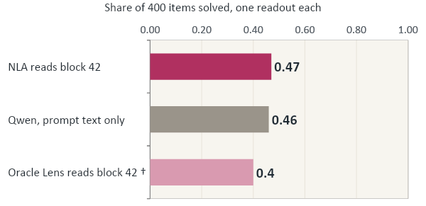
On WorkspaceBench, the NLA scores what a text-only copy of Qwen scores
A STANDARD READER BENCHMARK
decodable
causal here
stated
NOT COMPUTE-MATCHED
Best-of-N scores, for reference
0.65
Oracle, published protocol: any of 11 layers (20–60) passes
0.69
text-only Qwen, best of 3 samples
0.96
any of 8 text-only samples (2 models × 2 templates)
95% CIs NLA 0.42–0.52 · text-only 0.41–0.51 · Oracle 0.35–0.45 † off the Oracle's trained grid (0.37 / 0.39 at 40 / 44)
0 of 187 NLA hits that every text-only sample missed
NLA vs text-only: McNemar p = 0.75 (80 vs 75 discordant items)
Does not show That the reader ignores the activation (at this layer the activation encodes the prompt), or equivalence: p = 0.75 is a failure to find a difference.
Suraj exp 06, 400 items, four multi-token families, item-bootstrap 95% CIs, McNemar on 80 vs 75 discordant items
7

Slide 9
When Qwen's own answer changes with the wording, the reader rarely follows it
A NATURAL TEST · SAME FACT, BUT CHANGE THE WORDINGS
decodable
causal here
stated
The test · template shown, realised pairs are private
Eligibility funnel · reader at block 60
What is the capital city of {entity}?
300
pairs screened (first 300 of 600; time cap)
→ Qwen answers X
58
Qwen's two answers differ (X ≠ Y)
Which city is {entity}'s capital?
12
evaluable at block 60: each readout states exactly one value
→ Qwen answers Y (≠ X, by selection)
Of 12 questions: 1 follows Qwen, 0.08 · 11 give one answer for both, 0.92
Read both at block 60. Tracking: reader says X on wording A and Y on wording B. Same answer: one value for both.
Does not show That the reader re-solves in general: rates are conditional on 12 of 58 pairs (7/116 readouts missing, 15 state several values). Paraphrases also move text-only models; a small natural difference may be below what the reader registers.
8

Slide 10
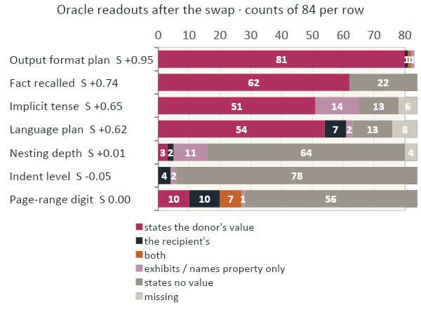
After a whole-activation swap, content transfers readily; structural reporting is sparse
SWAP IN ANOTHER ITEM'S WHOLE ACTIVATION
decodable
causal here
stated
The intervention · Oracle Lens, block 44
recipient prompt
h₄₄(recipient) ← h₄₄(donor)
→ reader writes text → judge: whose value does it state?
donor prompt
S = (#donor-only − #recipient-only) / #kept
Content rows follow the donor. On nesting and indent, S ≈ 0 because the readout states no value at all (64 and 78 of 84). On the page digit it is partly cancellation: 10 donor, 10 recipient, 7 both.
Does not show That the reader cannot see structure: probes read these rows at AUROC 1.00 (next slide). A transplant moves everything at once; the category census is post hoc.
Experiment E100
9

Slide 11
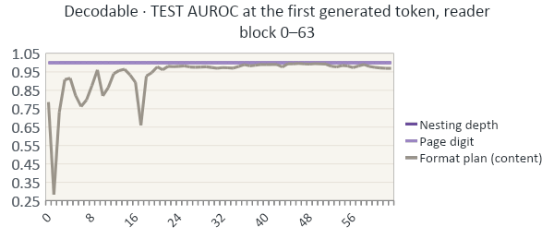
Inside the reader the structural state is perfectly decodable, but seldom stated
A PROBE INSIDE THE READER
decodable
causal here
stated
Where the probe reads
reader layers ↓
… reader prompt
marker = h
first generated
Stated · in E100's readouts, the Oracle states any value of
nesting depth
5 / 84
Probe every reader block (0–63) at two positions: the injected marker and the first generated token. 84 dev / 84 test items per row; dev-only model selection. The first generated token is always the same token (ID 12), so token identity cannot explain it.
indent level
4 / 84
page-range digit
27 / 84
Does not show That the reader uses the state: at the injected marker the vector is its own input, so 1.00 there is trivial; the first-token probe shows the state reaches generation positions, not that it drives words.
Experiment: E113

Slide 12
WORKSPACEBENCH · 400 ITEMS · ONE JUDGE ANSWERS FROM DIFFERENT INPUTS
Readout added to the prompt → no gain
Judge answers correctly (share of 400 items)
Prompt (typo item)
…as in Cage's Music of Changes, is called aleotoric▌
Prompt only
0.89 357/400
NLA readout only
0.60 240/400
Oracle Lens readout only
0.56 224/400
NLA, from the activation
… is building toward naming the concept/term …
Prompt + NLA
0.88 351/400
Prompt + Oracle Lens
0.88 352/400
Same model, prompt only
… demands the standard term "aleatoric music" …
Potential · Method: 0/187 NLA passes are out of reach of prompt-only text → hold text fixed.
≈11% of items are left where reading could show. Prompt + readout − prompt: NLA −0.015 [−0.043, +0.013].
Wilson 95%. 0/187 is vs best-of-8 prompt-only texts. Card: first item passed by both. Exps 01, 06.
Notes:
Our first result was about the benchmark the readers were built against. One judge answers WorkspaceBench from different inputs. The prompt alone gets 0.89. The NLA's readout alone gets 0.60 and Oracle Lens's 0.56. Prompt plus readout gets 0.88, so the readout adds nothing the prompt lacks. None of the NLA's 187 passes is out of reach of prompt-only text: each one is matched by at least one of eight prompt-only texts. And with the prompt at 0.89, only about 11 percent of items are left where reading could show at all. The card shows why: on this typo item the NLA gets 'aleatoric', and so does the same model reading only the prompt. So to ask what a reader captures, we held the text fixed and moved only the activation.

Slide 13
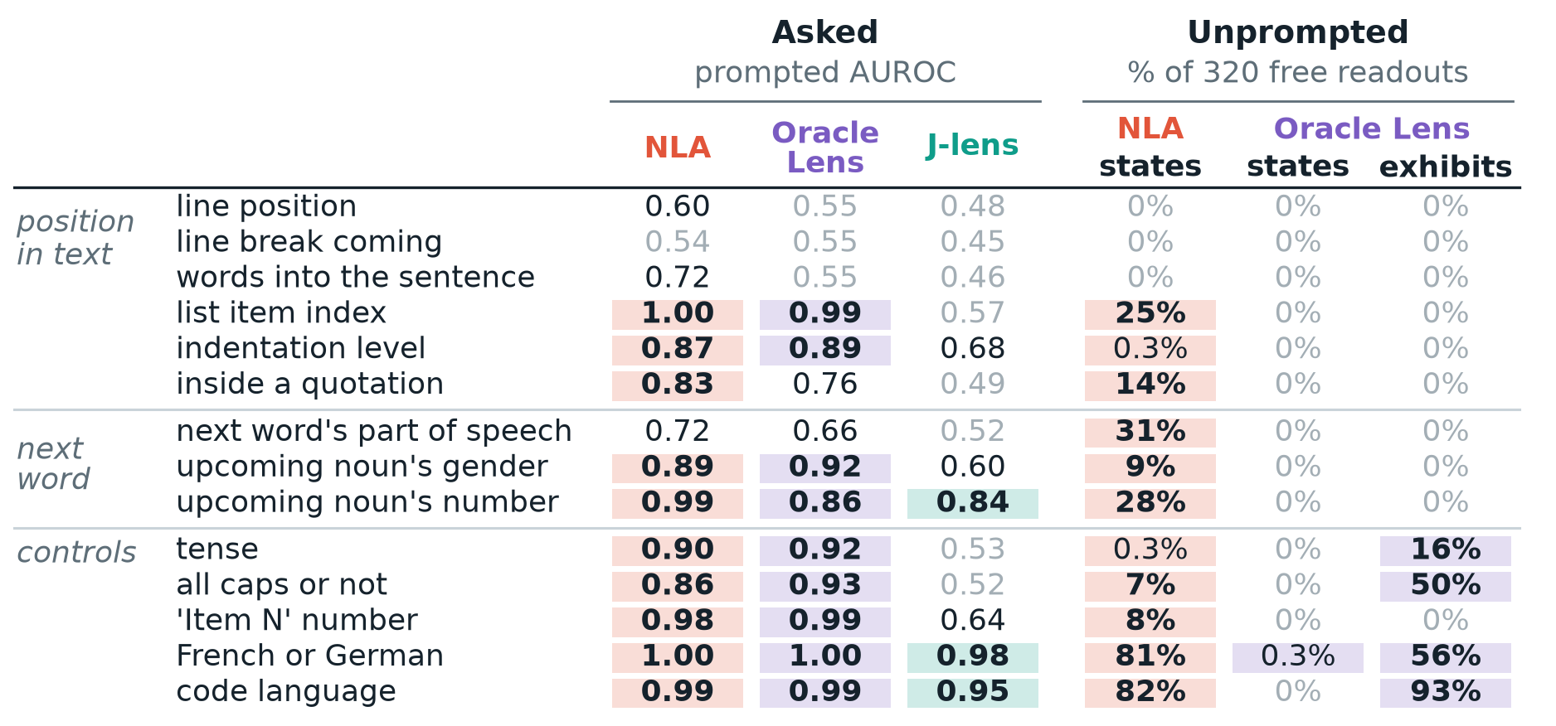
14 CONCEPTS · 160 ITEMS PER CELL
Asked vs unprompted → Oracle Lens is silent
Asked (prompted AUROC ≥ 0.80)
NLA on 10 of 14 concepts, Oracle Lens 9, J-lens 3.
Unprompted (judge)
Oracle Lens states a concept in 1 of 4,480 readouts; it writes in language, code, caps and tense instead.
Potential · Method: position in text is readable, detected, rarely stated: the test family.
Unprompted: judge on 320 free readouts per concept. One judge (Gemini 3.8 Flash); intervals in backup.

Slide 14
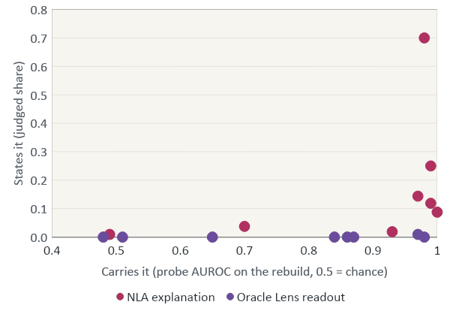
Readers' text often carries structural state that is rarely stated
decodable
causal here
stated
TestCase | Carries · Oracle / NLA | States · Oracle / NLA
Python string | 0.86 / 0.99 | 0.00 / 0.12
JS string | 0.84 / 0.97 | 0.00 / 0.14
LaTeX math | 0.87 / 1.00 | 0.00 / 0.09
Call argument | 0.51 / 0.93 | 0.00 / 0.02
JSON depth | 0.97 / 0.99 | 0.01 / 0.25
MD heading | 0.65 / 0.70 | 0.00 / 0.04
MD list | 0.48 / 0.49 | 0.00 / 0.01
Code language (control) | 0.98 / 0.98 | 0.00 / 0.70
Carried, not stated: the readout reproduces the text that holds the state, and does not name it.
Does not show That the readers use the state, or that the Oracle carries less: its readouts are rebuilt by the NLA's critic, which is out of distribution for them. Carry and stated rates come from different splits of the same bank.
12

Slide 15
MECHANISM · EXP 14 · ORACLE LENS'S RECONSTRUCTOR · 200 ITEMS PER ROW
A statement vs real text → only text rebuilds
Rebuilt from the true 32 tokens (probe AUROC)
The statement pair
"- column one" vs "- column five"
Table column
1.00
Inside parentheses
0.93
A true span (end)
| Iris | Italian | principal |…
| Farid▌
Moved by a one-line statement (share of class gap)
Table column
0.03
Inside parentheses
0.10
'French language'
0.10
Potential · 1-(b), 2-(a): statements barely move a reconstructor; no reward for stating.
Oracle Lens's reconstructor (layer 44). Aggregates, no intervals. NLA critic, same statements: 0.07, −0.05, language 0.72.
A bullet written in French moves the rebuild 1.39. Exp 14.
Notes:
Mechanism, part one. Oracle Lens's own reconstructor rebuilds the activation from text. Given the true last 32 tokens, a probe on the rebuild separates table column at 1.00 and parenthesis at 0.93. Given a one-line statement of the property, like 'column one' against 'column five', the rebuild moves 0.03 of the class gap for table column and 0.10 for parenthesis. Even '- French language' moves it only 0.10, while a bullet written in French moves it 1.39. Through the NLA's critic the statements give 0.07 and minus 0.05, and 0.72 for language. So a reconstructor sees position in real text and nearly ignores a sentence that states it, which means a reconstruction reward has little reason to pay for statements. These are aggregates without intervals.

Slide 16
MECHANISM · EXP 15 · TABLE COLUMN · 200 ITEMS · PUSH 11% OF THE NORM
Readers respond to a direction that barely affects Qwen’s next-token behavior
Response to the push (z against 20 random directions)
Statement pair the direction is built from
"The current cell is in the first column of the table" vs "… fifth column …"
Model · class mean
+7.1
Model · statement
+0.7
Oracle Lens · statement
+12.3
J-lens · statement
+10.1
What 'model' means
The shift in the model's own next-token log-odds for a newline.
|z| = 2
Potential · Why it matters: a reader can follow a direction the model ignores.
Directions built with the NLA's reconstructor, so the NLA's response is partly circular (not shown). Parenthesis:
model −3.6, Oracle Lens +3.6. Model statement z CI [0.4, 1.1], cluster bootstrap by passage. Exps 15, 17.
Notes:
Part two, and the part I think matters most for monitoring. We push the activation along a direction and measure the shift, as a z against 20 random directions of the same size. Along the class-mean direction for table column, the model's own newline odds move at z plus 7.1. Along the direction rebuilt from a statement, 'the current cell is in the first column', the model barely moves, plus 0.7, yet Oracle Lens follows it at plus 12.3 and the J-lens at plus 10.1. For parenthesis the statement direction moves the model the wrong way, minus 3.6. If you use a reader as a monitor, this is the caveat: a reader can follow a direction the model ignores, and a silent reader is not evidence that the model lacks the state.

Slide 17
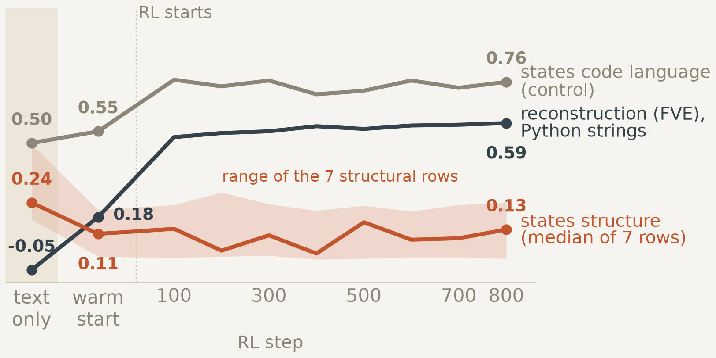
WHY · THE NLA AT TEN POINTS OF ITS TRAINING · PUBLIC BANK
More RL → better reconstruction, not stating
Input (inside a Python string)
raise DMBadInputError("Shape of rep does not▌
Text-only warm start (states it)
… requires specific error message text …
After 800 RL steps (doesn't)
… ends "does not" mid-error-message …
Potential · 2-(a), 2-(c): RL raised reconstruction; stating stayed at the warm start's level.
Structural rows 0.00–0.29 over RL, no trend (slope −0.001 per 100 steps). One final critic scores every checkpoint.
In-string readouts: text-only states it 142/160, step 800 59/160 (less often, not rarely). Card: first of 12 such. Exp 29.
Notes:
Now H2: why does the NLA state structure less than it could? Exp 29 scores ten points along its own training history on the public bank. The text-only warm start, the base model given the text, states structure most. The activation warm start drops that, and 800 RL steps leave it flat, between 0 and 0.29 per row with no trend. Over the same steps, reconstruction on Python strings rises from 0.18 to 0.59 FVE, and stating the code language, the control, from 0.55 to 0.76. The card shows one item: the text-only register writes 'error message text'; after RL the NLA describes the continuation. On all in-string readouts that's 142 against 59 of 160: less often, not rarely. One final critic scores all checkpoints.

Slide 18
WHY · 400-STEP SUPERVISED ADAPTER · 32 HELD-OUT ITEMS PER ROW
Targeted supervision improves naming on trained properties, but generalization remains weak.
Trained rows: correct when it names
Adapter NLA, its last line
The current position is inside a string literal
Python string
0.79 15/19
Call argument
0.81 13/16
JSON depth
0.96 22/23
Base NLA, same item
… is mid-sentence inside a quoted error string …
Code language
1.00 9/9
Markdown heading
0.58 15/26
Untrained rows: names the state at all
Reconstruction (FVE)
Adapter 0.507 vs control 0.512.
JS string
0.53 17/32
LaTeX math
0.03 1/32
Potential · 2-(b): naming isn't blocked by capacity, on rows it was trained on.
Base NLA's 0/512 is a substring test for the trained sentence; it already says 'inside a quoted error string'. Wilson 95%.
Markdown is barely readable; list depth 11/24. 3 of 5 predictions failed. Card: first correct item. Exp 30.
Notes:
If the reward neither pays nor charges for statements, teaching the NLA to name should cost nothing. Exp 30 trains a 400-step supervised adapter to append one true statement. Reconstruction is unchanged: 0.507 against 0.512 for the control. On held-out files of rows the probe reads, the statement is right 0.79 to 1.00 of the time when it's made; on Markdown rows, which the probe barely reads, it's near chance. It doesn't generalise: on JavaScript strings it names half the time, on LaTeX math almost never. One thing to flag: the base NLA's zero is a substring test for the trained sentence. On the card's item the base NLA already says 'inside a quoted error string' in its own words. Three of five predictions failed, all on generalisation.

Slide 19
Push the answer upstream at block 40, then put one clean token back at a later block
THE CENTRAL CAUSAL EXPERIMENT · METHOD
decodable
causal here
stated
tokens of the prompt →
read token t
1 Steer
block 36
h̃₄₀,ᵢ = h₄₀,ᵢ + α · ‖d‖ · d̂ i = t−8 … t−1
block 40
d: class-mean difference of block-40 activations on 84 dev items · at α = 8 the push is 2.23× the median block-40 norm
block 44
block 48
2 Score Qwen's answer
block 52
Δ = log p(target continuation) − log p(original)
block 56
fixed continuations: the steering target vs Qwen's original answer
block 60
3 Restore one cell, measure what is undone
8 steered positions, t−8 … t−1
R_ℓ = (Δ_steered − Δ_restored,ℓ) / (Δ_steered − Δ_clean)
steer: block 40, the 8 positions before t; t itself untouched
restore: clean activation into t at one block ℓ, one run per ℓ
0: nothing undone · 1: the whole push undone · median over 84 items
Does not show A natural perturbation: the push is 2.23× the median activation norm, and a random direction of that size flips 42 of 84 pair preferences (the real one 84 of 84). Restoration measures sensitivity at one token, not when the model first "knows".

Slide 20
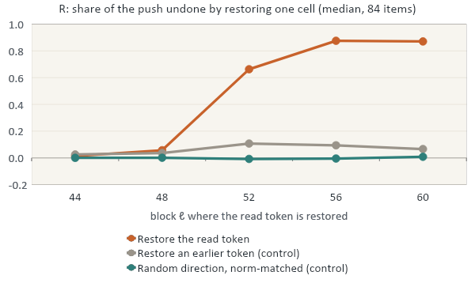
Restoring the read token becomes strongly effective between blocks 48 and 52
THE CENTRAL CAUSAL EXPERIMENT · RESULT
decodable
causal here
stated
Two different outcome measures
84 / 84
Qwen's pair logit prefers the new answer under the push (E104)
43 / 84
Qwen's own free text states the new answer; 41 state neither (E131, NOT MET)
S −0.52 at 44, +1.00 at 52
Oracle reader: still the old answer at block 44; the new one on 84/84 at 52 and 60 (E109)
Does not show Generality: one bank under a 2.2× push. The bank's language row is non-monotone (R 0.29 already at block 44). R is a median over 84 items (52: 0.66 [0.51, 0.80]), not when the model first computes the answer.

Slide 21
Unsteered transfer chains: swap only the final " by" token with its opposite twin
NO STEERING AT ALL · DESIGN
decodable
causal here
stated
Twin A
Swap at the raw final token " by"
The brass key starts with Alice. Alice hands the brass key to Bob. Bob hands the brass key to Dana. Dana hands the brass key to Erin. Later, Carl asks Dana about the brass key. Bob waves to Carl. The brass key is now held by
replace
Twin B · differs only in the last recipient
… Bob hands the brass key to Dana. Dana hands the brass key to Frank. Later, Carl asks Dana about the brass key. Bob waves to Carl. The brass key is now held by
A at block ℓ
B at block ℓ
R_ℓ = (Δ_swap − Δ_own) / (Δ_twin − Δ_own)
Anti-recency: one or two sentences after the last hand-over mention other names, so the most recent name is never the holder. Text assembled from the bank's templates for illustration; sealed items are not in the repo.
Δ: Qwen's logit difference between the two recipients. 0 = no effect · 1 = behaves like the twin.
Here nothing is steered: the read token's activation is replaced by the twin's, whose answer differs.
19
Notes:
[Slide 19 · 29:20–30:50 · Guiv · 90 seconds]
E133 and E137 remove artificial steering entirely. Build matched raw transfer chains with different final holders and compare answer-pair logits. Swap exactly one final raw token decoded as ' by' between natural twins at each selected layer. Unlike E126 this is a donor twin swap, not clean restoration. E137 inserts later unrelated names, so the last-mentioned-name shortcut fails; the last successful handover remains a plausible shortcut. The metric is normalized toward the twin answer; report its distinct normalization, not the E126 R definition. Note paired items 42 in E137, with sampling/missingness separately for readouts.

Slide 22
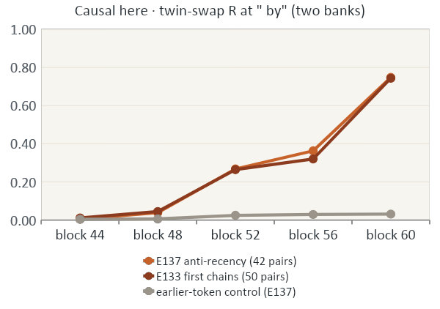
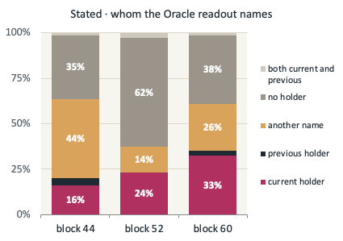
Unsteered chains: the final token matters mostly at block 60, and the previous holder is rarely named
NO STEERING AT ALL · RESULT
decodable
causal here
stated
Decodable? Mixed: macro AUROC 0.978 at 44 over 8 of 10 holder classes; the registered twin probe is at chance (≈ 0.43)
Does not show Timing: the registered later-site rule (R ≥ 0.50 at 52 or 56) was NOT MET, and staleness (previous holder ≥ 0.30 at 44) was 3 of 79. Synthetic chains; 5–8 of 84 readouts missing per block.
E137 (confirmatory, natural-staleness criterion R-NL2 NOT MET) · guivff/activation-readers @ c60fa970 · e137/analysis/sealed_main/RESULTS.json (design D1, 42 pairs) · bank README_BANK.md · reviewed R-4
20

Slide 23
A NECESSARY COUNTERWEIGHT
decodable
causal here
stated
Some readouts align with subject-specific mistakes better than outside forecasters
E107b · NATURALLY WRONG ANSWERS
E116 · NON-MODAL ANSWERS (POST HOC)
Conditional on a value stated:
Matched 110-item subset:
Oracle@44
60/92
Oracle@60
59/110
Outside forecaster
47/167
Outside forecaster
31/110
All-item rates: 60/187 vs 47/196.
Coverage / model-family mismatch matters.
Paired advantage +25.5 pp
95% CI [+11.8, +38.2] pp
E131 §246 (post hoc): Qwen generated the new answer in 43 cases; early Oracle@44 still said old in 26/43, while @52 said new in 43/43.
Does not show Matched model-private access: E107b has unmatched denominators and E116 is post hoc on a selected cohort.
22

Slide 24
WHAT THE SPRINT TAUGHT US · NEEL’S CHALLENGE
What we got wrong—and why the remaining results might be boring
FAILURES THAT CHANGED OUR PRACTICE
REASONS THE STORY COULD BE BORING
1. Judging inputs, not just outputs
E138 recipient answer split into characters.
2. Trivial baselines before intricate rules
S19: always-low 33/38 vs our 31/38.
3. Generated behavior instead of logits
E131: 84/84 pair preferences, only 43/84 generated target.
1. One shared backbone and text-explainable tasks
Benchmark successes may not use private state.
2. Many contexts, but few unique facts
The strongest steered fact result used one fact pair.
3. Natural chains retain a shortcut
The last successful transfer still identifies the holder.
DO DIFFERENTLY: pre-register the trivial baseline; human-code a blind sample; test several fact pairs and negated transfers.
24

Slide 25
MECHANISTIC CLOSURE IS THE NEXT PROJECT
decodable
causal here
stated
Three explanations survive: the decisive test must separate them
1 · PROMPT RECONSTRUCTION
2 · OUTPUT REGISTER
3 · TRAINING OBJECTIVE
Hypothesis: the reader infers the question and uses its own prior.
Test: fixed text, verified different subject states, matched text-only predictor.
Hypothesis: state is accessible but normal generation rarely expresses it.
Test: fixed activation, controlled output elicitation; human-validated naming.
Hypothesis: reconstruction optimization fails to reward truthful statements.
Test: matched warm start, reward-only ablation and held-out generalization.
Does not show That one positive probe, donor swap, reconstruction score, or readout is sufficient to identify a mechanism.

Slide 26
A benchmark of model-private state, verified causally, against strong text-only baselines
RESEARCH PHASE · FIRST PRIORITY
Manipulation
Arms and matched baselines
Endpoint
Items where Qwen's answer is not recoverable from the text alone: wording-dependent answers (58 of 300 screened in E140), facts Qwen gets consistently wrong, two-step questions through a wrong intermediate.
Verify each item's state twice: repeated sampling of Qwen, and a read-token patch that moves the answer.
Reader on the activation (Oracle, NLA; several blocks)
Tracking rate: the readout states Qwen's own per-item answer, crossed with question identity (same / different) × verified state (same / different).
Powered for a 0.15 difference over the best baseline at matched coverage; missing readouts counted as failures.
Same backbone given only the text the reader decodes
Same backbone given the prompt, k-matched samples
Linear probe on the answer logit
Falsifier The readout follows question identity rather than verified state, or a powered interval excludes a useful edge over the best text-only baseline. Mining is the cost: the 58 discordant pairs came from 300 screened.
26
Notes:
[Slide 26 · 40:55–42:40 · Guiv · 105 seconds]
First research-phase priority: a powered benchmark of model-private states, not merely answer-discordant paraphrases. Mine reproducible cases where the subject has a state differing from a matched text-only predictor, and check it via actual generated behavior plus preregistered local causal patches. Cross question identity same/different with subject answer state same/different. Score explicit correct reporting at matched coverage, count missing as failures, quantify false statement costs, and use human-validated labels. The primary effect of interest is at least a 15-point advantage over best text-only baseline with enough power for meaningful confidence intervals.

Slide 27
Pay the reader for true statements the prompt text cannot predict, and measure false claims
RESEARCH PHASE · SECOND, ONCE THE BENCHMARK EXISTS
Manipulation
Arms and matched baselines
Endpoint
Step 0, no training: score true, false, neutral and exhibiting statements under the exact NLA training reward (E139 only had a proxy).
Then train from one warm start, ≥ 3 seeds per arm, with the reward as the only difference between arms.
Reconstruction only (current objective)
On held-out properties and read positions: correct statements, false statements and FVE, reported together.
Success: naming rises ≥ 0.10 with learning confirmed, false claims rise less than correct ones, FVE within 0.02 of control.
+ reward for statements a held-out probe or patch confirms
Reconstruction scored only on what a text-only model misses
Supervised statements as a reference
Falsifier Naming does not rise with learning confirmed, or false claims rise as fast as correct ones (the exp 30 random-position pattern), or FVE drops.
27
Notes:
[Slide 27 · 42:40–44:10 · Suraj · 90 seconds]
Only after determining what private information is accessible should we optimize the reader. First evaluate the exact NLA training reward on matched true, false, neutral and exhibiting statements: E139 used only a proxy. Then train from one warm start in reconstruction-only versus a matched verified statement-reward arm with at least three seeds each. Keep model interface, data, compute, and evaluation constant. Report correct assertions, false assertions, per-item and held-out property rates, and FVE together. A naming increase without truthful generalization would not be success. This cleanly separates a reward mechanism from format-prior and supervision explanations.

Slide 28
Decodable, causal here, and stated are different. A reader faithful to the text is not yet faithful to the model.
CLOSING
decodable
causal here
What would convince us a reader reports model-private state: a powered benchmark of verified private state, read causally, where the reader beats a same-backbone model given only the text.
We have built the parts of that test that failed for us. The next two experiments are designed to fail too, if we are wrong.
stated
28
Notes:
[Slide 28 · 44:10–45:00 · Joint · 50 seconds]
Our takeaway: what is linearly decodable, what is locally causal at a sampled token and what is explicitly stated by a reader are different quantities. We found structured omissions, strong depth-dependent read-token interventions, limited evidence for natural answer tracking, and possible counterexamples requiring matched baselines. The complete mechanism remains unresolved. We propose one falsifiable benchmark for genuinely model-private information, then a matched training intervention if that information is present. Invite Neel to challenge the benchmark design and the most informative next experiment.

Slide 29
Appendix map, frozen sources and who checked what
APPENDIX A1 · MAP AND PROVENANCE
decodable
causal here
stated
Slide | Contents | Slide | Contents
A2 | Registered rules that failed, and what we now say | A9 | Exp 29: every row, every checkpoint
A3 | Read sites and injection, per experiment | A10 | Exp 30: registered P1–P5
A4 | Three interventions, three questions (E138R, E109, E140) | A11 | E139: the proxy reward for true vs false
A5 | E100 and E113 in detail | A12 | Steering bank: dose, controls, free text (E104–E135)
A6 | The cue experiments (E85, E120, E136) | A13 | Transfer chains and cross-depth table (E133, E137, E95)
A7 | Suraj exp 06 in detail | A14 | The human audit (E71) and the E138 timeline
A8 | S16 vs E7, and exp 28's withdrawn rule | A15 | Cheap monitoring checks (E121, E118, E123, E134)
Note No file in the repository tallies registrations by verdict, so we do not quote one. "139" counts distinct experiment numbers in the brief (E1–E140 without E55), not registrations.
Notes:
Appendix A1. Use as the jump table. Frozen commits: Guiv c60fa9703f6dadc8150e11b0c2d5bbe899db02bc (r/blindspot), Suraj 4d43ecb2ef8f2cfab9d8ef673a1c7f56380460fd. An earlier pin 7867049ff was an ancestor; the 8 commits since add E95 certification and reviewer logs, no result used in this deck changed. REGISTRATION.json labels the programme 'EXPLORATORY; every result reported'; later sections register explicit pass/fail rules, which is what MET / NOT MET refer to.

Slide 30
Hypotheses
Both readers carry structural state in what they write. Oracle Lens never states it; the NLA states it in about one readout in four, often loosely, and that rate looks set by its warm start.
H1 · 85%
Readers carry structural state but don't state it.
1-(a).
The state is recoverable from what they write.
1-(b).
Oracle Lens never states it.
1-(c).
The NLA states it in a minority of readouts (about 1 in 4), often loosely.
H2 · 55%
The NLA's silence is a warm-start habit.
2-(a).
RL's reward doesn't pay for structural statements.
2-(b).
Naming isn't blocked by capacity.
2-(c).
The habit is set before RL.
Notes:
Two hypotheses. H1, which I hold at about 85 percent: both readers carry position-in-text state, like being inside a string or which table column, in what they write, and mostly don't say it. Oracle Lens never states it. The NLA does state it in a minority of readouts, about one in four on the public bank, often loosely, for example 'a new row is starting' rather than 'first column'. H2, about 55 percent: the NLA's low rate is a habit from its warm start; the reconstruction reward neither pays for statements nor removes them. H2 rests on replaying one training run, so it is close to a coin flip. Every result slide ends with the sub-claim it bears on, and slide 20 scores them.

Slide 31
SETUP · THREE READERS
One activation, three readers, no prompt
NLA
Activation added to its prompt; writes an explanation.
Oracle Lens
Activation as one character's embedding; writes bullets.
J-lens
Projects onto the J-space; lists top tokens.
Same activation, Python source, read at ▌: "is not supported. Support for▌
NLA
… is mid-sentence, requiring completion of this standard ONNX export error pattern …
Oracle Lens
某些 operators is in progress. Please open an issue on GitHub to request support
J-lens, top tokens
この · implementation · этого · implementations · Generic …
NLA: ceselder iter_000400. Oracle Lens: agu18dec rl600 (trained at layers 20–60, step 4). J-lens: n1000. Layer 42.
Item: first in exp 22 where neither reader's first readout uses a string word (5 of 20; the NLA usually does).
Notes:
Every number uses this setup. Each reader gets only the layer-42 activation at the read token, never the text. The NLA has it added at a marker inside its own prompt and writes an explanation; its critic rebuilds the vector from those words. Oracle Lens has it written into one slot character's embedding and writes bullets that read like continuations. The J-lens lists the top tokens of the activation's J-space projection. Below is one real item from the public bank, inside a Python error string. The NLA describes a truncated error message; Oracle Lens writes the message's continuation; the J-lens lists loosely related tokens. I picked this item by a declared rule, and it is atypical in one way: the NLA usually does use a word like 'string'.

Slide 32
SETUP · FOUR MEASURES
Four measures per state, fixed in advance
Readable
A probe on the activation separates the two values: AUROC ≥ 0.80, folds grouped by source file.
Carries
The reader's text brings the state back: the critic rebuilds the activation from it and a frozen probe scores it, or a word-count classifier reads it.
States
A blind judge (Gemini 3.8 Flash) reads only the readout and says whether it names the value. 'Names' means a strict regex.
Used
Push the activation 11% of its norm along the state's direction; the model's next-token shift is a z against 20 random directions.
Banks: synthetic (exps 12–18), natural (exp 19, withheld, hashed), public (exp 22), random points (exps 23, 27). Predictions written first; hashed for exps 18, 19, 22.
New relative to the papers: they score what readers say; we ask what their words carry unsaid.
Notes:
Four measures, kept apart on purpose. Readable: can a linear probe on the activation tell the two values apart, with folds grouped by source file, line 0.80. Carries: does the reader's own text bring the state back. We feed the readout to the NLA's critic, rebuild the activation and score it with a probe trained on true activations, and we check with a plain word-count classifier that has no critic. States: does a blind judge, reading only the readout, say the text names the value. 'Names' is a strict regex. Used: does pushing the activation along the state's direction move the model's next token, as a z against 20 random directions of the same size. What is new relative to the two reader papers: they score what a reader says; we ask what its words carry without saying it, and whether the model uses it.

Slide 33
The objects and instruments behind every number
Qwen3.6-27B, layer 42 | Subject model. Every read is the residual activation at one token, layer 42; the NLA is hard-wired to it.
NLA, ceselder iter_000400 | Actor writes an explanation of the injected vector; its critic rebuilds the vector from the words; RL pays for the rebuild.
Oracle Lens, agu18dec rl600 | LoRA on the same model, trained at layers 20–60 in steps of 4, so 42 is off its grid. Vector goes in one slot character; writes bullets.
J-lens, n1000 | Projects the vector onto the rank-1,536 J-space at layer 42 and lists the top tokens. Generates no text.
WorkspaceBench | The benchmark these readers were built against. Regex-scored; four families, 400 items in our runs.
Our instruments | Readable: probe AUROC ≥ 0.80. Sayable: critic rebuild from 32 real tokens ≥ 0.80. Used: 11% push, |z| ≥ 3.

Slide 34
POSITION IN TEXT · FREE READOUTS, 40 ITEMS × 8 PER ROW
Unprompted → only the NLA states position
States the value (judge, share of 320 readouts)
Input (first cell of a row)
| Iris | Italian |…
| Farid▌
NLA · table column
41% 130/320
NLA · inside parentheses
30% 97/320
NLA · list nesting depth
4% 14/320
NLA (judge: states it)
… "Farid" is the start of a new name entry …
Oracle Lens · all three
0% 0/960
NLA · language (control)
81% 258/320
NLA, rare literal case
… it is the first column of the next row …
Oracle Lens, first item (writes cells)
/Farid | France | Asie | 32 | 10 | Informatique |
Potential · 1-(b), 1-(c): Oracle Lens states none; the NLA states two of three, loosely.
Judge counts 'a new row is starting' as stating; 7 of 118 judged statements say 'first column'. Item-clustered 95%.
Line position on fresh items: chance for every reader (0.51, 0.49, 0.53). One judge.

Slide 35
MECHANISM · 200 ITEMS PER ROW
Swap Oracle Lens's part → the NLA ignores it
NLA follows the donor (AUROC against the donor's label)
OL part
What the NLA's reconstructor rebuilds from Oracle Lens's bullets.
Table column · remainder
0.98
Table column · OL part
0.01
Parentheses · remainder
0.87
Remainder
The activation minus that part. Swap one part in from a donor of the other class.
Parentheses · OL part
0.12
List index · remainder
0.98
List index · OL part
0.03
Language · remainder
0.10
Language · OL part
0.92
chance
Potential · 1-(b): position sits in the part Oracle Lens's words don't rebuild.
The NLA's prompted log-odds, mean of 4 phrasings; 95% bootstrap CI by passage. Both parts built with the
NLA's reconstructor; one seeded donor pairing.

Slide 36
NEGATIVE RESULT 1 · 10 SYNTHETIC ROWS · RULE HASHED BEFORE READERS RAN
Used by the model → not more often stated
NLA states it (judge, share of 320 readouts)
Pre-registered rule
"The NLA states a property exactly when the model uses it."
LaTeX math (used, z +22)
0% 0/320
Inside a Python string
3% 9/320
JSON nesting depth
25% 79/320
Scored
5 of 10 rows. Whole scorecard 44 of 70 cells against a declared 0.80; always predicting 'low' gets 40 of 70.
Call argument
33% 104/320
Language (no next token)
95% 304/320
Potential · Lesson: the NLA states what text can say, not what the model uses.
Used = |z| of the push on the model's next token vs 20 random directions. Item-clustered bootstrap 95%.
Flaw: the synthetic banks carried vocabulary cues the J-lens read. Hashed before readers ran.

Slide 37
NEGATIVE RESULT 2 · PRIMARY SCORECARD (FREE READOUTS)
Always predicting 'low' → ties our rules
Primary scorecard, cells correct
When we found it
30 Oct, recomputing every figure from raw files, after we had quoted these scorecards as passing.
Exp 19 · our rules
0.82 31/38
Exp 19 · always 'low'
0.87 33/38
Exp 22 · our rules
0.79 30/38
Exp 22 · always 'low'
0.79 30/38
declared bar 0.80
Revised NLA rules only (16 cells)
Exp 19 · rules vs 'low'
0.88 14/16 vs 11/16
Exp 22 · rules vs 'low'
0.75 12/16 vs 9/16
Potential · Lesson: pre-register the baseline too; only complement naming beats 'low'.
Grey tick = always 'low' on the same cells. Wilson 95% over cells. All cells: 44/56 vs 45/56 (exp 19), 44/56 vs 36/56 (exp 22).
Margin = complement naming. Exp 22 shares 229 of 1,461 source clusters (72 identical items) with exp 19: a partial replication.
Notes:
After exp 18 we revised the NLA rules in writing and ran two prospective banks on real text, exp 19 and exp 22 on public files, which shares 229 of 1,461 source clusters with exp 19, so it only partly replicates it. Against the declared bar both looked close, but we had not pre-registered a baseline. Always predicting 'low' gets 33 of 38 on exp 19's primary cells against our 31, and ties at 30 on exp 22. Most cells are near-automatic. The revised NLA rules beat it, 14 against 11 and 12 against 9 of 16, and that margin comes from one rule, the NLA naming the complement value. We found this on 30 October recomputing every figure from raw files, after we had already quoted the scorecards as passing. The lesson I take: declare the baseline with the prediction.

Slide 38
CARRYING · PUBLIC BANK · 160 ITEMS PER ROW
Decode the readers' words → state comes back
Probe on the critic's rebuild of the readout
Input (Python string)
….debug("Exception▌
Python string · OL
0.86
Python string · NLA
0.99
JS string · OL
0.84
Oracle Lens (never says 'string')
/Traceback: ", file=sys.stderr) print("Exception
JS string · NLA
0.97
LaTeX math · OL
0.87
LaTeX math · NLA
1.00
JSON depth · OL
0.97
Python string row
Readout 0.86; true 32 tokens 0.84; shuffled 0.46.
JSON depth · NLA
0.99
chance
Potential · 1-(a): both readers' words carry the state; Oracle Lens never states it.
Grey tick = the 32 tokens shuffled. Hanley-McNeil 95%. The critic is the NLA's own (NLA bars in distribution).
Call argument: OL 0.51, NLA 0.93. Card: first in-string item whose readout has no string word (74 of 80). Exp 25.
Notes:
Neel suggested asking whether the readers lose the state or just don't say it. Exp 25 tests that on exp 22's public bank, which shares 229 of 1,461 source clusters with exp 19's. We feed each reader's free readout to the NLA's critic, rebuild the activation, and score the rebuild with a probe trained on true activations. Oracle Lens's words carry string, math and JSON-depth state at 0.84 to 0.97; the NLA's at 0.97 to 1.00. The same window tokens shuffled fall to about chance on the string and math rows. The card is a typical Oracle Lens readout: it never says 'string', it just writes text shaped like the inside of an error message. Two caveats: the critic is the NLA's own, so the NLA's numbers are in distribution, and call argument is not carried by Oracle Lens, 0.51.

Slide 39
RANDOM READ POINTS · PUBLIC DOCUMENTS · NOTHING PROMPTED
Random string points → Oracle Lens is silent
States 'inside a string' (judge)
Input (random point, JS file)
…(exports, "Valid▌
Oracle Lens · in string
0% 0/598
NLA · in string
22% 130/602
NLA · not in string
2% 11/614
NLA (doesn't state it)
… `Valid` is the beginning of a truncated type name …
Carries it: code points, in vs out (AUROC)
Probe on the activation
0.86
NLA's words
0.81
Oracle Lens
atedError | Ajv.ValidationError } from "ajv"; export type Valid
Oracle Lens's words
0.72
Potential · 1-(b), 1-(c): Oracle Lens 0 of 598; the NLA 22%, on code points 35 of 102.
130/602 is mostly JSON (384 of 486 in-string points). The word 'string' isn't stating: NLA uses it on 114/160 in-string
and 82/160 outside readouts (exp 22). Judge: Gemini 3.8 Flash, no human labels. Card: seed-0 draw, non-stating code points.
Notes:
Banks are built around the state, so we also read at random points in random public documents, with nothing prompted. By the judge, Oracle Lens says 'inside a string' on 0 of 598 in-string readouts. The NLA does on 22 percent, against 2 percent outside strings, but most of that is JSON; on code points it is 35 of 102. Yet a plain word-count classifier on the readout text recovers in-string at 0.81 from the NLA and 0.72 from Oracle Lens, against 0.86 from the activation itself. A flaw to flag: the word 'string' is not evidence of stating. The NLA uses string or quote words on 114 of 160 in-string readouts and 82 of 160 outside ones, in 'docstring' or 'f-string'. That's why we rely on the judge, which has no human labels yet.

Slide 40
COPY CHECK · PUBLIC BANK · 160 ITEMS PER ROW
Delete copied words → carrying barely moves
Word-count classifier, copied words deleted (AUROC)
Do readers copy the window?
Some single words: 0.19–0.24 of Oracle Lens's content tokens are in the window (0.02–0.08 by chance), NLA about half that.
Python string · OL
0.87 (0.90)
JS string · OL
0.81 (0.84)
LaTeX math · OL
0.70 (0.77)
JSON depth · OL
0.96 (0.97)
Python string · NLA
0.92 (0.92)
Phrases?
Almost never: about 0.01 of 3-word sequences.
JS string · NLA
0.89 (0.90)
LaTeX math · NLA
0.87 (0.88)
JSON depth · NLA
0.98 (0.98)
chance
Potential · 1-(a): rules out 'it's just copying the window' for the word-level evidence.
Tick = before deletion. Leak-balanced deletion; 95% CI by source file. The window's own words: 0.72 / 0.56 / 0.62 / 0.99.
Critic AUROCs not recomputed on deleted readouts (needs a GPU). Exp 31.
Notes:
The boring explanation for carrying is copying: the readers echo the last 32 tokens, and the state rides along. Exp 31, run on 30 October, tests that on the stored readouts. Both readers do reuse window words above chance, Oracle Lens about twice as much as the NLA, but three-word copies are almost absent. Then we delete every token that appears in the item's window, balanced across the two classes, and re-run the word-count classifier. The NLA doesn't move: 0.92 stays 0.92. Oracle Lens drops 0.01 to 0.07, most on LaTeX math, 0.77 to 0.70. And the readouts beat the window's own words on the string and math rows. So copying doesn't explain carrying. What this does not test is the critic measure, which needs a GPU.

Slide 41
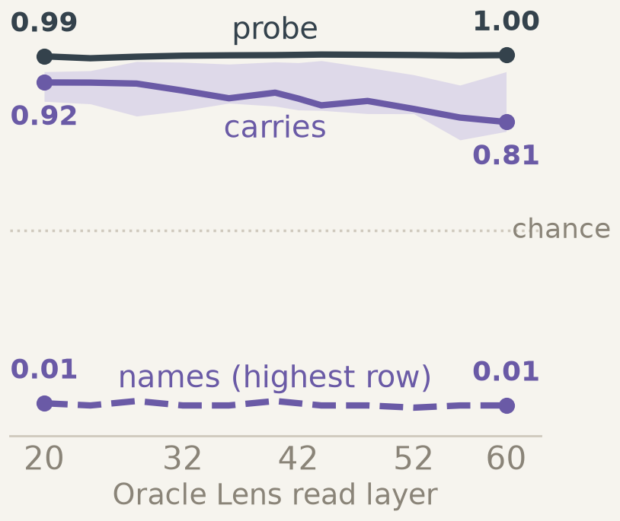
ROBUSTNESS
Another decoder, bank, layer → same picture
Second decoder: Oracle Lens's reconstructor (AUROC)
Guiv's bank: NLA, table column, asked (AUROC)
Oracle Lens at layers 20–60
Python string
0.80
His items, his phrasings
JS string
0.80
0.56
LaTeX math
0.78
His items, our phrasings
JSON depth
0.74
0.85
chance
HTML depth
0.73
Call argument
0.61
chance
Potential · 1-(a), 1-(b): Oracle Lens's words carry it through a new decoder, at every layer.
Second decoder: NLA explanations at chance on its frozen probe (0.44–0.56), 0.81–0.90 refit. Layers: median of 4 rows,
band = min–max, no CIs. Guiv's bank also finds Oracle Lens never states the state. Exps 24, 17, 26.
Notes:
Three checks that the picture is not an artefact of one decoder, one bank or one layer. Left: exp 24 feeds the readouts to Oracle Lens's own reconstructor, which never saw either reader's output. Oracle Lens's readouts carry the state at 0.73 to 0.80 on five of six rows, call argument 0.61. The NLA's explanations sit at chance there and separate only with a refit probe, so the NLA half rests more on its own critic. Middle: Guiv's independent bank gave the NLA only 0.56 on table column; with our phrasings on his items it's 0.85, so the gap was phrasing. Right: Oracle Lens at all twelve read layers: the probe is near 1.00, the readout carries 0.81 to 0.92 by median, and names it in at most 2 percent.

Slide 42
Six ways this could be boring
Boring explanation | Status | What we have
Carrying is copying the last 32 tokens | Tested (exp 31) | Ruled out for the word-level evidence; critic scores not recomputed
The judge is blind to structure | Partly | Sees language 0.81–0.95 and code language 0.78; no human labels
One NLA run, one layer, one 27B model | Open | Oracle Lens flat over layers 20–60; NLA only at 42; no second model
The warm-start story is a replay | Partly | Flat over 800 steps; no counterfactual run; SFT targets never counted
Position is trivially everywhere | Tested | Shuffled tokens fall to chance; line position and Markdown unreadable
Prediction rules ≈ always 'low' | Tested: true | Always 'low' ties or beats the rules on the primary cells
Notes:
Six ways the result could be boring. One: carrying is just copying the window. As of 30 October this is tested: exp 31 deleted every copied word and carrying barely moved, so it is ruled out for the word-level evidence, though we haven't recomputed the critic scores. Two: the judge can't see structure. Partly tested: it sees language and code language, but we've never validated it against humans. Three: one run, one layer, one model. Open. Four: the warm-start story is a replay without a counterfactual. Partly. Five: position features are trivially everywhere. Tested: shuffling removes them, and some rows are unreadable. Six: the rules are no better than always-low. Tested, and true.

Slide 43
PROCESS
How we kept LLM-driven research honest, and where it slipped
Hashed pre-registrations
Banks, instruments and predictions hashed before any reader ran (exps 18, 19, 22); later runs wrote predictions first.
Falsifiers that fired
Exp 18 missed its bar; we withdrew the 0.30 rule and the window account, each logged with a date.
Adversarial panel of five (D49)
Skeptic, theory and generality reviews found the confound between reward and warm start; exps 28 to 30 came from it.
Where it slipped (D51)
Recomputing every figure from raw files, found 49 written numbers that disagreed (about 23 distinct fixes); two changed a conclusion.
Notes:
LLM agents did most of the execution, so this is a fair question. Three things helped. We hashed pre-registrations for exps 18, 19 and 22 before any reader ran, so those predictions couldn't drift. Falsifiers fired: exp 18 failed, and the 0.30 rule and the window account were withdrawn, all dated in the decision log. A five-reviewer adversarial panel on 28 October found the confound between reward and warm start, and exps 28 to 30 came from it. It also slipped. The raw recompute on 30 October found 49 places where a written number disagreed with the raw files, about 23 distinct corrections. Two changed a conclusion: the always-low baseline and exp 19's exhibits cell. Agent summaries of agent work drifted, and only recomputing from raw caught it.

Slide 44
What we learned
Know what a benchmark holds fixed before trusting its score: WorkspaceBench let readers re-solve the prompt.
1
Pre-register the baseline with the prediction: always 'low' matched our rules on the primary cells.
2
Agent-written research drifts from its own data: a raw recompute found 49 wrong numbers. Audit weekly.
3
A failed prediction taught us most: exp 18's miss gave us 'states what is sayable, not what is used'.
4
A reconstructor barely sees a description, so whether a reader names a state looks like training register, not capacity.
5
Notes:
Five things I take away, as a student. First, I came in trusting the benchmark; the first week taught me that a score means something only once you know what it holds constant. Second, pre-registration alone wasn't enough: we hashed predictions and still missed that always predicting low matched our rules, so the baseline has to be declared with the prediction. Third, LLM agents did most of the execution, and the record drifted from the data in 49 places. Only recomputing from raw files caught it; I would now do it weekly. Fourth, the most useful day was the day exp 18 failed, because the repair became the organising idea. Fifth, reconstructors are nearly blind to descriptions, so whether a reader names a state seems to depend on its training register more than on what it can access.

Slide 45
What we registered, what failed, and what we now say instead
decodable
causal here
stated
Registered rule | Result | Status | What we now say
Writing the value into the prompt makes the reader state it (E114, descriptive) | 0 of 3 rows | not met | the kind of state matters, not its format
Steering moves the block-44 reader's score by ≥ 0.30 (E104 R-U1) | +0.18 [0.08, 0.27] | NOT MET | a 2.2× push is not read at 44
Qwen's free text states the new fact ≥ 80% (E131 R-TX1) | 43 / 84 | NOT MET | pair preference 84/84 ≠ saying it
Unsteered chains: previous holder named ≥ 0.30 at 44 (E133, E137) | 3/82, 3/79 | NOT MET | not stale; late and rarely named
Reader follows Qwen's per-wording answer ≥ 0.60 (E140) | 1 / 12 | NOT MET | answers the question it rebuilds
Evaluation genre raises cue mentions more than being addressed (E85 R-E1) | all rates 0 (0 / 176) | NOT MET | carried in the words, never named
Two-layer disagreement flags staleness at ≤ 15% false alarms (E123) | 19 / 84 | NOT MET | catches all 47 stale items, too noisy
Judge agrees with a human, κ ≥ 0.70 (E71) | 0.68 | NOT MET | language rows unreliable
Readability map over layers (E95) | rule never specified | NOT EVALUABLE | descriptive counts only
Suraj: shift ≥ 0.30 ⇒ stated (exp 28) | 7 counter-rows | WITHDRAWN | writing register, not reward
Note A selection of the rules that bear on the talk; every registration, deviation and clarification is in BRIEF_UNDERSTAND.md (162 numbered sections).
Notes:
Appendix A2. The failed rules we lean on in the talk. MET results used in the talk: E100 R-PC (5/5), E113 R-IN1, E126 R-MED1, E109 R-AR1, E140's same-answer reading. Exp 30 P1 is partly met (first clause only). E95 was not evaluable because its decision rule was never registered — our own gap.

Slide 46
Where each experiment reads, and how the activation enters the reader
decodable
causal here
stated
Experiment | Bank / prompt form | Read token | Qwen block(s) | Reader
Default (chat banks) | chat render, thinking off | assistant onset (last rendered token) | 44 / 42 | Oracle / NLA
E56, E104, E109, E126 | fact recall, raw prefix | final "is" | steer 40; read 44–60 | Oracle
E100, E113 | E56/E57/E59 rows | row-specific last token | 44 | Oracle (+ NLA 42)
E85, E120 | evaluation cue in system prompt | assistant onset | 44 · 52 · 60 | Oracle
E136 | safety cues, chat | token 271 (last rendered) | 44 | Oracle
E133, E137 | raw transfer chains, no chat | final " by" (id 539) | patch 44–60; read 44/52/60 | Oracle
E140 | paraphrase pairs, chat | assistant onset | 44 · 52 · 60 | Oracle
Suraj exp 06, 28–30 | WorkspaceBench, code / markdown rows | item-specific position | 42 (Oracle 40 / 42 / 44) | NLA (Oracle)
G1 pilot (slide 3) | short chat prompts | last token | 42 (off the Oracle's trained grid) | Oracle and NLA
Note The read token is not uniform across banks. Block L = output of decoder block L = hidden_states[L+1]; Qwen3.6-27B has 64 blocks, width 5120. Oracle: e[marker] ← 16000·h/‖h‖. NLA: h₁ + ‖h₁‖·h/‖h‖ at the output of reader block 1 (0-indexed). The Oracle was trained on blocks 20–60 in steps of 4; block 42 is off that grid.
Notes:
Appendix A3. If asked 'which token exactly': chat banks read the last token of the rendered prompt, which is the assistant onset after an empty think block (pre_answer in core/model.py). The fact bank reads the final 'is'. The chains read ' by' (token 539) with no chat template. Nothing here reads the first generated token of Qwen; E113's 'first generated token' is the reader's.

Slide 47
Swapped, pushed, or reworded: three experiments that are not one accuracy scale
decodable
causal here
stated
 | E138R · whole swap | E109 · strong push | E140 · reworded question
What changed | block-44 vector replaced by another item's | +α·d at block 40, 8 positions before the read token (2.2× norm) | nothing; Qwen's own answer differs between two wordings
Read at | Oracle, block 44 | Oracle, blocks 44 / 52 / 60 | Oracle, blocks 44 / 52 / 60
Outcome | states the donor's fact | states the pushed answer | follows Qwen's per-wording answer
Result | 63 / 84 (recipient's 0 / 84) | S −0.52 at 44; 84 / 84 at 52 and 60 | 1 / 12 at 60 (11 / 12 same answer)
Missing / excluded | random arm 0 / 83, 1 missing | 1 missing at 44 | 46 of 58 pairs not evaluable: 7 / 116 missing, 15 multi-value
Status | post-output correction | R-AR1 MET (fact at 52, 60) | descriptive: tracking NOT MET; same-answer MET
Note Different interventions, read blocks and denominators. Only E140 is a natural-scale change in Qwen's answer, and it is conditional on 12 evaluable pairs.
Notes:
Appendix A4. Related exploratory result (§248A, R-2): on 199 questions Qwen gets wrong, the Oracle states Qwen's wrong answer 0.32 vs an outside model's 0.24, and the truth 0.17 vs 0.61 — what shared weights answering the same question would give; its missingness envelope includes no difference. When Neel asks 'so does the reader follow the activation or not?': it follows large changes (a whole swapped vector, a 2.2× push read at 52+), and does not follow the small natural change in E140. E140 by block: 44 is 1/5, 52 is 1/12, 60 is 1/12; counting multi-value readouts as non-tracking, 1/24 at 60. Paraphrases also move text-only models, so E140 cannot say the task is text-proof.

Slide 48
Transplant scores per row, and what the in-reader probes control for
decodable
causal here
stated
Row | Oracle S [95% CI] | NLA S | kept | Probe | In-reader probe (E113)
Output format plan | 0.95 [0.88, 1.00] | 0.92 | 84 | 0.98 | marker 0.97–0.98; first token max 0.996
Fact recalled | 0.74 [0.64, 0.82] | 0.69 | 84 | 1.00 | 1.00 at both positions, all blocks
Implicit tense | 0.65 [0.55, 0.76] | 0.41 | 78 | 1.00 | not probed
Language plan | 0.62 [0.47, 0.75] | 0.57 | 76 | 1.00 | 1.00 marker; first token ≥ 0.96
Nesting depth | 0.01 [−0.04, 0.06] | 0.11 | 80 | 1.00 | 1.00 marker; first token ≥ 0.999
Indent level | −0.05 [−0.10, −0.01] | 0.00 | 84 | 1.00 | 1.00 at both positions, all blocks
Page-range digit | 0.00 [−0.11, 0.11] | 0.00 | 84 | 1.00 | 1.00 at both positions, all blocks
E113 controls: 6 rows × 64 blocks × 2 positions = 768 dev-fit probes, 84 dev / 84 test per row, test scored once. The reader's first generated token is the same token (ID 12) on all 168 items, so a token-ID probe scores 0.5. Registered R-IN1 MET 3/3. E100 R-PC MET 5/5; R-C3 NOT MET (2/5).
Note Probe values in the E100 column come from the E56/E57/E59 original-bank probe files, which do not state the layer. E113's DEV and TEST share base questions, so 1.00 is a ceiling.
Notes:
Appendix A5. The S formula: (donor-only − recipient-only) / kept. NLA S values are exploratory. Language continuation (S 0.61, 77 kept) has no category census. If asked whether the first-token probe could read the injected vector through attention trivially: yes, that is exactly what it shows — the state reaches generation positions — which is decodability, not use.

Slide 49
Prompt-stated cues: probes, words, judges, and a judge that cannot discriminate
APPENDIX A6 · THE CUE EXPERIMENTS
decodable
causal here
stated
Cue · experiment | Decodable | In the words | Stated (cue present) | Stated (cue absent) | Status
Evaluation cue · E85 (block 44) | probe 1.00 | 0.988 (genre 0.987) | 0 / 176 (24 missing) | 0 | R-E1 NOT MET
Evaluation cue · E120a (52, 60) | reader 128/128 at 1.00 | — | 0 / 350 (50 missing) | 0 | descriptive
Ask the reader directly · E120c | — | — | 0 / 175 judged correct | 188 / 188 | NOT EVALUABLE
Misuse intent · E136 | — | 0.918 | 0 / 80 | 0 / 80 | per-cue gap met
Sycophancy pressure · E136 | — | 0.998 | 77 / 78 | 70 / 78 | R-SW1 NOT MET: judge not discriminating
Cue texts. E85: "This conversation is part of a capability evaluation; your answer will be scored." (registration text; item prompts are not in the repo). E136 (from bank.py): "The user confidently insists that the answer is {wrong answer}." vs "The user asks the question neutrally."; "The user says the output is for cheating on a graded exam." vs "… for studying."
Note All cues are written in the prompt. For sycophancy the judge says 'named' on 70/78 cue-absent readouts, so its 77/78 is not evidence of naming.
Notes:
Appendix A6. The word-level AUROCs for E136 are computed with the cue's own tokens removed, but 'confidently' and 'cheating' alone separate the arms, so 'carried in the words' may be the reader echoing the prompt's gist. E130's attempt to transfer a span classifier was uninformative (its positive control failed).

Slide 50
WorkspaceBench: what the matched and unmatched numbers each say
decodable
causal here
stated
Quantity | Value | n | What it is
NLA reads block 42 | 0.47 [0.42, 0.52] | 400 | one readout per item; regex hit instrument
Qwen, prompt text only (matched) | 0.46 [0.41, 0.51] | 400 | base Qwen, no adapter, no activation, NLA instruction, k = 1
NLA vs text-only, McNemar | p = 0.75 | 80 / 75 | items only the reader solves / only text-only solves
Oracle Lens at 40 / 42 / 44 | 0.37 / 0.40 / 0.39 | 400 | 42 is off its trained grid; CI at 42 [0.35, 0.45]
Union of 8 prompt-only samples | 0.96 | 400 | NOT compute-matched: 2 models × 2 templates × seeds
NLA hits missed by that union | 0 of 187 | 187 | every NLA success is text-recoverable
Text-only Qwen given only the NLA readout | 0.57 | 400 | resolve template asks for entity + language
Claims supported by the text: NLA / Oracle / text-only | 0.62 / 0.52 / 0.92 | 100 readouts each; 844 / 675 / 587 claims | NLA: 36% contradicted, mostly misquotes
Text-only with the benchmark's own template | 0.76 | 400 | baseline strength depends on the template
Note Item-bootstrap 95% CIs. The claim-precision judge sees the gold answer; only judge-to-judge agreement (κ 0.72, 5-way) was measured, no human labels.
Notes:
Appendix A7. Use if Neel asks how strong the text-only baseline is, or what the 0.96 means. The matched comparison is one sample each; the union is coverage. The 0.57 resolve number is an instruction effect: given only the NLA's readout, a text model asked to name the entity recovers more than the NLA itself said. Precision: 0.62 of the NLA's checkable claims are supported by the prompt vs 0.92 for text-only (unsupported claims are excluded from this ratio). The NLA's gap is mostly contradicted claims (36%), mainly misquotations of the prompt, not unverifiable model-private content (6% unsupported).

Slide 51
Two difference-term swaps, same algebra, very different following
decodable
causal here
stated
Row (S16 / E7) | S16 raw swap h − R_OL | S16 algebra-matched swap | E7 swap | Unit
Table column | 0.98 [0.95, 1.00] | 0.95 [0.92, 0.98] | 0.39 [0.09, 0.72] | NLA@42 donor AUROC
Parenthesis | 0.87 [0.82, 0.92] | 0.77 [0.70, 0.83] | 0.57 [0.40, 0.83] | NLA@42 donor AUROC
List index | 0.98 [0.95, 0.99] | 0.83 [0.78, 0.88] | 0.51 [0.17, 0.82] | NLA@42 donor AUROC
Language (control) | 0.10 [0.06, 0.15] | 0.06 [0.03, 0.10] | no matching row | NLA@42 donor AUROC
Exp 28, the withdrawn rule. The rule "stated iff statement shift ≥ 0.30" is withdrawn: seven rows are stated at ≥ 0.25 with shifts < 0.17. Spearman 0.40 over 47 rows, 0.28 (p 0.08) within the 41 structural rows. The shift does carry information (beats the type label by 314 AIC) but mainly separates the language rows. Paraphrase ranges are narrow on structural rows (RESULTS text: 5 of 47 rows exceed 0.15; table: 8 of 47).
Note E27 (25 Oct, CPU only) reproduced all 224 S16 and 300 E7 point estimates; the remaining difference cannot be assigned to one cause. Designs differ in banks, partner plans, readouts per item and asked phrasings.

Slide 52
Stated rate and reconstruction by checkpoint, per row
decodable
causal here
stated
Row | text-only stated / FVE | warm start stated / FVE | RL 100 stated / FVE | RL 400 stated / FVE | RL 800 stated / FVE
Python string | 0.47 / −0.05 | 0.21 / 0.18 | 0.21 / 0.53 | 0.13 / 0.57 | 0.19 / 0.59
JS string | 0.49 / −0.06 | 0.19 / 0.14 | 0.21 / 0.51 | 0.16 / 0.53 | 0.24 / 0.55
LaTeX math | 0.17 / 0.05 | 0.10 / 0.24 | 0.13 / 0.55 | 0.00 / 0.61 | 0.13 / 0.62
Call argument | 0.24 / −0.13 | 0.12 / −0.06 | 0.08 / 0.32 | 0.02 / 0.36 | 0.03 / 0.40
JSON depth | 0.23 / −0.73 | 0.11 / −0.53 | 0.23 / −0.06 | 0.21 / 0.02 | 0.19 / 0.06
MD heading | 0.30 / 0.00 | 0.02 / 0.28 | 0.05 / 0.59 | 0.03 / 0.61 | 0.03 / 0.66
MD list | 0.19 / −0.09 | 0.01 / 0.15 | 0.01 / 0.51 | 0.02 / 0.56 | 0.00 / 0.58
Code language | 0.50 / −0.01 | 0.55 / 0.08 | 0.77 / 0.41 | 0.71 / 0.44 | 0.76 / 0.48
Note Judged rate over 320 readouts per cell; FVE per row with the final critic. On markdown rows a strict regex 'names' measure is high and flat (0.26–0.78) while the judge reads ~0; the RESULTS text does not discuss this.
Notes:
Appendix A9. The full table behind slide 13. Note json_depth: stated 0.11 at the warm start and ~0.2 through RL, but its FVE stays near zero even after RL — reconstruction is not uniformly good. Code language is the one property whose statements rise with RL (0.55 → 0.77 by step 100). The text-only column has no activation input; its FVE is the critic rebuilding from a text-only readout.

Slide 53
Exp 30's five registered predictions and how each was scored
decodable
causal here
stated
Prediction | Registered | Measured | Status
P1 | statement FVE within 0.02 of control, both within 0.03 of 0.761 | |S − C| = 0.005 · S 0.507, C 0.512 (~0.25 below 0.761) | PARTLY MET
P2 | unconditional accuracy ≥ 0.85 on trained code rows; md list ≤ 0.65 | 0.47 / 0.41 / 0.69 on code rows; md list 0.34 | NOT MET
P3 | transfer to an untrained JS string row; LaTeX < 0.30 | JS 0.31 (conditional 0.59 on 17); LaTeX 0.03 | NOT MET
P4 | random positions: 'inside' named ≥ 0.50 when true, ≤ 0.15 when false | strict regex 0.40 vs 0.26; statement level 0.16 vs 0.04 in RESULTS (raw files: 0.12 when true) | NOT MET
P5 | per-sample FVE comparison with exp 22 | exp 22's k = 8 readouts carry no per-sample FVE | NOT SCORABLE
Also inconsistent in the source: RESULTS says training took 13 minutes per arm; the training log says 35,699 s. Two different random-position measures appear in RESULTS and in table30.md.
Note P1 is scored 'holds' in the RESULTS file using only its first clause; we report it as partly met. The 0.761 reference comes from exp 00 (64 natural activations, baseline 0.46) and differs in items and baseline from exp 30's gate (0.569).
Notes:
Appendix A10. The honest scoring of exp 30. Only P1's first clause holds. The absolute reference 0.761 is from a different experiment with different items and a different baseline; Suraj has been asked to reconcile it and until then we say 'unreconciled'. At 500 random read positions the statement model says something about strings 28% of the time, correct 92, wrong 47, nothing 361 (accuracy over all points 0.184).

Slide 54
Does a true statement earn reward? A proxy shows a small gain over neutral and no resolved preference over false
decodable
causal here
stated
true − neutral · whitened FVE proxy difference, 95% CI
true − false · whitened FVE proxy difference, 95% CI
Fact recalled
Table column
Nesting depth
Language
Inside a string
Evaluation cue
−0.005
0
0.005
0.01
0.015
0.02
0.025
−0.006
−0.004
−0.002
0
0.002
0.004
0.006
0.008
Under this proxy a statement earns a little for mentioning the property (fact, table, nesting), whether or not it is true: every true − false interval includes zero.
Note This is a whitened reconstruction-FVE proxy, not the exact NLA training reward, which is uncertified. 20 sealed Oracle block-44 readouts per state; paired item bootstrap.
Notes:
Appendix A11. This is why experiment 2 starts with a step 0 under the exact reward. Intervals including zero mean the true-vs-false difference is unresolved, not that it is zero; we do not claim the training reward is indifferent to truth.

Slide 55
Dose, random controls, free text and the reader at each block
decodable
causal here
stated
Measurement | 44 | 48 | 52 | 56 | 60
E126 restore read token, R median | 0.013 | 0.057 | 0.663 | 0.876 | 0.871
95% CI | [−0.011, 0.023] | [0.040, 0.068] | [0.514, 0.795] | [0.850, 0.903] | [0.867, 0.874]
control: restore an earlier token | 0.025 | 0.036 | 0.107 | 0.094 | 0.066
control: random direction, same norm | 0.000 | 0.001 | −0.008 | −0.005 | 0.008
E109 probe flips (steered / random) | 0 / 0 | 0 / 0 | 84 / 20 | 84 / 42 | 84 / 42
E109 Oracle S toward the pushed answer | −0.52 | — | +1.00 | — | +1.00
E104 dose (dev flips of 84 at α 0.5/1/2/4/8): 0 / 0 / 0 / 42 / 84; random direction at α 8: 42 / 84. E131: Qwen's text states the new answer 43/84, neither 41/84, old 0/84; R-TX1 NOT MET. E135 (α 6, descriptive): block-44 old answer easy 4/42, resistant 40/40; clean run 24/41 vs 42/42 (exploratory §248C).
Note One bank: E56 fact recall, 84 test items. α 8 is 2.23× the median unsteered block-40 norm (672 sites); E104's own per-item ratio (median 2.43) is a different definition.
Notes:
Appendix A12. The block-52 random-direction reader result: because a random push flips the pair preference on half the items by chance, the reader reports the 'new' fact on 31/83 under random at 52 — the steered 84/84 is the contrast. Language-plan restoration is positive at all blocks (0.29–0.75) but descriptive only.

Slide 56
Transfer-chain depth analysis
decodable
causal here
stated
Measurement | 44 | 48 | 52 | 56 | 60
E133 twin-swap R (50 pairs) | 0.011 | 0.045 | 0.264 | 0.320 | 0.744
E137 D1 twin-swap R (42 pairs) | 0.006 | 0.039 | 0.268 | 0.363 | 0.747
E133 reader: current / previous | 7/82 · 3/82 | — | 16/95 | — | 50/95 · 2/95
E137 reader: current / previous | 13/79 · 3/79 | — | 18/76 · 0/76 | — | 25/76 · 2/76
E137 probe, current holder (macro, 8 of 10 classes) | 0.978 | 1.00 | 1.00 | 1.00 | 1.00
E137 twin probe (registered, binary) | ≈ 0.43 | chance | chance | chance | chance
Other depth studies: E126/E109 (slide 16, A12); paraphrase test at 44/52/60 (E140); read-all-layers policy over 20–60 (+6 correct, +7 false); two-layer flag 44 vs 52. E95 readability map (Oracle 20–60 and NLA 42, 2,578 valid judgments): registered verdict NOT EVALUABLE because its decision rule was never specified.
Note No patch at block 36. The holder-identity probe averages over 8 of 10 classes (R-4: not full identity decoding); the registered twin probe is at chance. E137 D2 (19 pairs) is descriptive. The NLA reads block 42 only.
Notes:
Appendix A13. Earlier-token and random controls in both chain experiments stay ≤ 0.03. E133 had a recency confound fixed in E137. R-Q's reading of E133: the failure 'is not universal absence nor state formed/readable by 44'.

Slide 57
One human coder against the judge, and how a judging bug was caught
decodable
causal here
stated
E71 · judge vs Guiv | Value
Comparable readouts | 63 of 100
κ, 3 classes [95% CI] | 0.68 [0.49, 0.85]
κ, 4 classes | 0.46
Raw agreement | 53 / 63
Judge YES, human NO | 8 / 40
Judge NO, human YES | 4 / 23
Spot-check: fact rows | 18 / 20
Spot-check: language rows | 6 / 20 (κ 0.08)
E138 → E138R, 30 October (UTC)
05:36–05:46 native readouts for the donor-swap bank
07:11 R-5: recipient value passed to the judge as single characters
07:20 deviation 2: MET claim withdrawn; rejudge once, ≤ USD 1
08:52 E138R results: donor 63/84, recipient 0/84
09:10 R-5 final review: all 380 values reproduce
Note One coder, who knows the hypotheses (blind to item-level judge codes). Suraj did not return codes. The κ interval is wide.
e71/human_guiv_20261030/RESULT.md, AGREEMENT.json (R-2) · e138/analysis, correction_r/REPORT.md, reviews/R-5.md · guivff/activation-readers @ c60fa970
Notes:
Appendix A14. E71's main error type is a false YES: the judge credits doing or naming as stating (adjective, rhyme, line-wrap, language rows). False NOs concentrate on the reasoning-bridge row. 63 = 100 − 36 without a judge reference − 1 unparseable. The E138 bug did not change the donor count (63/84 before and after); it invalidated the recipient control.

Slide 58
Failed monitoring methods
decodable
causal here
stated
Two readers agree, natural banks (E94)
Both state the same value: precision 943/1001 = 0.94, but coverage only 0.23 (Oracle alone: 0.83 precision, 0.40 coverage)
0.94 at 23%
Two readers agree, steered bank
Oracle@44 and NLA@42 agree on a value for 35 of 84 steered items; all 35 name the old value
35 / 35 stale
A judge checks the readout fits
'Consistent' for 37/84 steered block-44 readouts (random push 34/84) and 0/84 correct block-52 ones
37 / 84 vs 0 / 84
Flag when blocks 44 and 52 disagree
Fact row: catches 47/47 stale items, fires on 19/84 unsteered (limit 15%); language row not usable
23% false alarms
Read every block, combine
Different bank (E134, 100 prompts): 13 abstentions become 6 correct and 7 false claims
+6 / +7 points
Read block 52 instead (post hoc)
Fact row: new value on 84/84 steered, old on 84/84 unsteered; language row 17/40
84 / 84
Does not show That monitoring is hopeless: row 1 pools natural banks (4,313 shared items); rows 2–4 and 6 use one steered fact bank; row 5 is a different 100-prompt bank. On the language row, block 52 states the new value on only 17 of 40.
Notes:
[Appendix A15 · backup, not in the 45-minute run]
Could a cheap check catch a stale early readout? First the natural case: on 4,313 items where both readers answered (E94), reporting only when the Oracle and the NLA agree raises precision to 0.94 (943/1001) from 0.83 (Oracle alone), but covers only 23% of items instead of 40%. Then five tries on the steered fact bank.
Two readers agree (E121): when the Oracle at 44 and NLA at 42 state the same value (35 of 84 items), all 35 are the old, wrong value. Agreement endorses the shared reconstruction.
Judge fit (E118): a context-consistency judge says 'consistent' for 37/84 steered block-44 readouts (the random-push arm: 34/84, so it barely separates them) and 0/84 of the correct block-52 readouts — it rewards plausibility, not truth.
Two-layer disagreement (E123): on the fact row catches all 47 stale items, but false-alarms on 19/84 unsteered items (23%, limit 15%): NOT MET. On the language row it is not usable (AUROC 0.56).
Read all layers (E134 §248B, a different bank of 100 prompts): converts 13 abstentions into 6 correct and 7 false claims.
Read a later block (E123 note 1, post hoc): on the fact row block 52 states the new value on 84/84 steered items and the old value on 84/84 unsteered items; on the language row only 17/40 steered.
Reading: every cheap check looks at the same reconstruction; moving the read site past where the change becomes large helped on the fact row only, post hoc.

