Slide 1
Housewife: Free Choice vs. Coercion
钟赟

Slide 2

Gender discrimination in job market
Source:Report Of 2017 Status Quo In Workplace from ZhiLian Recruitment

Slide 3
Balance of family
Productivity
Personal preference

Slide 4
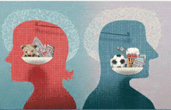
Productivity men vs. women
Productivity:
men > women
Ancient Agricultural Society
Modern Society：
Wisdom, professional skills

Slide 5
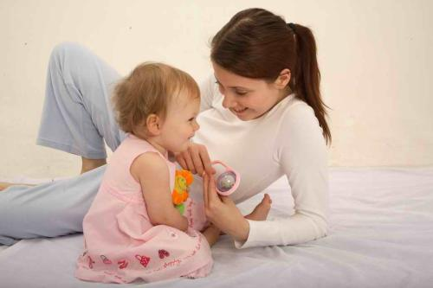
Personal preference men vs. women
Convention for Women
Women good at taking care of families Women love taking care of families
Parenting Skills
Women practice to be a mother
Men seldom try
≠

Slide 6

Conclusion?
?
Coerced
vs.
Free choice
Coercion for women does exist.
Gender equality has a long way to go.
Note: all pictures from web

Slide 7
Thank you !

