Slide 1
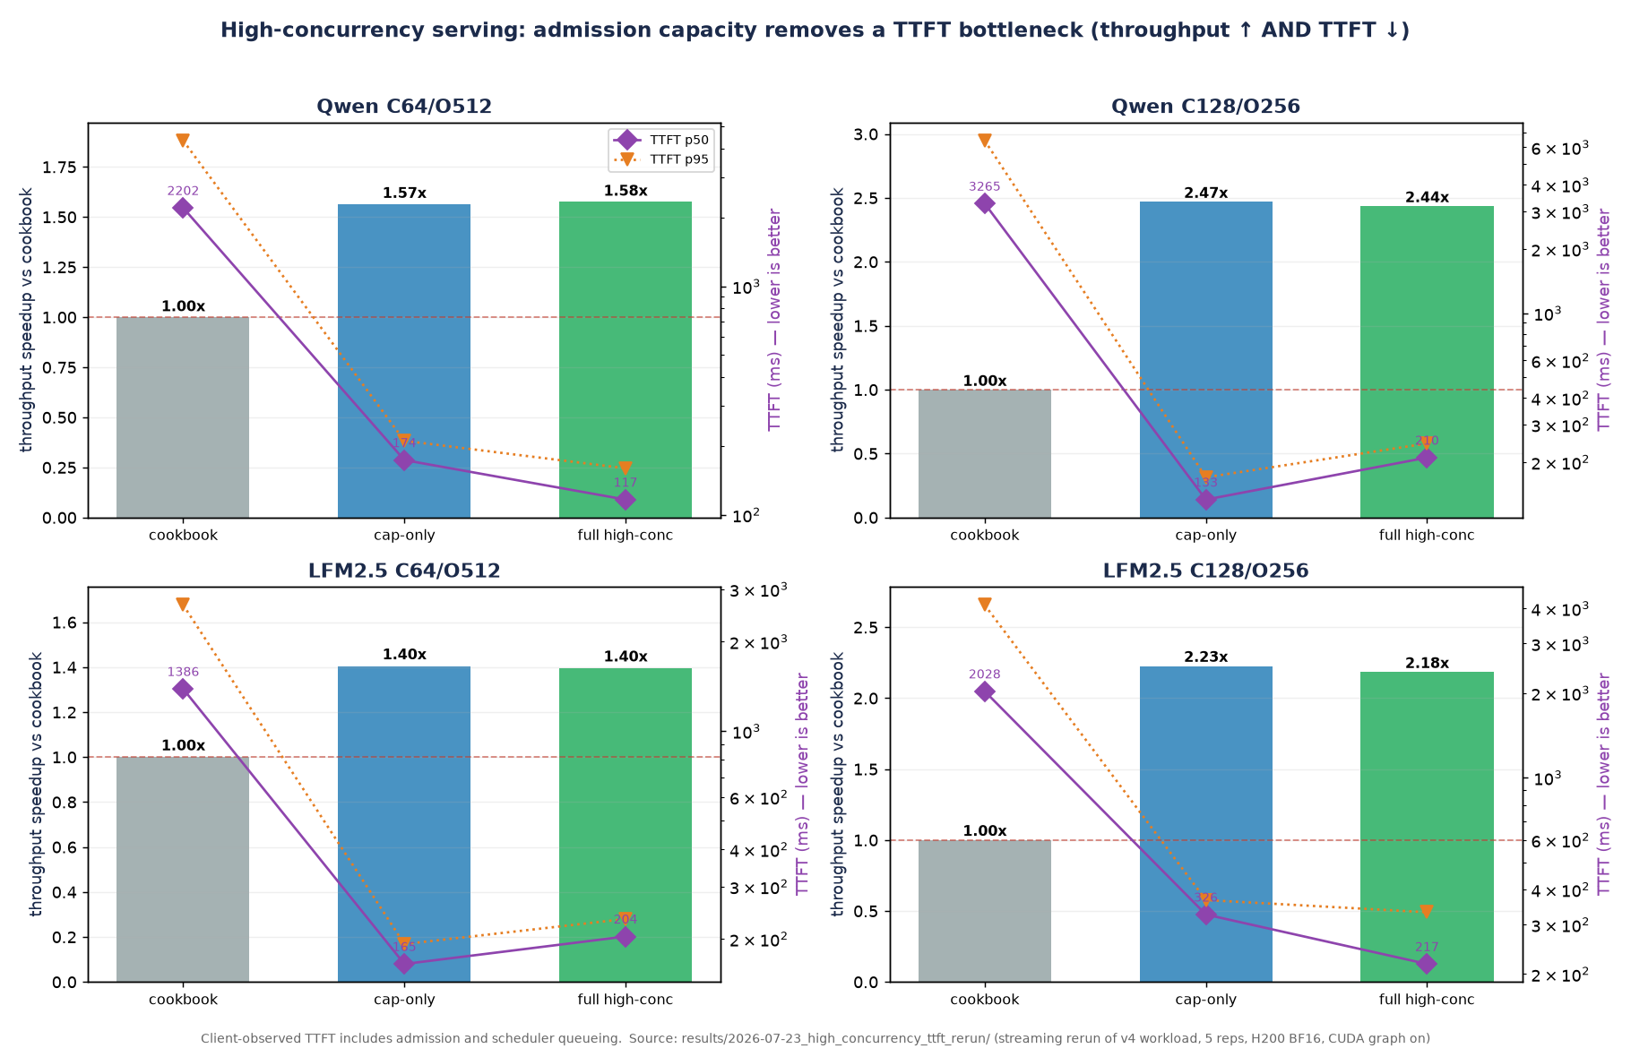
Different regimes expose different serving bottlenecks
High-concurrency decode: admission capacity · Qwen & LFM2.5 · single H200 · BF16 · speedup over frozen cookbook baseline
Full high-conc vs cookbook
Qwen C64/O512
tput 1.58× · TTFT p50 2202→117ms · p95 4336→160ms
Qwen C128/O256
tput 2.44× · TTFT p50 3265→210ms · p95 6446→244ms
LFM2.5 C64/O512
tput 1.40× · TTFT p50 1386→204ms · p95 2654→233ms
LFM2.5 C128/O256
tput 2.18× · TTFT p50 2028→217ms · p95 4112→332ms
Cap-only reproduces ~all of it → admission capacity is the cause; chunk/fcfs/mem add <2%.
Takeaway: the cookbook max-running-requests=32 throttles admission once concurrency exceeds 32; raising it lifts throughput 1.4–2.4× AND cuts TTFT p50/p95 by 85–96%. This removes an admission bottleneck — not a tradeoff.
Client-observed TTFT includes admission and scheduler queueing. Source: results/2026-07-23_high_concurrency_ttft_rerun/ (streaming rerun of v4 workload, 5 reps, CUDA graph on).

