Slide 1
Finding the Performance Gap in LLM Inference
Qwen3-30B-A3B and LFM2.5-8B-A1B · single H200 · TP1 · BF16 · SGLang
The question
• A model that runs is not a model that runs well — how much of the gap is just serving configuration?
What we do first
• Freeze a fair cookbook baseline, then enumerate the serving-configuration space (192 configurations) across six workload regimes.
• Measure throughput and TTFT / TPOT / E2E percentiles from raw per-request records — no metric is estimated from another.
Why it matters
• Whatever serving tuning cannot close is the gap that profiling, kernels, backends and communication must explain.
Goal: quantify the serving-level ceiling before blaming the kernels.
results/2026-07-24_serving_ceiling · sglang 0.5.12.post1 @ 17f7a1da1 · torch 2.9.1+cu128 · triton 3.5.1 · driver 580.105.08
Notes:
Framing slide. The deliverable of this section is an upper bound on what serving-level configuration alone can buy, measured under one frozen software stack. Everything after this slide is measured, not estimated.

Slide 2
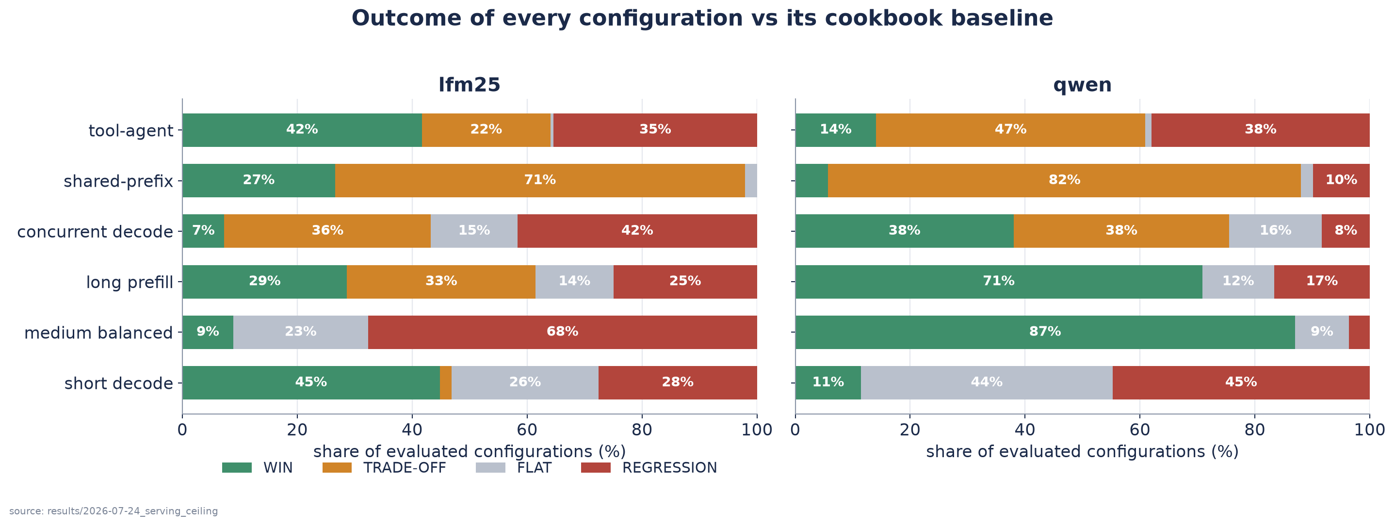
Runnable does not mean workload-optimal
Runnable deployment
• The official cookbook command starts the model and serves traffic correctly.
Hidden performance gap
• The same command is a fixed point in a large configuration space; nothing in it adapts to the traffic you actually receive.
The gap moves with the workload
• Admission capacity, prefill chunking and scheduling interact differently for short decode, long prefill, high concurrency and agentic traffic.
Same deployment, different traffic — the reachable gain is not a single number.
results/2026-07-24_serving_ceiling/plots/gain_distribution.png
Notes:
Problem definition. The right-hand chart already answers 'is tuning worth it?' with a distribution rather than a headline: for each regime it shows what fraction of the evaluated configurations are wins, flats, regressions or trade-offs relative to that model's own cookbook.

Slide 3
Freeze a fair baseline before measuring the gap
What the cookbook gives
• Official deployment command for this model / GPU / dtype cell.
• A supported, reproducible starting configuration.
What we additionally freeze
• Software: sglang 0.5.12.post1 @ 17f7a1da1, torch 2.9.1+cu128, triton 3.5.1.
• Resolved execution path: attention backend fa3, MoE runner auto, CUDA Graph on — parsed from every server log, not assumed.
• Identical workloads, seeds and request payloads for every configuration.
Why it matters
• No stale or handicapped baseline: the 2026-06-11 '5–9×' result came from a CUDA-Graph-disabled reference and collapses to 1.00–1.05× against the true default.
• Every claimed gap has a reproducible reference point.
The baseline is measured under the identical protocol — it is configuration #74 inside the same grid.
results/2026-07-24_serving_ceiling/baseline_definition.json · docs/2026-06-25/autotuning_honest_results.md
Notes:
Baseline-fairness slide. The key honesty point: our own earlier 5–9× number was an artifact of a CUDA-Graph-disabled baseline; measured against the true zero-flag default the same winner is 1.00–1.05×. We therefore run the cookbook config inside the grid under the identical harness instead of quoting a historical number.

Slide 4
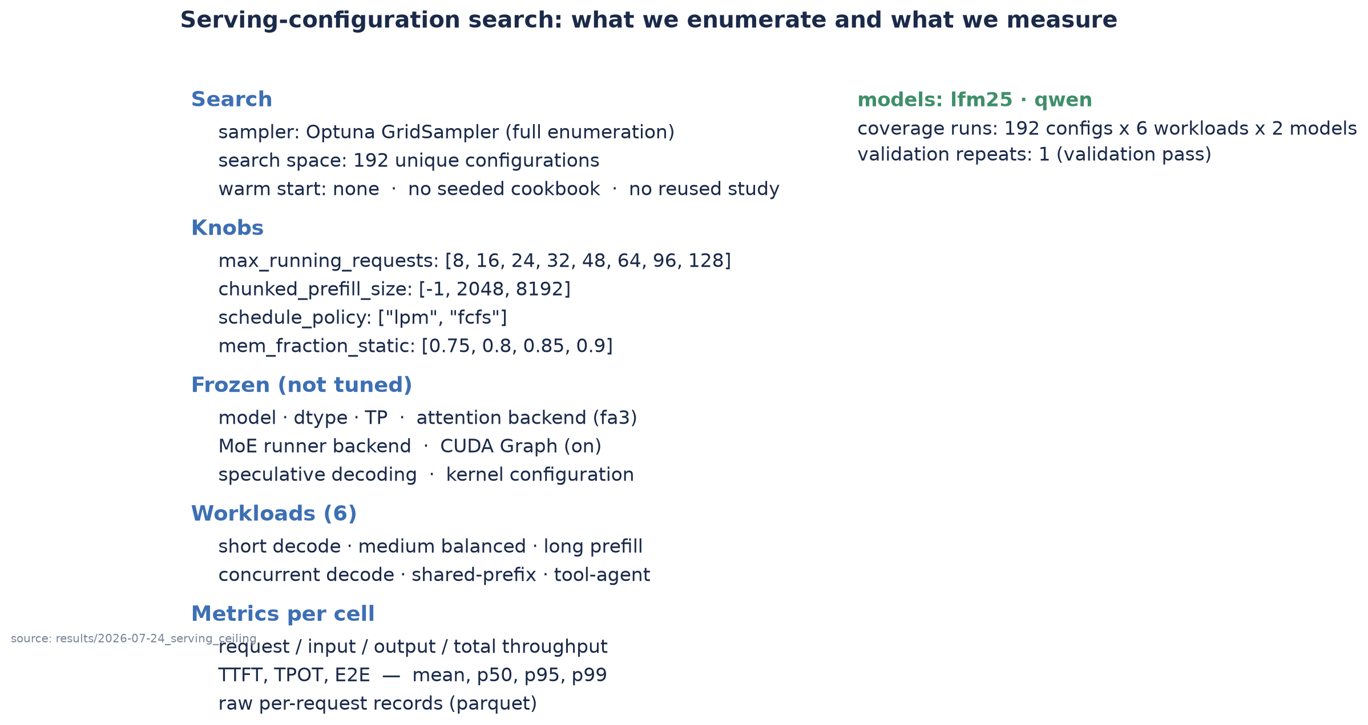
How we search the serving configuration space
results/2026-07-24_serving_ceiling/search_space.yaml · results/2026-07-24_serving_ceiling/workloads.yaml
Notes:
Method slide. Full grid enumeration (not TPE) because we need the whole Pareto frontier and the negative results, not one winner. No warm start, no seeded cookbook, no reused study. Backends and CUDA Graph are frozen so that anything we measure is attributable to the four serving knobs. Note chunked_prefill_size=8192 is effectively equal to -1 here because context length is 8192 — that pair doubles as a built-in noise estimate.

Slide 5
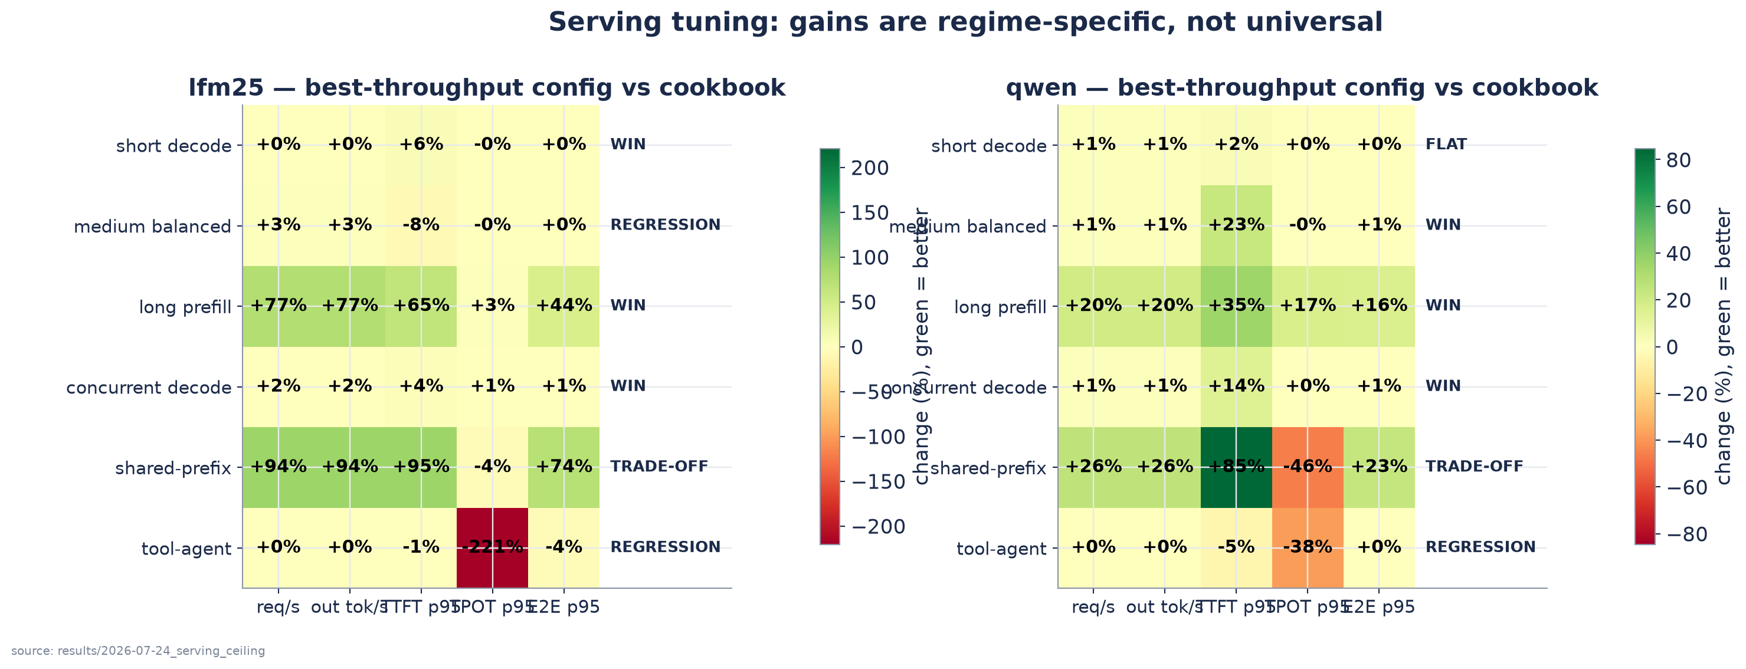
What serving tuning actually finds: wins, flats, regressions, trade-offs
Read the matrix
• lfm25: largest gain +94% (shared_prefix); smallest +0% (R_short_decode).
• qwen: largest gain +26% (shared_prefix); smallest +0% (tool_agent).
Also on the record
• Historical Qwen autotuning vs a correct baseline: 1.00–1.05× (flat).
• High-concurrency stress study: throughput 1.40–2.44× and TTFT p50/p95 −85…−96 %, driven almost entirely by admission capacity.
• The same chunking candidate helps LFM2.5 shared-prefix (+28.6 % req/s) and is neutral on Qwen (−2.9 %).
Serving tuning finds workload-specific cliffs, not a universal winner.
results/2026-07-24_serving_ceiling/summary_matrix.csv · results/2026-07-23_high_concurrency_ttft_rerun/comparison.md · results/consolidated_v7_config_sweep.csv
Notes:
Result slide. Green cells are improvements, red are regressions; the label at the right of each row is the WIN/FLAT/REGRESSION/TRADE-OFF classification. Deliberately includes flat and negative regimes. The high-concurrency and cross-model numbers come from separate, clearly labelled studies with a different workload definition — they are supporting evidence, not cells of this matrix.

Slide 6
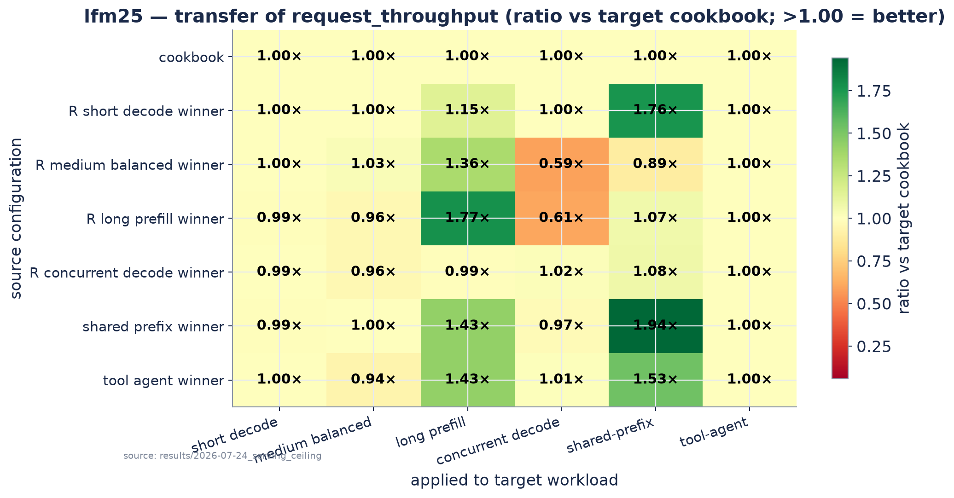
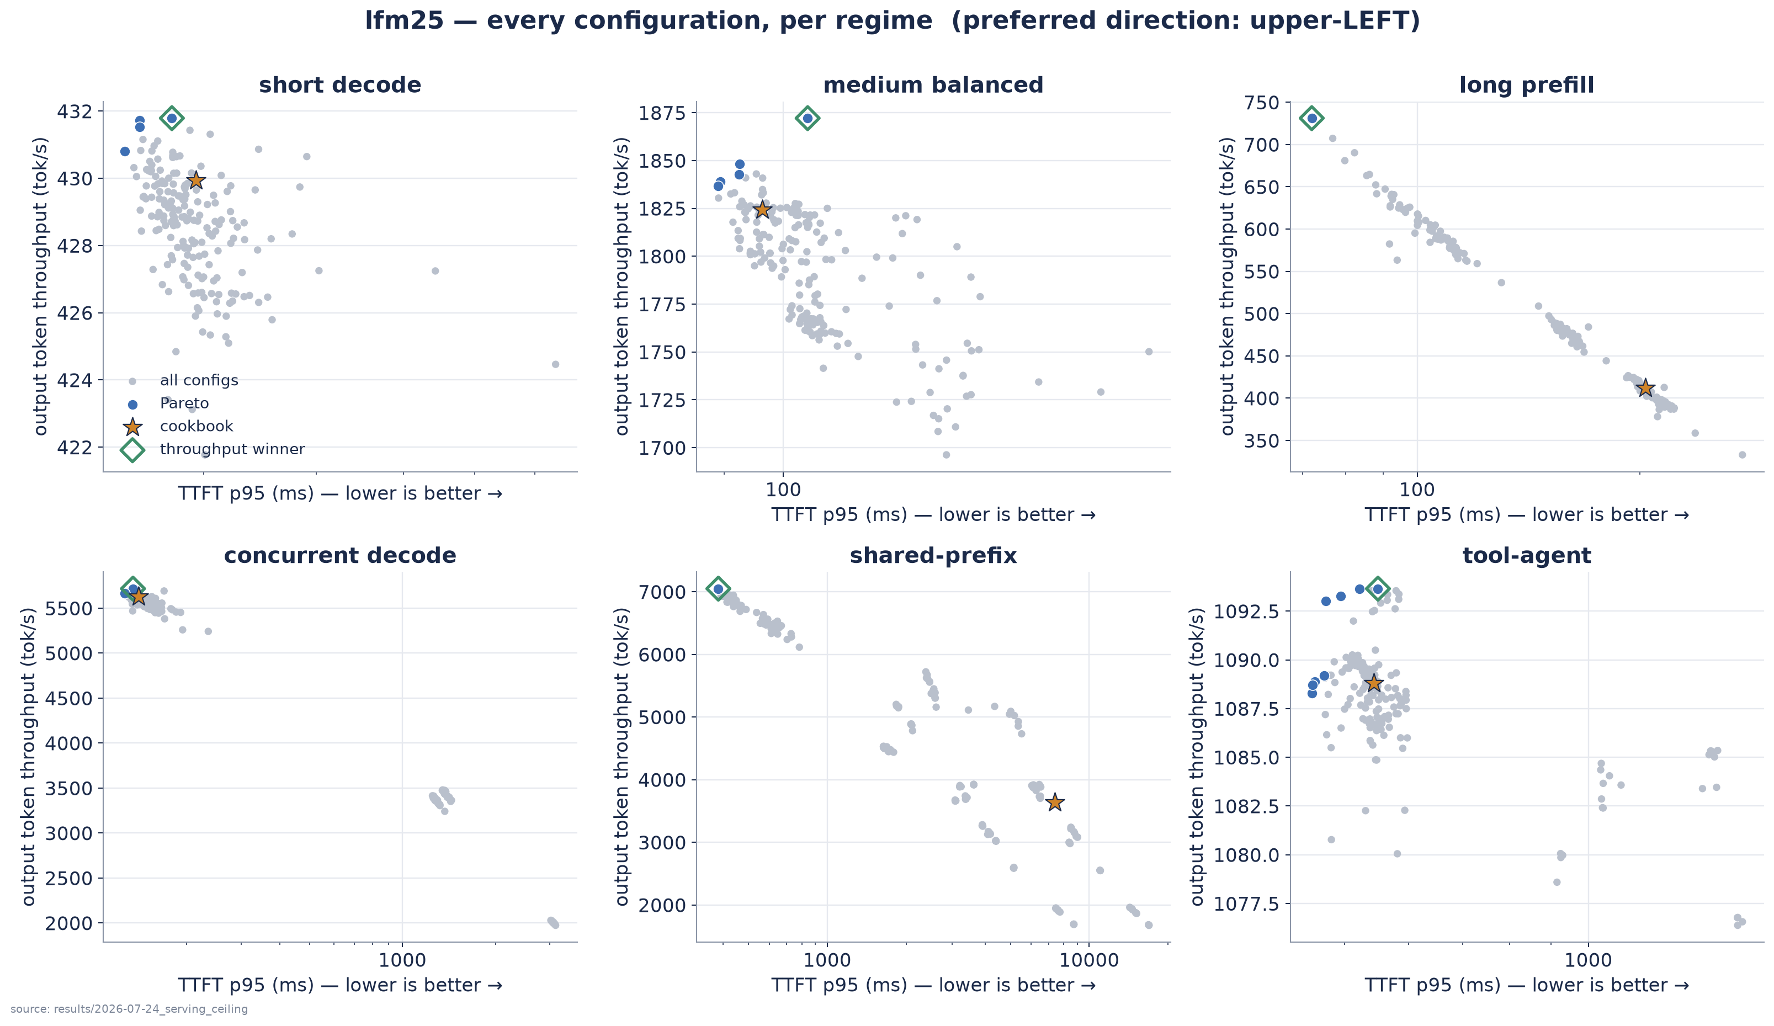
Synthetic winners do not transfer reliably to agentic workloads
• Rows are configurations that won some regime; columns are the regimes they are then applied to. Off-diagonal cells below 1.00× are failed transfers.
• Shared-prefix and tool-agent Pareto fronts show all evaluated points; cookbook is the star, the validated throughput winner is the diamond.
Serving search selects points on the frontier. Profiling is needed to move the frontier.
results/2026-07-24_serving_ceiling/analysis/lfm25/transfer_matrix_request_throughput.csv · results/2026-07-24_serving_ceiling/analysis/lfm25/pareto_points.csv
Notes:
Transfer slide, and the hand-off into the profiling/kernel section. The diagonal is by construction >= 1.00x; what matters is how far the off-diagonal cells fall below it, especially synthetic -> agentic. Ratios are computed against each target regime's own cookbook, so the matrix is dimensionless and comparable across regimes.

