Slide 1
Car Price Prediction using Machine Learning
OIBSIP Internship Task 3
Name : G.vaishanvi

Slide 2
: PROBLEM STATEMENT
Car price depends on many factors like brand, mileage, horsepower, etc.
The goal is to predict car price using Machine Learning.

Slide 3
DATASET
Dataset contains car details like:
Year
Fuel type
Transmission
Selling price
Source: Kaggle / provided dataset

Slide 4
DATA PREPROCESSING
Handled missing values
Converted categorical data using encoding
Cleaned dataset for ML model

Slide 5
MODEL USED
Model: Random Forest Regressor
Reason: High accuracy for regression problems

Slide 6
TRAINING PROCESS
Split dataset into training and testing (80/20)
Trained model using training data

Slide 7
RESULTS
Model predicts car price successfully
Accuracy (R² score): 0.9967795059779159

Slide 8
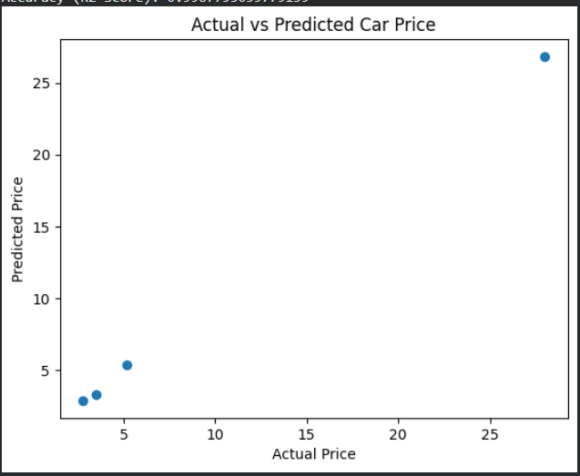
GRAPH

Slide 9
CONCLUSION
Machine learning helps predict car prices effectively
Random Forest gives good accuracy
Useful for car industry pricing systems

