Slide 1
Customer Behavior Analysis
Prepared for Data Analytics Internship

Slide 2
Objective
Analyze customer behavior patterns and generate business insights using data analytics.

Slide 3
Dataset Overview
Dataset sourced from Kaggle.
Contains customer-related transaction and behavior data.

Slide 4
Data Cleaning
• Checked missing values
• Removed duplicate rows
• Loaded dataset using Pandas

Slide 5
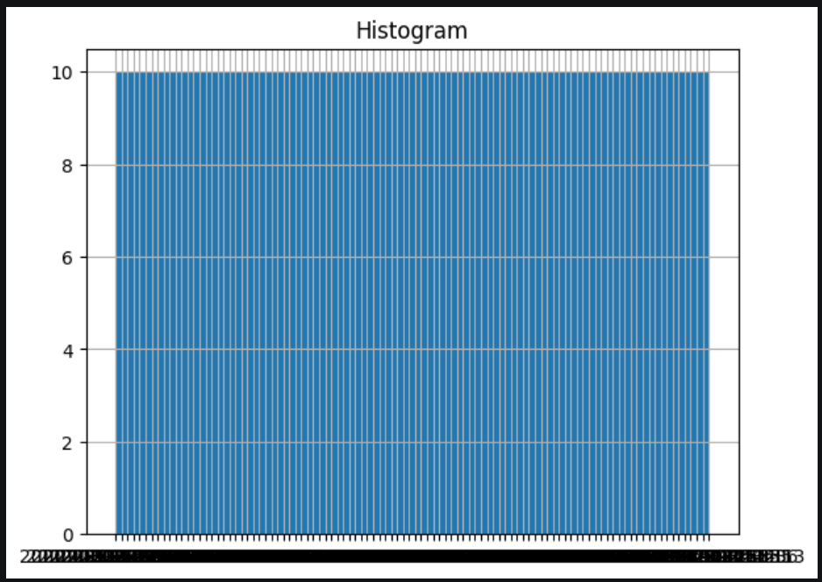
Histogram
Histogram shows data distribution patterns.

Slide 6
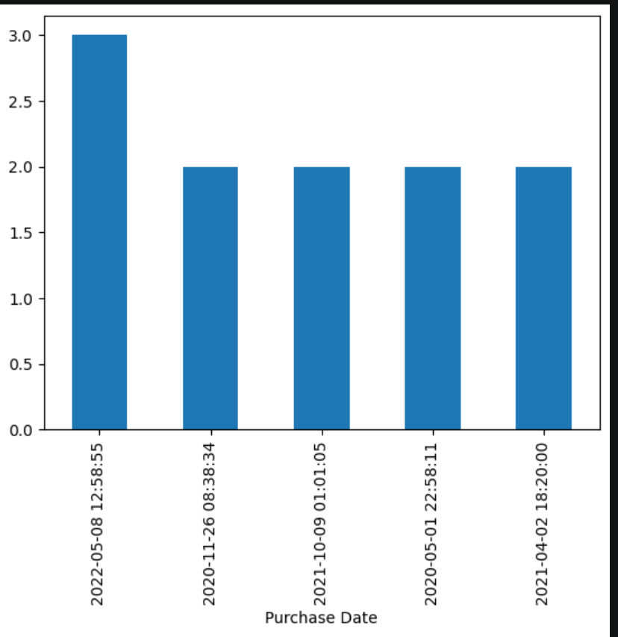
Bar Chart
Bar chart compares category frequencies.

Slide 7
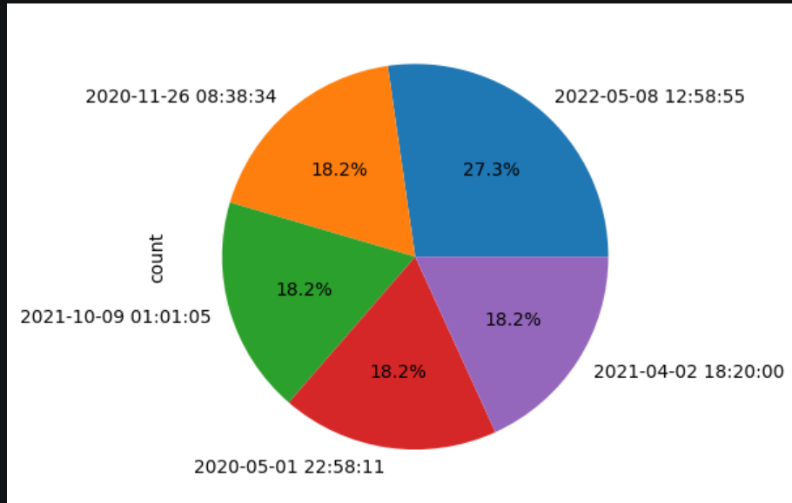
Pie Chart
Pie chart shows percentage contribution.

Slide 8
Insights
1. Customer behavior trends are visible
2. Some categories are more dominant
3. Data helps business decisions

Slide 9
Recommendations
1. Use targeted marketing
2. Improve customer engagement
3. Focus on high-performing categories

Slide 10
Conclusion
Data analytics helps businesses understand customers and improve decision-making.

