Slide 1
Superstore Sales Performance Analysis
Internship Project Report

Slide 2
Project Objective
Analyze sales performance across regions, categories, and time.
Identify best and worst performing products
Study seasonal sales trends
Build KPIs and dashboards
Suggest tactical business improvements

Slide 3
Key Performance Indicators (KPIs)
Important metrics used in the analysis:
Total Revenue
Total Profit
Profit Margin
Average Order Value (AOV)
Regional Sales Contribution
Shipping Performance

Slide 4
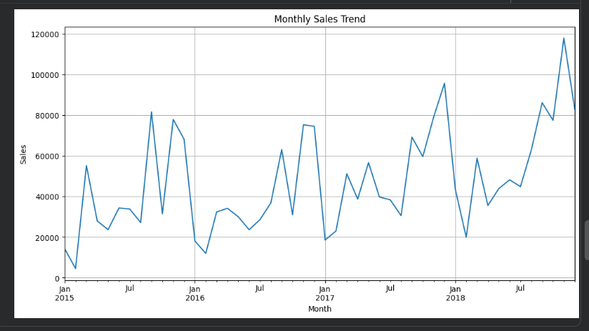
Sales Trend Analysis

Slide 5
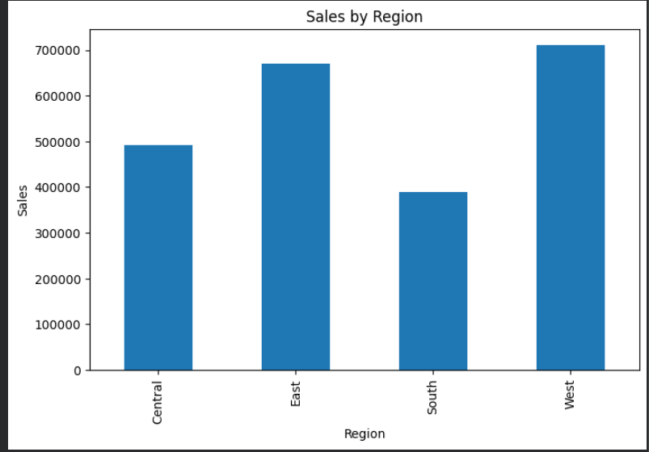
Regional Profitability

Slide 6
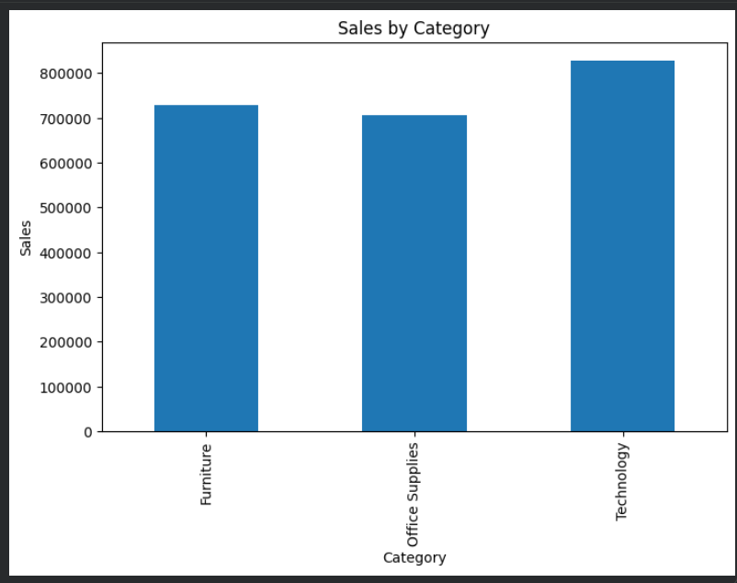

Slide 7
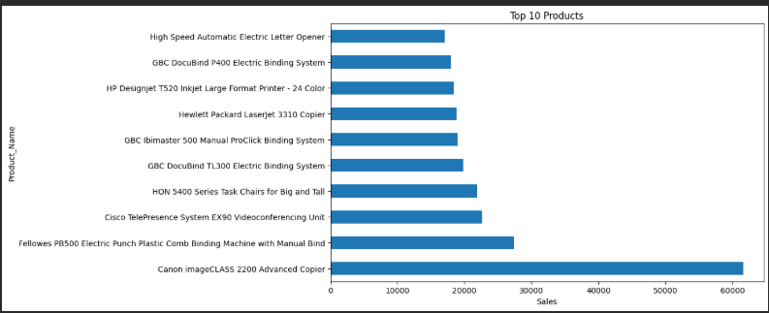

Slide 8
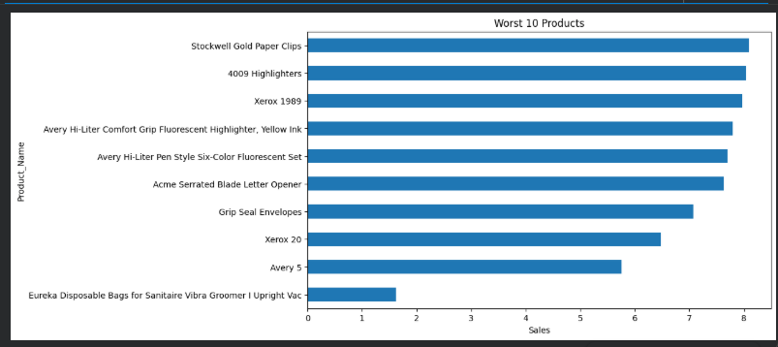

Slide 9
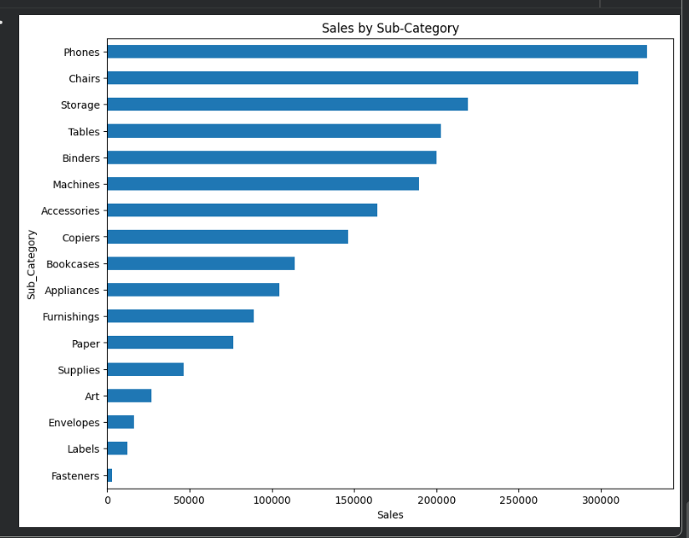

Slide 10
Product Performance Insights
Key observations from product analysis:
Technology products generated the highest revenue
Certain furniture products had low profit margins
Top-selling products contributed significantly to total sales
Loss-making products need pricing optimization

Slide 11
5 Tactical Improvements for Alfido Tech
Recommended business actions:
Increase focus on high-profit categories
Reduce discounts on loss-making products
Launch seasonal campaigns during peak months
Improve regional inventory management
Optimize shipping and delivery timelines

Slide 12
Conclusion
The analysis highlights strong sales opportunities in profitable categories and regions. Seasonal demand patterns and product-level insights can help Alfido Tech improve profitability and operational efficiency.

