Slide 1

Multi Output Ridge Regressor for Predicting Brain Connectivity Over Time
Kaggle group ID: 1
Batuhan Özdöl Ezgi Alçiçek
Onur Yavuz Ergut Yusuf Utku Gül
Kaggle rank: 5
Notes:
1

Slide 2
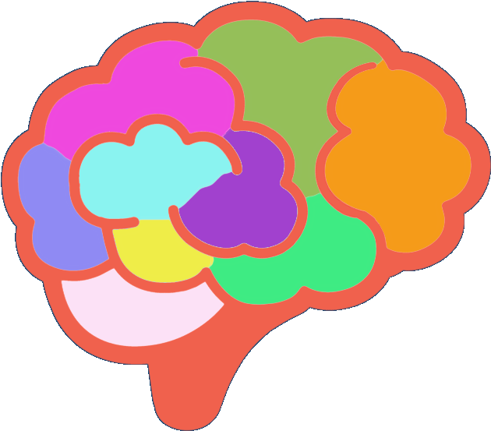


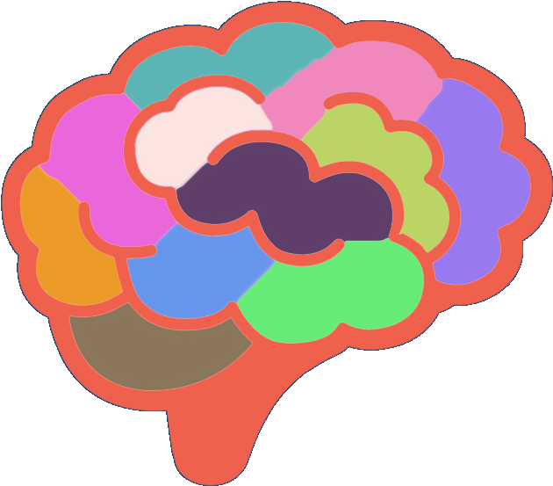
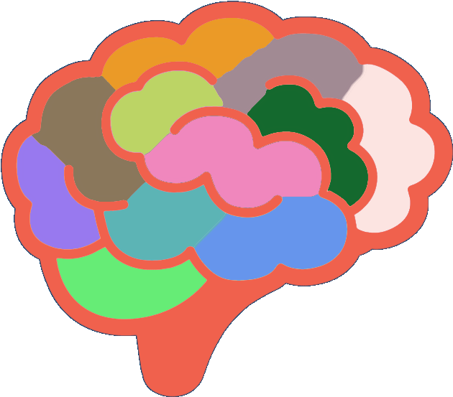
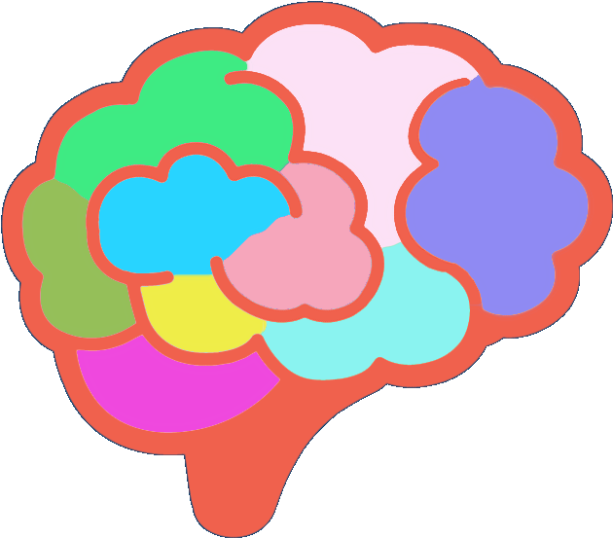
What is our main goal?
T₀
T₁
Predict brain connectivity features
Use regression models
?
Notes:
2

Slide 3
Problem
‘Overfitted’
Minimum error
Avoid overfitting
Notes:
3

Slide 4
Improvement Process
Data Preprocessing
Model Selection
Parameter Tuning
Training
Testing
Improvement until optimal result

Slide 5

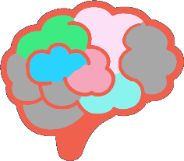

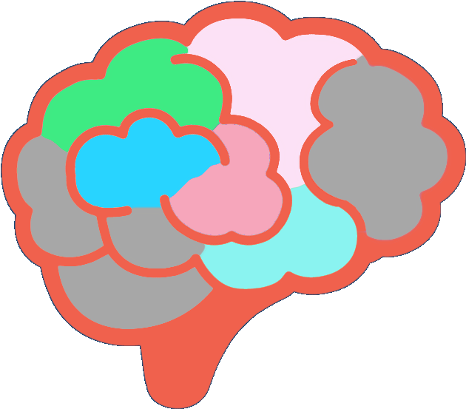



Data Preprocessing
Preparing data for proccessing
Applying feature selection with least square backward elimination technique
Outlier samples removed
Feature selection
Data reducing
Notes:
5

Slide 6
Model Selection & Parameter Tuning
Selecting the best model after testing and comparing constantly.
Tuning the parameters of the model with the same method.
Model comparison chart
Parameter comparison chart

Slide 7
Our Model
Minimize
sum of the squared residuals
+
lambda * slope²
Regularization strength
Notes:
7

Slide 8
How to further improve our model?
Increasing sample rate (interpolation)
Dividing samples to use with different models

Slide 9
Thank you

