Slide 1

Bitocracy: “In Blockchain We Trust”
Direct democracy with decentralized Bitcoin blockchain
Transparent, unhackable, and anonymous
Solves problem of group decisions and central server causing corruption
Notes:
Use Bitcoin or other crypto-currencys secure, anonymous, digital transaction system to create an inexpensive, totally secure, public online voting system. Benefits of using crypto currency blockchains for democratic voting: Anonymous: Allows for anonymous voting Trust: Permanently Auditable: you can forever view/audit unchangeable public ledger voting records in blockchain. Security: Difficult or impossible to falsify vote counts or records or allow repeated voting. Open: Source code is open, tested, and trusted Extensibility: New voting features can be added. Reliability: Bitcoin system has almost perfect uptime. Decentralized: Runs on trusted public Bitcoin infrastructure. No hardware investment needed.

Slide 2
Use Cases
Government: local town issues and budget
Personal: social club decisions and fun
Corporate: group software team decisions instead of PM, features everyone wants

Slide 3
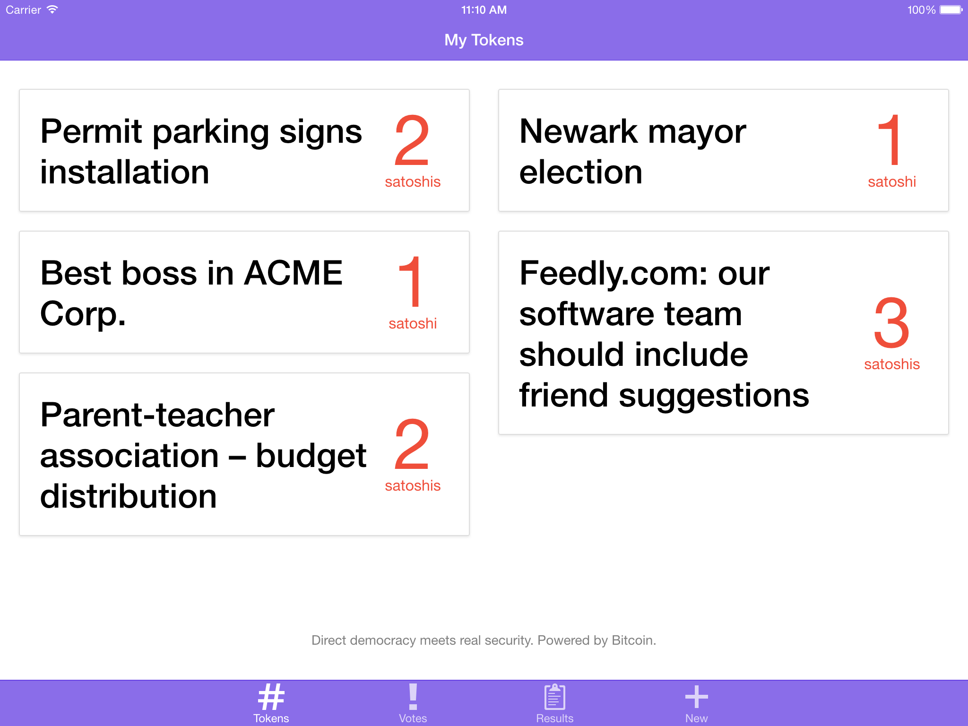
Decentralized Backend
Leader sends out unique link to voting pool
Clicking on the link in the app gives you 0.000001BTC
Decide issue and click vote
Sends BTC back to leader with message
Message contains vote, used for total

