Slide 1
Domain Name System(DNS) Security Issues and Mitigation Techniques
Name : Mohd Gulam Ansari
Roll No : 242CS023
Class : M. Tech. Computer Science (Sem-1)

Slide 2
Overview
Introduction
Problem statement
Security Challenges
Existing Research on DNS Attack
Methodology to Mitigate DNS Issue
Result and Discussion
Future Scope
Conclusion
References

Slide 3
Introduction
What does the below number sequence denote?
93.184.216.34
As internet usage is increasing tremendously, so is the number of websites.
To visit any website, we need the IP address of the web server which hosts the site. Searching the website using the IP address is not an easy task.
Moreover, the IP address of a site will be changing. This will create more overhead to the user.

Slide 4
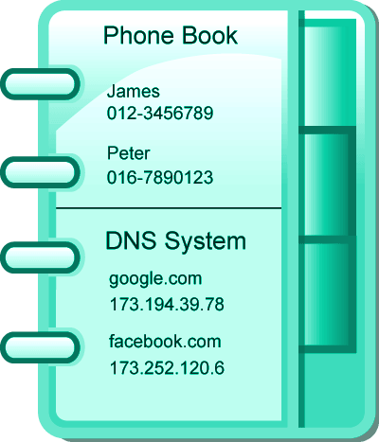
What is DNS ?
The Domain Name System (DNS) is a hierarchical and distributed name service that provides a naming system for computers, services, and other resources on the Internet or other Internet Protocol (IP) networks.
The system by which Internet domain names and addresses are tracked and regulated as defined by IETF RFC 1034 and other related RFCs.

Slide 5
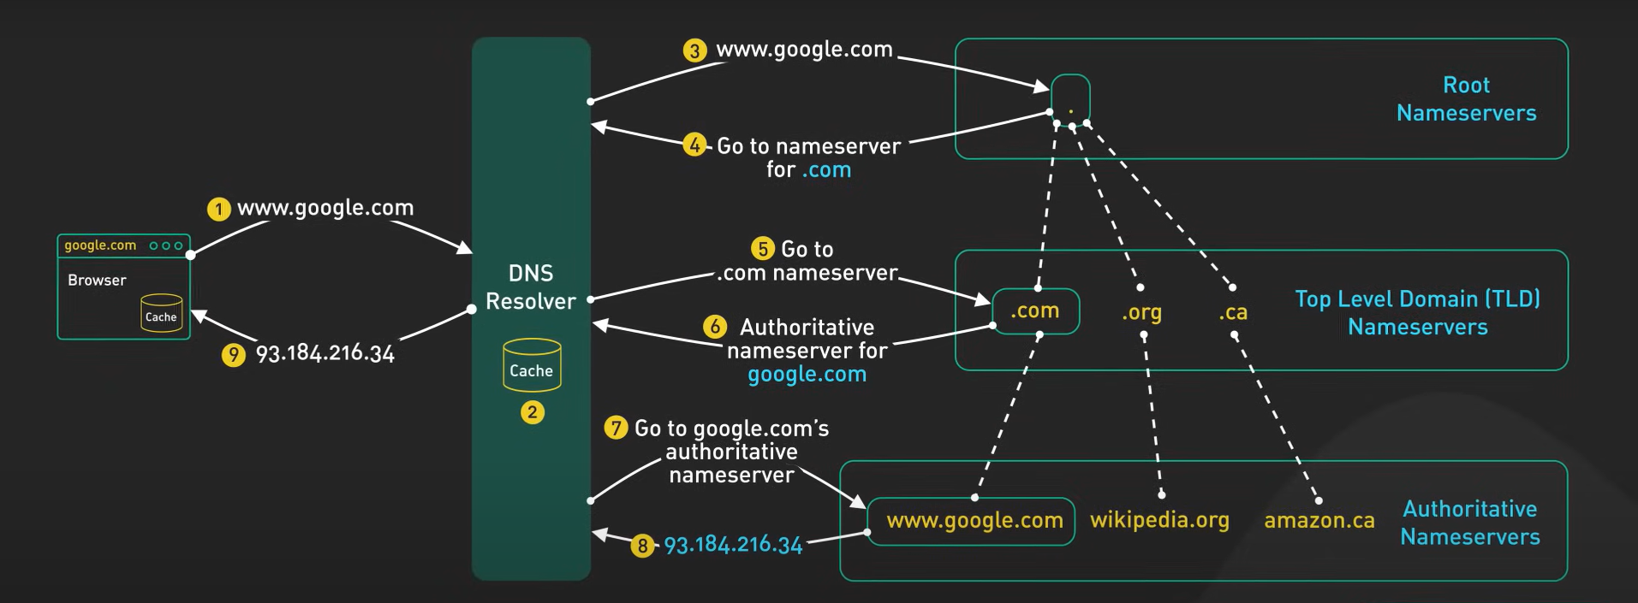
Working of Domain Name System (DNS)

Slide 6
Problem Statement
The Domain Name System (DNS), originally designed in the 1980s, for small network without any security consideration, leaving it vulnerable to attacks such as DNS spoofing.
When a recursive resolver queries an authoritative name server, it has no way to verify the authenticity of the response beyond checking the source IP address, which can easily be forged.
As a result, attackers can impersonate authoritative servers by spoofing responses, redirecting users to malicious websites without detection. This significant vulnerability in DNS design poses a serious risk to internet security and user privacy.

Slide 7
Vulnerabilities of DNS in Internet Functioning
DNS is inherently vulnerable to attacks because it was designed with minimal security in mind. Some of the main reasons for its vulnerabilities include:
No Authentication: DNS lacks built-in mechanisms for verifying the authenticity of responses, making it susceptible to DNS spoofing or cache poisoning attacks.
Unencrypted Communication:
DNS requests and responses are often transmitted in plaintext, exposing them to man-in-the-middle attacks where attackers can intercept and manipulate DNS data.
DDoS Attacks: DNS servers can be overwhelmed by Distributed Denial of Service (DDoS) attacks, disrupting internet access for users trying to resolve domain names.
Open Resolvers: Many DNS servers are configured as open resolvers, which can be exploited in amplification attacks, increasing the scale of DDoS attacks.

Slide 8
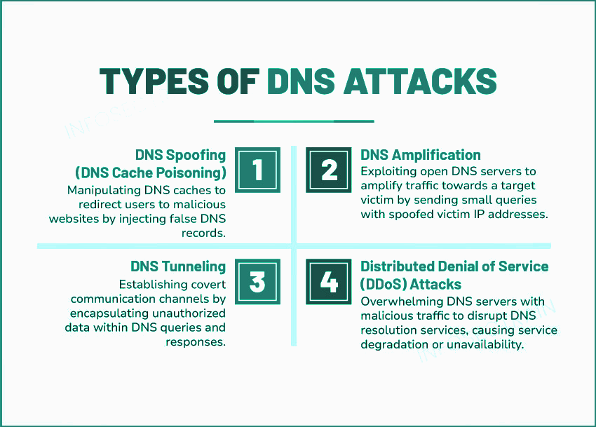

Slide 9
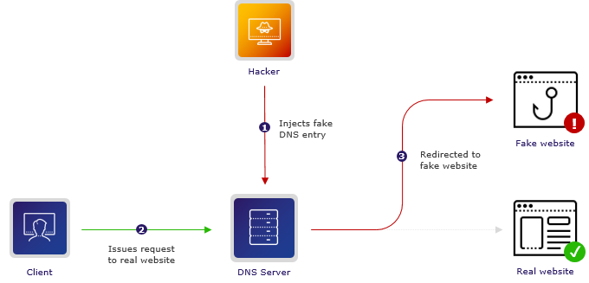
DNS Spoofing :
Working:
Attacker tries to inject a fake address into the cache of DNS Server.
If the server accepts the fake one, the cache is ‘poisoned’.
Requests are then answered by the attacker’s server.
Potential Impacts:
DNS spoofing can lead to users unknowingly visiting malicious websites, resulting in various consequences such as phishing attacks, malware distribution, or data theft and credential hijacking.

Slide 10
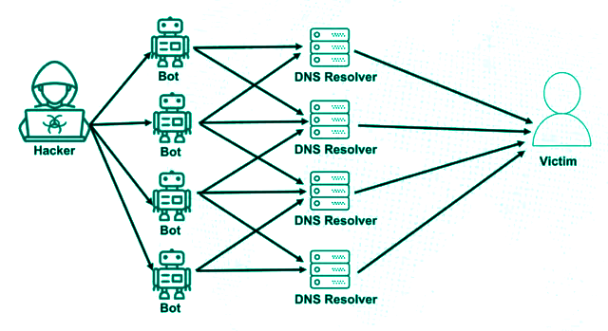
DNS Amplification:
Working:
Attackers send small DNS queries to these open DNS servers with spoofed source IP addresses belonging to the victim. The DNS servers then respond with much larger responses, effectively amplifying the volume of traffic directed toward the victim’s network.
Potential Impacts:
DNS amplification attacks can overwhelm network bandwidth, leading to service degradation or complete unavailability for legitimate users.
DNS Amplification Attack

Slide 11
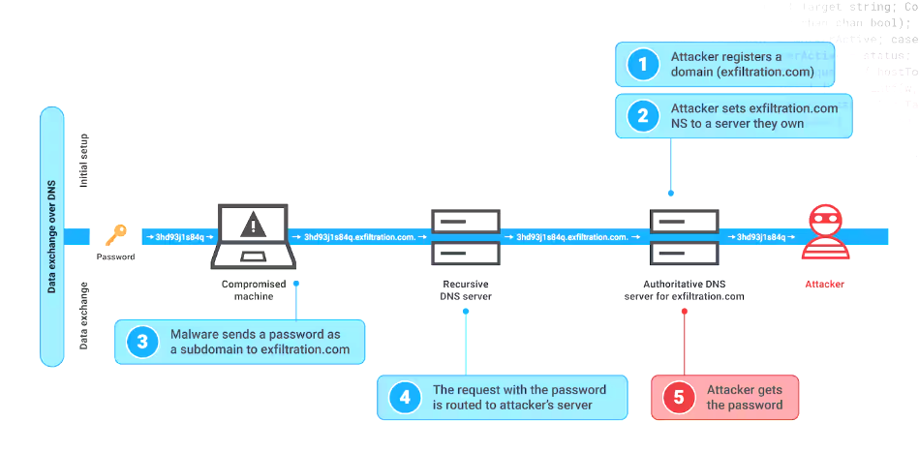
DNS Tunneling:
Working:
The attacker registers a host domain.
Infect a target computer with malware.
Connect Infected Computer to the Hacker’s Website.
Pass Malicious Code Through DNS Resolver.
Potential Impacts:
DNS tunneling can lead to severe impacts, such as data exfiltration (theft of sensitive information) and circumvention of network security (bypassing firewalls and filters), potentially enabling unauthorized access or malware communication.

Slide 12
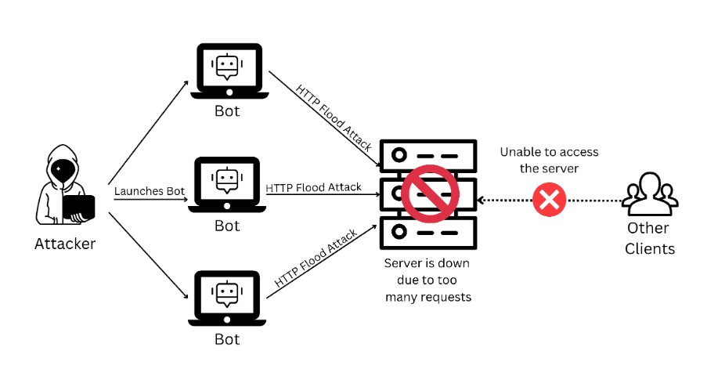
Distributed Denial of Service (DDoS) Attacks:
Working:
Botnet Setup: Attackers infect multiple devices to create a botnet.
Flood of DNS Queries: The botnet sends overwhelming DNS requests to the target server.
Resource Overload: The DNS server becomes overloaded, depleting its resources.
Service Outage: Legitimate users are denied access as the server fails to respond.
Potential Impacts:
The attack can cause service disruption, downtime, revenue loss, and network congestion.
DNS Flood Attack

Slide 13
Methodology to Mitigate DNS Issues

Slide 14
Domain Name System Security Extensions
DNSSEC protects against DNS spoofing attacks or 'cache poisoning' by ensuring DNS information is validated cryptographically before the DNS server redirects the end-user to the website.
Algorithm :
Client queries for a DNS Record from its local recursive server.
Local recursive server retrieves DNS record along with public keys of authoritative server.
Local Recursive Server validates public keys of authoritative server through the DS record stored on the TLD server.
Local Recursive Server retrieves public keys for TLD server.
Local Recursive Server validates TLD server public keys through the DS record stored on the Root server.
Local Recursive Server retrieves public keys for Root server.
Local Recursive Server validate the Root server.
DNS query is returned once the servers have been all validated.

Slide 15
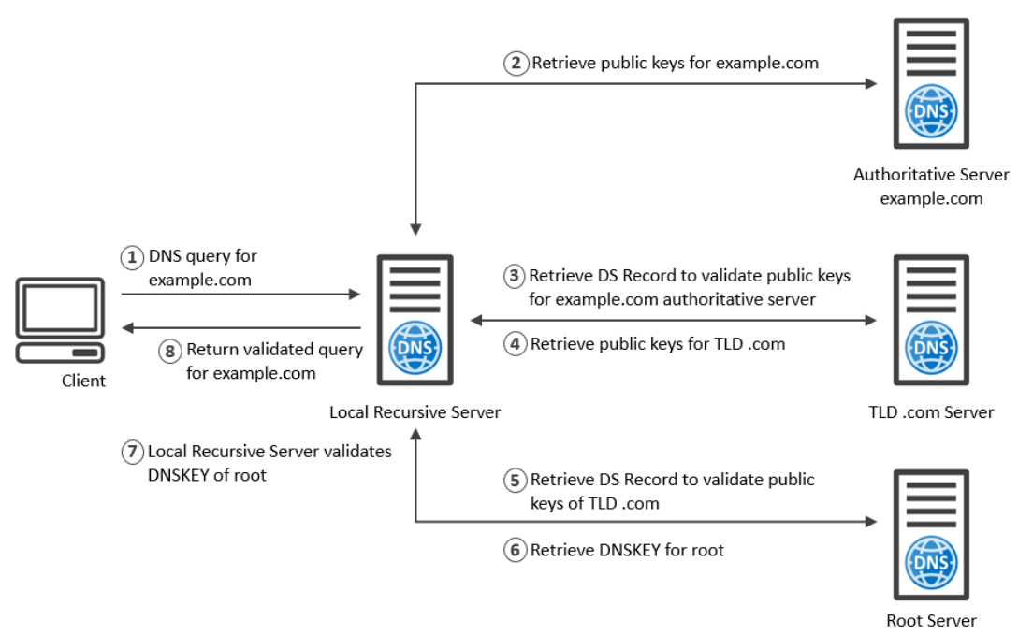
Domain Name System Security Extensions

Slide 16
RRL - Response Rate Limiting
RRL, or Response Rate Limiting, is an enhancement to the DNS protocol which serves as a mitigation tool for the problem of DNS amplification attacks.
Algorithm :
RRL is an algorithm that limits the number of DNS responses a DNS server sends to a particular client in a specific timeframe.
How it works:
When the server detects that too many responses are being sent to a single source (potentially from spoofed requests), it throttles or blocks further responses. This reduces the effectiveness of DNS amplification by limiting the number of large responses.

Slide 17
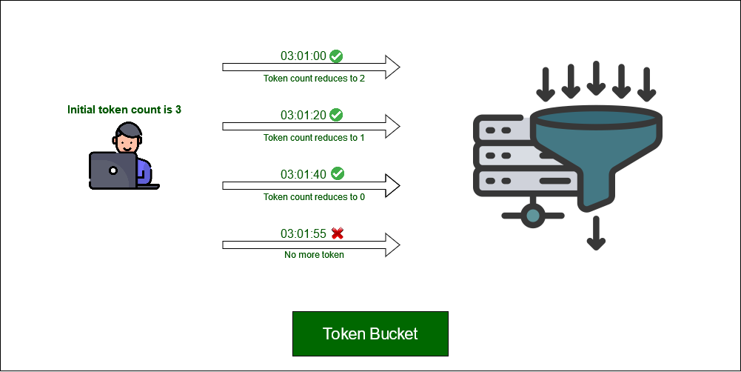
RRL - Response Rate Limiting
Token Bucket

Slide 18
DNS Encryption and DNS-over-HTTPS Blocking
DNS over HTTPS (DoH) is a protocol that encrypts DNS queries and responses using the HTTPS protocol which can mitigate DNS Tunneling Attack.
Algorithm :
Block or inspect DNS-over-HTTPS (DoH) and DNS-over-TLS (DoT) requests to avoid tunneling over encrypted channels.
How it works:
DoH and DoT encrypt DNS traffic, making it harder to inspect and detect tunneling. Organizations can block DNS over these protocols or force the use of centralized, monitored DNS servers.

Slide 19
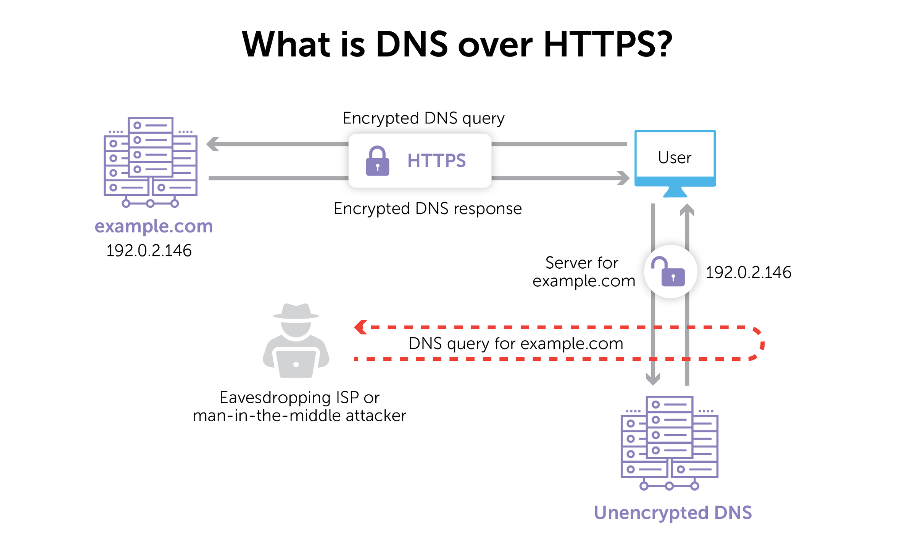
DNS Encryption and DNS-over-HTTPS Blocking

Slide 20
Cloud-based DDoS Protection:
DNS Firewalling is a technique that is used to resolve DNS Flooding Attack.
Cloud-based DDoS Mitigation platforms use sophisticated algorithms to detect and mitigate DNS flood attacks.
How it works:
Cloud providers can absorb DNS flood traffic by distributing it across a large, globally distributed infrastructure. They use advanced AI-based traffic filtering, rate limiting, and IP reputation filtering to scrub malicious traffic before it reaches the DNS servers.
This ensures that legitimate DNS traffic still gets through, while malicious traffic is discarded in the cloud.

Slide 21
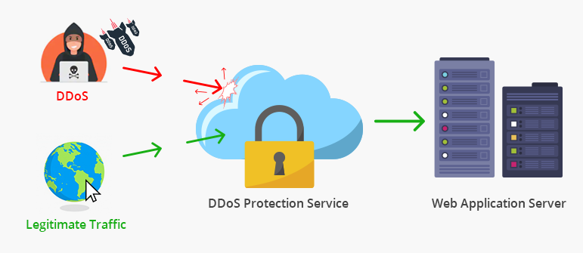
Cloud-based DDoS Protection:

Slide 22
Result and Discussion :
Type of DNS Attack | Description | Impact | Estimated Percentage Impact | Source
DNS Spoofing/Cache Poisoning | Attackers insert false DNS records into a resolver cache. | Users are redirected to malicious sites. | 30% - 40% of DNS attacks | Cisco
DNS Amplification Attack | Attackers exploit DNS servers to flood a target with traffic. | Service disruption and increased load on servers. | 25% - 35% of DDoS attacks | Cloudflare
DNS Tunneling | Data is exfiltrated over DNS queries and responses. | Data breaches and unauthorized access. | 15% - 20% of data breaches | Imperva
DNS Flood Attack | Overloading DNS servers with queries to exhaust resources. | Service unavailability. | 20% - 30% of DNS-based attacks | A10 Networks

Slide 23
Future Scope :
Zero Trust Architectures: Moving DNS to a zero-trust model, where DNS queries are authenticated and verified continuously, will help mitigate these types of attacks.
Blockchain-Based DNS: A blockchain-based DNS system is decentralized, meaning that no single entity controls the entire domain registration or resolution process. The blockchain ledger is distributed across multiple nodes, making it harder for attackers to compromise the entire system.
Post-Quantum Cryptography (PQC): As quantum computers become a potential threat to current encryption methods, post-quantum cryptography will be essential in safeguarding DNS queries and responses from being compromised by future quantum attacks.

Slide 24
Conclusion :
DNS Security is Essential: DNS is vulnerable to attacks like DNS spoofing and DDoS, which threaten online safety. Strengthening DNS security is crucial to protect users and data.
Effective Mitigation Techniques: Solutions like DNSSEC and DNS over HTTPS help reduce these risks by ensuring secure and reliable communication.
Future Focus: Advancements like blockchain-based DNS and new encryption methods will further improve DNS security against future threats

Slide 25
References :
“The Evolution of DNS Security and Privacy”, Levente Csikor, Dinil Mon Divakaran. (2023)
“The Role of DNS Security in Mitigating Cyber Threats: An Analysis of Recent Attacks and Recommended Strategies”,Arindam Bhattacharya. (2023)
“DNS Security: Attacks and Countermeasures”, Fazlali et al. (2020)
“A Survey on DNS Security Issues and Mitigation Techniques”, Anju Ramdas,Ramakrishnan Muthukrishnan .( 2019)

Slide 26
“There are only two different types of companies in the world: those that have been breached and know it and those that have been breached and don’t know it.”
― Ted Schlein

Slide 27

Thank
You

