Slide 1
RESTful API Security
Under The Guidance :
Professor P. Santhi Thilagam
Name : Mohd Gulam Ansari
Roll No : 242CS023
Class : M. Tech. CSE

Slide 2
Overview
Introduction
REST API Architecture
HTTP Methods and Status Code
Implementation of REST API Demonstration
Authentication & Authorization
Session Based Authentication
JWT Based Authentication
DDoS Attack and Mitigation
Conclusion
References

Slide 3
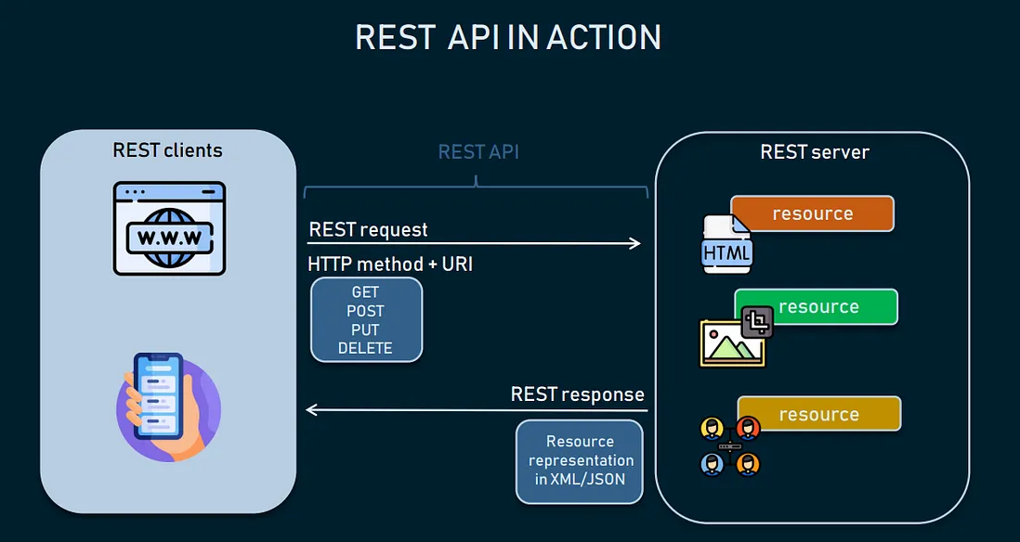
Introduction
REST API stands for Representational State Transfer API. It is a type of API (Application Programming Interface) that allows communication between different systems over the internet.
APIs are the backbone of modern applications, enabling seamless communication between services, platforms, and devices.
If APIs aren’t properly secured, hackers can use them to steal data or break into systems.

Slide 4
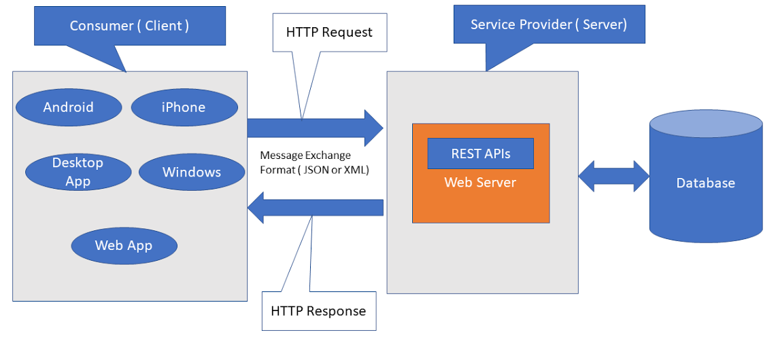
RESTful API Architecture
Client and Server Model : The client (like a phone or browser) sends a request, and the server replies with the data.
Stateless Communication : Each request from the client must contain all the info the server needs — it doesn't remember past requests.
Use of HTTP Methods : REST APIs use common web actions like GET (to read), POST (to send), PUT (to update), and DELETE (to remove data).

Slide 5
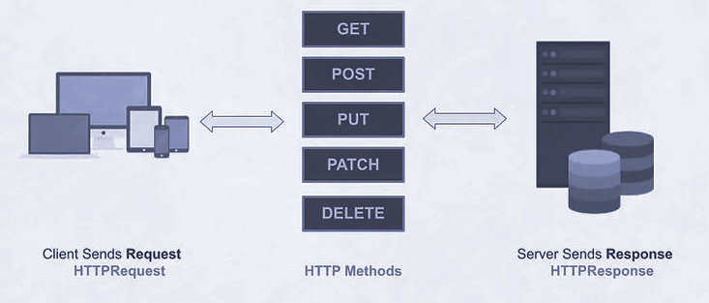
HTTP Methods and Status Codes

Slide 6
HTTP Methods and Status Codes
Each method tells the API what action to perform, and the status code shows if it worked or failed.
HTTP Method | Action | Example Endpoint | What it Does
GET | Fetch all patients | /patients/ | Returns a list of all patients
GET | Fetch one patient | /patients/5 | Returns details of patient with ID = 5
POST | Create a new patient | /patients/ | Adds a new patient to the system
PUT | Update patient info | /patients/5 | Updates info of patient with ID = 5
DELETE | Delete a patient | /patients/5 | Deletes patient with ID = 5

Slide 7
HTTP Methods and Status Codes
Status Code | Meaning | In Our Patient API - Action
200 OK | Success | Data fetched, updated, or deleted successfully
201 Created | New resource added | New patient was created and added to the database
400 Bad Request | Input is invalid | Missing or incorrect data (e.g. empty name or age field)
401 Unauthorized | Not logged in or invalid | Accessing a protected route without token (if auth used)
404 Not Found | Resource doesn't exist | Patient with the given ID doesn't exist
500 Server Error | Internal crash | Server error like DB crash or unhandled exception

Slide 8
RESTful API Implementation
Tech Stack:
Programming Language : Python
Libraries and Tools : FastAPI, Pydantic for data validation, Uvicorn, Render for deployment
Key Features:
1. Create, Read, Update, Delete (CRUD) for Patient data
2.Input validation using Pydantic as python is dynamically type language
3.API Documentation with Swagger UI
Live Demo Link:
https://patient-api-zo4v.onrender.com

Slide 9
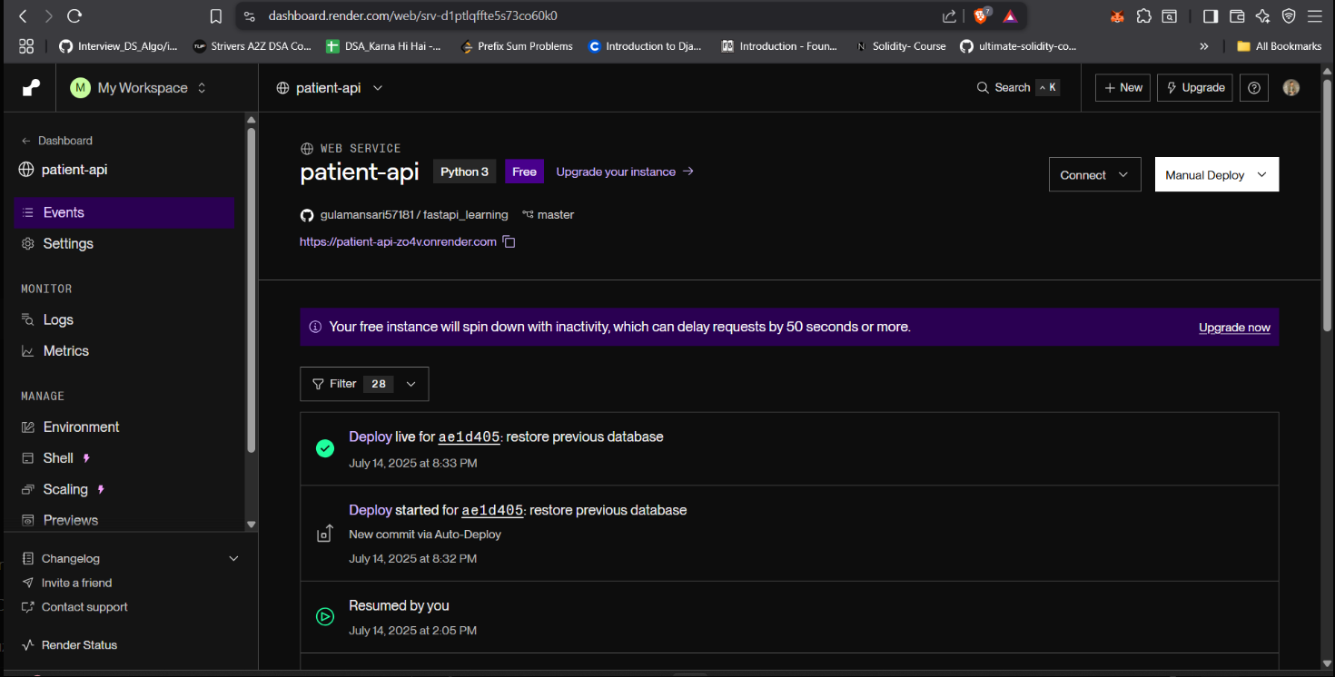
Implementation Snapshots
Patient API is live and hosted on Render at: https://patient-api-zo4v.onrender.com

Slide 10
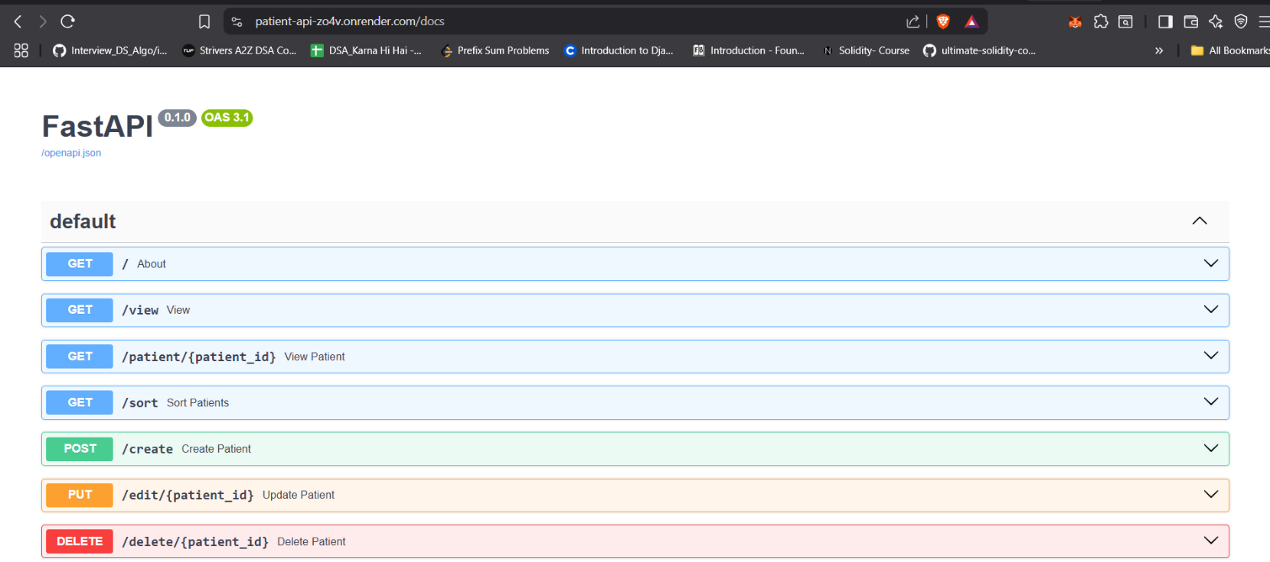
Implementation Snapshots
The interactive Swagger documentation displays all available Patient API endpoints with HTTP methods.

Slide 11
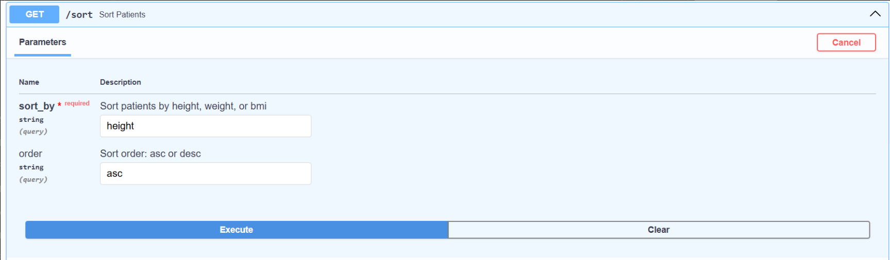
Implementation Snapshots
GET /sort Endpoint : This endpoint allows sorting patient data by height, weight, or BMI using query parameters.

Slide 12
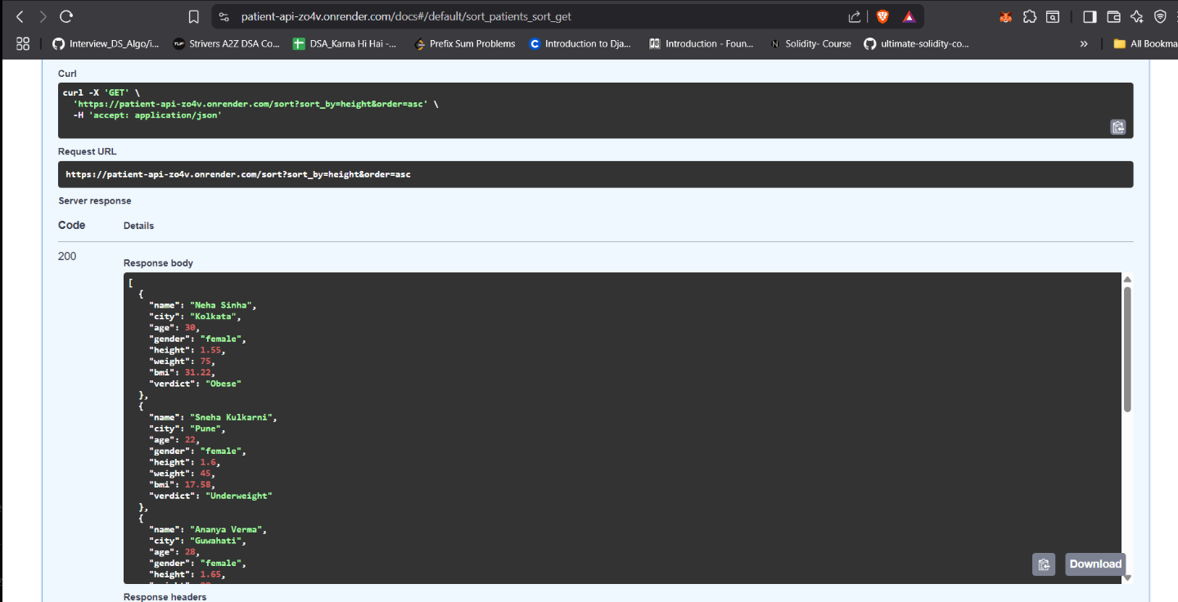
Implementation Snapshots
Sort API Response Example : /sort endpoint showing patients sorted by height in ascending order.

Slide 13
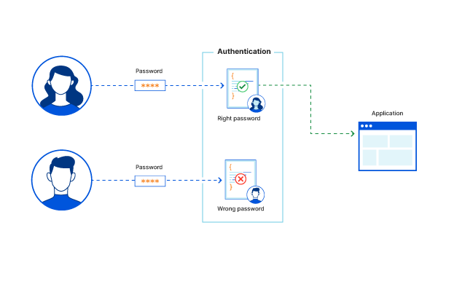
Authentication & Authorization
Authentication :
Authentication is an important part of identity and access management (IAM), which dictates who can view data and what they can do with it.
Authorization :
Authorization is concerned with permissions, or what someone is allowed to do once they gain access to a protected system or resource.
They protect our RESTful API from unauthorized access and misuse.
Image source : https://www.cloudflare.com/learning/access-management/what-is-authentication/

Slide 14
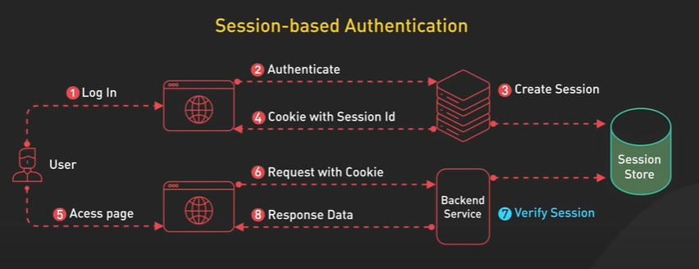
Session-Based Authentication
Working:
When a user logs in, the server creates a session and stores it (usually in memory or a database).
The server sends a session ID to the user’s browser, which is stored as a cookie.
For every request, the browser automatically sends the session ID, and the server uses it to identify the user.
It is for websites because it’s simple and browser-friendly, but it struggles with scalability and doesn’t work well for stateless APIs or mobile apps
Image Source :Bytesystem.com/session-based-authentication

Slide 15
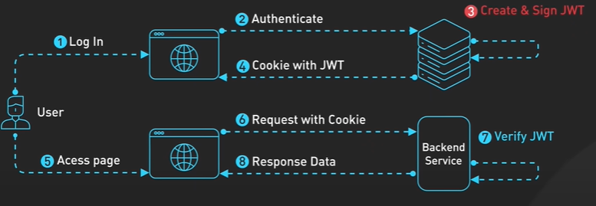
JWT-Based Authentication
Working:
When a user logs in, the server generates a JWT (JSON Web Token) and sends it to the client.
The client stores this token (usually in localStorage or memory).
The token is sent with every request (in the header), and the server verifies it.
JWT is perfect for APIs and mobile apps because it’s stateless and scalable, but harder to revoke access of the user (token expiry mechanism).
Image Source :ByteSystem.com/jwt-authentication

Slide 16
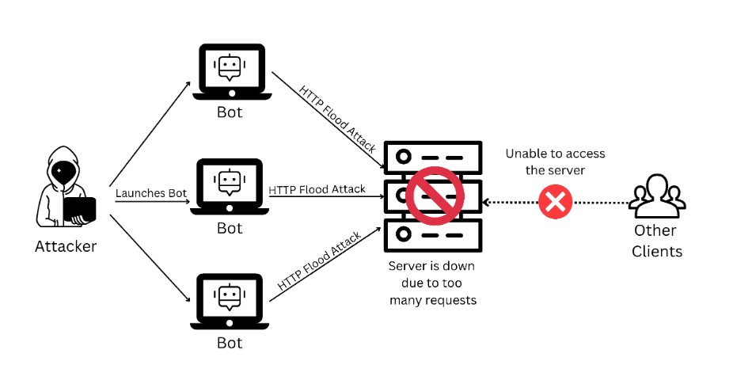
Distributed Denial of Service (DDoS) Attacks:
Working:
Botnet Setup: Attackers infect multiple devices to create a botnet.
Flood of DNS Queries: The botnet sends overwhelming requests to the target server.
Resource Overload: The server becomes overloaded, depleting its resources.
Service Outage: Legitimate users are denied access as the server fails to respond.
Potential Impacts:
The attack can cause service disruption, downtime, revenue loss, and network congestion.

Slide 17
RRL - Response Rate Limiting
RRL, or Response Rate Limiting, is an enhancement which serves as a mitigation tool for the problem of amplification attacks.
Algorithm :
RRL is an algorithm that limits the number of responses a server sends to a particular client in a specific timeframe.
How it works:
When the server detects that too many responses are being sent to a single source (potentially from spoofed requests), it throttles or blocks further responses. This reduces the effectiveness of amplification by limiting the number of large responses.

Slide 18
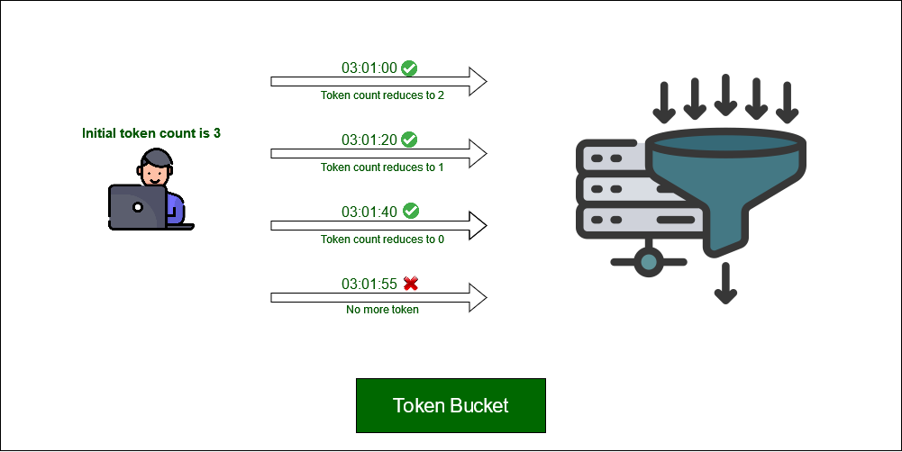
RRL - Response Rate Limiting
Token Bucket

Slide 19
Conclusion :
Understood how RESTful APIs working — including HTTP methods, status codes, and how their clients and servers architecture.
Learn to built and deployed my own Patient API — using FastAPI, with Swagger UI for testing and Render for live hosting.
Explored and implemented JWT Authentication — to protect sensitive endpoints and control access using tokens.
Gained hands-on understanding of common API security threats and how to protect APIs using input validation, authentication and rate limiting.

Slide 20
References :
“Security measures implemented in RESTful API Development”,Arvind A Kumar
and Divya TL (2024)
Lokesh Gupta. (2024, October 23). REST API Best Practices. RESTfulAPI.net — Includes sections on security, versioning, and performance
Postman. (2024). API Security Best Practices. Postman Learning Center. https://learning.postman.com/docs/sending-requests/authorization/
FastAPI. (2024). Security - First Steps. FastAPI Official Documentation. https://fastapi.tiangolo.com/tutorial/security/
https://bytebytego.com/guides/api-web-development/
Github Link of Project : https://github.com/gulamansari57181/fastapi_learning/tree/master

Slide 21

Thank
You

