Slide 1
Introduction to Differential Privacy
Z. Gu 2020

Slide 2

Motivation
Large companies collect lots of data from consumers, but how to protect privacy of each individual?
https://www.apple.com/privacy/approach-to-privacy/

Slide 3
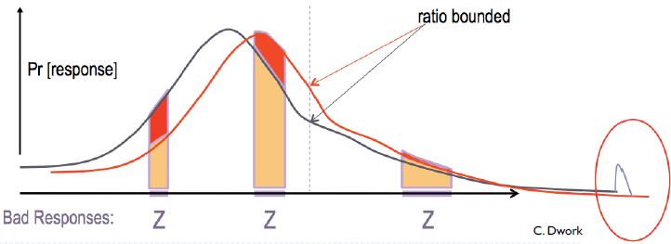
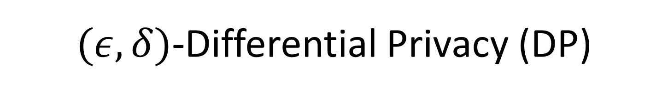
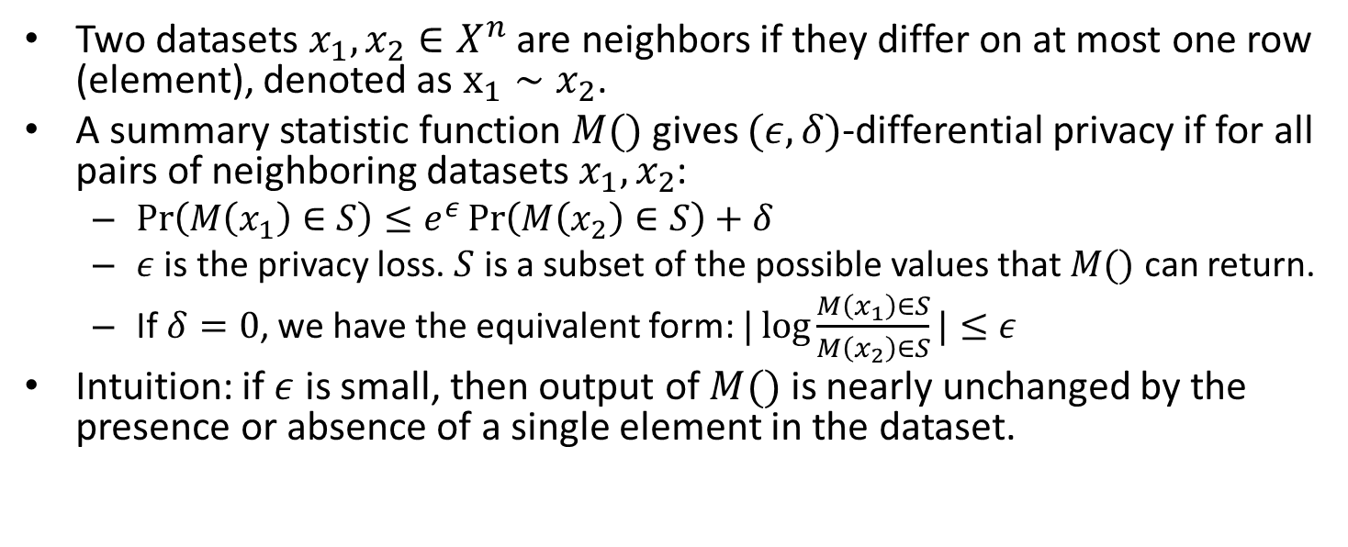
$(ε,δ)$-Differential Privacy (DP)
Two datasets $x_{1},x_{2}∈X^{n}$ are neighbors if they differ on at most one row (element), denoted as $x_{1}∼x_{2}$.
A summary statistic function $M()$ gives $(ε,δ)$-differential privacy if for all pairs of neighboring datasets $x_{1},x_{2}$:
$\operatorname{Pr}\left(M\left(x_{1}\right)∈S\right)≤e^{ε}\operatorname{Pr}\left(M\left(x_{2}\right)∈S\right)+δ$
$ε$ is the privacy loss. $S$ is a subset of the possible values that $M()$ can return.
If $δ=0$, we have the equivalent form: $|\log{\frac{M\left(x_{1}\right)∈S}{M\left(x_{2}\right)∈S}}|≤ε$
Intuition: if $ε$ is small, then output of $M()$ is nearly unchanged by the presence or absence of a single element in the dataset.
Notes:
A summary statistic function $A()$ gives $ε$-differential privacy if for all pairs of datasets $S,S′$ differing in only one element, and all choices of the test set $Q$:
$\operatorname{Pr}\left(A\left(S\right)∈Q\right)≤e^{ε}\operatorname{Pr}\left(A\left(S^{′}\right)∈Q\right)$, or equivalently:
$$|\log{\frac{\operatorname{Pr}\left(A\left(S\right)∈Q\right)}{\operatorname{Pr}\left(A\left(S^{′}\right)∈Q\right)}}|≤ε$$
where $ε$ is the privacy loss
Thanks to randomness introduced by $A().$
Intuition: if $ε$ is small, then output of $A()$ is nearly unchanged by the presence or absence of a single element in the test set $Q$.

Slide 4

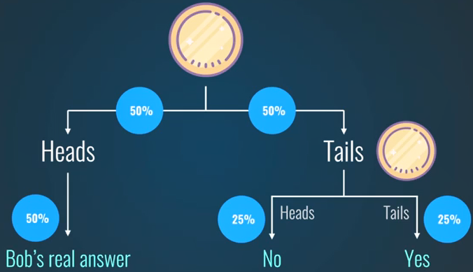
DP Toy Example
Suppose I want to know the expected/average percentage of people who pick their nose without revealing whether any specific individual picks his/her nose
I can use a survey to collect yes/no answers, then add noise by flipping a coin for each individual as follows
DP only works for sufficiently large datasets
Will introduce non-negligible errors for small datasets

Slide 5
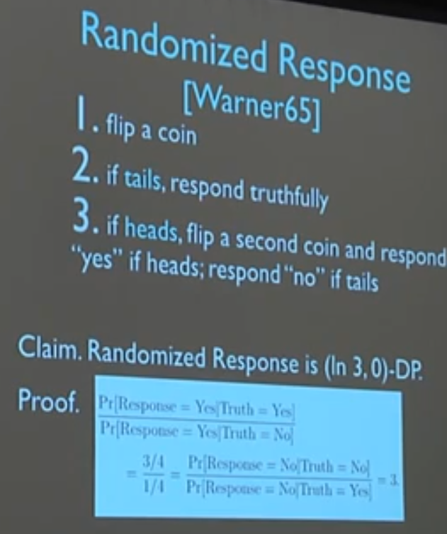
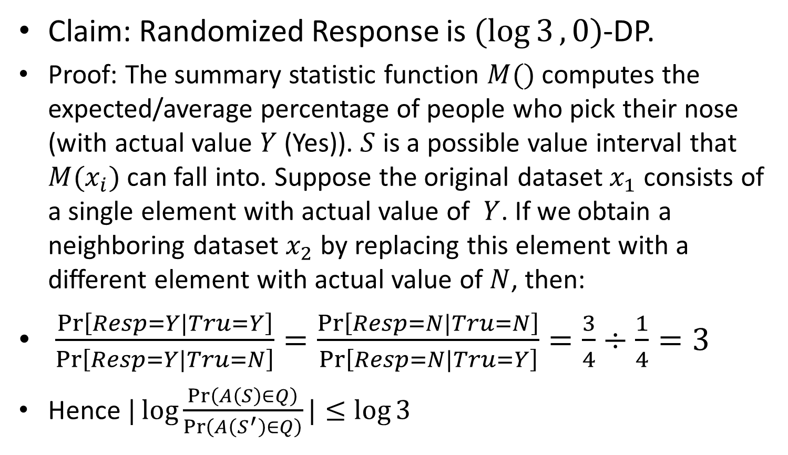
DP Example: Randomized Response
Claim: Randomized Response is $(\log{3},0)$-DP.
Proof: The summary statistic function $M()$ computes the expected/average percentage of people who pick their nose (with actual value $Y$ (Yes)). $S$ is a possible value interval that $M(x_{i})$ can fall into. Suppose the original dataset $x_{1}$ consists of a single element with actual value of $Y$. If we obtain a neighboring dataset $x_{2}$ by replacing this element with a different element with actual value of $N$, then:
$\frac{\operatorname{Pr}\left[Resp=Y|Tru=Y\right]}{\operatorname{Pr}\left[Resp=Y|Tru=N\right]}=\frac{\operatorname{Pr}\left[Resp=N|Tru=N\right]}{\operatorname{Pr}\left[Resp=N|Tru=Y\right]}=\frac{3}{4}÷\frac{1}{4}=3$
Hence $|\log{\frac{\operatorname{Pr}\left(A\left(S\right)∈Q\right)}{\operatorname{Pr}\left(A\left(S^{′}\right)∈Q\right)}}|≤\log{3}$

Slide 6

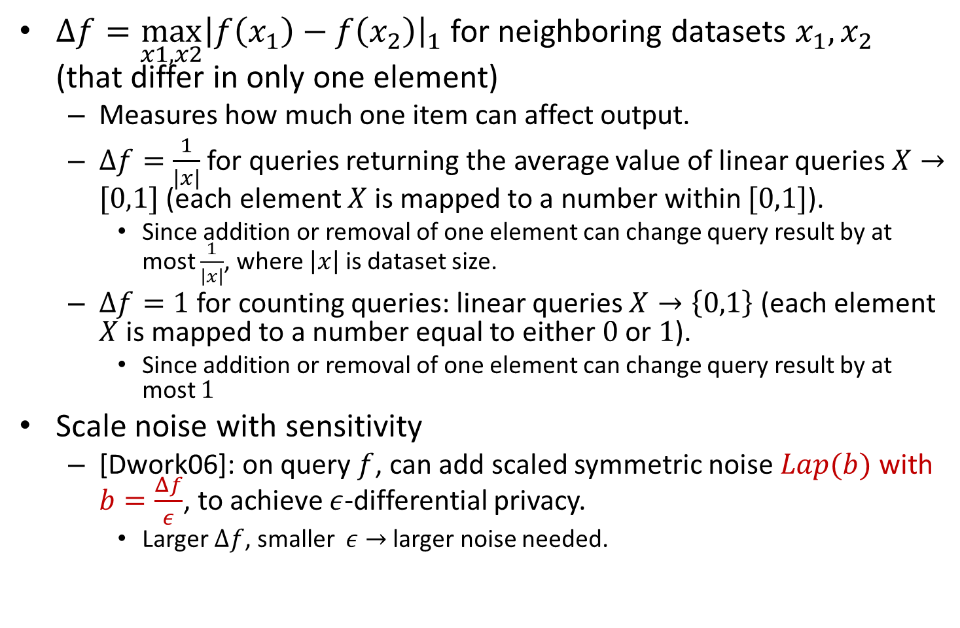
Sensitivity of a Function $f$
$Δf={\max_{x1,x2}\left|f\left(x_{1}\right)−f\left(x_{2}\right)\right|}_{1}$ for neighboring datasets $x_{1},x_{2}$ (that differ in only one element)
Measures how much one item can affect output.
$Δf=\frac{1}{\left|x\right|}$ for queries returning the average value of linear queries $X→[0,1]$ (each element $X$ is mapped to a number within $[0,1]$).
Since addition or removal of one element can change query result by at most $\frac{1}{\left|x\right|}$, where $\left|x\right|$ is dataset size.
$Δf=1$ for counting queries: linear queries $X→\left\{0,1\right\}$ (each element $X$ is mapped to a number equal to either $0$ or $1$).
Since addition or removal of one element can change query result by at most $1$
Scale noise with sensitivity
[Dwork06]: on query $f$, can add scaled symmetric noise $Lap(b)$ with $b=\frac{Δf}{ε}$, to achieve $ε$-differential privacy.
Larger $Δf$, smaller $ε→$ larger noise needed.
Notes:
sensitivity is 1/|x| for queries returning the average
value of count queries mapping X to {0,1}
• linear queries : X →[0,1] over the dataset (think
statistical queries)

Slide 7
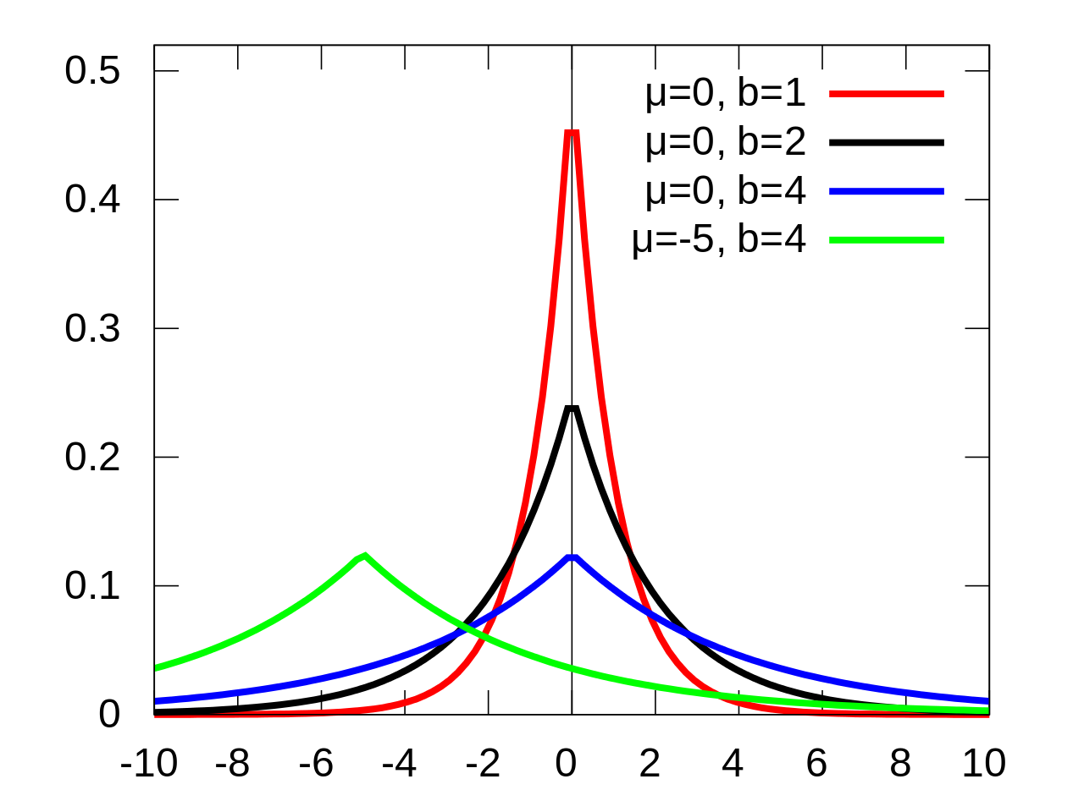

Laplacian Distribution
$pdf\left(x\right)=f\left(x|μ,b\right)=\frac{1}{2b}exp⁡(−\frac{\left|x−μ\right|}{b})$, variance=$2b^{2}$
For random var $X∼Lap\left(b\right),\operatorname{Pr}\left(\left|X\right|≥bt\right)=e^{−t}$
Notes:
$$p_{x}\left(μ,b\right)=$$

Slide 8
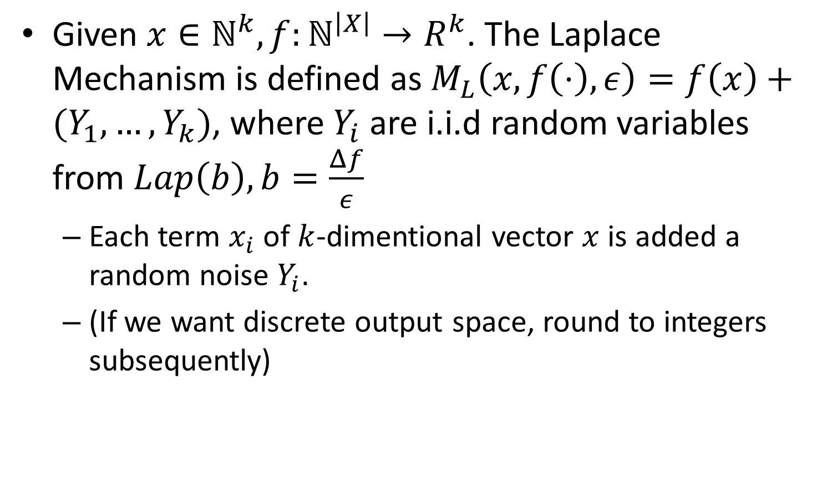
Laplace Mechanism
Given $x∈ℕ^{k},f:ℕ^{\left|X\right|}→R^{k}$. The Laplace Mechanism is defined as $M_{L}\left(x,f\left(⋅\right),ε\right)=f\left(x\right)+(Y_{1},…,Y_{k})$, where $Y_{i}$ are i.i.d random variables from $Lap\left(b\right), b=\frac{Δf}{ε}$
Each term $x_{i}$ of $k$-dimentional vector $x$ is added a random noise $Y_{i}$.
(If we want discrete output space, round to integers subsequently)

Slide 9
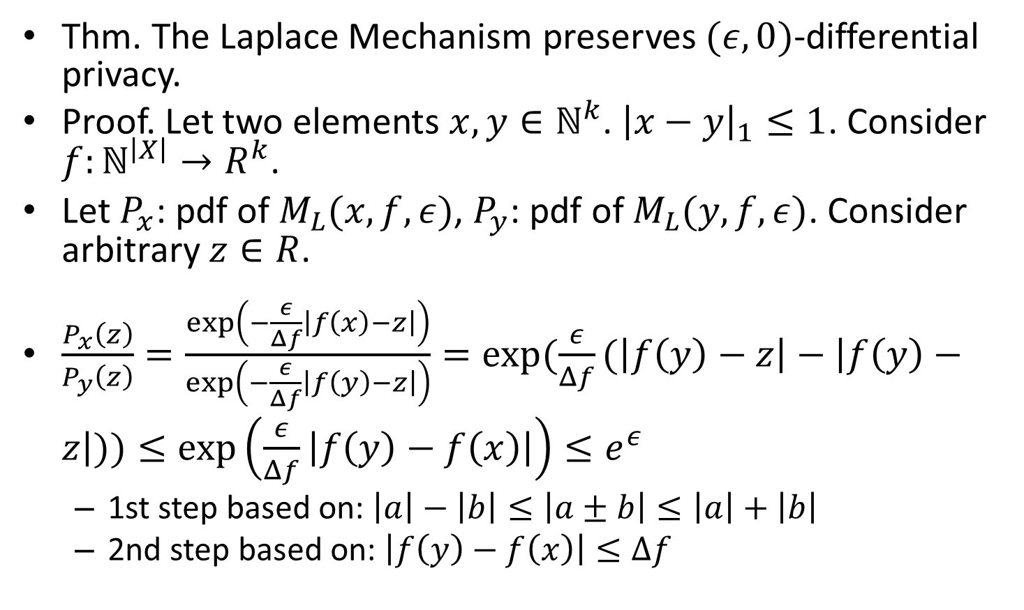
Laplace Mechanism
Thm. The Laplace Mechanism preserves $(ε,0)$-differential privacy.
Proof. Let two elements $x,y∈ℕ^{k}$. ${\left|x−y\right|}_{1}≤1$. Consider $f:ℕ^{\left|X\right|}→R^{k}$.
Let $P_{x}$: pdf of $M_{L}(x,f,ε)$, $P_{y}$: pdf of $M_{L}(y,f,ε)$. Consider arbitrary $z∈R$.
$\frac{P_{x}\left(z\right)}{P_{y}\left(z\right)}=\frac{\exp\left(−\frac{ε}{Δf}\left|f\left(x\right)−z\right|\right)}{\exp\left(−\frac{ε}{Δf}\left|f\left(y\right)−z\right|\right)}=\exp{(\frac{ε}{Δf}(\left|f\left(y\right)−z\right|−\left|f\left(y\right)−z\right|))}≤\exp\left(\frac{ε}{Δf}\left|f\left(y\right)−f\left(x\right)\right|\right)≤e^{ε}$
1st step based on: $\left|a\right|−\left|b\right|≤\left|a±b\right|≤\left|a\right|+\left|b\right|$
2nd step based on: $\left|f\left(y\right)−f\left(x\right)\right|≤Δf$

Slide 10
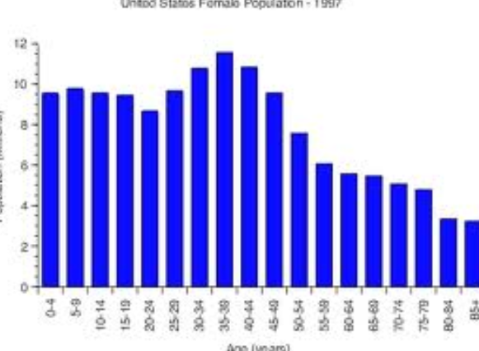
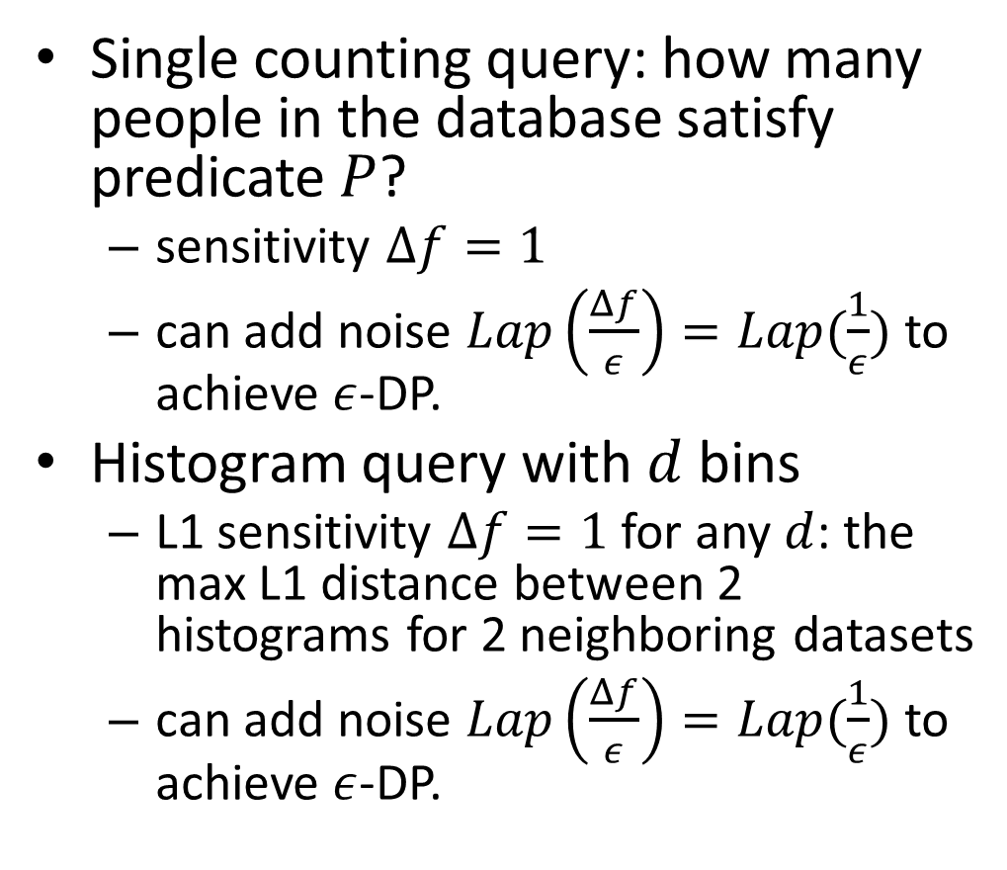
Applying the Laplace Mechanism
Single counting query: how many people in the database satisfy predicate $P$?
sensitivity $Δf=1$
can add noise $Lap\left(\frac{Δf}{ε}\right)=Lap(\frac{1}{ε})$ to achieve $ε$-DP.
Histogram query with $d$ bins
L1 sensitivity $Δf=1$ for any $d$: the max L1 distance between 2 histograms for 2 neighboring datasets
can add noise $Lap\left(\frac{Δf}{ε}\right)=Lap(\frac{1}{ε})$ to achieve $ε$-DP.
Notes:
but actually only need ~Lap(1/ε), since
sensitivity generalizes as max L1 distance

Slide 11
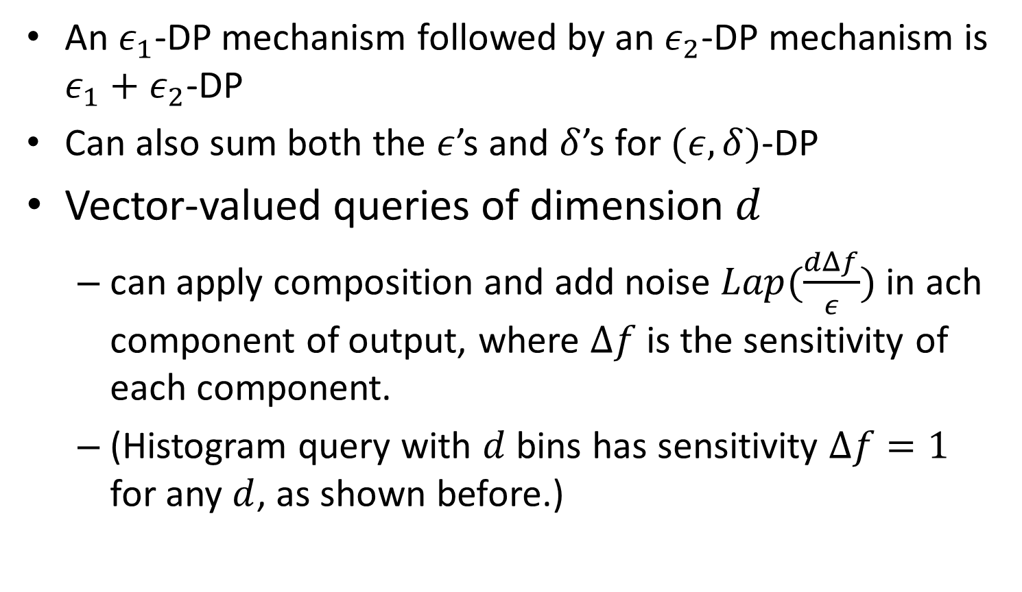
Composition of Multiple Queries
An $ε_{1}$-DP mechanism followed by an $ε_{2}$-DP mechanism is $ε_{1}+ε_{2}$-DP
Can also sum both the $ε$’s and $δ$’s for $(ε,δ)$-DP
Vector-valued queries of dimension $d$
can apply composition and add noise $Lap(\frac{dΔf}{ε})$ in ach component of output, where $Δf$ is the sensitivity of each component.
(Histogram query with $d$ bins has sensitivity $Δf=1$ for any $d$, as shown before.)
Notes:
(Could also split the noise unevenly. Could also
treat the queries separately and apply
composition.)

Slide 12
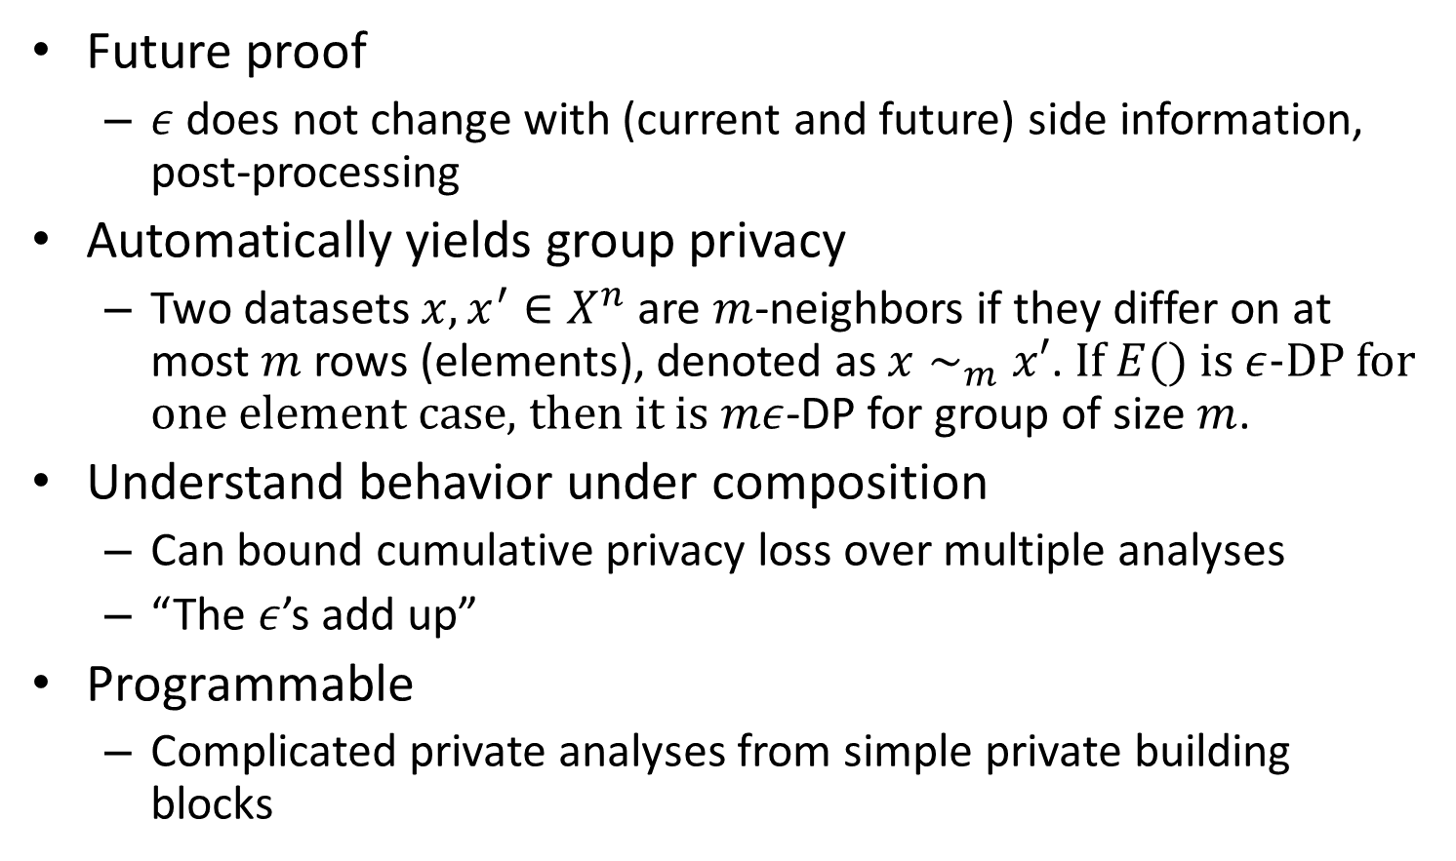
Properties of DP
Future proof
$ε$ does not change with (current and future) side information, post-processing
Automatically yields group privacy
Two datasets $x,x^{′}∈X^{n}$ are $m$-neighbors if they differ on at most $m$ rows (elements), denoted as $x∼_{m}x′$. If $E()$ is $ε$-DP for one element case, then it is $mε$-DP for group of size $m$.
Understand behavior under composition
Can bound cumulative privacy loss over multiple analyses
“The $ε$’s add up”
Programmable
Complicated private analyses from simple private building blocks

Slide 13
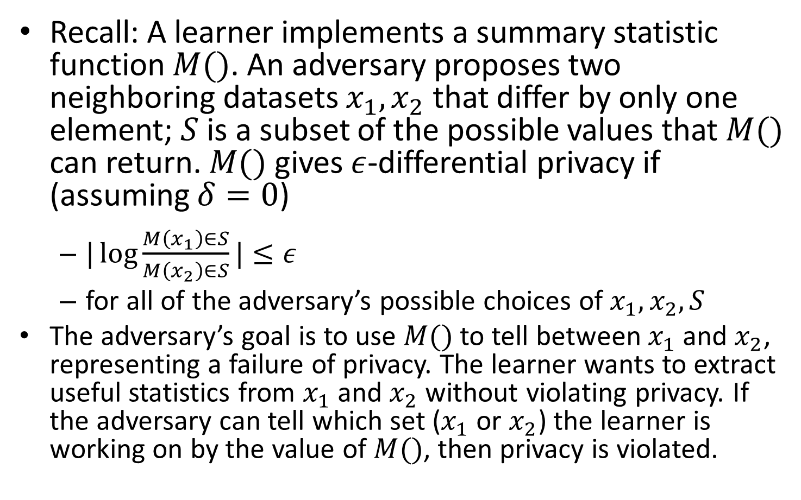
Example: DP in the Presence of Adversary
Recall: A learner implements a summary statistic function $M()$. An adversary proposes two neighboring datasets $x_{1}, x_{2}$ that differ by only one element; $S$ is a subset of the possible values that $M()$ can return. $M()$ gives $ε$-differential privacy if (assuming $δ=0$)
$|\log{\frac{M\left(x_{1}\right)∈S}{M\left(x_{2}\right)∈S}}|≤ε$
for all of the adversary’s possible choices of $x_{1},x_{2},S$
The adversary’s goal is to use $M()$ to tell between $x_{1}$and $x_{2}$, representing a failure of privacy. The learner wants to extract useful statistics from $x_{1}$and $x_{2}$ without violating privacy. If the adversary can tell which set ($x_{1}$ or $x_{2}$) the learner is working on by the value of $M()$, then privacy is violated.
Notes:
Identifying a unique elementrow (the one which changed markings) violates privacy.

Slide 14
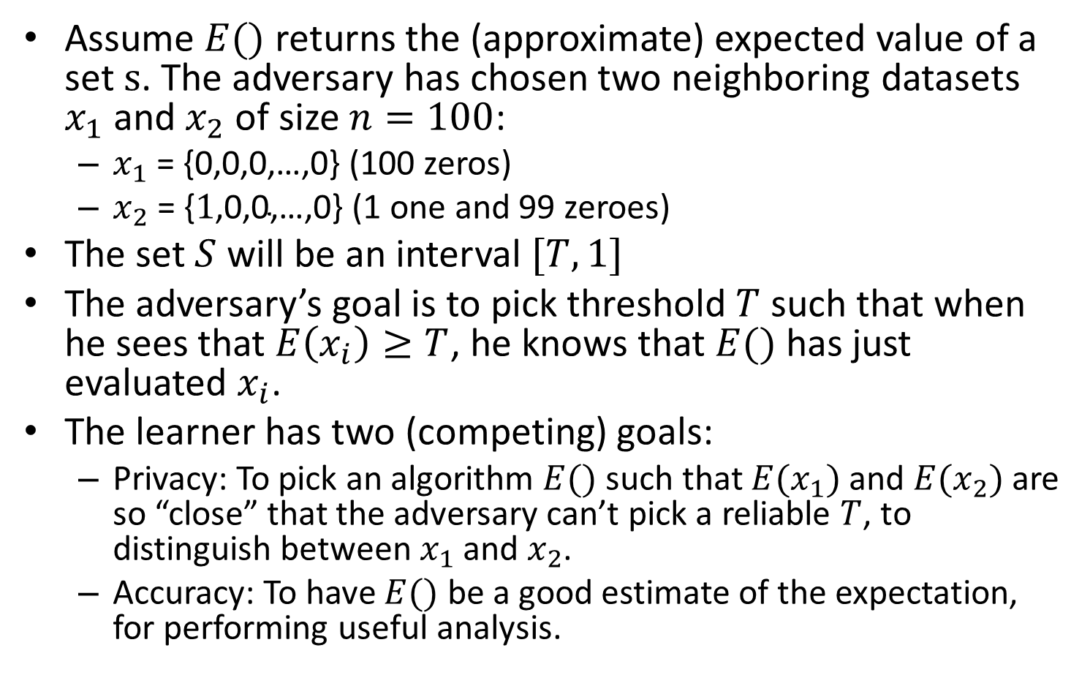
Example: DP in the Presence of Adversary
Assume $E()$ returns the (approximate) expected value of a set $s$. The adversary has chosen two neighboring datasets $x_{1}$ and $x_{2}$ of size $n=100$:
$x_{1} \text{= \{0,0,0,…,0\}}$ (100 zeros)
$x_{2} \text{= \{}1\text{,0,0,…,0\}}$ (1 one and 99 zeroes)
The set $S$ will be an interval $[T,1]$
The adversary’s goal is to pick threshold $T$ such that when he sees that $E\left(x_{i}\right)≥T$, he knows that $E()$ has just evaluated $x_{i}$.
The learner has two (competing) goals:
Privacy: To pick an algorithm $E()$ such that $E(x_{1})$ and $E(x_{2})$ are so “close” that the adversary can’t pick a reliable $T$, to distinguish between $x_{1}$ and $x_{2}$.
Accuracy: To have $E()$ be a good estimate of the expectation, for performing useful analysis.
Notes:
“Close” is defined by epsilon.

Slide 15
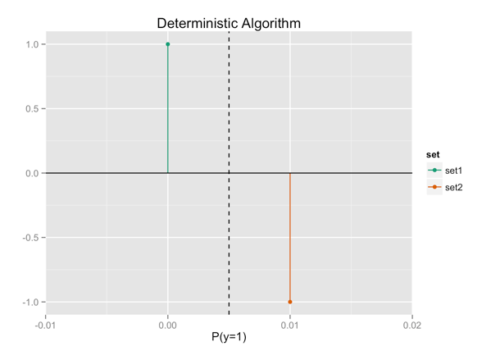
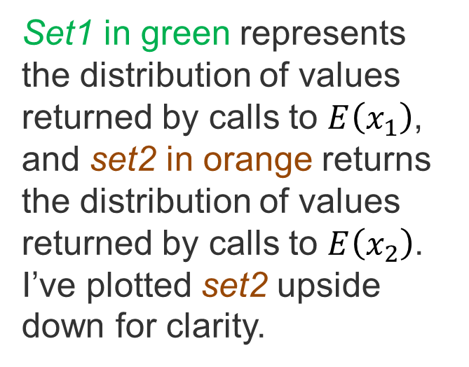
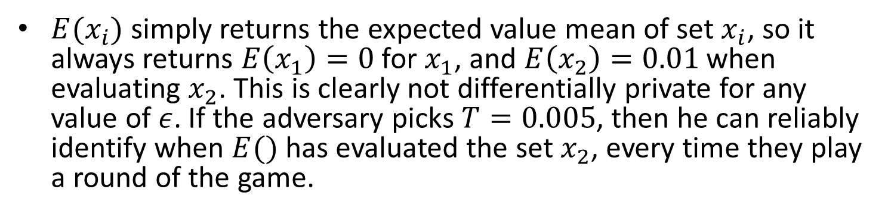
The Deterministic Case
$E(x_{i})$ simply returns the expected value mean of set $x_{i}$, so it always returns $E\left(x_{1}\right)=0$ for $x_{1}$, and $E\left(x_{2}\right)=0.01$ when evaluating $x_{2}$. This is clearly not differentially private for any value of $ε$. If the adversary picks $T=0.005$, then he can reliably identify when $E()$ has evaluated the set $x_{2}$, every time they play a round of the game.
Set1 in green represents the distribution of values returned by calls to $E\left(x_{1}\right)$, and set2 in orange returns the distribution of values returned by calls to $E\left(x_{2}\right)$. I’ve plotted set2 upside down for clarity.

Slide 16
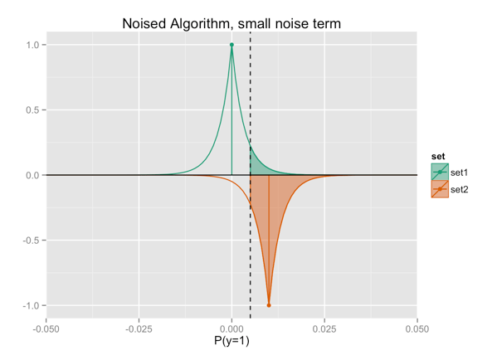


Adding Noise to give Privacy
We add noise from a Laplace distribution with width $σ=\frac{1}{3n}=0.003$ (b in previous slide)
The shaded green region represents the chance that $E\left(x_{i}\right)≥T$, the probability that the adversary will mistake $x_{1}$ for $x_{2}$ in a round of the game. We’ve now made that probability non-zero, but it’s still very likely that if $E\left(x_{i}\right)≥T$, then $x_{i}=x_{2}$
T

Slide 17
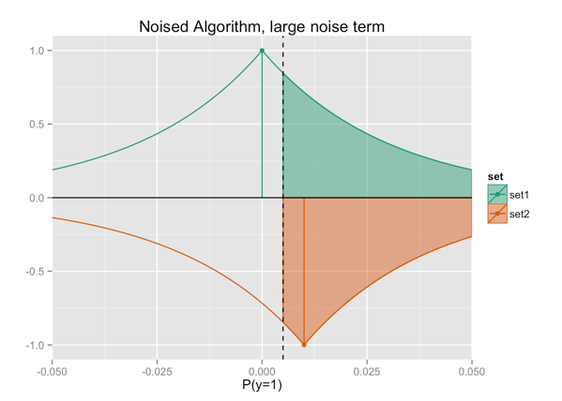

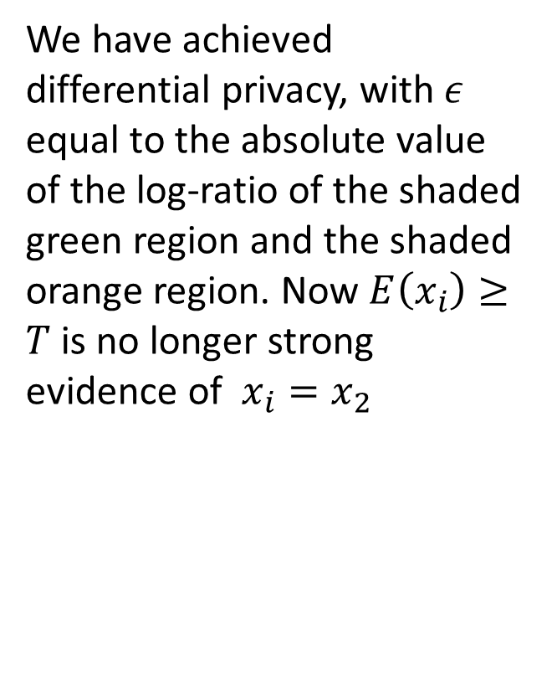
Adding Larger Noise
We add larger noise from a Laplace distribution with width $σ=\frac{3}{n}=0.03>0.01=E\left(x_{2}\right)−E\left(x_{1}\right)$
We have achieved differential privacy, with $ε$ equal to the absolute value of the log-ratio of the shaded green region and the shaded orange region. Now $E\left(x_{i}\right)≥T$is no longer strong evidence of $x_{i}=x_{2}$
T

