Slide 1
Introduction to Differential Privacy
Z. Gu 2020

Slide 2

Motivation
Large companies collect lots of data from consumers, but how to protect privacy of each individual?
https://www.apple.com/privacy/approach-to-privacy/

Slide 3
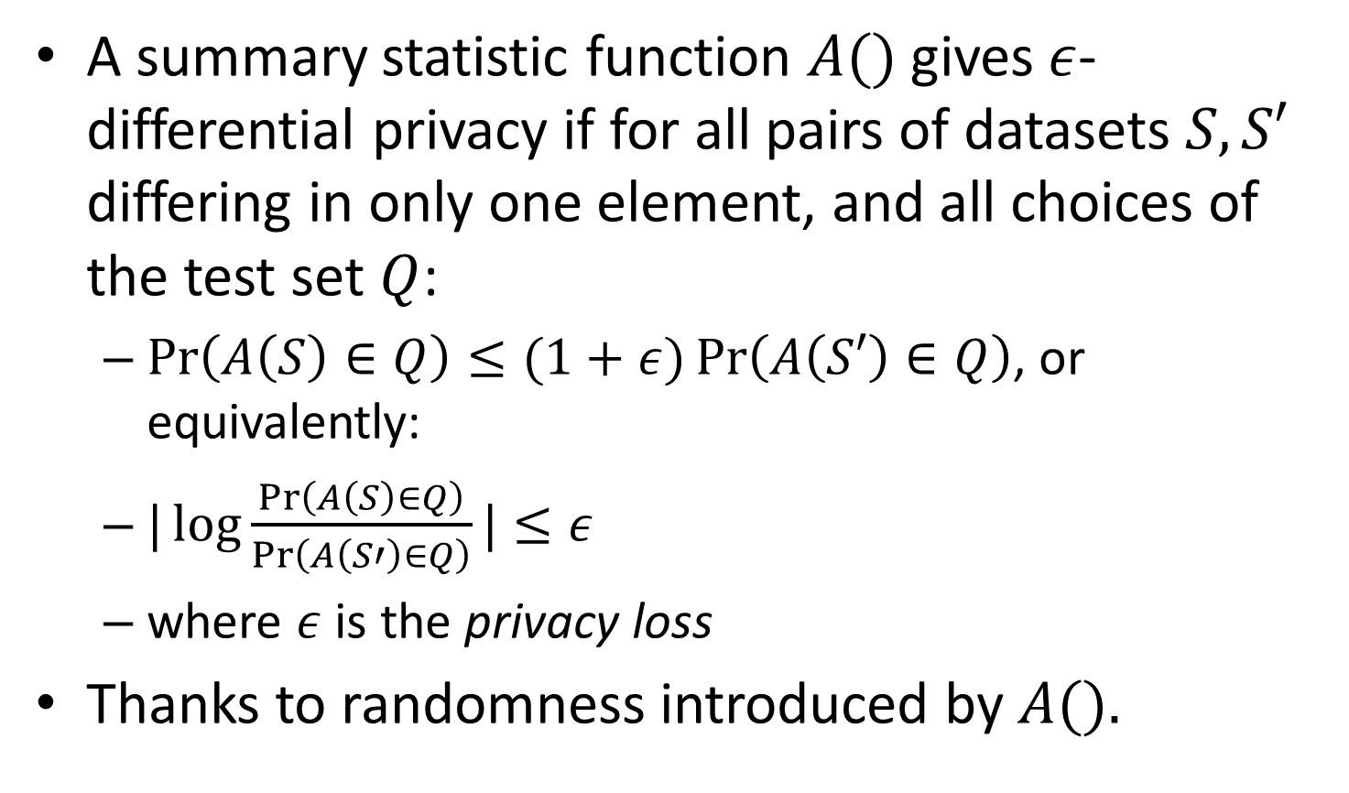
Formal Definition of DP
A summary statistic function $A()$ gives $ε$-differential privacy if for all pairs of datasets $S,S′$ differing in only one element, and all choices of the test set $Q$:
$\operatorname{Pr}\left(A\left(S\right)∈Q\right)≤(1+ε)\operatorname{Pr}\left(A\left(S′\right)∈Q\right)$, or equivalently:
$|\log{\frac{\operatorname{Pr}\left(A\left(S\right)∈Q\right)}{\operatorname{Pr}\left(A\left(S′\right)∈Q\right)}}|≤ε$
where $ε$ is the privacy loss
Thanks to randomness introduced by $A().$

Slide 4

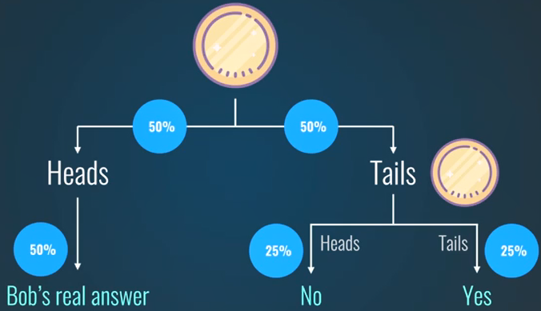
DP Toy Example
Suppose I want to know the average percentage of people who pick their nose without revealing whether any specific individual picks his/her nose
I can use a survey to collect yes/no answers, then add noise by flipping a coin for each individual as follows
DP only works for sufficiently large datasets
Will introduce non-negligible errors for small datasets

Slide 5
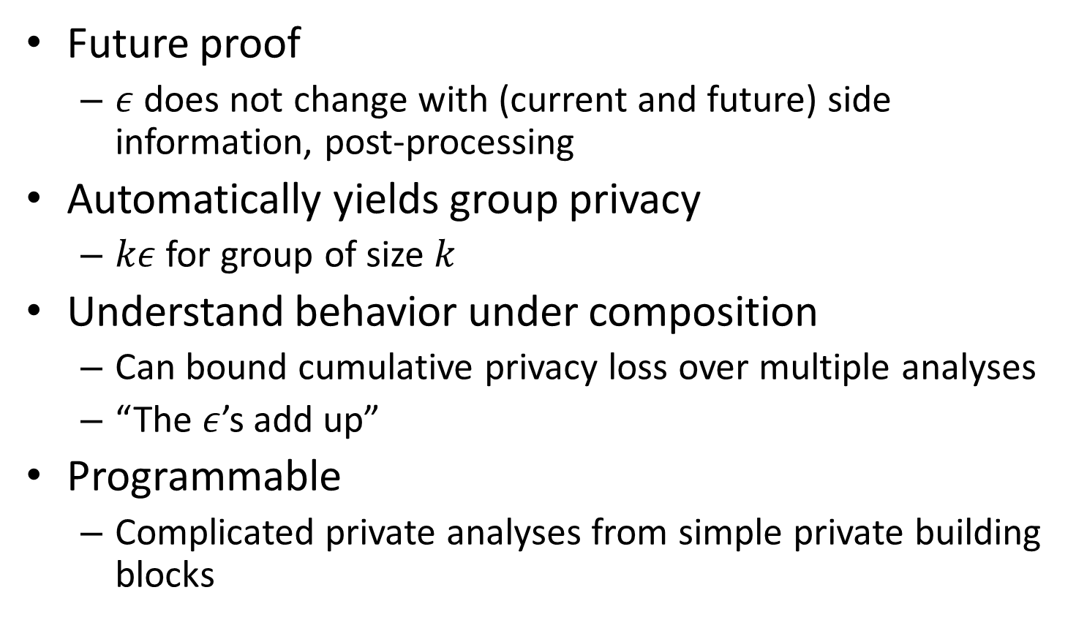
Properties
Future proof
$ε$ does not change with (current and future) side information, post-processing
Automatically yields group privacy
$kε$ for group of size $k$
Understand behavior under composition
Can bound cumulative privacy loss over multiple analyses
“The $ε$’s add up”
Programmable
Complicated private analyses from simple private building blocks

Slide 6
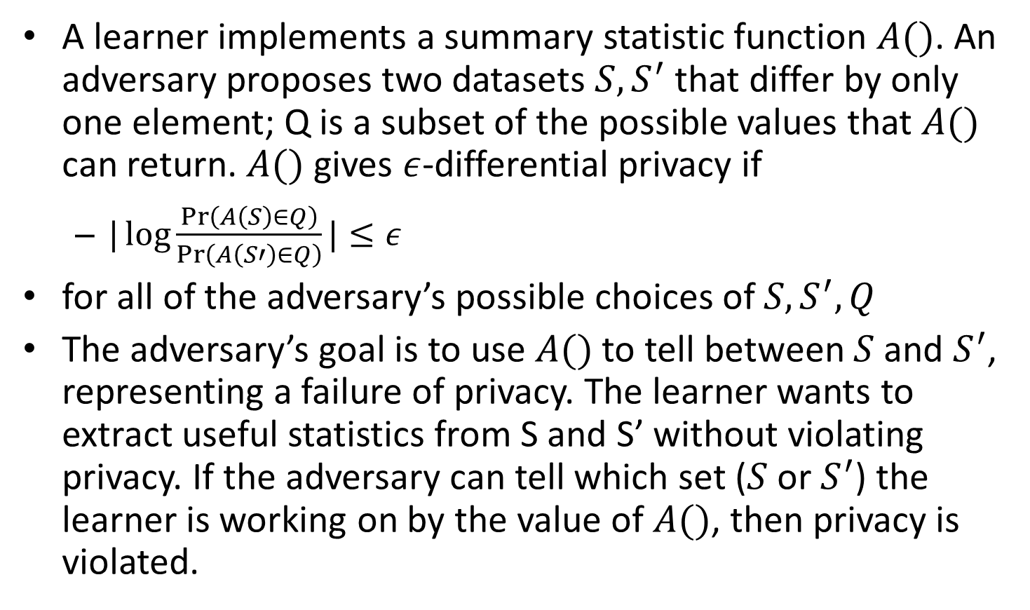
DP in the Presence of Adversary
A learner implements a summary statistic function $A()$. An adversary proposes two datasets $S, S^{′}$ that differ by only one element; Q is a subset of the possible values that $A()$ can return. $A()$ gives $ε$-differential privacy if
$|\log{\frac{\operatorname{Pr}\left(A\left(S\right)∈Q\right)}{\operatorname{Pr}\left(A\left(S′\right)∈Q\right)}}|≤ε$
for all of the adversary’s possible choices of $S, S^{′},Q$
The adversary’s goal is to use $A()$ to tell between $S$and $S^{′}$, representing a failure of privacy. The learner wants to extract useful statistics from S and S’ without violating privacy. If the adversary can tell which set ($S$ or $S^{′}$) the learner is working on by the value of $A()$, then privacy is violated.
Notes:
Identifying a unique elementrow (the one which changed markings) violates privacy.

Slide 7
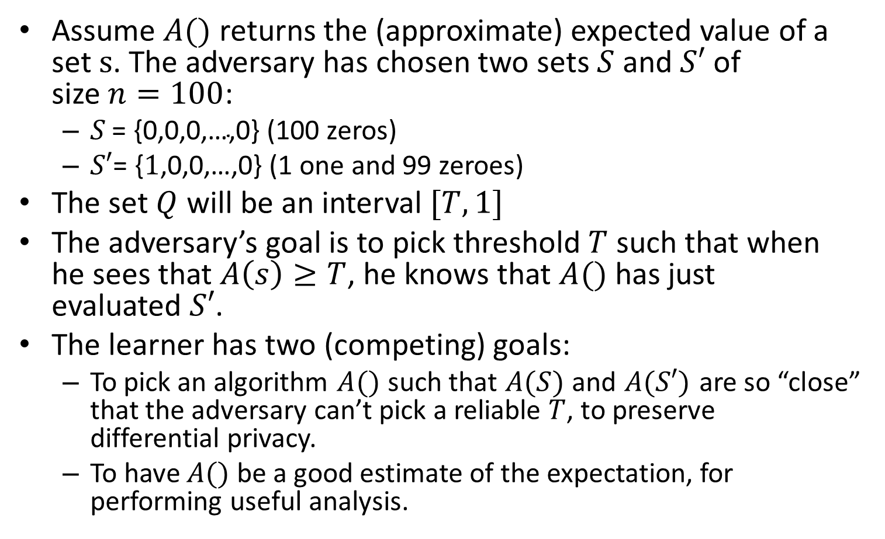
DP in the Presence of Adversary
Assume $A()$ returns the (approximate) expected value of a set $s$. The adversary has chosen two sets $S$ and $S′$ of size $n=100$:
$S \text{= \{0,0,0,…,0\}}$ (100 zeros)
$S′\text{= \{}1\text{,0,0,…,0\}}$ (1 one and 99 zeroes)
The set $Q$ will be an interval $[T,1]$
The adversary’s goal is to pick threshold $T$ such that when he sees that $A\left(s\right)≥T$, he knows that $A()$ has just evaluated $S′$.
The learner has two (competing) goals:
To pick an algorithm $A()$ such that $A(S)$ and $A(S′)$ are so “close” that the adversary can’t pick a reliable $T$, to preserve differential privacy.
To have $A()$ be a good estimate of the expectation, for performing useful analysis.
Notes:
“Close” is defined by epsilon.

Slide 8
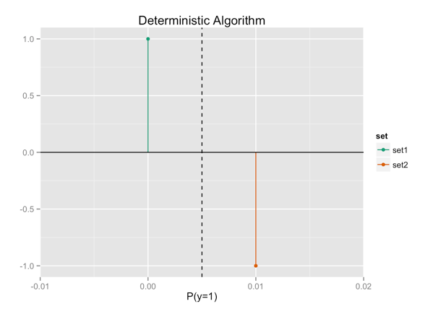
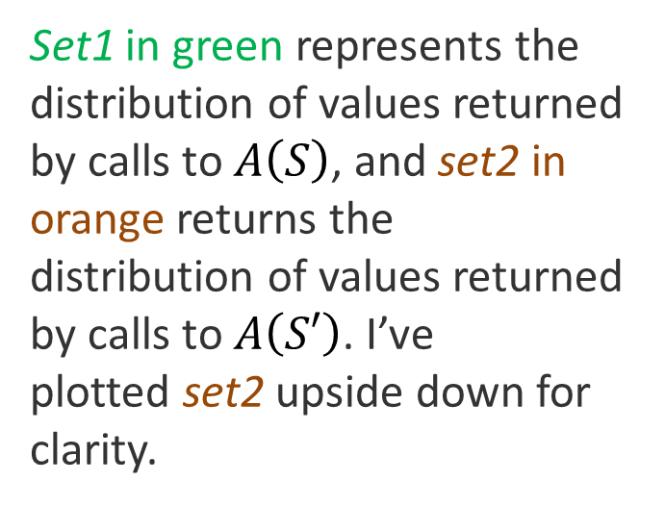
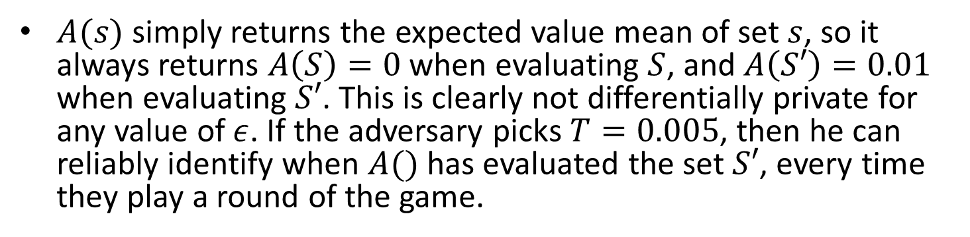
The Deterministic Case
$A(s)$ simply returns the expected value mean of set $s$, so it always returns $A\left(S\right)=0$ when evaluating $S$, and $A\left(S′\right)=0.01$ when evaluating $S′$. This is clearly not differentially private for any value of $ε$. If the adversary picks $T=0.005$, then he can reliably identify when $A()$ has evaluated the set $S′$, every time they play a round of the game.
Set1 in green represents the distribution of values returned by calls to $A\left(S\right)$, and set2 in orange returns the distribution of values returned by calls to $A\left(S′\right)$. I’ve plotted set2 upside down for clarity.

Slide 9
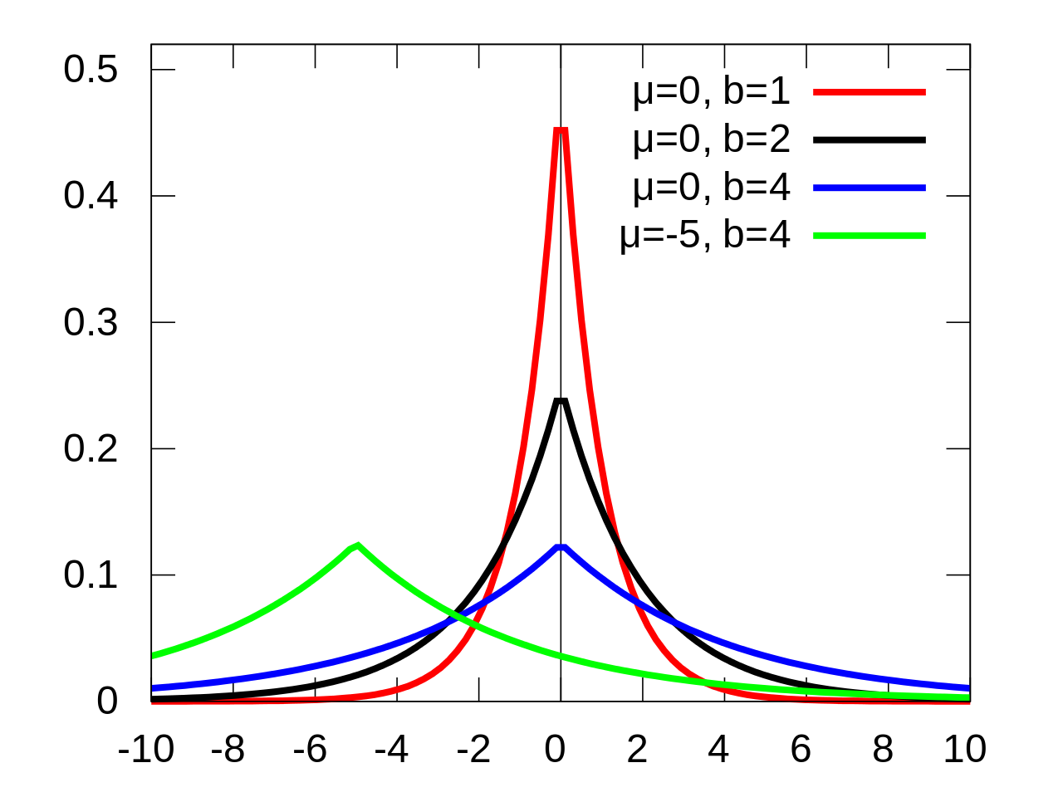
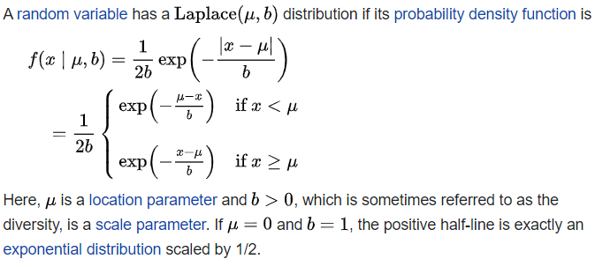
Laplacian Distribution

Slide 10
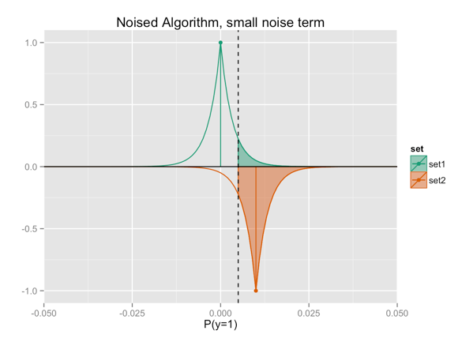


Adding Noise to give Privacy
We add noise from a Laplace distribution with width $σ=\frac{1}{3n}=0.003$ (b in previous slide)
The shaded green region represents the chance that $A\left(S\right)≥T$, the probability that the adversary will mistake $S$ for $S′$ in a round of the game. We’ve now made that probability non-zero, but it’s still very likely that if $A\left(s\right)≥T$, then $s=S′$.
T

Slide 11
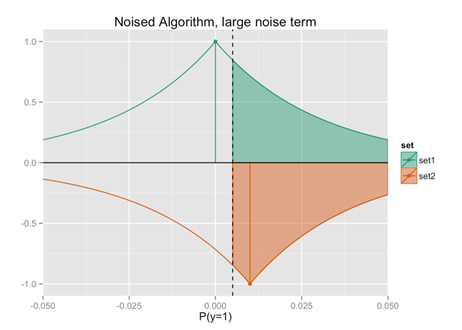

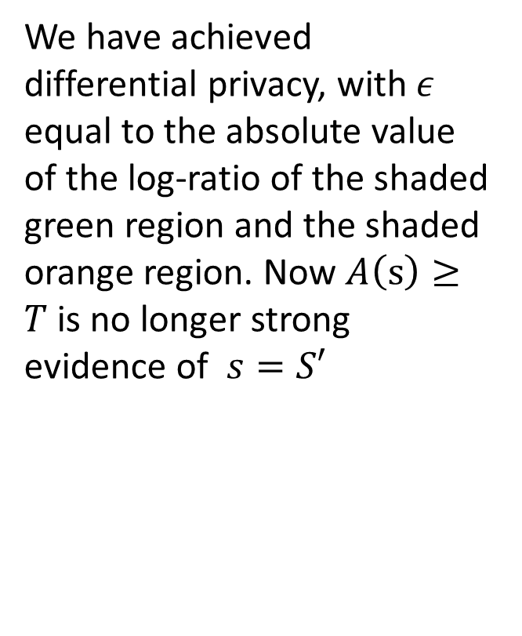
Adding Larger Noise
We add larger noise from a Laplace distribution with width $σ=\frac{3}{n}=0.03>0.01=A\left(S^{′}\right)−A(S)$
We have achieved differential privacy, with $ε$ equal to the absolute value of the log-ratio of the shaded green region and the shaded orange region. Now $A\left(s\right)≥T$is no longer strong evidence of $s=S′$
T

