Slide 1
Meltdown & Spectre
Credit: https://seedsecuritylabs.org

Slide 2


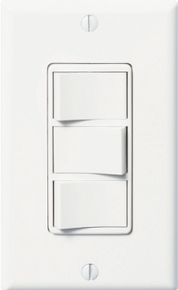
An Example of Side Channel Analysis
Room
Outside of the room: 3 light bulbs. Inside of the room: 3 light switches
Q: Can you determine which light bulb is connected to which switch, by going into the room once and playing with the switches and then come out to check the lights?
A: Yes. Initially all switches are off. Turn on switch 1, wait for 10 min, then turn on switch 2, and immediately come out.
The light bulb that is lit and warm is connected to Switch 1;
The light bulb that is lit and cold is connected to Switch 2;
The light bulb that is not lit is connected to Switch 3;

Slide 3
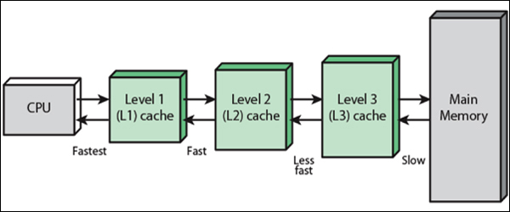
Memory Hierarchy
Cache hierarchy is managed by cache controller hardware
On a data access:
if data ∈ L-x cache ⇒ cache hit ⇒ low latency access
if data ∉ L-x cache ⇒ cache miss ⇒ higher latency access to next level L-(x+1) cache or main memory
https://www.undocopy.com/2017/07/what-is-cache-memory-types-and.html
Notes:
Virtual to physical address mapping assisted by the hardware (Translation LB)
Registers ↔ memory hierarchy
By compiler (or assembler programmer)
Cache ↔ main memory
By the cache controller hardware
Focus of this lecture
Main memory ↔ disks (secondary storage)
By the OS (virtual memory)
By the programmer (files) Goal: create the illusion of accessing as much memory as is available in main memory at the speed of the fast cache

Slide 4
Principle of Locality
Principle of Locality: Programs access small portion of address space at any instant of time (spatial locality) and repeatedly access that portion (temporal locality)
Temporal Locality (locality in time)
If a memory location is referenced, then it will tend to be referenced again soon
Keep recently-accessed blocks in the cache
Spatial Locality (locality in space)
If a memory location is referenced, the locations with nearby addresses will tend to be referenced soon
Cache prefetch: when fetching a block into cache, also fetch nearby blocks based on recent block access pattern
Notes:
How does the memory hierarchy work? Well it is rather simple, at least in principle.
In order to take advantage of the temporal locality, that is the locality in time, the memory hierarchy will keep those more recently accessed data items closer to the processor because chances are (points to the principle), the processor will access them again soon.
In order to take advantage of the spatial locality, not ONLY do we move the item that has just been accessed to the upper level, but we ALSO move the data items that are adjacent to it.
+1 = 15 min. (X:55)

Slide 5
Quiz: What locality does this program have?
int sum = 0, a[n];
…
for (i = 0; i < n; i++) {
sum += a[i];
}
return sum;
Data:
Temporal locality: variable sum is referenced in each iteration
Spatial locality: array a[] is accessed with stride 1 in each iteration
Instruction:
Temporal locality: the loop body is executed repeatedly for n times
Spatial locality: instructions are accessed sequentially (with 1 branch in each iteration)

Slide 6
FLUSH+RELOAD Cache Side Channel Analysis
Suppose victim holds some secret value x
Attacker constructs probing array array[N∗STEP], where x<N, and flushes the entire array to memory
Let the victim access element array[x∗STEP] to bring it into cache
Attacker reloads elements array[0∗STEP], array[1∗STEP],…, array[(N-1)∗STEP] by reading them in sequence, and measures access time of each element. Only accessing array[x∗STEP] should be a cache hit. This reveals the secret x
STEP should be much larger than cache block size:
No two different elements array[i∗STEP],array[j∗STEP], i≠j are in the same cache block
To mitigate the effect of cache prefetching, where multiple cache blocks are brought into cache upon a cache miss
Secret S
FLUSH:
Flush the
CPU Cache
Access memory location at S
RELOAD:
Check which one is in the cache

Slide 7
FLUSH+RELOAD Toy Example
Suppose cache block size is 2 Bytes, STEP=6.
Attacker constructs probing array char a[5∗STEP]; Victim holds secret value x=2, and accesses a[2∗STEP]=a[12], causing cache block containing elements {a[12], a[13]} to be brought into cache. Attacker reloads 5 elements a[0],a[6],a[12],a[18],a[24], and finds out that only accessing a[12] is a cache hit, so he can deduce the secret x=12/STEP=2.
STEP should be much larger than cache block size
If the cache prefetching algorithm brings ≥4 blocks into the cache when accessing a[12], including a[3∗STEP]=a[18], then attacker cannot decide if x=2 or 3.
a[0*STEP] | a[0*STEP+1] | a[0*STEP+2] | a[0*STEP+3] | a[0*STEP+4] | a[0*STEP+5]
a[1*STEP] | a[1*STEP+1] | a[1*STEP+2] | a[1*STEP+3] | a[1*STEP+4] | a[1*STEP+5]
a[2*STEP] | a[2*STEP+1] | a[2*STEP+2] | a[2*STEP+3] | a[2*STEP+4] | a[2*STEP+5]
a[3*STEP] | a[3*STEP+1] | a[3*STEP+2] | a[3*STEP+3] | a[3*STEP+4] | a[3*STEP+5]
a[4*STEP] | a[4*STEP+1] | a[4*STEP+2] | a[4*STEP+3] | a[4*STEP+4] | a[4*STEP+5]
Cache block accessed
by victim;
Fast reload by attacker
Reloaded Elements

Slide 8
An Analogy of FLUSH+RELOAD
Imagine that you (i.e. a malicious process) want to know whether someone (i.e. a victim process) has checked out a particular library book. The library (i.e. the CPU) refuses to give you access to their records. What you do is follow the victim into the library whenever he wants to check out a book. You then ask the librarian for a copy of the book you want to know whether the person has checked out. (In this library, when a person checks out a book (reads a variable), he also leaves a copy under the librarian’s desk (in the cache).)
If the librarian looks down under his desk and says "You are in luck, I have a copy right here!" then you know the victim had just checked out that book. If the librarian has to go look in the book shelves (main memory) and comes back 5 minutes later with the book, you know that the person didn’t just check it out.
Notes:
The way to make the library secure against this kind of attack is to require that all books be reshelved before they can be lent out again, unless the current borrower is requesting an extension. There are many other ways to use the behavior of the librarian and the time it takes to retrieve a book to figure out which books a person is reading. and does not keep a slip inside the front cover. You can only see the record of which books you have checked out
(Not a perfect analogy: a person who checks out a book will take it home, not leave it under the librarian’s desk. But let’s assume he does.)

Slide 9
Meltdown

Slide 10
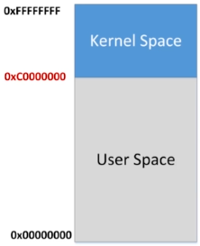
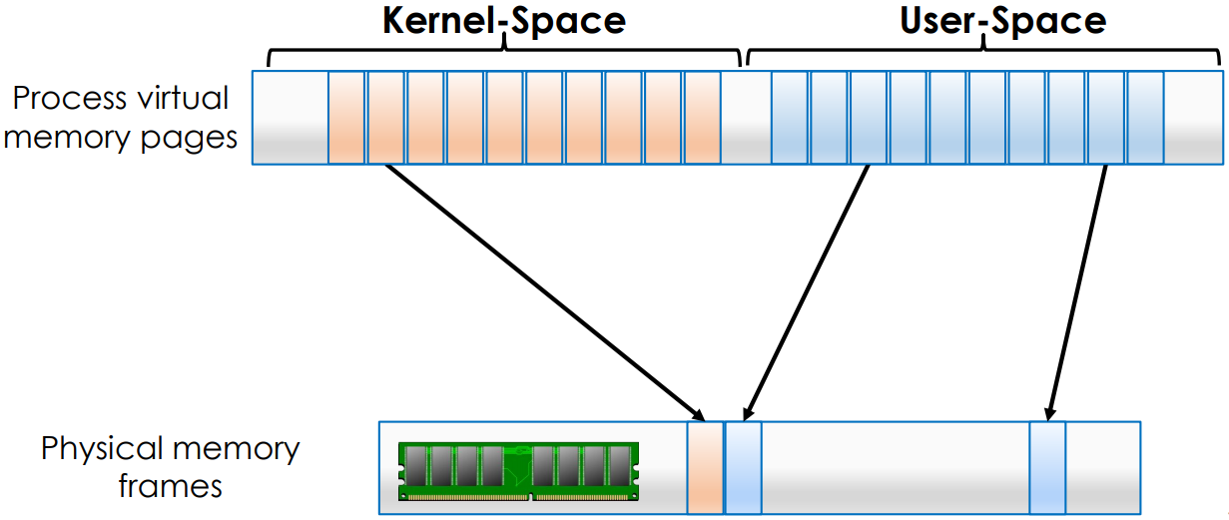
Virtual Memory
Each process sees a continuous virtual address space with size 2^{N} Bytes (N=16, 32, 64…)
Part of the address range is user-space, accessible by both user processes and OS kernel
Part of the address range is kernel-space, accessible by the OS kernel
Right fig shows the Linux address space of 2³² Bytes on a 32-bit computer.
Security isolation: user processes should not be able to access kernel-space.

Slide 11
Meltdown Lab Tasks
Tasks 1 and 2: Side Channel Attacks via CPU Caches
Task 1: Reading from Cache versus from Memory
Task 2: Using Cache as a Side Channel
Tasks 3-5: Preparation for the Meltdown Attack
Task 3: Place Secret Data in Kernel Space
Task 4: Access Kernel Memory from User Space
Task 5: Handle Error/Exceptions in C
Task 6: Out-of-Order Execution by CPU
Task 7: The Basic Meltdown Attack
Task 7.1: A Naive Approach
Task 7.2: Improve the Attack by Getting the Secret Data Cached
Task 7.3: Using Assembly Code to Trigger Meltdown
Task 8: Make the Attack More Practical

Slide 12
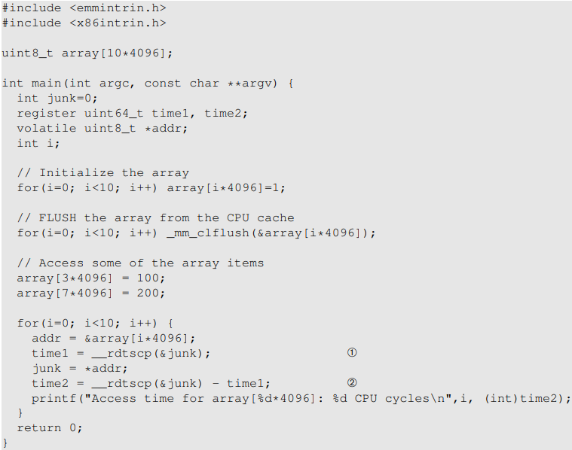
Task 1: Reading from Cache versus from Memory
Access 2 elements of array[] to bring them into cache
Subsequent accesses to these elements will be cache hits and will be much faster
Listing 1: CacheTime.c
Notes:
Accessing 2 elements of array[] to bring them into cache, causes future accesses to these 2 elements

Slide 13
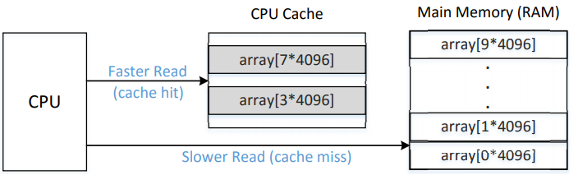
array[] in memory and cache
Each memory page is 4KB (STEP=4096 Bytes).
Each cache block is 64 Bytes
array[] contains 10 pages (40KB) of 1-Byte elements, each page has starting address of 0*4096, 1*4096, …., 9*4096.
Notes:
Accessing 2 elements of array[] to bring them into cache, causes future accesses to these 2 elements

Slide 14
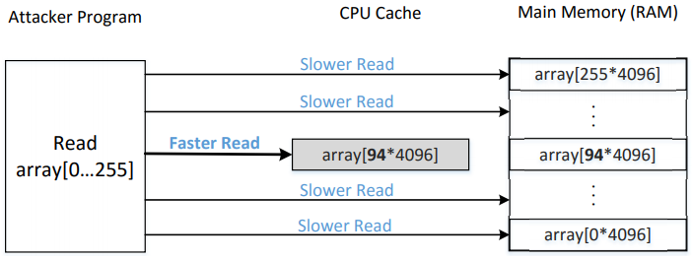
Task 2: Using Cache as a Side Channel
1. FLUSH the entire array from the cache to make sure the array is not cached.
2. Invoke the victim function, which accesses one of the array elements based on the value of the secret. This action causes the corresponding array element to be cached.
3. RELOAD the entire array, and measure the time it takes to reload each element. Loading element corresponding to the secret element will be a cache hit, and be much faster.

Slide 15
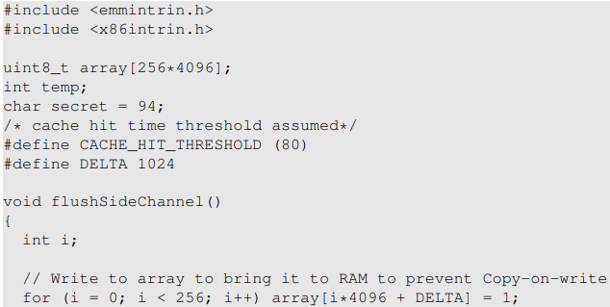
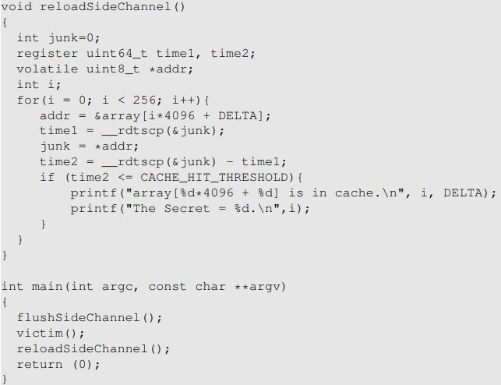
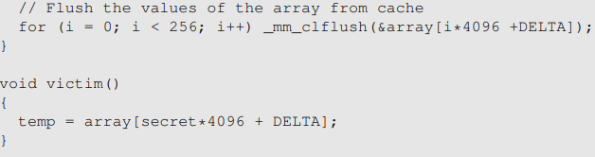
Listing 2: FlushReload.c
FLUSH
Flush the
CPU Cache
Invoke
victim() w
secret=94
RELOAD
Check which one is in the cache

Slide 16
Toy Example with DELTA=2
Since a[0] may be accidentally brought into cache before the attack, due to due to cache prefetch, when some other program accesses variables in adjacent memory addresses smaller than &a[0], we use array[k*STEP+ DELTA] for all k values
DELTA=2 in table below; DELTA=1024 in Listing 2.
a[0*STEP] to a[0*STEP+DELTA] act as a safety buffer to absorb accidental accesses by other programs so they do not affect the attack.
Safety Buffer
Cache block accessed by victim;
Fast reload by attacker
a[0*STEP] | a[0*STEP+1] | a[0*STEP+2] | a[0*STEP+3] | a[0*STEP+4] | a[0*STEP+5]
a[1*STEP] | a[1*STEP+1] | a[1*STEP+2] | a[1*STEP+3] | a[1*STEP+4] | a[1*STEP+5]
a[2*STEP] | a[2*STEP+1] | a[2*STEP+2] | a[2*STEP+3] | a[2*STEP+4] | a[2*STEP+5]
a[3*STEP] | a[3*STEP+1] | a[3*STEP+2] | a[3*STEP+3] | a[3*STEP+4] | a[3*STEP+5]
a[4*STEP] | a[4*STEP+1] | a[4*STEP+2] | a[4*STEP+3] | a[4*STEP+4] | a[4*STEP+5]
Reloaded Elements
Notes:
when accessing variables in adjacent memory addresses smaller than &a[0] Since array[0] may be accidentally brought into cache before the attack, due to cache prefetching when some other program accesses variables in adjacent memory addresses smaller than &array[0], we use array[k*4096 + DELTA] for all k values (DELTA=1024 in Listing 2)

Slide 17
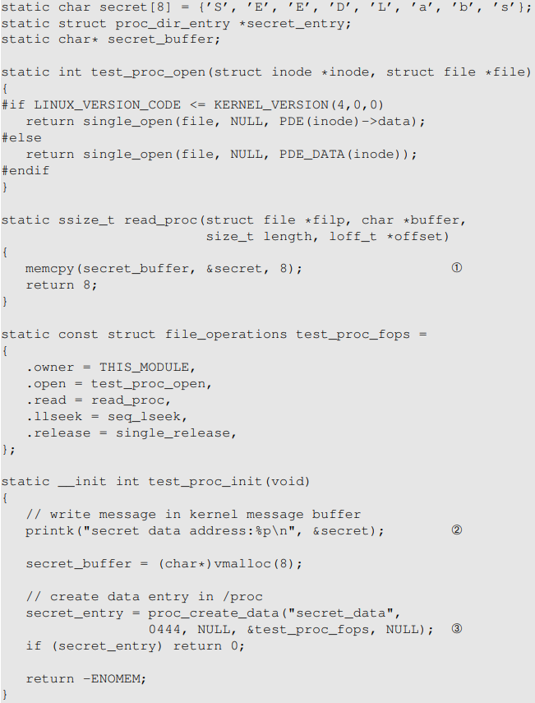
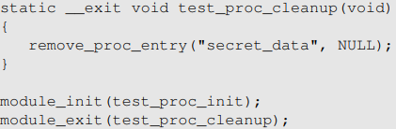
Task 3: Place Secret Data in Kernel Space
Listing 3: MeltdownKernel.c
Line 1: saves the address of the secret data into the kernel message buffer ()
Use the secret once to bring it into cache
Line 3: create a data entry /proc/secret_data. When a user-level program reads from this entry, the read proc() function in the kernel module will be invoked, inside which, the secret variable will be loaded (Line 1) and thus be cached by the CPU

Slide 18

Finding the Secret Data Address
After compilation, use the insmod command to install the kernel module, then use the dmesg command to find the secret data’s address from the kernel message buffer.
In real Meltdown attacks, attackers have to figure out a way to get the address, or they have to guess.

Slide 19
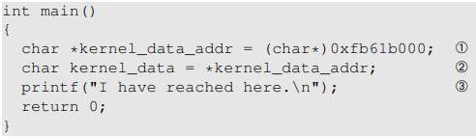
Task 4: Access Kernel Memory from User Space
Replace this address with the address obtained from Task 3
This program will crash, since you are illegally trying to access kernel memory from user space

Slide 20
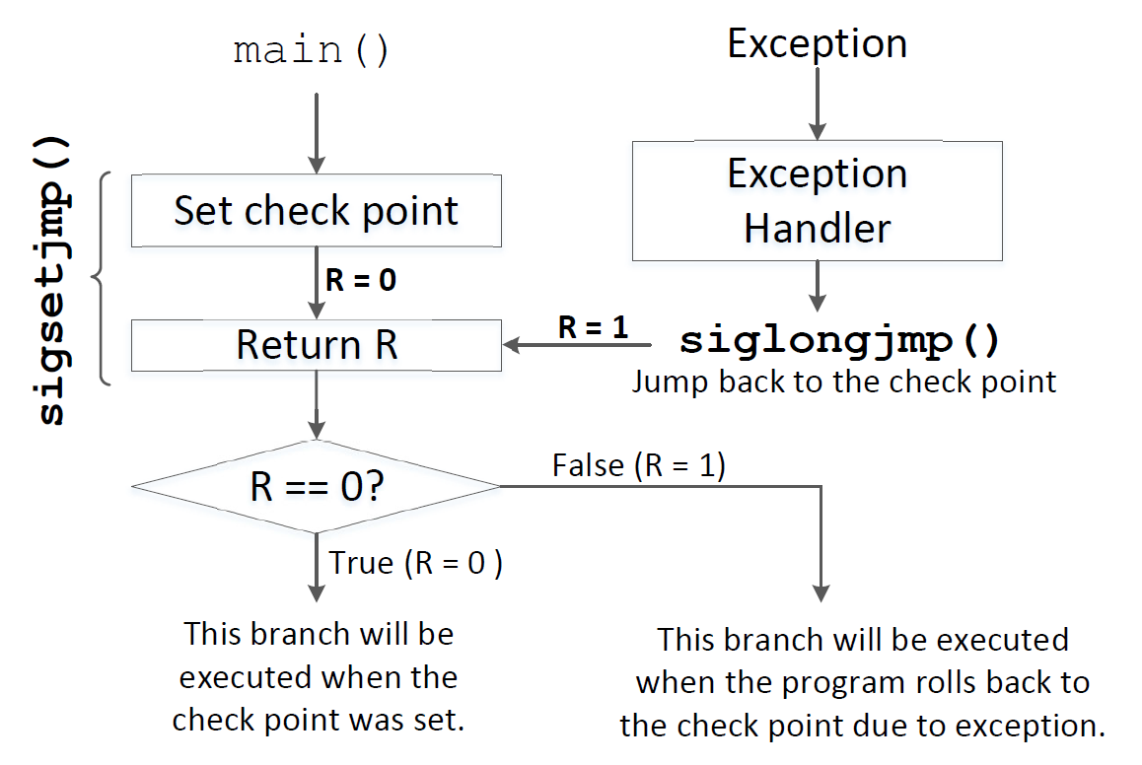
Task 5: Handle Error/Exceptions in C
Instead of crashing, we want to print out a message “"Memory access violation!”
Listing 4: ExceptionHandling.c: Define our own signal handler to capture the exception raised by accessing kernel memory from user space.
(You do not need to understand this code).
Notes:
To catch the exception SIGSEGV caused by accessing kernel memory address from user space, we emulate the try/catch clause in C++ using sigsetjmp() and siglongjmp(),

Slide 21

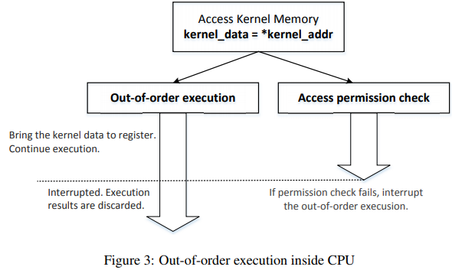
Task 6: Out-of-Order Execution by CPU
Instruction 3A: access and load kernel_data stored at kernel_address into cache and then into CPU register
Instruction 3B: check access permission for kernel_address.
Out-of-Order Execution: 3A and 3B execute in parallel in the CPU pipeline. If permission check fails, roll back any instructions (Line 3) executed after the check.
(Line 3 already brings kernel_data into cache, so Line 4 is actually redundant.)
Just before
Inst 3A
Inst 3B
Notes:
Line 3 involves two operations at assembly code level:
In-order execution: instructions 3.A, 3.B and 4 execute in order
3.A

Slide 22
Meltdown Attack
Just before inst 3
3A will be rolled back if permission check fails
Permission check (3B)
Access kernel data and bring it into cache (3A)
Race condition
Race condition between 3A and 3B; either one may execute first
If instruction 3B executes before 3A, and permission check fails, then 3A will not execute at all
If instruction 3A executes speculatively before 3B, and permission check fails, then roll back any effect of 3A
The rolled-back instructions do not have any externally visible effect: variable number stays unchanged
However, kernel_data, the data stored at memory address kernel_address, has been brought into the cache, and attacker can find its value by cache side channel analyis

Slide 23
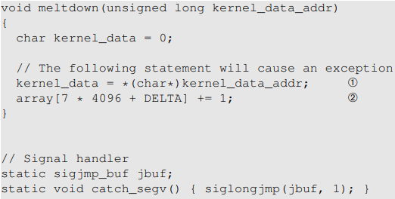
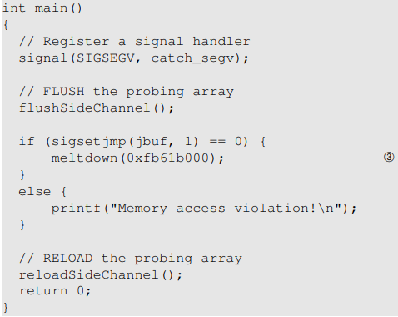
MeltdownExperiment.c
Line 2: array[7 * 4096 + DELTA] will be loaded into the CPU cache due to Out-of-Order execution, but a memory access violation will occur subsequently, so its value will not be actually incremented at the end
Replace 7 with kernel_data
Replace this address with the address obtained from Task 3

Slide 24
Task 7: The Basic Meltdown Attack Task. 7.1: A Naive Approach
Instead of array[7*STEP + DELTA], we access array[kernel_data*STEP + DELTA]
Using the FLUSH+RELOAD technique, we check the access time of array[i*STEP + DELTA] for i = 0, . . ., 255.
If we find out that only array[k*STEP + DELTA] is in the cache, we can infer that the value of the “kernel_data” is k.

Slide 25
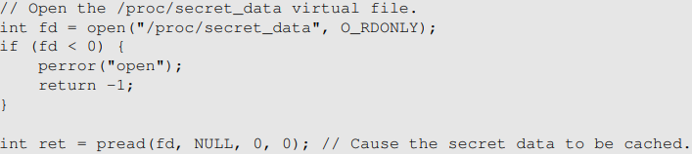
Task 7.2: Improve the Attack by Getting the Secret Data Cached
To maximize chance of success of attack, we can preload the kernel secret data into cache before launching the attack
The following user-level program uses system calls open() and pread() to access the secret data without leaking it to the user-level program by reading 0 bytes into a NULL buffer
ssize_t pread(int fildes, void *buf, size_t nbyte, off_t offset);
Notes:
ssize_t pread(int fildes, void *buf, size_t nbyte, off_t offset);

Slide 26
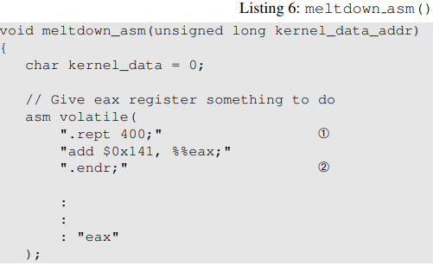

Task 7.3: Using Assembly Code to Trigger Meltdown
Useless Computation
Delays
Just before inst 3
Permission Check (3B)
Access kernel data and bring it into cache (3A)
Race condition
To maximize chance of success, meltdown_asm() runs a useless computation loop for 400 times, in order to occupy the CPU’s Arithmetic Logic Units (ALUs) to delay execution of Permission Check, making it more likely to execute *after* instruction 3A.
“Useless computation” will cause delay to “Permission check” (3B), since they are both computation instructions; but not to (3A), since (3A) is a memory instruction, so they can execute concurrently.
(This is Instruction-Level Parallelism within an Out-of-Order CPU core, not Thread-Level Parallelism.)

Slide 27
Task 8: Make the Attack More Practical
The actual timing measurements may be noisy due to cache prefetch, OS scheduling, interrupts and other interference effects, making it difficult to set the proper value of CACHE_HIT_THRESHOLD that works always.
Statistical technique: create a score array of size 256, one element for each possible secret value. We then run our attack for 1000 times. Each time, if our attack program says that k is the secret (this result may be false), we add 1 to scores[k]. After running the attack for many times, we use the value k with the highest score as our final estimation of the secret.
Notes:
(Cache access time measurements are noisy, not guaranteed to work every time.)

Slide 28
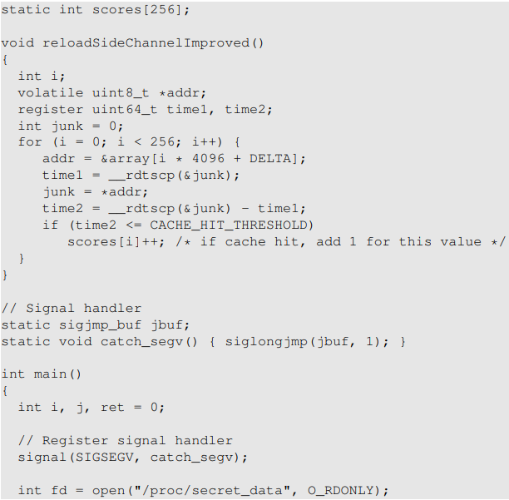
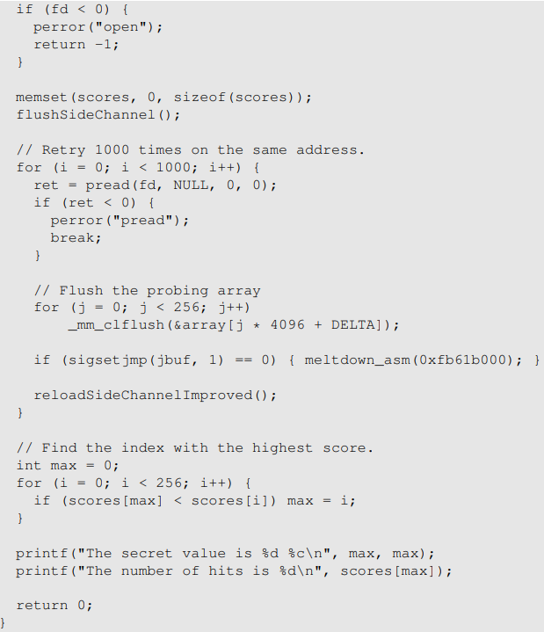
Statistical technique

Slide 29



Meltdown Attack Analogy
Secret: 7
Guard with
Memory Eraser
Restricted Room
Bob has a secret (say 7) inside the restricted room. You want to steal the secret, but you do not have the security clearance to enter the room.
Outside of the room: you prepare 10 lightbulbs with 10 light switches. All lightbulb-to-switch connections are known, and you fully control them anytime and anywhere (wirelessly).
The security guard is busy. He usually stops you from entering the room, but sometimes he tries to optimize performance and lets you into the room regardless of your security clearance. But if he later finds out that you do not have security clearance, he will erase your memory and kick you out.
Q: Can you steal the secret 7 with side channel analysis?
A: Yes. Initially reset all lightbulbs to be off. Try many times to enter the room. If you get lucky and enter the room, see Bob’s secret 7, copy it into your memory by turning on lightbulb #7. The guard later finds out, erases your memory and kicks you out. Once outside, you don’t remember the secret 7 since your memory has been erased, but you can see that lightbulb #7 is on, so you have stolen the secret 7.
Notes:
Suppose all light bulb-to-switch connections are known, and you can reset all lightbulbs to be off without entering the room

Slide 30
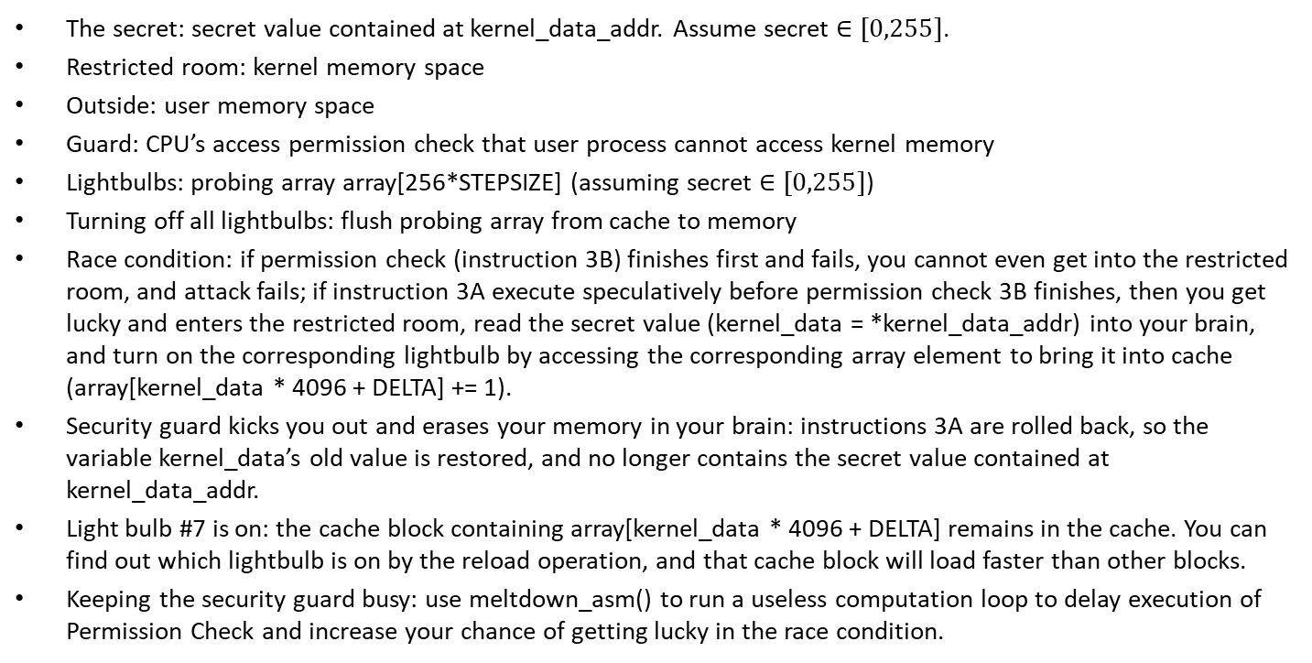
Meltdown Attack Analogy
Secret: 7
Guard with
Memory Eraser
The secret: secret value contained at kernel_data_addr. Assume secret $∈[0,255]$.
Restricted room: kernel memory space
Outside: user memory space
Guard: CPU’s access permission check that user process cannot access kernel memory
Lightbulbs: probing array array[256*STEPSIZE] (assuming secret $∈[0,255]$)
Turning off all lightbulbs: flush probing array from cache to memory
Race condition: if permission check (instruction 3B) finishes first and fails, you cannot even get into the restricted room, and attack fails; if instruction 3A execute speculatively before permission check 3B finishes, then you get lucky and enters the restricted room, read the secret value (kernel_data = *kernel_data_addr) into your brain, and turn on the corresponding lightbulb by accessing the corresponding array element to bring it into cache (array[kernel_data * 4096 + DELTA] += 1).
Security guard kicks you out and erases your memory in your brain: instructions 3A are rolled back, so the variable kernel_data’s old value is restored, and no longer contains the secret value contained at kernel_data_addr.
Light bulb #7 is on: the cache block containing array[kernel_data * 4096 + DELTA] remains in the cache. You can find out which lightbulb is on by the reload operation, and that cache block will load faster than other blocks.
Keeping the security guard busy: use meltdown_asm() to run a useless computation loop to delay execution of Permission Check and increase your chance of getting lucky in the race condition.
Restricted Room
Notes:
Turning on the light switch that encodes the secret 7: bring element array[7*STEP] into the cache
(assuming security guard and you share the same CPU core

Slide 31
Meltdown Attack Analogy
Lightbulbs | Your memory in your brain | Guard erasing your memory
Attacker’s probing array for FLUSH+RELOAD array[256*STEPSIZE] | Attacker program reads the secret value into variable kernel_data = *kernel_data_addr) | CPU rollbacks variable assignment to kernel_data, but cannot affect cache contents (turn off the lightbulb that you have turned on before to encode the secret *kernel_data_addr)
Notes:
Plays two rolessimultaneously
1) variable assignment to kernel_data in memory AND
2) Probing array in cache
N/A
Rollback value of 1) kernel_data (turn off lightbulbs) but cannot affect 2) the probing array (lightbulb stays warm)

Slide 32
Spectre

Slide 33
Non-Pipelined Instruction Execution (hypothetical)
Fetch
PC
Decode
PC+2
PC+4
Execute
PC+6
Write-Back
1st Instruction (Adrs: PC)
Fetch
Decode
Execute
Write-Back
1st Instruction (Adrs: PC)
Fetch
Decode
Execute
Write-Back
Time
None-pipelined instruction execiution with IPC=0.25 (1 instruction every 4 cycles). PC (Program Counter) is incremented by 2 to point to next instruction, assuming each instruction is 2 Bytes.

Slide 34
Pipelined Instruction Execution
Fetch
PC
1st Instruction (Adrs: PC)
Fetch
Decode
Execute
Write-Back
Decode
2nd Instruction (Adrs: PC+2)
PC+2
Fetch
Decode
Execute
Write-Back
3rd Instruction (Adrs: PC+4)
PC+4
Execute
Fetch
Decode
Execute
Write-Back
4th Instruction (Adrs: PC+6)
Fetch
Decode
Execute
PC+6
Write-Back
Time
Pipelining allows multiple instructions to be in progress simultaneously during any one processor clock cycle. While one instruction is fetched, another is decoded, another is executed, and anther is written-back. IPC (Instructions per Cycle)=1.
Notes:
Thumb instructions are 16 or 32 bits wide, with the majority being 16 bits. Thus, while the address held in PC is being used to read one 16-bit instruction from memory, the previous instruction (from address PC-2) is decoded, and the one before that (from address PC-4) is executed. One instruction completed every cycle.

Slide 35
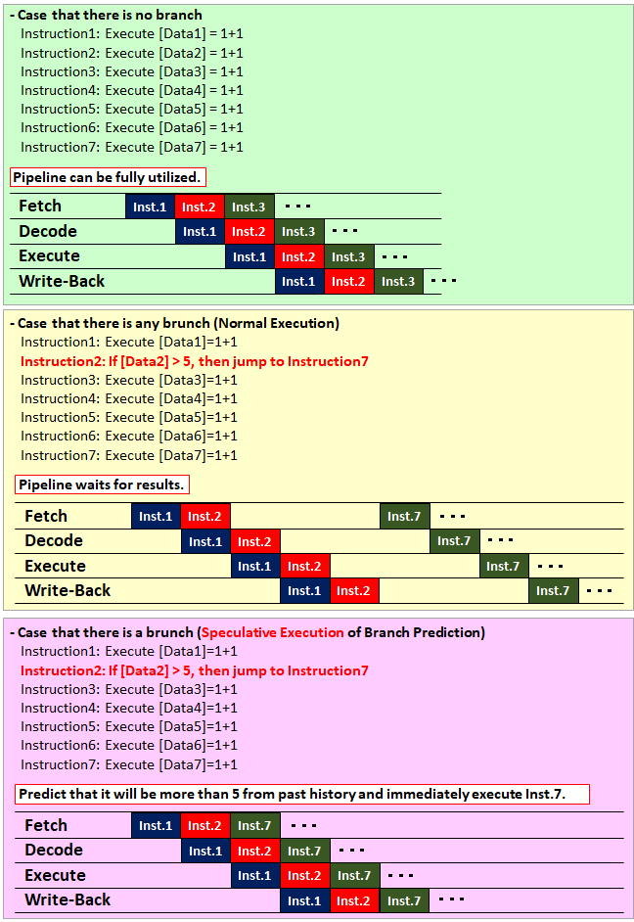
Branch Prediction
Branch Prediction (BP): predicting from the past history which branch to take before evaluating conditional expression.
Without BP: until the result of the conditional expression ([data2]>5) is confirmed, CPU pipeline will stay idle. if data2 used in conditional expression is not in the cache and needs to be read from memory, CPU pipeline will be kept idle for a long time.
With BP: if BP makes a prediction of [data2]>5, then program counter jumps directly to Inst. 7 without waiting.
If prediction is incorrect, we rollback instruction execution on the wrong branch.
If prediction is correct, we have reduced idle time and improved performance.
Notes:
https://milestone-of-se.nesuke.com/en/nw-advanced/nw-security/meltdown-spectre/ is implementation of Speculative Execution, and means

Slide 36
Spectre Lab Tasks
Tasks 1 and 2: Side Channel Attacks via CPU Caches (same as Meltdown attack and can be omitted)
Task 1: Reading from Cache versus from Memory
Task 2: Using Cache as a Side Channel
Task 3: Out-of-Order Execution and Branch Prediction
Task 4: The Spectre Attack
Task 5: Improve the Attack Accuracy
Task 6: Steal the Entire Secret String

Slide 37
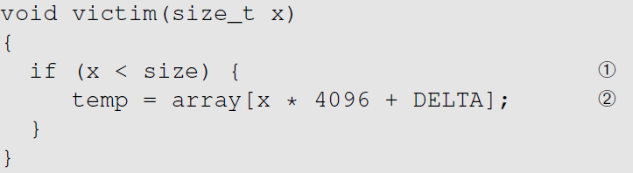
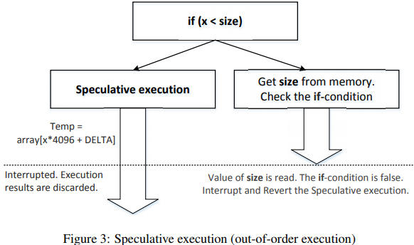
Task 3: Out-of-Order Execution and Branch Prediction
In-order execution: function victim() that accesses the probing array is executed only if condition (x < size) is true
Out-of-order execution: even if condition (x < size) is false, function victim() may be executed speculatively:
Condition check may be slow if x or size is not in cache
The CPU branch predictor predicts direction of each branch, and the predicted branch, (x < size) is true, may be executed speculatively before condition is checked
If it turns out (x < size) is false (branch prediction was wrong), then speculative execution is rolled back, and the correct branch will be executed
Just before
Notes:
Race condition if branch predictor Left branch executes function victim():
predicts condition to be true
; its effects will be rolled back if (x < size) is false

Slide 38
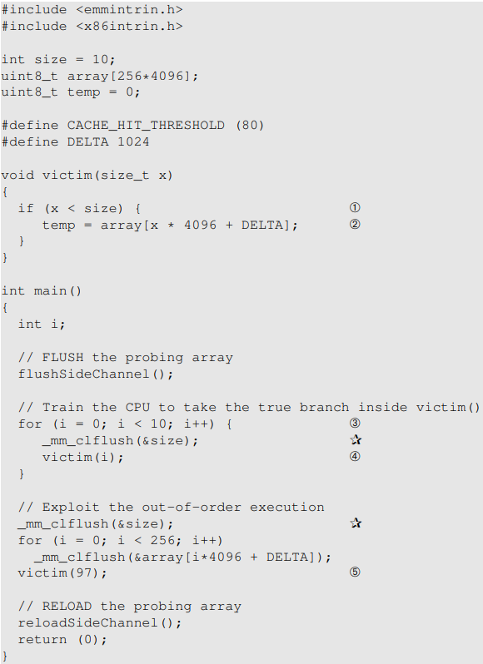
Listing 3: SpectreExperiment.c
The for loop starting from Line 3 invokes victim() with a small argument (from 0 to 9). These values are less than the value size, so the true-branch of the if-condition in Line 1 is always taken. This is the training phase, which trains the branch predictor to expect the next if-condition to be “true”.
We pass a larger value (97) to the victim() function (Line 5). This value is larger than size, so Line 2 should not be executed; but the branch predictor makes the prediction of “true”, so Line 2 will be executed speculatively.
We flush the variable “size” from the cache, in order to make the check “if (x < size)” slow due to memory access, so program will execute the branch speculatively based on branch prediction

Slide 39
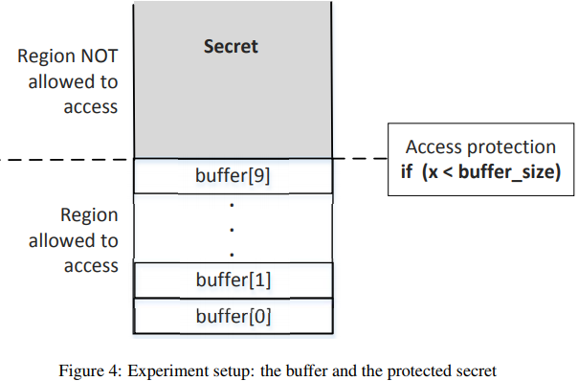
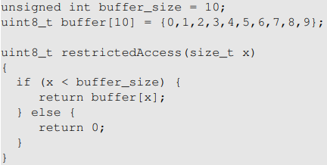
Task 4: The Spectre Attack
True-branch should not be executed if x is larger than the buffer size, to prevent attacker from accessing Secret directly.
But it can be executed speculatively and some traces can be left behind in the cache even if the execution is rolled back.
Training
Train CPU BP to go to the true branch
FLUSH
Flush the
CPU Cache
Invoke
victim(97)
RELOAD
Check which one is in the cache

Slide 40
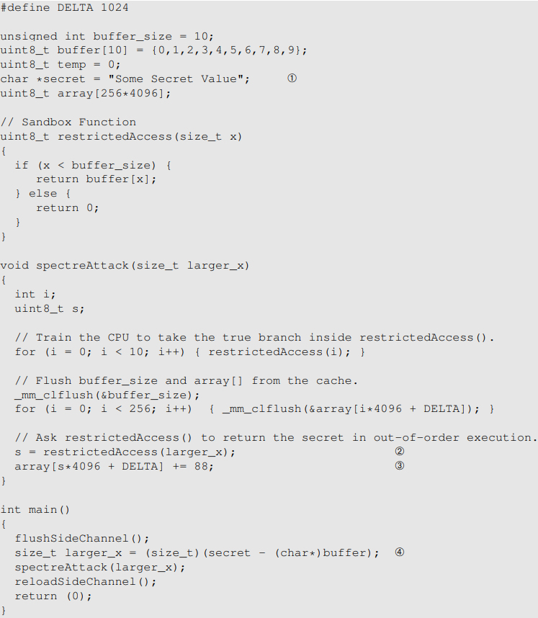
Listing 4: SpectreAttack.c
Line 4 calculates the offset of the secret from the beginning of the buffer(if offset is unknown, must find it with testing or guessing)
The offset larger_x is larger than 10, and buffer[larger_x] contains value of the secret.
“return buffer[x]” in restrictedAccess(), and Lines 2, 3 in spectreAttack() will be executed speculatively to assign s= buffer[larger_x], and bring it into the cache. Its effects will be rolled back later, and the correct branch “return 0” will be executed to assign s=0, but value of buffer[larger x] is left in the cache, and attacker can find it with cache side channel
The code only steals the first byte of the secret ‘S’.

Slide 41
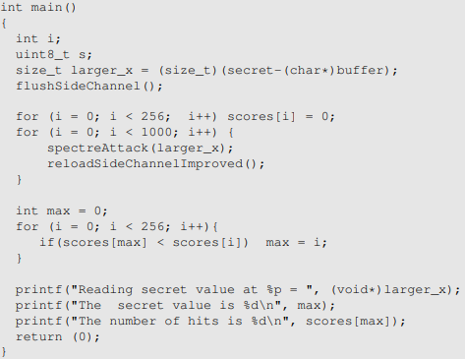
Task 5: Improve the Attack Accuracy
Statistical technique: create a score array of size 256, one element for each possible secret value. We then run our attack for 1000 times. Each time, if our attack program says that k is the secret (this result may be false), we add 1 to scores[k]. After running the attack for many times, we use the value k with the highest score as our final estimation of the secret
Tip: add usleep(100) to sleep for 100us between spectreAttack() and reloadSideChannelImproved(), to increase attacker’s chance of winning the race condition
It works but I am not sure why. Maybe it increases the chances of evicting variable larger_x from the cache, which increases delay of condition check “if (x < buffer_size)” in restrictedAccess(x)?
usleep(100)
Notes:
XXX but why

Slide 42
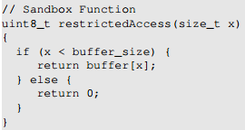
Task 5: scores[0]
“You may observe that when running the code above, the one with the highest score is always scores[0]. Please figure out the reason, and fix the code above, so the actual secret value (which is not zero) will be printed out.”
“return 0” in restrictedAccess() is always executed eventually, when the condition “if(x<buffer_size)” is checked to be false
“return buffer[larger_x]” in restrictedAccess() may or may not be executed speculatively, depending on the race condition between it and the condition check
So reloadSideChannel() is likely to see two cache hits, for values of 0 and buffer[larger_x]
If we know that buffer[larger_x] ≠ 0, then we can simply ignore the value of 0.
But what if buffer[larger_x] ==0? Then we cannot identify buffer[larger_x]

Slide 43
Task 6: Steal the Entire Secret String
char *secret = "Some Secret Value";
secret is pointer to the memory address of the 0th array element secret[0] (‘S’)
secret+1 is pointer to the memory address of the 1st array element secret[1] (‘o’)
…

Slide 44
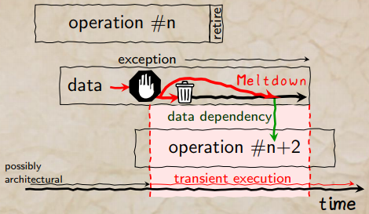
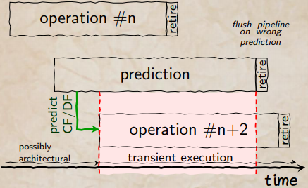
Meltdown vs. Spectre
Meltdown: an instruction accessing kernel memory causes an exception, but subsequent instructions are executed speculatively, and bring array[x*STEP] into cache
The speculative execution is rolled back when permission check fails and causes an exception, but cache state is altered
Spectre: a branch condition should prevent execution of certain instructions, but subsequent instructions in the wrong branch are executed speculatively, and bring array[x*STEP] into cache
The speculative execution is rolled back upon getting the actual branch condition, but cache state is altered
(Assume each instruction is 2 Bytes, hence the next instruction is n+2)

Slide 45
Meltdown vs. Spectre Cont’d
Meltdown steals secret from kernel address space
Spectre steals secret from out-of-bound array element

Slide 46
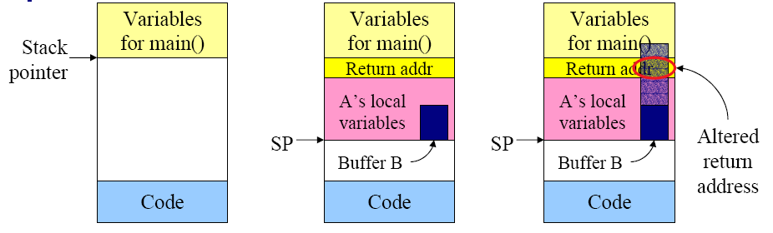
Spectre vs. Stack Overflow
(a) Situation when main program is running
(b) After procedure A() called
(c) Buffer overflow alters the return address from A().
Checking array bounds (if (x < buffer_size)) prevents buffer overflow attack that performs writes to unauthorized addresses, but not Spectre attack that performs reads from unauthorized addresses by exploiting speculative execution and cache side channel analysis.

