Slide 1
Advanced OSs L01: Overview of OS Concepts
ZJU 2020
Slides credit: Berkeley CS194-24

Slide 2
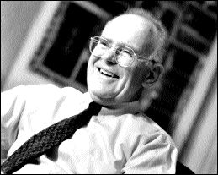
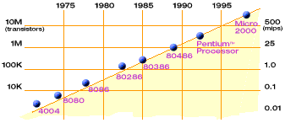
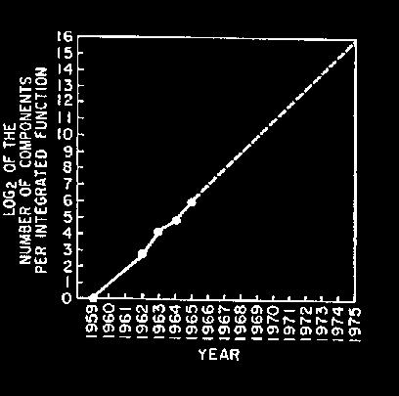
Technology Trends: Moore’s Law
Moore’s Law
2X transistors/Chip Every 1.5 years
Called “Moore’s Law”
Gordon Moore (co-founder of Intel) predicted in 1965 that the transistor density of semiconductor chips would double roughly every 18 months.
Microprocessors have become smaller, denser, and more powerful.

Slide 3
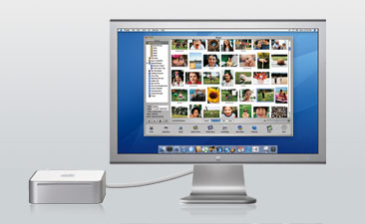
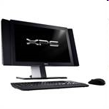
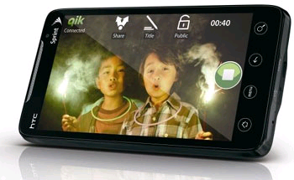
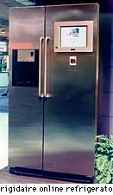
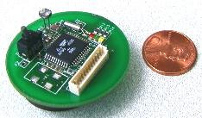

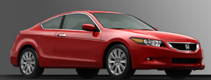
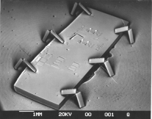
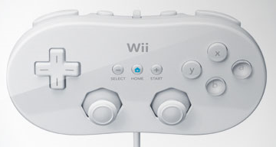
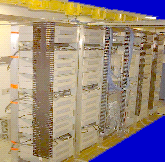


Societal Scale Information Systems
The world is a large parallel system
Microprocessors in everything
Vast infrastructure behind them
Massive Cluster
Clusters
Gigabit Ethernet
Internet Connectivity
Scalable, Reliable,
Secure Services
Databases
Information Collection
Remote Storage
Online Games
Commerce
…
MEMS for
Sensor Nets
Notes:
Of the enormous variety of CITRIS projects going on at Berkeley, I will present one set that is tied together by this picture: the design, construction and use of MEMS devices, the sensor networks containing them, and making the information from these networks available to widely distributed users as scalable, reliable and secure services.
The name we give to such an integrated system is a Societal Scale Information System, a name meant to evoke its scale – enormous - and purpose – benefiting people and the economy.
I will leave the details of all the specific applications that Ruzena mentioned, be it to energy efficiency or education or disaster response the social sciences, and indeed most details, to later talks and posters.
Some topics were covered in depth the last time we met, so I will only give you highlights of progress since then,
and provide pointers for further information.
My main goal is to show you the breadth of work, and give you a vision of how it all ties together.

Slide 4
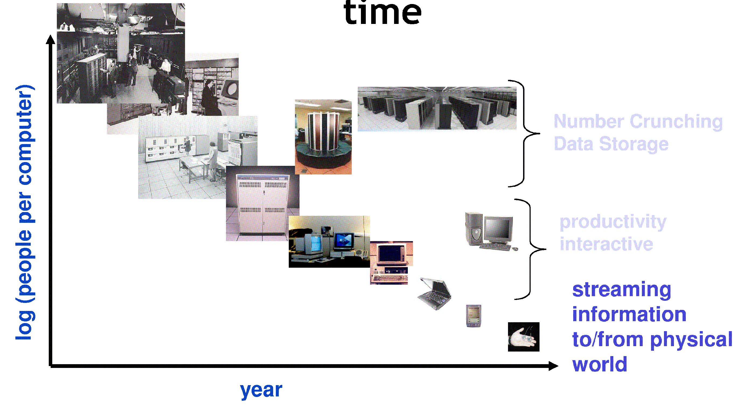
People-to-Computer Ratio Over Time
From David Culler
Today: Multiple CPUs/person

Slide 5
New Challenge: Slowdown in Joy’s law of Performance
3X
From Hennessy and Patterson, Computer Architecture: A Quantitative Approach, 4th edition, Sept. 15, 2006
⇒ Sea change in chip design: multiple “cores” or processors per chip
VAX : 25%/year 1978 to 1986
RISC + x86: 52%/year 1986 to 2002
RISC + x86: ??%/year 2002 to present

Slide 6
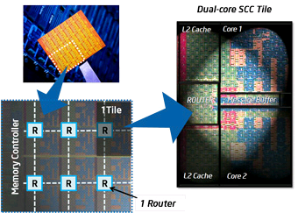
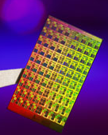
Manycore Processsors
Intel 80-core multicore chip (Feb 2007)
80 simple cores
Two FP-engines / core
Mesh-like network
100 million transistors
65nm feature size
Intel Single-Chip Cloud Computer (August 2010)
24 “tiles” with two cores/tile
24-router mesh network
4 DDR3 memory controllers
Hardware support for message-passing
“Manycore” refers to many processors/chip
64? 128? Hard to say exact boundary
How to program these?
Use 2 CPUs for video/audio
Use 1 for word processor, 1 for browser
76 for virus checking???
Parallelism must be exploited at all levels

Slide 7
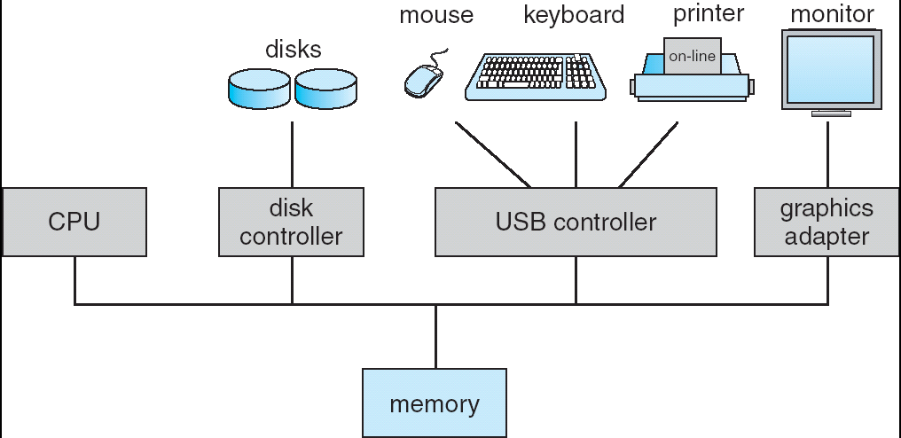
Computer System Organization
Computer-system operation
One or more CPUs, device controllers connect through common bus providing access to shared memory
Concurrent execution of CPUs and devices competing for memory cycles

Slide 8
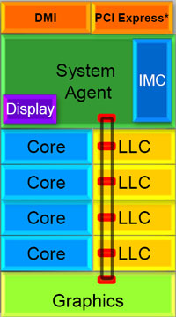
Chip-scale features of SandyBridge
Significant pieces:
Four OOO cores
New Advanced Vector eXtensions (256-bit FP)
AES instructions
Instructions to help with Galois-Field mult
4 μ-ops/cycle
Integrated GPU
System Agent (Memory and Fast I/O)
Shared L3 cache divided in 4 banks
On-chip Ring bus network
Both coherent and non-coherent transactions
High-BW access to L3 Cache
Integrated I/O
Integrated memory controller (IMC)
Two independent channels of DDR3 DRAM
High-speed PCI-Express (for Graphics cards)
DMI Connection to SouthBridge (PCH)

Slide 9
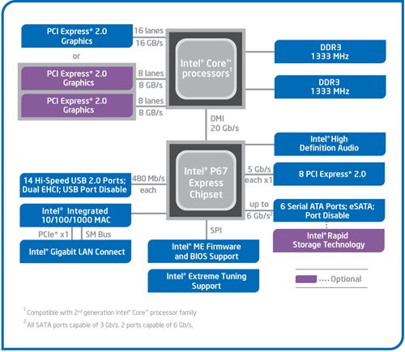
SandyBridge I/O: PCH
Platform Controller Hub
Used to be “SouthBridge,” but no “NorthBridge” now
Connected to processor with proprietary bus
Direct Media Interface
Code name “Cougar Point” for SandyBridge processors
Types of I/O on PCH:
USB
Ethernet
Audio
BIOS support
More PCI Express (lower speed than on Processor)
Sata (for Disks)
SandyBridge
System Configuration

Slide 10
Sample of Computer Architecture Topics
Input/Output and Storage
Disks, WORM, Tape
RAID
Emerging Technologies
Interleaving
Bus protocols
DRAM
Memory
Hierarchy
Coherence,
Bandwidth,
Latency
L2 Cache
Network
Communication
Other Processors
L1 Cache
Addressing,
Protection,
Exception Handling
VLSI
Instruction Set Architecture
Pipelining, Hazard Resolution,
Superscalar, Reordering,
Prediction, Speculation,
Vector, Dynamic Compilation
Pipelining and Instruction
Level Parallelism

Slide 11
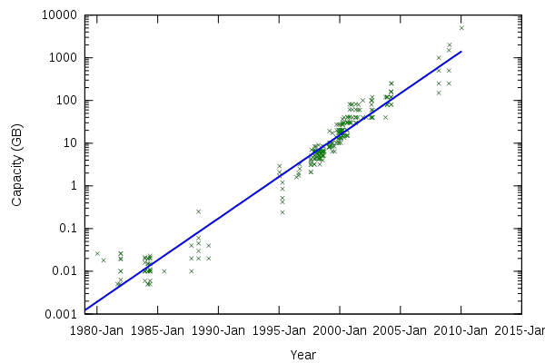
Storage Capacity
Hard disk capacity (in GB) (source: http://www.digitaltonto.com/2011/our-emergent-digital-future/)

Slide 12
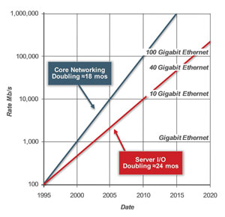
Network Capacity
(source: http://www.ospmag.com/issue/article/Time-Is-Not-Always-On-Our-Side)

Slide 13
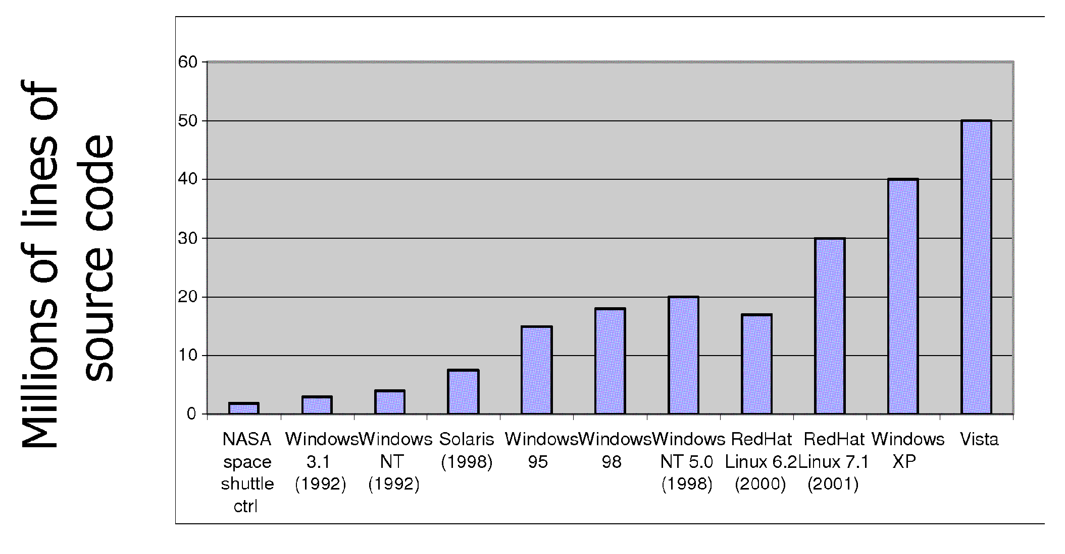
Increasing Software Complexity
From MIT’s 6.033 course

Slide 14
How do we tame complexity?
Every piece of computer hardware different
Different CPU
x86, PowerPC,ARM, MIPS
Different amounts of memory, disk, …
Different types of devices
Mice, Keyboards, Sensors, Cameras, Fingerprint readers
Different networking environment
Cable, DSL, Wireless, Firewalls,…
Questions:
Does the programmer need to write a single program that performs many independent activities?
Does every program have to be altered for every piece of hardware?
Does a faulty program crash everything?
Does every program have access to all hardware?

Slide 15
OS Tool: Virtual Machine Abstraction
Application
OS
Hardware
Virtual Machine Interface
Physical Machine Interface
Software Engineering Problem:
Turn hardware/software quirks ⇒ what programmers want/need
Optimize for convenience, utilization, security, reliability, etc…
For Any OS area (e.g. file systems, virtual memory, networking, scheduling):
What’s the hardware interface? (physical reality)
What’s the application interface? (nicer abstraction)

Slide 16
Interfaces Provide Important Boundaries
software
instruction set
hardware
Why do interfaces look the way that they do?
History, Functionality,Bugs, Management

Slide 17
Virtual Machine Interface by OS
Software emulation of an abstract machine
Make it look like hardware has features you want
Programs from one hardware & OS on another one
Programming simplicity
Each process thinks it has all memory/CPU time
Each process thinks it owns all devices
Different Devices appear to have same interface
Device Interfaces more powerful than raw hardware
Bitmapped display ⇒ windowing system
Ethernet card ⇒ reliable, ordered, networking (TCP/IP)
Fault Isolation
Processes unable to directly impact other processes
Bugs cannot crash whole machine
Protection and Portability
Stability of POSIX interface between systems
Limits to what Users programs are allowed to do

Slide 18
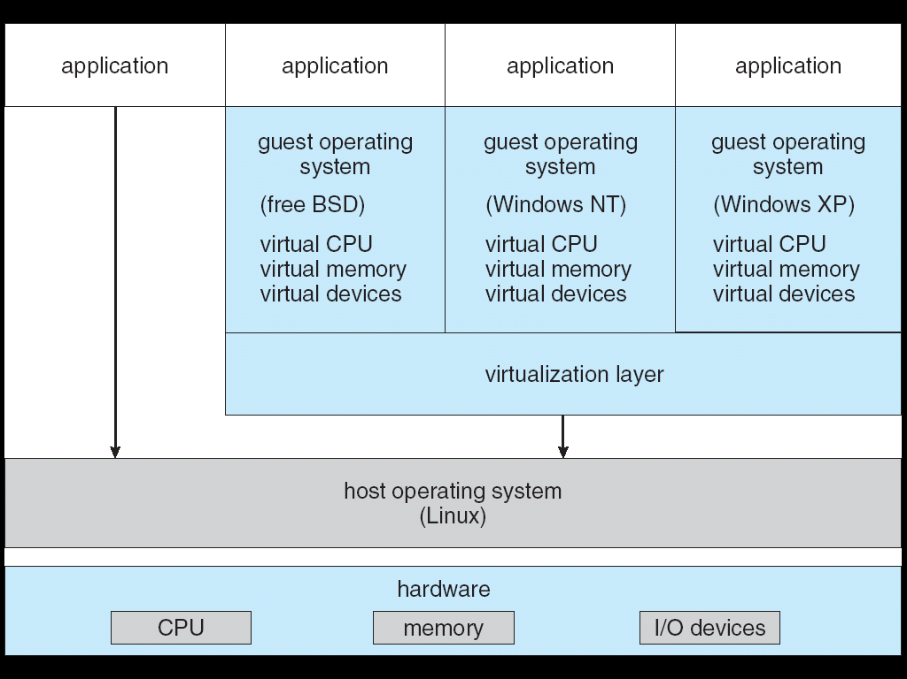
Virtualization
When OS crashes, restricted to one VM

Slide 19
What does an OS do?
Silerschatz and Gavin: “An OS is similar to a government”
Coordinator and Traffic Cop:
Manages all resources
Settles conflicting requests for resources
Prevent errors and improper use of the computer
Facilitator:
Provides facilities that everyone needs
Standard Libraries, Windowing systems
Make application programming easier, faster, less error-prone
Some features reflect both tasks:
e.g. File system is needed by everyone (Facilitator)
But File system must be Protected (Traffic Cop)

Slide 20
What is an OS,… Really?
OS components:
Memory Management
I/O Management
CPU Scheduling
Networking Stack
File System
What about?
Multimedia Support?
User Interface?
Internet Browser? ☺
Microsoft claims its browser (Edge or Internet Explorer) is part of Windows OS, to justify bundling its browser with Windows
But it is an application

Slide 21
OS Definition (Cont.)
No universally accepted definition
“Everything a vendor ships when you order an OS” is good approximation
But varies wildly
“The one program running at all times on the computer” is the OS kernel.
Everything else is either a system program (ships with the OS) or an application program

Slide 22
Example: Protecting Processes from Each Other
Problem: Run multiple applications in such a way that they are protected from one another
Goal:
Keep User Programs from Crashing OS
Keep User Programs from Crashing each other
Keep Parts of OS from crashing other parts
(Some of the) Mechanisms:
Address Translation
Dual Mode Operation
Simple Policy:
Programs are not allowed to read/write memory of other Programs or of OS

Slide 23
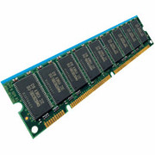
Address Translation
Address Space
Each process has the view of a contiguous range of virtual memory addresses, e.g., for a 32 bit machine, the range is [0, 2³²] Bytes (2³²Bytes=4GB)
Address Translation:
Memory Management Unit (MMU) translates from Virtual Addresses (emitted by CPU) into Physical Addresses (of memory) with a Page Table
Virtual
Addresses
Physical
Addresses
CPU
MMU

Slide 24
Example of Address Translation
Code
Data
Heap
Stack
Data 2
Code
Data
Heap
Stack
Stack 1
Heap 1
Code 1
Stack 2
Proc 1
Virtual
Address
Space 1
Data 1
Proc 2
Virtual
Address
Space 2
Heap 2
Code 2
OS code
OS data
OS heap &
Stacks
Physical Address Space

Slide 25
Address Translation Details
Translation is done with Page Table:
Translation helps protection:
Control translations, control access
User processes should not be able to change Page Table
10
Virtual
Address
V page no.
offset
Page Table
V
Access
Rights
PA
index
into
page
table
table located
in physical
memory
P page no.
offset
Physical
Address
10

Slide 26
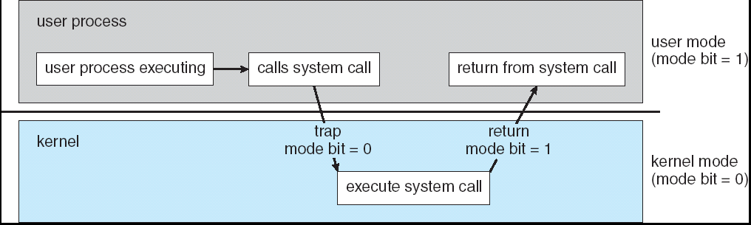
Dual Mode Operation
Hardware provides at least two modes:
“Kernel” mode (or “supervisor” or “protected”)
“User” mode: Normal programs executed
Some instructions/ops prohibited in user mode:
Example: cannot modify page tables in user mode
Attempt to modify ⇒ Exception generated
Transitions from user mode to kernel mode:
System Calls, Interrupts, Other exceptions

Slide 27
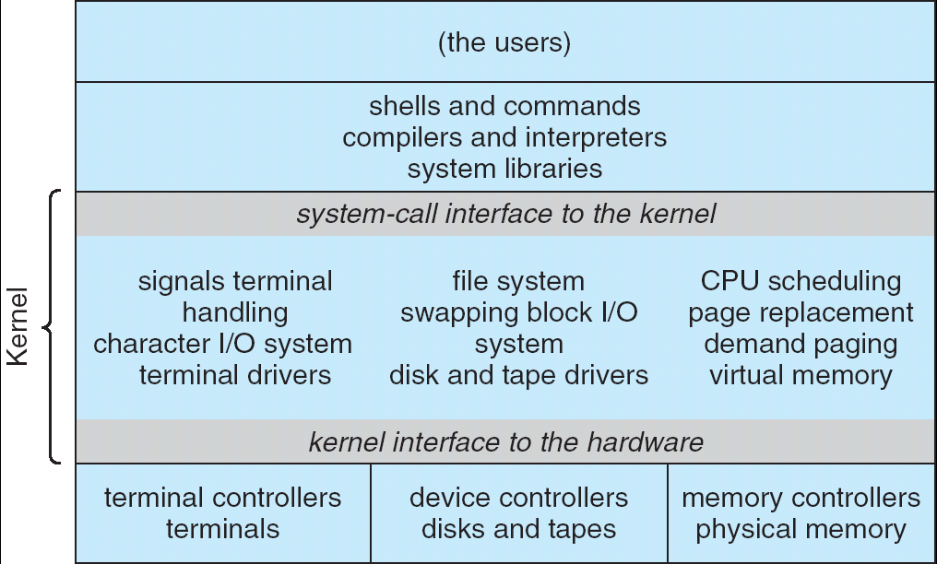
UNIX System Structure
Applications
User Mode
Standard Libs
Kernel Mode
Hardware

Slide 28
OS Systems Principles
OS as illusionist:
Make hardware limitations go away
Provide illusion of dedicated machine with infinite memory and infinite processors
OS as government:
Protect users from each other
Allocate resources efficiently and fairly
OS as complex system:
Constant tension between simplicity and functionality or performance
OS as history teacher
Learn from past
Adapt as hardware tradeoffs change

Slide 29
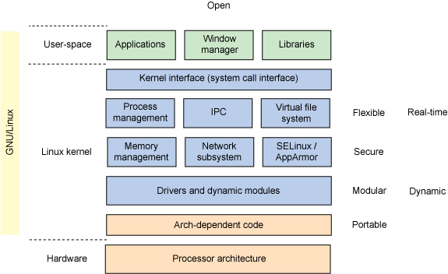
Linux Structure

Slide 30
Layout of Linux Sources
Layout of basic linux sources:
kubitron@kubi(16)% ls
arch/ drivers/ Kbuild modules.builtin samples/ usr/
block/ firmware/ kernel/ modules.order scripts/ virt/
COPYING fs/ lib/ Module.symvers security/ vmlinux*
CREDITS include/ MAINTAINERS net/ sound/ vmlinux.o
crypto/ init/ Makefile README System.map
Documentation/ ipc/ mm/ REPORTING-BUGS tools/
kubitron@kubi(17)%
Specific Directories:
arch: Architecture-specific source
block: Block I/O layer
crypto: Crypto API
Documentation: Kernel source Documentation
drivers: Device drivers
firmware: Device firmware needed to use certain drivers
fs: The VFS and individual filesystems
include: Kernel headers
init: Kernel boot and initialization
ipc: Interprocess Communication code
kernel: Core subsystems, such as the scheduler
lib: Helper routines
mm: Memory management subsystem and the vm
net: Networking subsystem
samples: Sample, demonstrative code
scripts: Scripts used to build the kernel
security: Linux Security Module
sound: Sound subsystem
usr: Early user-space code (called initramfs)
tools: Tools helpful for developing Linux
virt: Virtualization infrastructure

Slide 31
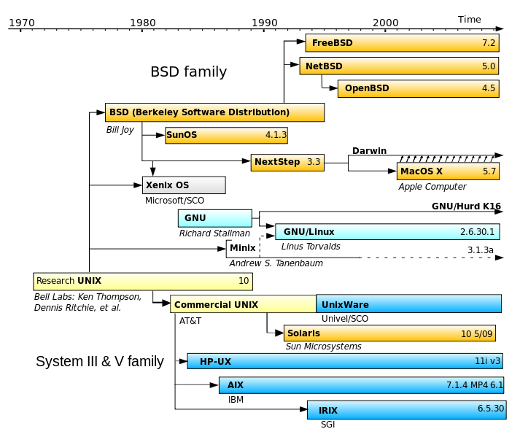
History of Unix

Slide 32
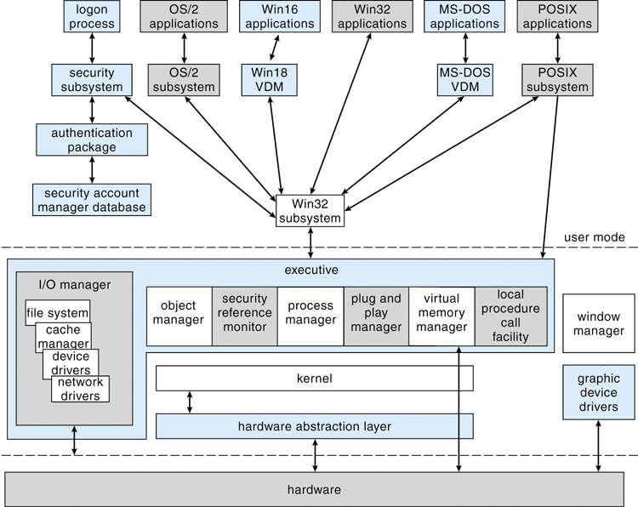
Microsoft Windows Structure

Slide 33
Major Windows Components
Hardware Abstraction Layer
Hides hardware chipset differences from upper levels of OS
Kernel Layer
Thread Scheduling
Low-Level Processors Synchronization
Interrupt/Exception Handling
Switching between User/Kernel Mode.
Executive
Set of services that all environmental subsystems need
Object Manager
Virtual Memory Manager
Process Manager
Advanced Local Procedure Call Facility
I/O manager
Cache Manager
Security Reference Monitor
Plug-and-Plan and Power Managers
Registry
Booting
Programmer Interface: Win32 API, POSIX

Slide 34
Is Windows a microkernel-based OS
Is Windows a microkernel-based OS?
No – not using the academic definition (OS components and drivers run in their separate address spaces, layered on a primitive microkernel)
All kernel components live in a common shared address space
Therefore no protection between OS and drivers
Why not pure microkernel?
Performance – separate address spaces would mean context switching to call basic OS services
But it does have some attributes of a microkernel OS
OS personalities running in user space as separate processes
Kernel-mode components don’t reach into one another’s data structures
Use formal interfaces to pass parameters and access and/or modify data structures
Therefore the term “modified microkernel”
https://micksmix.wordpress.com/2011/02/20/does-windows-have-a-microkernel-or-monolithic-kernel/

Slide 35
OS Resources – at the center of it all!
What do modern OSs do?
Control access to resources!
Control of Resources
Access/No Access/ Partial Access
Check every access to see if it is allowed
Resource Multiplexing
When multiple valid requests occur at same time – how to multiplex access?
What fraction of resource can requester get?
Performance Isolation
Can requests from one requester prevent requests from another?
Independent
Requesters
Access Control and Multiplexing

Slide 36
What is a Resource?
Processor, Memory, Cache
Multiplex through: scheduling, Virtual memory
Abstraction: Process, Thread
Network
Multiplex through: Queues, Input Filters
Abstraction: Sockets API
Disk
Multiplex through: Buffer Cache
Abstraction: File System API

Slide 37
More Complex Resources: OS Services
System Services
File system (Uses Disk Drive)
File API: Create, Read, Write, Delete
Access Control: User, Group, World, Read/Write/Execute
Windows System (Uses Graphics Card)
Windowing API: Write Text, Draw/Fill in figures
Access Control: Per Window (User created)
Data Base (Uses Disk Drive or Memory or Network)
DB API: SQL Queries and Transactions
Access Control: Per user, Group, others
Access controlled through syscall interface (Kernel Level)
Service controls access to resources using identity
Service decides multiplexing/isolation policies
Often first-come-first-serve
May be priority-based

Slide 38
System Calls: Details
Challenge: Interaction Despite Isolation
How to isolate processes and their resources…
While still permitting them to request help from the kernel
Letting them interact with resources while maintaining usage policies such as security, QoS, etc
Enter the System Call interface
Layer between the hardware and user-space processes
Programming interface to the services provided by the OS
Mostly accessed by programs via a high-level Application Program Interface (API) rather than directly
Get at system calls by linking with libraries in glibc
Common APIs:
Win32 API for Windows
POSIX API for POSIX-based systems (including all versions of Windows, UNIX, Linux, and Mac OS)
Call to printf()
Printf() in the C library
Write() system call

Slide 39
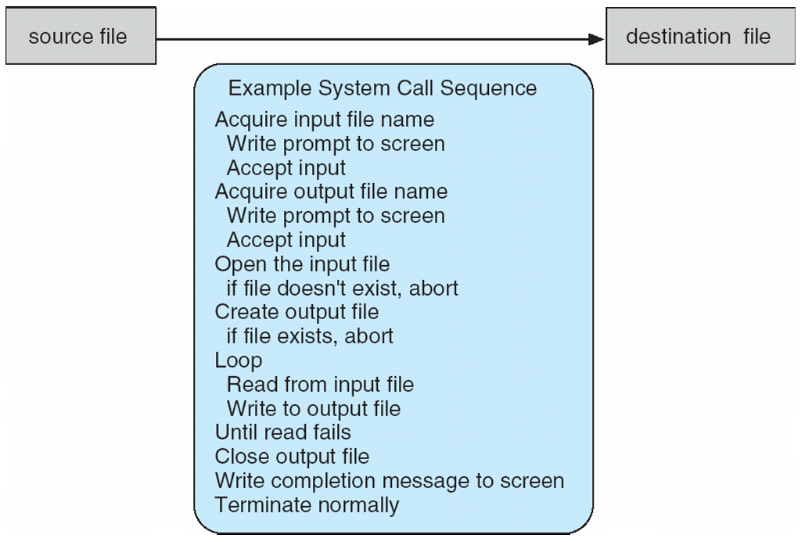
Example of System Call usage
System call sequence to copy the contents of one file to another file:
Many crossings of the User/Kernel boundary!
The cost of traversing this boundary can be high

Slide 40
Example: Use strace to trace syscalls
prompt% strace wc production.log
execve("/usr/bin/wc", ["wc", "production.log"], [/* 52 vars */]) = 0
brk(0) = 0x1987000
mmap(NULL, 4096, PROT_READ|PROT_WRITE, MAP_PRIVATE|MAP_ANONYMOUS, -1, 0) = 0x7ff24b8f7000
access("/etc/ld.so.preload", R_OK) = -1 ENOENT (No such file or directory)
open("/etc/ld.so.cache", O_RDONLY) = 3
fstat(3, {st_mode=S_IFREG|0644, st_size=137151, ...}) = 0
mmap(NULL, 137151, PROT_READ, MAP_PRIVATE, 3, 0) = 0x7ff24b8d5000
close(3) = 0
open("/lib64/libc.so.6", O_RDONLY) = 3
read(3, "\177ELF\2\1\1\3\0\0\0\0\0\0\0\0\3\0>\0\1\0\0\0\360\355\241,0\0\0\0"..., 832) = 832
fstat(3, {st_mode=S_IFREG|0755, st_size=1922112, ...}) = 0
mmap(0x302ca00000, 3745960, PROT_READ|PROT_EXEC, MAP_PRIVATE|MAP_DENYWRITE, 3, 0) = 0x302ca00000
mprotect(0x302cb89000, 2097152, PROT_NONE) = 0
mmap(0x302cd89000, 20480, PROT_READ|PROT_WRITE, MAP_PRIVATE|MAP_FIXED|MAP_DENYWRITE, 3, 0x189000) = 0x302cd89000
mmap(0x302cd8e000, 18600, PROT_READ|PROT_WRITE, MAP_PRIVATE|MAP_FIXED|MAP_ANONYMOUS, -1, 0) = 0x302cd8e000
close(3) = 0
mmap(NULL, 4096, PROT_READ|PROT_WRITE, MAP_PRIVATE|MAP_ANONYMOUS, -1, 0) = 0x7ff24b8d4000
mmap(NULL, 4096, PROT_READ|PROT_WRITE, MAP_PRIVATE|MAP_ANONYMOUS, -1, 0) = 0x7ff24b8d3000
mmap(NULL, 4096, PROT_READ|PROT_WRITE, MAP_PRIVATE|MAP_ANONYMOUS, -1, 0) = 0x7ff24b8d2000
arch_prctl(ARCH_SET_FS, 0x7ff24b8d3700) = 0
mprotect(0x302cd89000, 16384, PROT_READ) = 0
mprotect(0x302c81f000, 4096, PROT_READ) = 0
munmap(0x7ff24b8d5000, 137151) = 0
brk(0) = 0x1987000
brk(0x19a8000) = 0x19a8000
open("/usr/lib/locale/locale-archive", O_RDONLY) = 3
fstat(3, {st_mode=S_IFREG|0644, st_size=99158576, ...}) = 0
mmap(NULL, 99158576, PROT_READ, MAP_PRIVATE, 3, 0) = 0x7ff245a41000
close(3) = 0
stat("production.log", {st_mode=S_IFREG|0644, st_size=526550, ...}) = 0
open("production.log", O_RDONLY) = 3
read(3, "# Logfile created on Fri Dec 28 "..., 16384) = 16384
open("/usr/lib64/gconv/gconv-modules.cache", O_RDONLY) = 4
fstat(4, {st_mode=S_IFREG|0644, st_size=26060, ...}) = 0
mmap(NULL, 26060, PROT_READ, MAP_SHARED, 4, 0) = 0x7ff24b8f0000
close(4) = 0
read(3, "m: cannot remove `/tmp/fixrepo/g"..., 16384) = 16384
read(3, "a36de93203e0b4972c1a3c81904e': P"..., 16384) = 16384
read(3, "xrepo/git-tess/gitolite-admin/.g"..., 16384) = 16384
Many repetitions of these reads
read(3, "ixrepo/git-tess/gitolite-admin\n "..., 16384) = 16384
read(3, "ite/redmine/vendor/plugins/redmi"..., 16384) = 16384
read(3, "ited with positive recursionChec"..., 16384) = 16384
read(3, "ting changes to gitolite-admin r"..., 16384) = 2262
read(3, "", 16384) = 0
fstat(1, {st_mode=S_IFCHR|0620, st_rdev=makedev(136, 3), ...}) = 0
mmap(NULL, 4096, PROT_READ|PROT_WRITE, MAP_PRIVATE|MAP_ANONYMOUS, -1, 0) = 0x7ff24b8ef000
write(1, " 4704 28993 526550 production."..., 36 4704 28993 526550 production.log) = 36
close(3) = 0 close(1) = 0
munmap(0x7ff24b8ef000, 4096) = 0
close(2) = 0
exit_group(0)

Slide 41
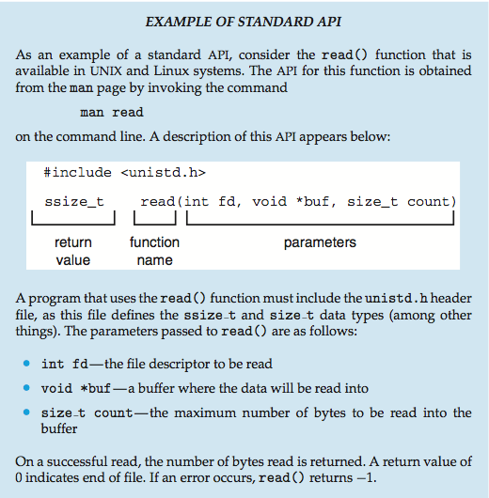
Example of Standard API

Slide 42
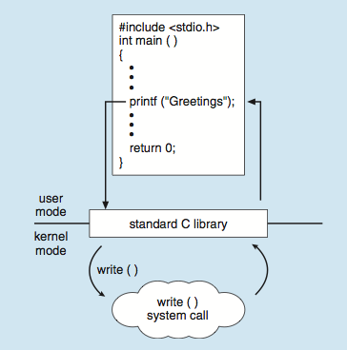
System Call Implementation
A number associated with each system call
System-call interface maintains a table indexed according to these numbers
System call returns status of the system call and any return values
Return value 0 indicates success; -1 indicates an error
On error – return code placed into global “errno” variable
Can translate into human-readable errors with the “perror()” call
Programmer does not use the system call interface directly; he uses API supplied by run-time support library (e.g., libc)
Example: C program invokes printf() API, which calls write() system call

Slide 43
Types of System Calls
Process control
end, abort
load, execute
create process, terminate process
get process attributes, set process attributes
wait for time
wait event, signal event
allocate and free memory
Dump memory if error
Debugger for determining bugs, single step execution
Locks for managing access to shared data between processes

Slide 44
Types of System Calls (Con’t)
File management
create file, delete file
open, close file
read, write, reposition
get and set file attributes
Device management
request device, release device
read, write, reposition
get device attributes, set device attributes
logically attach or detach devices
Information maintenance
get time or date, set time or date
get system data, set system data
get and set process, file, or device attributes

Slide 45
Types of System Calls (Cont.)
Communications
create, delete communication connection
send, receive messages if message passing model to host name or process name
From client to server
Shared-memory model create and gain access to memory regions
transfer status information
attach and detach remote devices
Protection
Control access to resources
Get and set permissions
Allow and deny user access

Slide 46
POSIX standard
Portable OS Interface for UNIX
An attempt to standardize a “UNIXy” interface
Conformance: IEEE POSIX 1003.1 and ISO/IEC 9945
POSIX.1: Core Services
Process Creation and Control
Signals
Floating Point Exceptions, Segmentation/memory violations, illegal instructions, Bus Erors
Timers
File and Directory Operations
Pipes
C Library (Standard C)
I/O Port Interface and Control
Process Triggers
POSIX.1b: Realtime Extensions
POSIX.2: Shell and Utilities

Slide 47
POSIX (cont)
Process Primitives:
fork, execl, execlp, execv, execve, execvp, wit, waitpid
_exit, kill, sigxxx, alarm, pause, sleep….
Example file access primitives:
opendir, readdir, rewinddir, closedir, chdir, getcwd, open, creat, umask, link, mkdir, unlink, rmdir, rename, stat, fstat, access, fchmod, chown, utime, ftruncate,pathconf,fpathconf
I/O primitives:
pipe, dup, dup2, close, read, write, fcntl, lseek, fsync
C-Language primitives:
abort, exit, fclose, fdopen, fflush, fgetc, fgets, fileno, fopen, fprintf, fputc, fputs, fread, freopen, fscanf, fseek, ftell, fwrite, getc, getchar, gets, perror, printf, putc, putchar, puts, remove, rewind, scanf, setlocale, siglongjmp, sigsetjmp, tmpfile, tmpnam, tzset
Synchronization:
sem_init, sem_destroy, sem_wait, sem_trywait, sem_post, pthread_mutex_init, pthread_mutex_destroy, pthread_mutex_lock, pthread_mutex_trylock, pthread_mutex_unlock
Memory Management
mmap, mprotect, msync, munmap

Slide 48
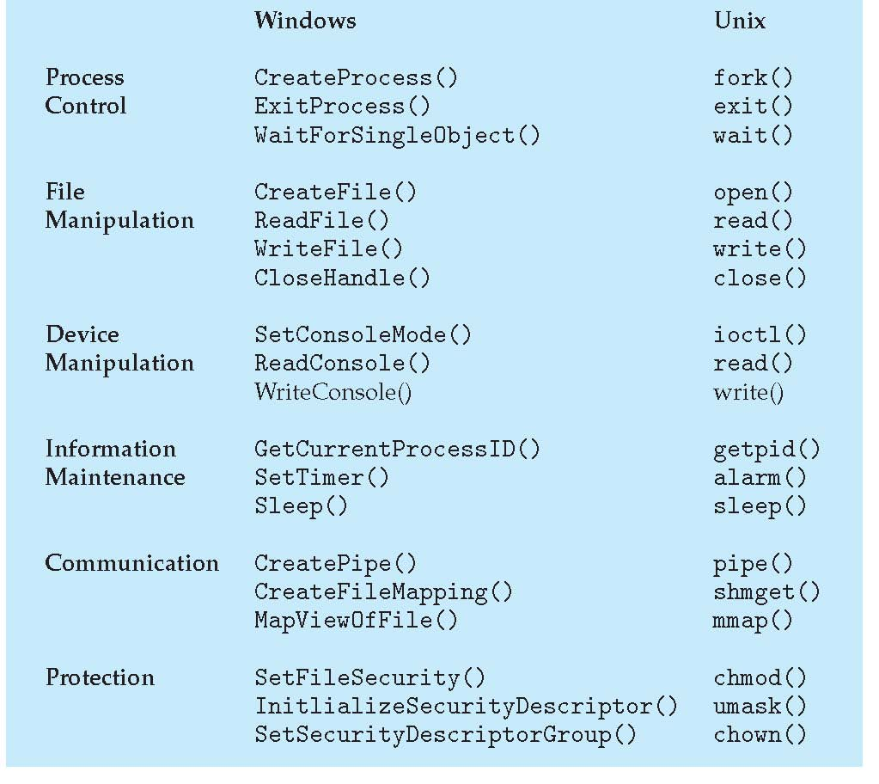
Examples of Windows and Unix System Calls

Slide 49
OSs Structures
Simple Structure vs. Layered Structure
Monolithic kernel
All OS functions in kernel space
Microkernel
Many OS functions implemented as user-level processes
ExoKernel
Cell-based OS (Space-Time Partitioning)

Slide 50
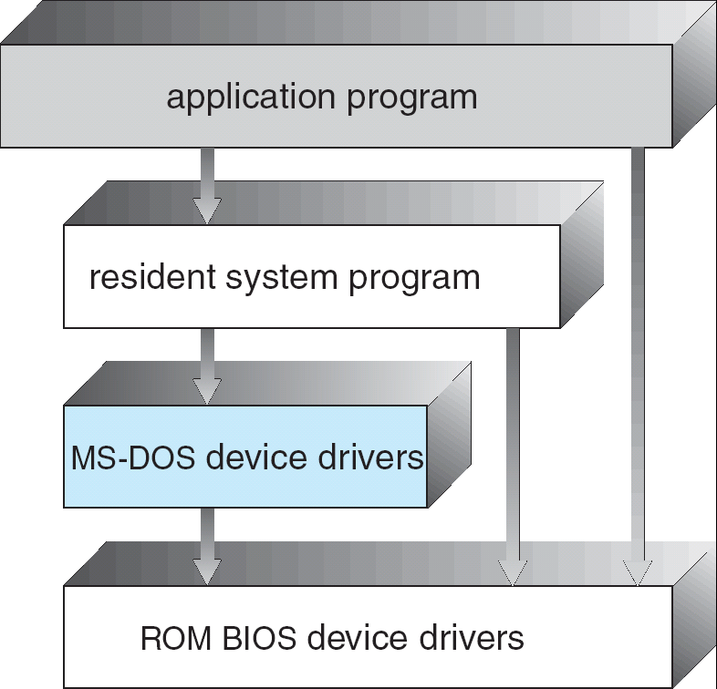
Simple Structure
All aspects of the OS linked together in one binary
APIs not carefully designed (and/or lots of global variables)
Interfaces and levels of functionality not well separated
No address protection
Example: MS-DOS
provide the most functionality in the least space
Made sense in early days of personal computers with limited processors (e.g. 6502)
Advantages?
Low memory footprint
Disadvantages?
Very fragile, no enforcement of structure/boundaries
Still used in resource-constrained embedded systems

Slide 51
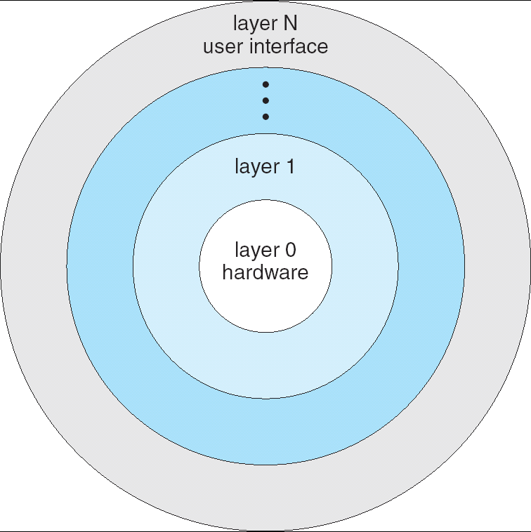
Layered Structure
OS is divided many layers (levels)
Each built on top of lower layers
Bottom layer (layer 0) is hardware
Highest layer (layer N) is the user interface
Each layer uses functions (operations) and services of only lower-level layers
Advantage: modularity ⇒ Easier debugging/Maintenance
Not always possible: Does process scheduler lie above or below virtual memory layer?
Need to reschedule processor while waiting for paging
May need to page in information about tasks
Important: Machine-dependent vs independent layers
Easier migration between platforms
Easier evolution of hardware platform
Good idea for you as well!
Can utilize hardware enforcement
Intel x86 processor: 4 “rings”

Slide 52
Monolithic Kernels: UNIX, Windows, MacOS
Applications
User Mode
Standard Libs
Kernel Mode
Hardware
Two-Layered Structure: User vs Kernel
All code representing protection and management of resources placed in same address space
Compromise of one OS component can compromise whole OS

Slide 53
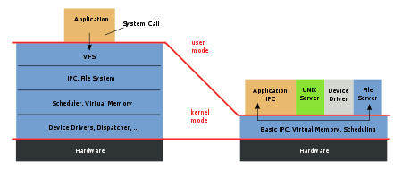
Microkernels
Figure ©Wikipedia
Monolithic
Kernel
Microkernel
Moves functionality from the kernel into user space
Small microkernel runs at kernel level
OS Services built from many independent user-level processes
Benefits:
Easier to extend a microkernel
Easier to port OS to new architectures
More reliable
Fault Isolation (parts of kernel protected from other parts)
More secure
Detriments:
IPC (Inter-Process Communication) performance can be slow

Slide 54
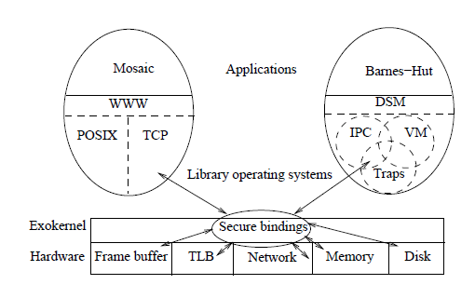
ExoKernel: Separate Protection from Management
Thin abstraction layer exports hardware resources directly to users
LibraryOS: traditional OS functionality at User-Level
Customize resource management for every application
Is this a practical approach?
Low-level abstraction layer
Need specialized skills to develop LibraryOS

Slide 55
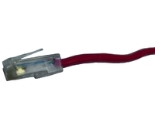

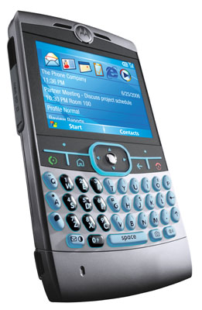


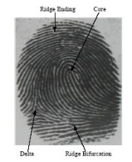
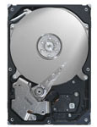
Tessellation: Cell-based OS (Space-Time Partitioning)
Normal Components split into pieces
Device drivers (Security/Reliability)
Network Services (Performance)
TCP/IP stack
Firewall
Virus Checking
Intrusion Detection
Persistent Storage (Performance, Security, Reliability)
Monitoring services
Performance counters
Introspection
Identity/Environment services (Security)
Biometric, GPS, Possession Tracking
Applications Given Larger Partitions
Freedom to use resources arbitrarily
Large Compute-Bound
Application
Firewall
Virus
Intrusion
Monitor
And
Adapt
Real-Time
Application
Video &
Window
Drivers
Persistent
Storage &
File System
Identity
HCI/
Voice
Rec
Device
Drivers

Slide 56
Summary
OSs provide a virtual machine abstraction to handle diverse hardware
OSs coordinate resources and protect users from each other
OSs simplify application development by providing standard services
OSs can provide an array of fault containment, fault tolerance, and fault recovery
Resource Control: In HW or SW!
Access/No Access/Partial Access
Resource Multiplexing
Performance Isolation
System-Call interface
This is the I/O for the process “virtual machine”
Accomplished with special trap instructions which vector off a table of system calls
Usually programmers use the standard API provided by the C library rather than direct system-call interface
POSIX interface
An attempt to standardize “unixy” Oses
OS Structure:
Common organizations: Monolithic, MicroKernel, ExoKernel

