Slide 1
Advanced Operating Systems
ZJU 2020

Slide 2
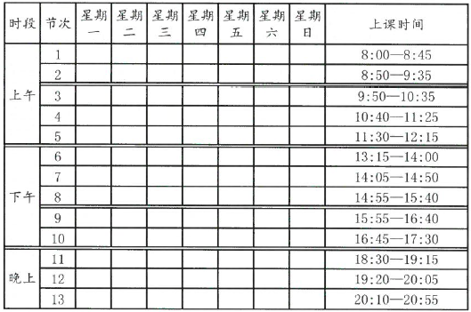
Logistics
Wed 7-10 (14:05–17:30)
Website for PPTs : https://gulaoshi.github.io/AdvOS/
Lecture schedule is subject to change.

Slide 3
Course Scope
SOSP and OSDI Call for Papers:
“The ACM Symposium on Operating Systems Principles (or the USENIX Symposium on Operating Systems Design and Implementation) seeks to present exciting, innovative research related to the design, implementation, analysis, evaluation, and deployment of computer systems software. SOSP takes a broad view of the systems area and solicits contributions from many fields of systems practice, including, but not limited to, operating systems, file and storage systems, distributed systems, cloud systems, mobile systems, secure systems, embedded systems, dependable systems, system management and virtualization. We also welcome work that explores the interface to related areas such as computer architecture, networking, programming languages, and databases.”
This course also takes a broad view of the systems area, instead of the narrow view of a specific OS, e.g., Linux

Slide 4
Lecture Topics
No textbook. I will introduce the latest research papers, and give you an overview of the recent research on the following topics (tentative):
Multicore & GPU resource management
Internet of Things (IoT) and Cyber-Physical Systems
Automotive Electrical/Electronic (E/E) Systems
Security and privacy issues
Anything related to “systems”
Course website will be updated throughout the semester
The objective is to give a broad overview of the state-of-the-art research advances, instead of digging deep into any classic topics.

Slide 5
Grading Scheme
Final Exam: 50%; Project: 50%
Notes:
This is a note

Slide 6
Final Exam
Covers PPTs on the website; does not include the papers and videos.
Consists of multiple-choice, single-answer questions. The exam is open-book.

Slide 7
Sample Questions
According to [David13] "Everything You Always Wanted to Know About Synchronization but Were Afraid to As", what is the main source of scalability problems in multicore synchronization?
A. Hardware
B. Software
C. Middleware
C. None of the above
ANS:_________________
A
In [Clements13] "The Scalable Commutativity Rule: Designing Scalable Software for Multicore Processors", what does it mean when we say a software system is "scalable"?
A. System performance stays constant with increasing number of cores on a multicore processor.
B. System performance increases linearly with increasing number of cores on a multicore processor.
C. System performance deteriorates with increasing number of cores on a multicore processor.
D. System performance is independent of the underlying hardware platform.
ANS: ________________
B
Which of the following does NOT describe [Rossbach11], "Rossbach, PTask: Operating System Abstractions To Manage GPUs as Compute Devices"?
A. to provide a dataflow programming model for GPU.
B. to reduce unnecessary memory transfers between CPU and GPU.
C. to provide more OS support for GPUs
D. to build next-generation GPU microarchitecture
ANS: ________________
D
In [Kim14] "GPUnet: Networking Abstractions for GPU Programs", RDMA (Remote Direct Memory Access) is used to:
A. perform memory transfers between CPU and GPU
B. offload transport layer processing to NIC (Network Interface Card)
C. maintain cache coherence between CPU and GPU
D. reduce unnecessary memory transfers between CPU and GPU.
ANS: ________________
B

Slide 8
According to [David13] "Everything You Always Wanted to Know About Synchronization but Were Afraid to As", what is the main source of scalability problems in multicore synchronization?
A. Hardware
B. Software
C. Middleware
C. None of the above
ANS:_________________
A
In [Clements13] "The Scalable Commutativity Rule: Designing Scalable Software for Multicore Processors", what does it mean when we say a software system is "scalable"?
A. System performance stays constant with increasing number of cores on a multicore processor.
B. System performance increases linearly with increasing number of cores on a multicore processor.
C. System performance deteriorates with increasing number of cores on a multicore processor.
D. System performance is independent of the underlying hardware platform.
ANS: ________________
B
Which of the following does NOT describe [Rossbach11], "Rossbach, PTask: Operating System Abstractions To Manage GPUs as Compute Devices"?
A. to provide a dataflow programming model for GPU.
B. to reduce unnecessary memory transfers between CPU and GPU.
C. to provide more OS support for GPUs
D. to build next-generation GPU microarchitecture
ANS: ________________
D
In [Kim14] "GPUnet: Networking Abstractions for GPU Programs", RDMA (Remote Direct Memory Access) is used to:
A. perform memory transfers between CPU and GPU
B. offload transport layer processing to NIC (Network Interface Card)
C. maintain cache coherence between CPU and GPU
D. reduce unnecessary memory transfers between CPU and GPU.
ANS: ________________
B
Cache coherence protocols are used to:
A. lock cache lines so they are not pushed out to memory
B. keep data consistent across multiple private caches on a multicore processor
C. implement virtual memory on a multicore processor
D. perform cache partitioning to give each application its own private cache space and avoid cache contention on a multicore processor.
ANS: ________________
B
In [Blagodurov11] "Case for NUMA-aware Contention Management on Multicore Systems", how to decide if two threads will hurt each other?s performance if co-scheduled in the same NUMA domain?
A. By using Per Entity Load Tracking Metric
B. By measuring Last-Level Cache (LLC) miss rate
C. By using AMD CPU¡¯s Miss Address Buffer (MAB)
D. By using high-resolution timestamps to measure thread start and finish times
ANS: ________________
B

Slide 9
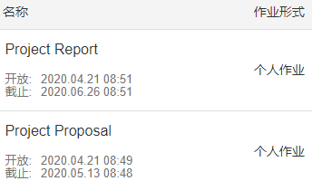
Project
Each group of 1-3 students
You can propose your own project idea
Can be a survey of a specific topic
Can be based on your own research topic (does not have to be related to OS)
Project proposal (5 pt) due 05/13
Project report (45 pt) is due 06/26. Minimum 4 pages, in English or Chinese. Do not send me source code.
Late policy: every late day costs 1 point.
Most students get full 50 points ☺
学在浙大:
Notes:
Refer to the “Links and References” page for related conferences and journals for possible ideas

Slide 10
Teaching Method
Reading of the discussed papers before class is encouraged, but not mandatory
I will sometimes play and discuss some videos in class, mainly talks from computer systems conferences from USENIX, ACM/IEEE
The videos will be put online, along with the PPTs

Slide 11
点名政策
不签到，不点名，可以课下看视频。上课问回答不计分。

