Slide 1
Multicore Architectures
Summer 2019, ZJU

Slide 2
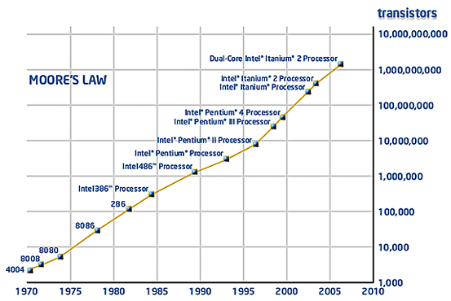
As Moore’s law goes on…
Number of transistor/chip doubles every 18 to 24 mm
Notes:
the number of transistors that can be inexpensively placed on an integrated circuit is increasing exponentially, doubling approximately every two years
Patterson & Hennessy: number of cores will double every 18 months, while power, clock frequency and costs will remain constant

Slide 3
…heating becomes a problem
P → V → f: Clock speed limited to less than 4 GHz
Power (W)
Pentium Tejas
cancelled!
Nuclear
Reactor
P4
STOP
P3
Pentium
P1
P2
Hot-plate
286
486
8086
386
8085
8080
8008
4004
Year

Slide 4
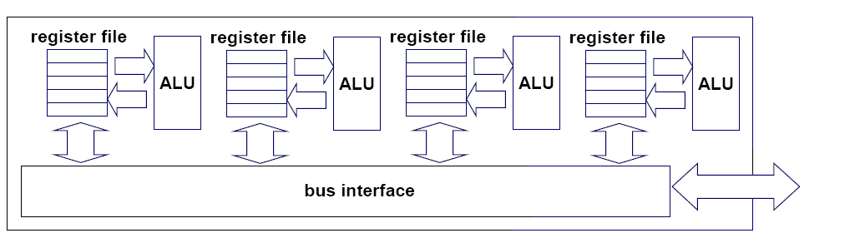
Keeping Moore’s law alive
Exploit the immense number of transistors in other ways
How to reduce gate size while keeping CPU frequency relatively low?
Put multiple cores on the chip, each operating at lower frequencies
Core 1
Core 2
Core 3
Core 4

Slide 5
Instruction-level parallelism (ILP)
Parallelism at the machine-instruction level
The processor can re-order, pipeline instructions, do aggressive branch prediction, etc.
Single-core processor performance improvement is due to ILP

Slide 6
Thread-level parallelism (TLP)
Multiple threads execute concurrently
Server can serve each client in a separate thread (Web server, database server)
A computer game can do AI, graphics, and physics in separate threads
Multicore architectures can exploit TLP with parallel execution of application threads on different cores
Single-core processors can also exploit TLP by time-sharing multiple threads with context-switching
Not true parallelism like multicore

Slide 7
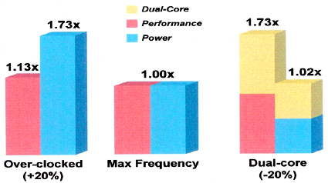
Multicore power vs. performance
1. Standard processor over-clocked 20% 2. Standard processor 3. Two standard processors each under-clocked 20%
Notes:
Two or more processor cores on the same chip
Intel Core Duo processor
Semiconductor trends
More transistors available per die
Clock scaling reaching limits due to power constraints. An empirical study suggests that a 1% clock increase results in a 3% power increase.
Moore’s Law has hit a wall due to power constraints

Slide 8
The cores run in parallel
thread 1
thread 2
thread 3
thread 4
core
1
core
2
core
3
core
4

Slide 9
Within each core, threads are time-sliced (just like on a uniprocessor)
several threads
several threads
several threads
several threads
core
1
core
2
core
3
core
4

Slide 10
Multiprocessor memory types
Shared memory: In this model, there is one (large) common shared memory for all processors
Distributed memory: In this model, each processor has its own (small) local memory, inter-connection is Network-on-Chip instead of bus. Suitable for manycore processors

Slide 11
Multicore processor is a special kind of a multiprocessor: All processors are on the same chip
Multicore processors are MIMD: Different cores execute different threads (Multiple Instructions), operating on different parts of memory (Multiple Data).
Multicore is a shared memory multiprocessor: All cores share the same memory

Slide 12
The memory hierarchy
L1 caches private
L2/L3 caches may be private or shared
Main memory is always shared

Slide 13
Intel Xeon processors
hyper-threads
Dual-core Intel Xeon processors
Each core is hyper-threaded
Private L1 caches
Shared L2 caches
C O R E 1
C O R E 0
L1 cache
L1 cache
L2 cache
memory

Slide 14
Designs with private L2 caches
C O R E 1
C O R E 0
C O R E 1
C O R E 0
L1 cache
L1 cache
L1 cache
L1 cache
L2 cache
L2 cache
L2 cache
L2 cache
L3 cache
L3 cache
memory
memory
Both L1 and L2 are private
Examples: AMD Opteron, AMD Athlon, Intel Pentium D
A design with L3 caches Example: Intel Itanium 2

Slide 15
Private vs shared caches
Advantages of private:
Faster access time due to its closeness to its core
No interference and contention between different cores
Advantages of shared:
Efficient utilization of limited cache space, since threads on different cores share the same cache
Efficient inter-core communication, since data can be written by one core and read by another core, without going through memory (assuming write-back cache instead of write-through)

Slide 16
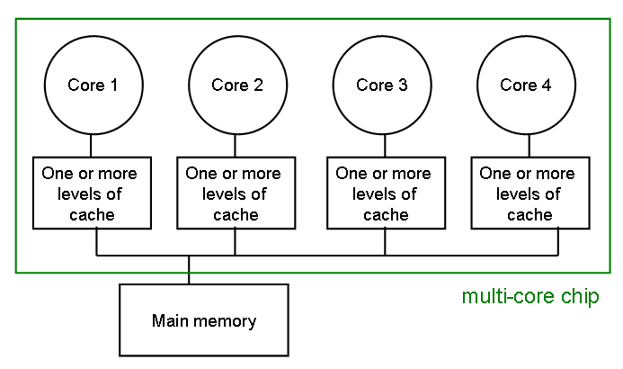
The cache coherence problem
Since we have private caches: How to keep the data consistent across caches?
Each core should perceive the memory as a contiguous array of addresses, shared among all cores

Slide 17
The cache coherence problem
Suppose variable x initially contains 15213
Core 1
Core 2
Core 3
Core 4
One or more levels of cache
One or more levels of cache
One or more levels of cache
One or more levels of cache
multicore chip
Main memory
x=15213

Slide 18
The cache coherence problem
Core 1 reads x
Core 1
Core 2
Core 3
Core 4
One or more levels of cache
x=15213
One or more levels of cache
One or more levels of cache
One or more levels of cache
multicore chip
Main memory
x=15213

Slide 19
The cache coherence problem
Core 2 reads x
Core 1
Core 2
Core 3
Core 4
One or more levels of cache
x=15213
One or more levels of cache
x=15213
One or more levels of cache
One or more levels of cache
multicore chip
Main memory
x=15213

Slide 20
The cache coherence problem
Core 1 writes to x, setting it to 21660
Core 1
Core 2
Core 3
Core 4
One or more levels of cache
x=21660
One or more levels of cache
x=15213
One or more levels of cache
One or more levels of cache
multicore chip
Main memory
x=21660
assuming write-through caches

Slide 21
The cache coherence problem
Core 2 attempts to read x… gets a stale copy
Core 1
Core 2
Core 3
Core 4
One or more levels of cache
x=21660
One or more levels of cache
x=15213
One or more levels of cache
One or more levels of cache
multicore chip
Main memory
x=21660

Slide 22
Invalidation Protocol with Snooping
A simple cache coherence protocol
Invalidation:
If a core writes to a data item, all other copies of this data item in other caches are invalidated
Snooping:
All cores continuously “snoop” (monitor) the bus connecting the cores.

Slide 23
Inter-core bus
Core 1
Core 2
Core 3
Core 4
One or more levels of cache
One or more levels of cache
One or more levels of cache
One or more levels of cache
multicore chip
Main memory
inter-core bus

Slide 24
The cache coherence problem
Revisited: Cores 1 and 2 have both read x
Core 1
Core 2
Core 3
Core 4
One or more levels of cache
x=15213
One or more levels of cache
x=15213
One or more levels of cache
One or more levels of cache
multicore chip
Main memory
x=15213

Slide 25
The cache coherence problem
Core 1 writes to x, setting it to 21660
Core 1
Core 2
Core 3
Core 4
One or more levels of cache
x=21660
One or more levels of cache
x=15213
One or more levels of cache
One or more levels of cache
sends invalidation request
INVALIDATED
multicore chip
Main memory
x=21660
assuming write-through caches
inter-core bus

Slide 26
The cache coherence problem
After invalidation:
Core 1
Core 2
Core 3
Core 4
One or more levels of cache
x=21660
One or more levels of cache
One or more levels of cache
One or more levels of cache
multicore chip
Main memory
x=21660

Slide 27
The cache coherence problem
Core 2 reads x. Cache misses, and loads the new copy.
Core 1
Core 2
Core 3
Core 4
One or more levels of cache
x=21660
One or more levels of cache
x=21660
One or more levels of cache
One or more levels of cache
multicore chip
Main memory
x=21660

Slide 28
Alternative to invalidate protocol: update protocol
Core 1 writes x=21660:
Core 1
Core 2
Core 3
Core 4
One or more levels of cache
x=21660
One or more levels of cache
x=21660
One or more levels of cache
One or more levels of cache
UPDATED
broadcasts updated value
multicore chip
Main memory
x=21660
assuming write-through caches
inter-core bus

Slide 29
Invalidation vs update
Multiple writes to the same variable
invalidation: only the first time
update: must broadcast each write (which includes new variable value)
Invalidation generally performs better: it generates less bus traffic

Slide 30
Invalidation protocols
This is just the basic invalidation protocol
More sophisticated protocols use extra cache state bits
MESI (Modified, Exclusive, Shared, Invalid)

Slide 31
Programming for multicore
Programmers must use threads or processes
Spread the workload across multiple cores
Write parallel algorithms
OS will map threads/processes to cores

Slide 32
Assigning threads to the cores
Each thread/process has an affinity mask that specifies what core(s) the thread is allowed to run on
Affinities are inherited across fork()
Example: this thread is allowed to run on cores 0,2,3, but not on core 1, on a quadcore processor
1
1
0
1
core 3
core 2
core 1
core 0

Slide 33
Default Affinities
Default affinity mask is all 1s: all threads can run on all cores of the processor
OS scheduler decides what threads run on what core
Load balancing: upon detection of skewed workloads, threads are migrated to less busy cores

Slide 34
Soft affinity
Thread/process migration is costly
Need to restart the CPU execution pipeline
Data in the private cache is invalidated and needs to be reloaded
OS scheduler tries to avoid migration as much as possible:
It tends to keeps a running thread/process on the same core, unless otherwise dictated by loading balancing requirements

Slide 35
Hard affinity
The programmer can prescribe her own affinities (hard affinities)
Rule of thumb: use the default scheduler unless a good reason not to

Slide 36

When to set your own affinities
Multiple threads have frequently-accessed shared variables
map to same core so that can share L1 cache
Real-time threads: Example: a thread running a robot controller: - must not be context switched, or else robot can go unstable - dedicate an entire core just to this thread
Source: Sensable.com

Slide 37
Summary
Multicore architecture is prevalent in all segments: embedded, desktop, server…
Cache coherence protocols
Processor affinities

