Slide 1
A Case for NUMA-aware Contention Management on Multicore Systems Sergey Blagodurov et al. 2011
ZJU 2020
Notes:
This chapter provides an overview of computer security. We begin with a discussion
of what we mean by computer security. In essence, computer security deals
with computer-related assets that are subject to a variety of threats and for which
various measures are taken to protect those assets. Accordingly, the next section of
this chapter provides a brief overview of the categories of computer-related assets
that users and system managers wish to preserve and protect, and a look at the
various threats and attacks that can be made on those assets. Then, we survey the
measures that can be taken to deal with such threats and attacks. This we do from
three different viewpoints, in Sections 1.3 through 1.5. We then lay out in general
terms a computer security strategy.
The focus of this chapter, and indeed this book, is on three fundamental
questions:
1. What assets do we need to protect?
2. How are those assets threatened?
3. What can we do to counter those threats?

Slide 2
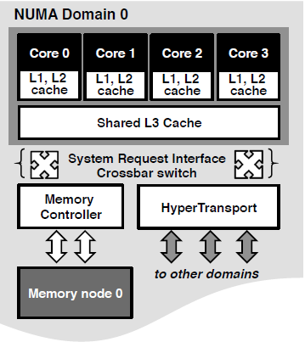
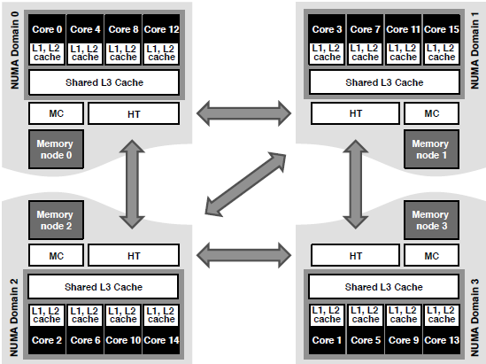
An AMD Opteron system with 4 domains

Slide 3
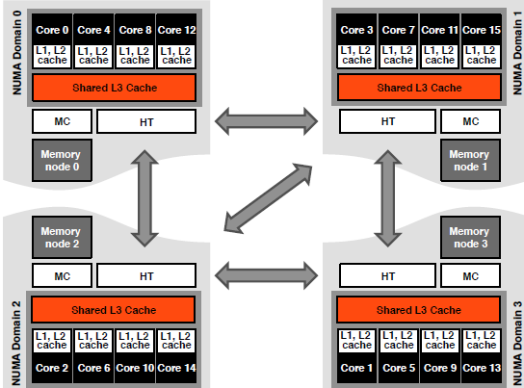
Contention for the shared last-level cache (CA)

Slide 4
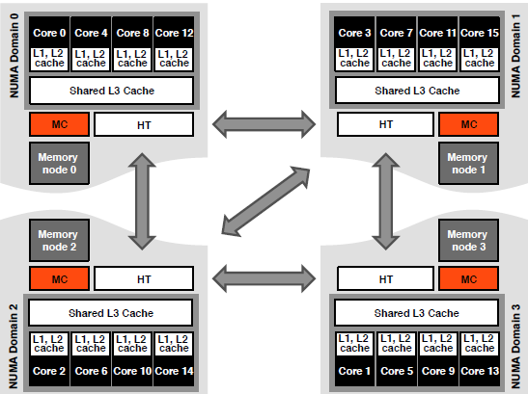
Contention for the memory controller (MC)

Slide 5
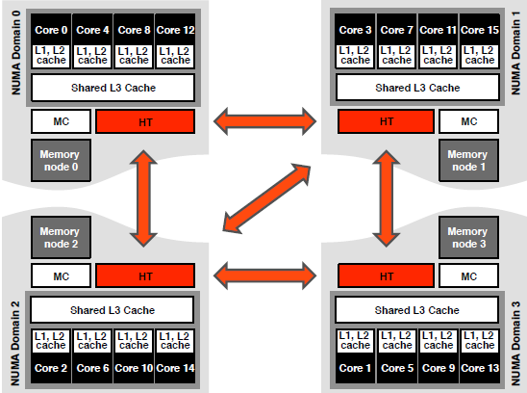
Contention for the inter-domain interconnect (IC)

Slide 6
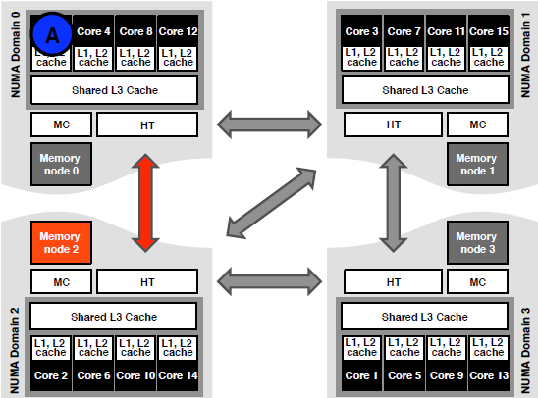
Remote access latency (RL)

Slide 7
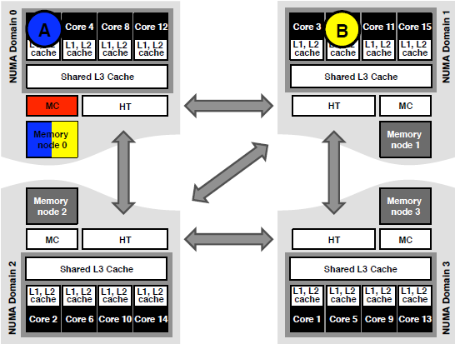
Isolating Memory controller contention (MC)
Run 2 threads A and B in 2 separate domains and send requests to the same memory node.

Slide 8
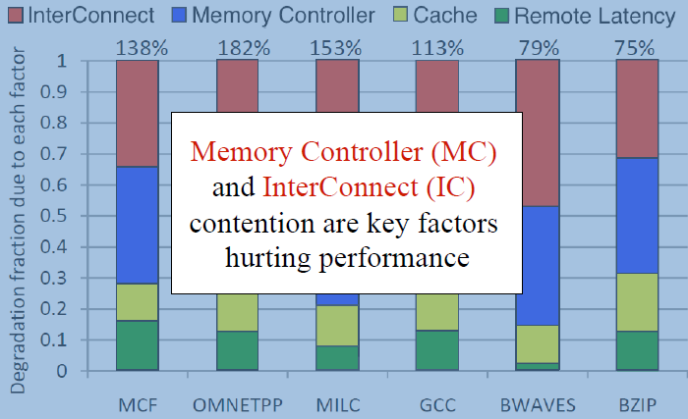
Dominant degradation factors

Slide 9


Contention-Aware Scheduling
Characterization method
Given two threads, decide if they will hurt each otherʼs performance if co-scheduled
Scheduling algorithm
Separate threads that are expected to interfere

Slide 10
Characterization Method
Limited observability
We do not know for sure if threads compete and how severely
Hardware does not tell us
Trial and error infeasible on large systems
Canʼt try all possible combinations
Even sampling becomes difficult
A good trade-off: measure LLC (Last Level Cache) Miss rate!
Assumes that threads interfere if they have high miss rates
No account for cache contention impact
Works well because cache contention is not dominant

Slide 11
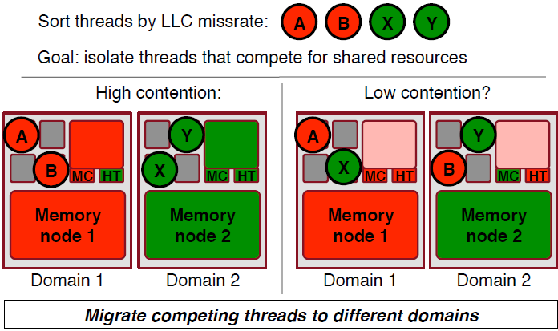
Our previous work: an algorithm for UMA systems Distributed Intensity (DI-Plain)

Slide 12
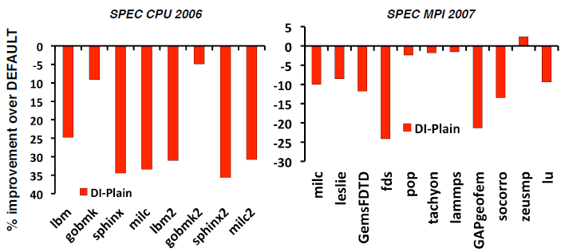
DI-Plain on NUMA system
DI-Plain hurts performance on NUMA systems because it does not migrate memory!
Failing to migrate memory leaves MC and introduces RL

Slide 13
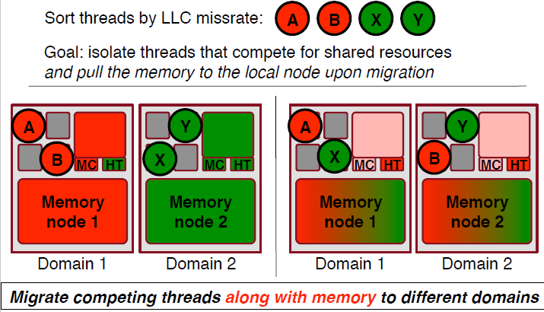
Solution #1: Distributed Intensity with memory migration (DI-Migrate)

Slide 14
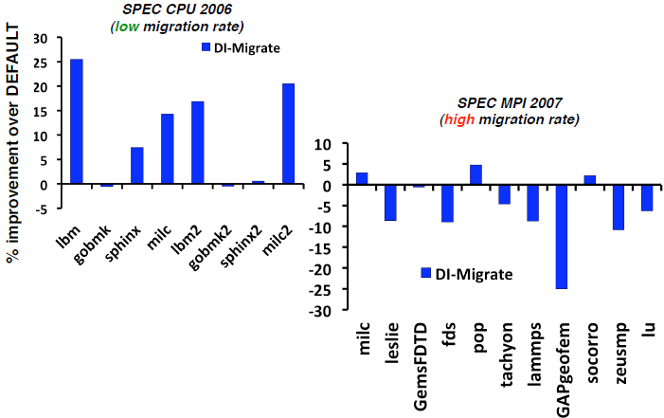
DI-Migrate Performance
DI-Migrate performs too many memory page migrations for MPI. Migrations are expensive on NUMA.

Slide 15
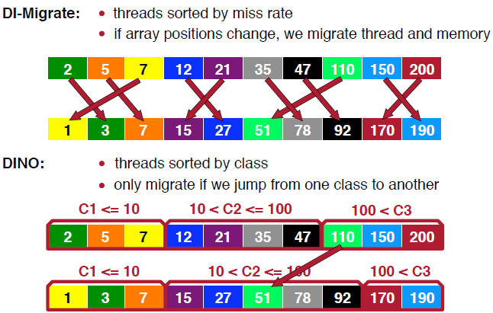
Solution #2: Distributed Intensity NUMA Online (DINO)

Slide 16
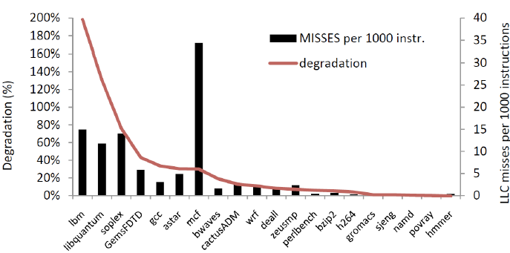
Miss rate vs. degradation
Loose correlation between miss rate and performance degradation, so most migrations will not payoff.

Slide 17
Summary
On NUMA systems we need to schedule threads and memory
Memory Controller contention when memory is not migrated
Interconnect Contention when memory is migrated too frequently
DINO is the contention-aware scheduling algorithm for NUMA systems that
migrates the memory along with the application
eliminates excessive migrations by trying to keep the workload on their old nodes,
if possible, utilizes Instruction Based Sampling to perform partial memory migration of “hot” pages

