Slide 1
PTask: Operating System Abstractions to Manage GPUs as Compute Devices
Chris Rossbach, Jon Currey, Microsoft Research
Mark Silberstein, Technion
Baishakhi Ray, Emmett Witchel, UT Austin
SOSP October 25, 2011

Slide 2
Motivation
There are lots of GPUs
3 of top 5 supercomputers use GPUs
In all new PCs, smart phones, tablets
Great for gaming and HPC/batch
Unusable in other application domains
GPU programming challenges
GPU+main memory disjoint
Treated as I/O device by OS
Notes:
GPUs are everywhere these days
We know how to use them very well in certain, narrow settings
But otherwise they are under utilized.
We also know that programming GPUs is challenging.
There are a number of reasons for this including their programming and memory models.
?? How is treatment as an IO device a programming challenge?
?? Is it a lesser know one? If so, introduce it on the next slide, when state agenda?

Slide 3
Motivation
There are lots of GPUs
3 of top 5 supercomputers use GPUs
In all new PCs, smart phones tablets
Great for gaming and HPC/batch
Unusable in other application domains
GPU programing challenges
GPU+main memory disjoint
Treated as I/O device by OS
These two things are related:
We need OS abstractions
Notes:
It turns out that the OS’s treatment of the GPU as an IO device also causes problems which inhibit broader use.
And hence that there is a need for better OS abstractions for GPUs.
We believe that OS abstractions based on Dataflow are a good fit for GPUs.

Slide 4
Outline
The case for OS support
PTask: Dataflow for GPUs
Evaluation
Related Work
Conclusion

Slide 5
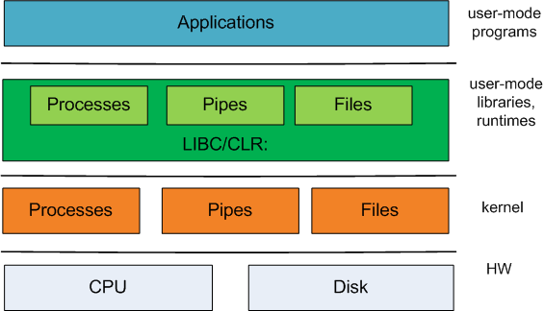

Traditional OS-Level abstractions
programmer-
visible interface
OS-level
abstractions
Hardware
interface
1:1 correspondence between OS-level and user-level abstractions

Slide 6
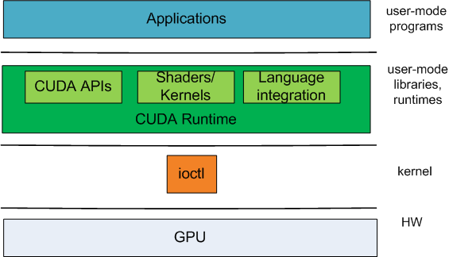
GPU Abstractions
programmer-
visible interface
DirectX/CUDA/OpenCL Runtime
GPGPU
APIs
Shaders/
Kernels
Language Integration
1 OS-level
abstraction!
No kernel-facing API
No OS resource-management
Poor composability

Slide 7
CPU-bound processes hurt GPUs
invocations per second
Higher is
better
CPU scheduler and GPU scheduler not integrated!
Image-convolution in CUDA
Windows 7 x64 8GB RAM
Intel Core 2 Quad 2.66GHz
nVidia GeForce GT230

Slide 8
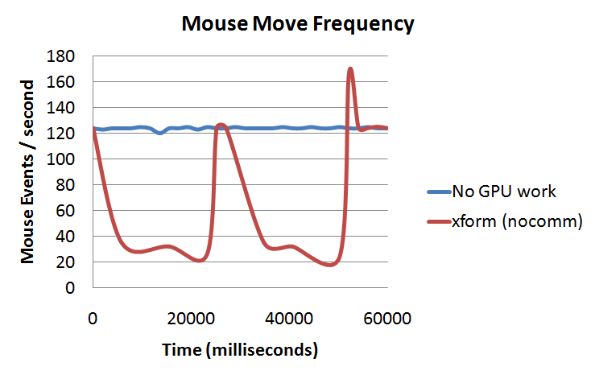
GPU-bound processes hurt CPUs
OS cannot prioritize cursor updates
WDDM + DWM + CUDA == dysfunction
Flatter lines
Are better
Windows 7 x64 8GB RAM
Intel Core 2 Quad 2.66GHz
nVidia GeForce GT230

Slide 9
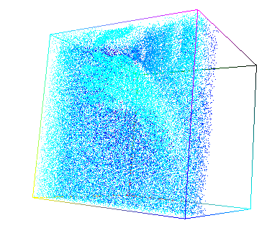
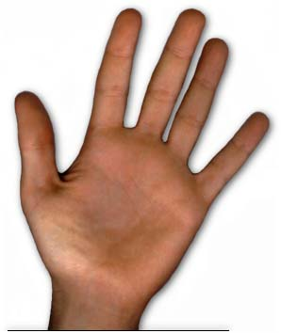
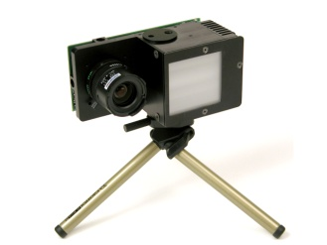
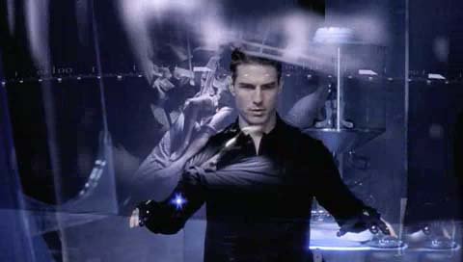
Composition: Gestural Interface
Raw images
“Hand”
events
capture
detect
noisy point cloud
capture camera images
detect gestures
xform
filter
geometric transformation
noise filtering
High data rates
Data-parallel algorithms … good fit for GPU
NOT Kinect: this is a harder problem!
Notes:
To illustrate the issues surrounding composability, lets consider a real-world problem that we have been working on: building a gestural interface.
In this particular system, there is a camera that produces depth information and a conventional image.
We have a processing pipeline that involves capturing frames from the camera… geometrically transforming the resulting point cloud … filtering it … and applying detection algorithms to the resulting data set, to produce ‘hand events’ in a Human Interface Device framework.
The Transform and Filter steps are highly data-parallel, and hence a good fit for the GPU.
Chris:
?? 2 cameras. Not kinect.
?? Talk about 2 cameras?

Slide 10
What We’d Like To Do
#> capture | xform | filter | detect &
CPU
GPU
GPU
CPU
Modular design
flexibility, reuse
Utilize heterogeneous hardware
Data-parallel components → GPU
Sequential components → CPU
Using OS provided tools
processes, pipes
Notes:
What we’d like to do is build this system in a modular fashion.
… For flexibility and reuse potential.
We want to be able to exploit our system’s heterogeneous hardware
… running the data-parallel components of the system on the GPU and more sequential ones on CPU cores
But also to build the system using the great tools provided by the OS.
But when we build the system using OS pipes, we run into problems.

Slide 11
GPU Execution model
GPUs cannot run OS: different ISA
Disjoint memory space, no coherence
Host CPU must manage GPU execution
Program inputs explicitly transferred/bound at runtime
Device buffers pre-allocated
Main memory
CPU
User-mode apps
must implement
Copy inputs
Copy outputs
Send commands
GPU memory
GPU

Slide 12
Data migration
#> capture | xform | filter | detect &
capture
xform
filter
capture
xform
filter
detect
detect
user
read()
write()
read()
write()
read()
write()
read()
OS executive
copy
to
GPU
copy
from
GPU
copy
to
GPU
copy
from
GPU
IRP
kernel
camdrv
GPU driver
HIDdrv
PCI-xfer
PCI-xfer
PCI-xfer
PCI-xfer
GPU
HW
Run!

Slide 13
GPUs need better OS abstractions
GPU Analogues for:
Process API
IPC API
Scheduler hints
Abstractions that enable:
Fairness/isolation
OS use of GPU
Composition/data movement optimization
Notes:
Intution: …

Slide 14
Outline
The case for OS support
PTask: Dataflow for GPUs
Evaluation
Related Work
Conclusion

Slide 15
PTask OS abstractions: dataflow!
ptask (parallel task)
Has priority for fairness
Analogous to a process for GPU execution
List of input/output resources (e.g. stdin, stdout…)
ports
Can be mapped to ptask input/outputs
A data source or sink
channels
Similar to pipes, connect arbitrary ports
Specialize to eliminate double-buffering
graph
DAG: connected ptasks, ports, channels
datablocks
Memory-space transparent buffers
OS objects→OS RM possible
data: specify where, not how

Slide 16
PTask Graph: Gestural Interface
#> capture | xform | filter | detect &
ptask graph
capture
xform
filter
detect
rawimg
cloud
f-in
f-out
rawimg
mapped mem
GPU mem →GPU mem
process (CPU)
ptask (GPU)
Optimized data movement
port
channel
Data arrival triggers computation
ptask graph
datablock
Notes:
To introduce PTask, we’ll show how the gestural interface application is implemented using it.
Processes, as before, for the sequential parts of the system.
PTask (for ‘Parallel Task’) instead of processes for the data parallel/GPU-based parts.
Associated with a
PTasks have priority, for fairness.
Ports for their inputs and outputs. Map to buffers in the GPU kernel that implements the PTask.
Channels – connect PTasks to one another and external inputs and outputs from other devices/main memory.
Graph – encapsulates set of connected PTasks. Operations at the graph level.
??? Show priority and associated GPU kernel code.
??? Should be two raw input ports on xform? And hence two channels from capture?
*** Have removed ports in processes. (Not in impl … check paper) ***
-----------------------------------------------------
ptask (parallel task)
Have priority for fairness
Analogous to a process for GPU execution
List of input/output resources (e.g. stdin, stdout…)
ports
Can be mapped to ptask input/outputs
A data source or sink
channels
Similar to pipes
Connect arbitrary ports
Specialize to eliminate double-buffering
datablocks
Memory-domain transparent buffers
OS objects→isolation possible
data: specify where, not how

Slide 17
PTask Scheduling
Graphs scheduled dynamically
ptasks queue for dispatch when inputs ready
Queue: dynamic priority order
ptask priority user-settable
ptask prio normalized to OS prio
Transparently support multiple GPUs
Schedule ptasks for input locality

Slide 18
Location Transparency: Datablocks
Datablock
Main Memory
GPU 0 Memory
GPU 1 Memory
space
V
M
RW
data
…
main
1
1
1 1
gpu0
0
1
1 0
gpu1
1
1
1 0
Logical buffer
backed by multiple physical buffers
buffers created/updated lazily
mem-mapping used to share across process boundaries
Track buffer validity per memory space
writes invalidate other views
Flags for access control/data placement

Slide 19
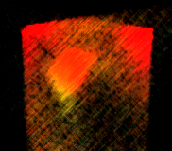
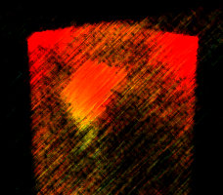
Datablock Action Zone
#> capture | xform | filter …
capture
xform
filter
…
rawimg
cloud
f-in
rawimg
cloud
Main Memory
GPU Memory
Datablock
process
ptask
space
V
M
RW
data
port
0
1
1 1
1
1 1
0
1
0 0
main
1
0
1 1
1
channel
gpu
0
0
0 0
1
1 1
1
1
1 1
1
datablock
Notes:
To introduce PTask, we’ll show how the gestural interface application is implemented using it.
Processes, as before, for the sequential parts of the system.
PTask (for ‘Parallel Task’) instead of processes for the data parallel/GPU-based parts.
Associated with a
PTasks have priority, for fairness.
Ports for their inputs and outputs. Map to buffers in the GPU kernel that implements the PTask.
Channels – connect PTasks to one another and external inputs and outputs from other devices/main memory.
Graph – encapsulates set of connected PTasks. Operations at the graph level.
??? Show priority and associated GPU kernel code.
??? Should be two raw input ports on xform? And hence two channels from capture?
*** Have removed ports in processes. (Not in impl … check paper) ***
-----------------------------------------------------
ptask (parallel task)
Have priority for fairness
Analogous to a process for GPU execution
List of input/output resources (e.g. stdin, stdout…)
ports
Can be mapped to ptask input/outputs
A data source or sink
channels
Similar to pipes
Connect arbitrary ports
Specialize to eliminate double-buffering
datablocks
Memory-domain transparent buffers
OS objects→isolation possible
data: specify where, not how

Slide 20
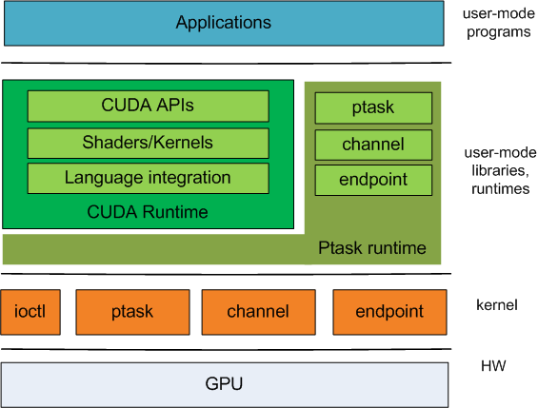
Revised technology stack
port
datablock
port
1-1 correspondence between programmer and OS abstractions
GPU APIs can be built on top of new OS abstractions

Slide 21
Outline
The case for OS support
PTask: Dataflow for GPUs
Evaluation
Related Work
Conclusion

Slide 22
Implementation
Windows 7
Full PTask API implementation
Stacked UMDF/KMDF driver
Kernel component: mem-mapping, signaling
User component: wraps DirectX, CUDA, OpenCL
syscalls → DeviceIoControl() calls
Linux 2.6.33.2
Changed OS scheduling to manage GPU
GPU accounting added to task_struct

Slide 23
Gestural Interface evaluation
Windows 7, Core2-Quad, GTX580 (EVGA)
Implementations
pipes: capture | xform | filter | detect
modular: capture+xform+filter+detect, 1process
handcode: data movement optimized, 1process
ptask: ptask graph
Configurations
real-time: driven by cameras
unconstrained: driven by in-memory playback

Slide 24
Gestural Interface Performance
lower is
better
compared to hand-code
11.6% higher throughput
lower CPU util: no driver program
compared to pipes
~2.7x less CPU usage
16x higher throughput
~45% less memory usage
Windows 7 x64 8GB RAM
Intel Core 2 Quad 2.66GHz
GTX580 (EVGA)
Notes:
Chris:
??? Runtime v. latency - relabel runtime?
??? How gpu util going down? Is lower better?

Slide 25
Performance Isolation
ptask
PTask provides throughput proportional to priority
Higher is
better
FIFO – queue invocations in arrival order
ptask – aged priority queue w OS priority
graphs: 6x6 matrix multiply
priority same for every PTask node
Windows 7 x64 8GB RAM
Intel Core 2 Quad 2.66GHz
GTX580 (EVGA)

Slide 26
Multi-GPU Scheduling
Synthetic graphs: Varying depths
Higher is
better
Data-aware provides best throughput, preserves priority
Data-aware == priority + locality
Graph depth > 1 req. for any benefit
Windows 7 x64 8GB RAM
Intel Core 2 Quad 2.66GHz
2 x GTX580 (EVGA)
Notes:
??? TimeGraph tackle multiple GPUs.

Slide 27
Linux+EncFS Throughput
user-prgs
R/W bnc
cuda-1
cuda-2
user-libs
EncFS
FUSE
libc
…
OS
Linux 2.6.33
PTask
HW
SSD1
SSD2
GPU
Simple GPU usage accounting
Restores performance
 | GPU/ CPU | cuda-1 Linux | cuda-2 Linux | cuda-1 PTask | cuda-2 Ptask
Read | 1.17x | -10.3x | -30.8x | 1.16x | 1.16x
Write | 1.28x | -4.6x | -10.3x | 1.21x | 1.20x
EncFS: nice -20
cuda-*: nice +19
AES: XTS chaining
SATA SSD, RAID
seq. R/W 200 MB
GPU defeats OS scheduler
Despite EncFS nice -19
Despite contenders nice +20
Simple GPU usage accounting
Restores performance
Does not require preemption!
Notes:
RAID (md)!
Move PTask to inside Linux
----------------------------------------
Possibly add back some of these deleted bullet points:
EncFS, running nice -20
GPU contenders run nice +19
Linux 2.6.33
AES in XTS chaining mode
“GPU” means AES → GTX470
“CPU” means AES → SSL lib impl
Core i5 3.2GHz, 12GB RAM
2x80GB SATA SSD, RAID (md)
seq. read/write 200 MB file
tput proportional to prio (see paper)

Slide 28
Outline
The case for OS support
PTask: Dataflow for GPUs
Evaluation
Related Work
Conclusion

Slide 29
Related Work
OS support for heterogeneous platforms:
Helios [Nightingale 09], BarrelFish [Baumann 09] ,Offcodes [Weinsberg 08]
GPU Scheduling
TimeGraph [Kato 11], Pegasus [Gupta 11]
Graph-based programming models
Synthesis [Masselin 89]
Monsoon/Id [Arvind]
Dryad [Isard 07]
StreamIt [Thies 02]
DirectShow
TCP Offload [Currid 04]
Tasking
Tessellation, Apple GCD, …
Notes:
[Weinsberg 08] TCP-Offload focused, didn’t evaluate GPU, no scheduler integration, Both the host OS and the target device firmware must support the interfaces defined by the programming API and implement the runtime functionality.

Slide 30
Conclusions
OS abstractions for GPUs are critical
Enable fairness & priority
OS can use the GPU
Dataflow: a good fit abstraction
system manages data movement
performance benefits significant
Thank you. Questions?
Notes:
??? priority ~= isolation?
Positive:
- int with OS enables OS to use GPU
- dataflow: let the system manage your hardware – separation of concerns.
Chris input?
--------------
OS must get involved in GPU support
Current approaches:
Require wasteful data movement
Inhibit modularity/reuse
Cannot guarantee fairness, isolation
OS-level abstractions are required
Dataflow: significant performance benefits

