Slide 1
Introduction to Android

Slide 2
Overview

Slide 3
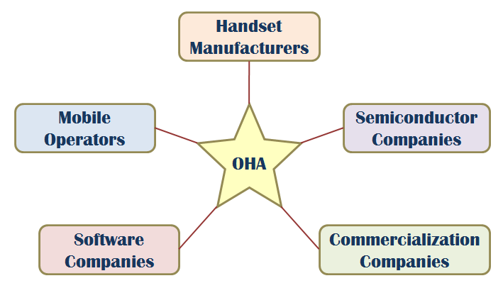
Android & OHA
SW stack for mobile devices developed and managed by OHA (Open Handset Alliance), free SW under Apache License
OHA: A business alliance consisting of 47 companies for developing open standards for mobile devices
Android
Key Applications
Middleware
Operating System
(Linux Kernel)
Notes:
2

Slide 4
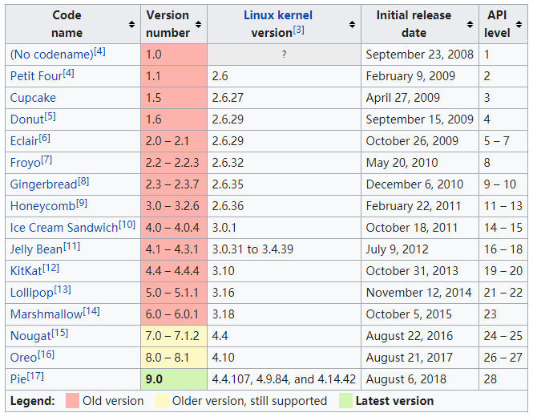
Android Version History

Slide 5
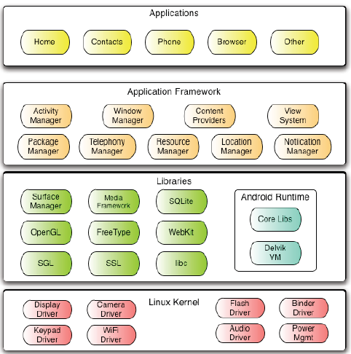
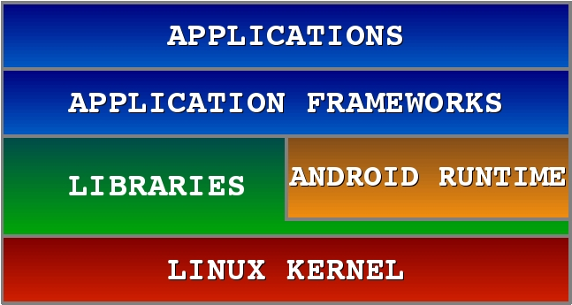
Android Software Stack

Slide 6
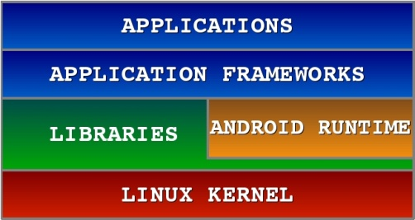
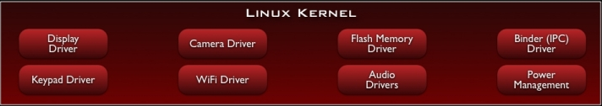
Android S/W Stack – Linux Kernel
Relying on Linux Kernel for core system services
Memory and Process Management
Network Stack
Driver Model
Security
Providing an abstraction layer between the H/W and the rest of the S/W stack

Slide 7
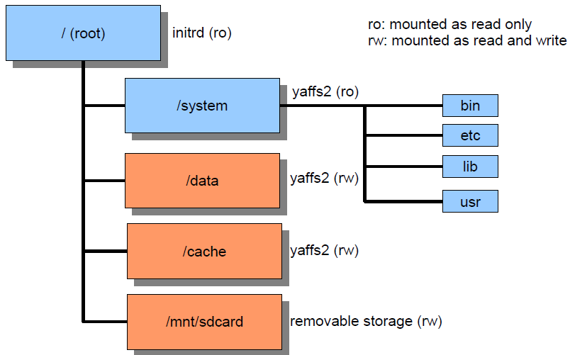
Directory Structure

Slide 8
Android S/W Stack – Linux Kernel (Cont)
Kernel Enhancements
Alarm
Kernel Debugger
Ashmem
Binder for IPC
Wakelock for Power Management
Low Memory Killer
Logger

Slide 9
Ashmem
Android / Anonymous SHared MEMory subsystem
$(TOP)/system/core/cutils/ashmem.h
int ashmem_create_region(const char *name, size_t size)→returns fd
int ashmem_set_prot_region(int fd, int prot)
int ashmem_pin_region(int fd, size_t offset, size_t len)
int ashmem_unpin_region(int fd, size_t offset, size_t len)
Kernel reclaims not ‘pin’ ed memory
Similar to weak reference of Java. Useful for implementing cache.
Accessed as android.os.MemoryFile from Java program

Slide 10
Binder
Binder
Driver to facilitate IPC between applications and services
Problems of Linux IPC
Applications and Services may run in separate processes but must communicate and share data
IPC can introduce significant processing overhead and security hole
Properties of Binder
High performance IPC through shared memory
Per-process thread pool for processing requests
Reference counting and mapping of object references across processes
Synchronous IPC calls between processes
A special device driver /dev/binder

Slide 11
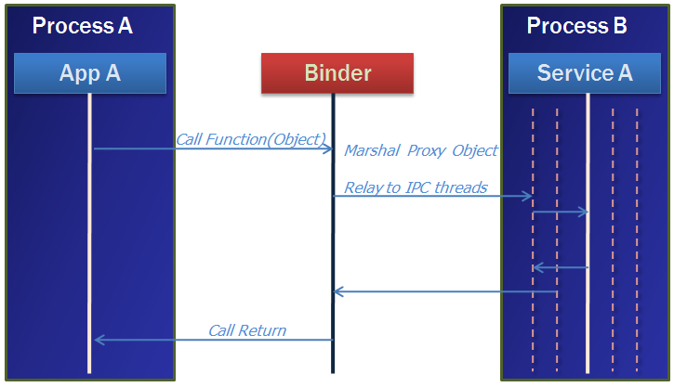
Binder (Cont)
A pool of threads is associated to each service application to process incoming IPC.
Binder performs mapping of object between two processes.
Binder uses an object reference as an address in a process’s memory space.

Slide 12
Low Low Memory Killer
Upon detecting memory shortage, the kernel can select a process with low priority and kills it.
It's OK. because specification in the Android component life cycle states that each application component is responsible for preserving its own state

Slide 13
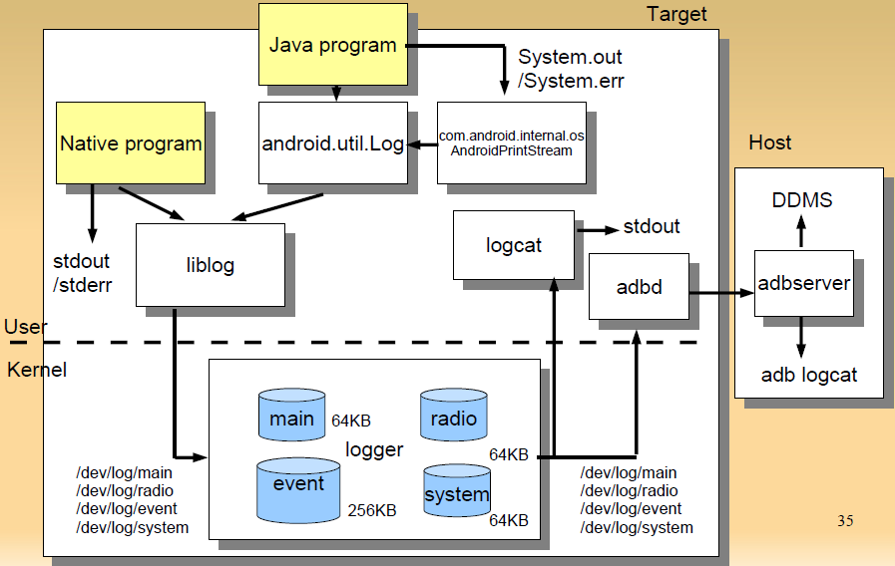
Logger

Slide 14
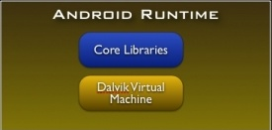
Android S/W Stack - Runtime
Core Libraries
Providing most of the functionality available in the core libraries of the Java language
APIs
Data Structures
Utilities
File Access
Network Access
Graphics
etc

Slide 15
Android S/W Stack – Dalvik
Dalvik Virtual Machine
Providing environment on which every Android application runs
Each Android application runs in its own process, with its own instance of the Dalvik VM
Compared to JVM:
Android Java = Java SE – AWT/Swing + Android API
16-bit, register-based (vs. 8-bit, stack-based JVM)
Runs .dex files (vs. byte-code in JVM)
More efficient and compact implementation (so that a device can run multiple VMs efficiently）
Different set of Java libraries than Java SDK
Has JIT (Just-In-Time) compilation & concurrent Garbage collection (similar to JVM)

Slide 16
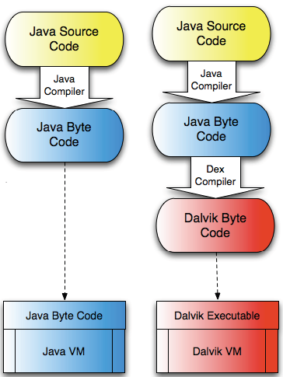
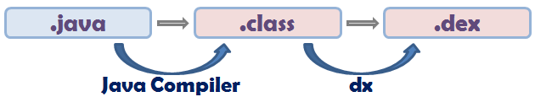
Android S/W Stack – Dalvik
Dalvik Virtual Machine
Executes the Dalvik Executable (.dex) format
.dex format is optimized for minimal memory footprint.
Compilation
Relies on Linux Kernel for:
Threading
Low-level memory management

Slide 17
Example Source code
public class Demo {
public static void foo() {
int a = 1;
int b = 2;
int c = (a + b) * 5;
}
}

Slide 18
Java Byte Code
0: iconst_1
1: istore_0
2: iconst_2
3: istore_1
4: iload_0
5: iload_1
6: iadd
7: iconst_5
8: imul
9: istore_2
10: return
10 bytes
9 reads
10 writes

Slide 19
Android Bytecode
0000: const/4 v0, #int 1 // #1
0001: const/4 v1, #int 2 // #2
0002: add-int/2addr v0, v1
0003: mul-int/lit8 v0, v0, #int 5 // #05
0005: return-void
5 bytes
4 reads
4 writes

Slide 20
File Size Comparison
Contents | Uncompressed jar File |  | Compressed jar File |  | Uncompressed dex File
 | In Bytes | In % | In Bytes | In % | In Bytes | In %
Common System Libraries | 21445320 | 100 | 10662048 | 50 | 10311972 | 48
Web browser Application | 470312 | 100 | 232065 | 49 | 209248 | 44
Alarm check Application | 119200 | 100 | 61658 | 52 | 53020 | 44

Slide 21
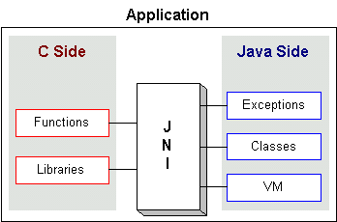
JNI: Java Native Interface
Java interface to non-Java code. It is Java's link to the "outside world"
Native methods are compiled into a dynamic link library (.dll, .so, etc.)
OS loads and links the library into the process that is running the Java or Dalvik VM
Serves as glue between java side and native side of an application
Allows Java code that runs inside a Java or Dalvik VM to interoperate with applications and libraries written in other programming languages, such as C, C++, and assembly

Slide 22
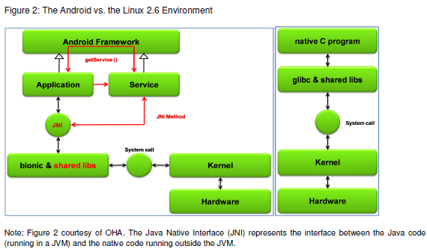
Android vs. Linux

Slide 23
Libraries

Slide 24
Library Layer
System C libraries and function Libraries, supporting multimedia, web browser, SQLite... Native Services to hardware
Android runtime
Dalvik Virtual Machine
Executes files in the Dalvik Executable (.dex) format
Java core Libraries
Provides most of the functionality of the Java programming language.
Rely on Dalvik VM and underlying Linux kernel

Slide 25
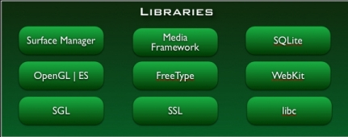
Android S/W Stack - Libraries
Including a set of C/C++ libraries used by components of the Android system
Exposed to developers through the Android application framework

Slide 26
Android S/W Stack – Libraries (Cont)
Features
System C Library (Bionic)
Media Libraries
Surface Manager (Surface Flinger)
Audio Manager (Audio Flinger)
LibWebCore (WebKit)
SGL
3D Libraries
FreeType
SQLite

Slide 27
Android S/W Stack – Libraries (Cont)
Bionic
Custom libc implementation optimized for embedded use
Problem with GNU libc
License | The authors want to keep GPL (GNU General Public License) out of user-space, since GPL license requires open-source. (bionic is under BSD license)
Size | Libc will load in each process, so it needs to be small.
Speed | Limited CPU power means it needs to be fast.

Slide 28
Android S/W Stack – Libraries (Cont)
Bionic (Cont)
Properties
BSD license
Small size and fast code paths
Very fast and small custom pthread implementation
No support for certain POSIX features
No compatibility with GNU libc
All native code must be compiled with bionic

Slide 29
Android S/W Stack – Libraries (Cont)
WebKit
An application framework that provides foundation for building a web browser based on open source WebKit browser
Properties
Ability to render pages in full (desktop) view
Full CSS, JavaScript, DOM, AJAX support
Support for single-column and adaptive view rendering

Slide 30
Android S/W Stack – Libraries (Cont)
Media Framework
A media framework based on PacketVideo OpenCore platform
Properties
Support for standard video, audio, still-frame formats
Support for hardware/software codec plug-ins
SQLite
Light-weight relational database management system for backend data storage

Slide 31
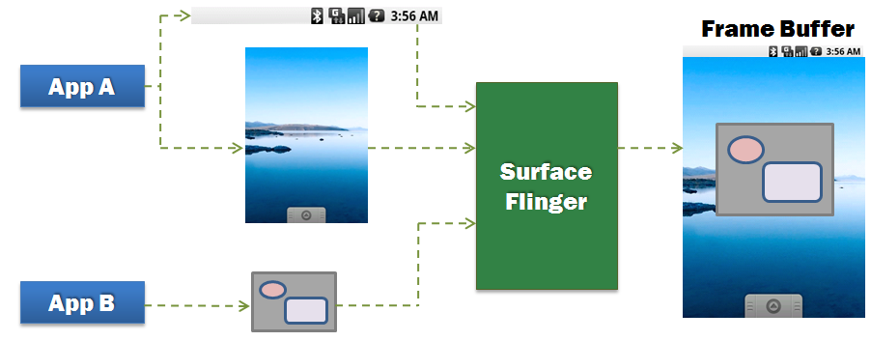
Android S/W Stack – Libraries (Cont)
Surface Manager (Surface Flinger)
Providing system-wide surface composer, handling all surface rendering to frame buffer device
Operation

Slide 32
Android S/W Stack – Libraries (Cont)
Surface Manager (Cont)
Properties
Can combine 2D and 3D surfaces and surfaces from multiple applications
Surfaces passed as buffers via Binder IPC calls
Can use OpenGL ES and 2D hardware accelerator for its compositions
Double-buffering using page-flip

Slide 33
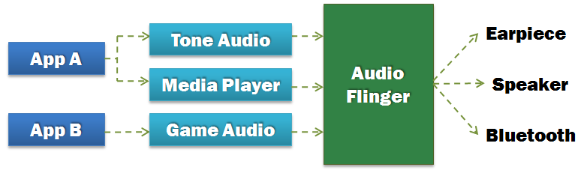
Android S/W Stack – Libraries (Cont)
Audio Manager (Audio Flinger)
Processing multiple audio streams into PCM audio out paths
Operation

Slide 34
Android S/W Stack – Libraries (Cont)
SGL
The underlying 2D graphics engine
3D Libraries
An implementation based on OpenGL ES 1.0 APIs
Using either H/W 3D acceleration (if available) or the included optimized 3D S/W rasterizer
FreeType
Rendering bitmap and vector font

Slide 35
Application Framework Layer
Simplify the reuse of components
Applications can publish their capabilities and any other application may then make use of those capabilities
Applications is a set of services
Views system, content providers, resources managers such as
Activity Manager, manages the lifecycle of applications and provides a common navigation backstack
Notification Manager, enables all applications to display custom alerts in the status bar
Resource Manager, providing access to non-code resources such as localized strings, graphics, and layout files
Views, used to build an application, including lists, grids, text boxes, buttons, and even an embeddable web browser

Slide 36
Processes & Threads

Slide 37
Processes and Threads
Processes
When the first of an application's components needs to be run, Android starts a Linux process for it with a single thread of execution (Main Thread).
Android may decide to kill a process to reclaim resources.
Application (.apk)
1
Process
1
Main Thread

Slide 38
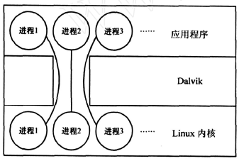
Process Model
One-to-one correspondence between Dalvik applications and Linux kernel processes
Each app runs in its own process
Each process has its own copy of Dalvik VM

Slide 39
Processes and Threads (Cont)
Process (Cont)
We can specify a process where an individual component should run by setting a process name to “process” attribute of <activity>, <service>, <receiver>, or <provider>.
Each component can run in its own process.
Some components share a process while others do not.
Components of different applications also can run in the same process.
We can set a default value that applies to all components by setting a default process to "process” attribute of <application>.

Slide 40
Processes and Threads (Cont)
Threads
Main Thread
All components are instantiated in the main thread of the specified process.
System calls to the components are dispatched from the main thread.
Methods that respond to those calls always run in the main thread of the process.
Components in main thread should not perform long or blocking operations (e.g. network downloads, computation loops)

Slide 41
Processes and Threads (Cont)
Threads (Cont)
Anything that may not be completed quickly should be assigned to a different thread.
Threads are created in code using standard Java Thread objects.
Some convenience classes Android provides for managing threads:
Looper for running a message loop within a thread
Handler for processing messages
HandlerThread for providing a handy way for starting a new thread that has a looper

Slide 42
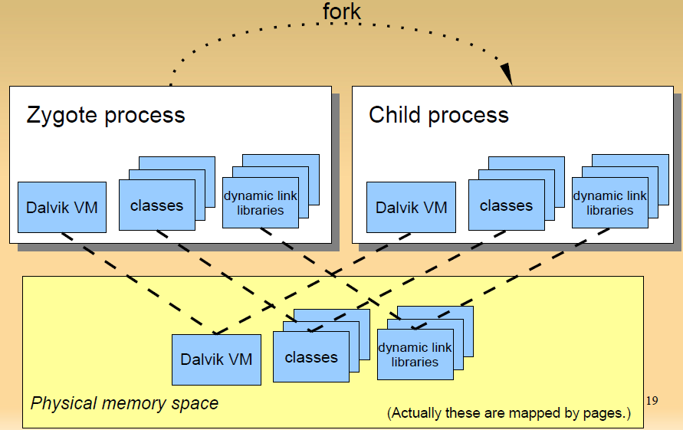
Zygote Process Forks Child Processes

Slide 43
Zygote (Cont)
Zygote process preloads typical (approx. 1800) classes and dynamic link libraries so that child processes start quickly.
Copy-on-write
Only when new process writes page, new page is allocated.
All pages not be written are shared among all zygote children.
Does not use Linux exec() system call

Slide 44
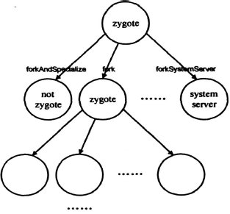
Zygote (Cont)
Only Zygote processes can fork child processes
fork() ,creates a zygote process。
forkAndSpecialize ( ) , creates a non-zygote process。
forkSystemServer ( ) , creates a system server process

Slide 45
UID & GID
UID(user id) and GID(group id) is used for managing multi-user, as in usual Linux system.
Android use this mechanism to isolate applications.
Each application has unique UID.
Can not read/write other application's files.
Zygote runs as UID=0 (root). After forking, each child process’ UID is changed by setuid() system call.

Slide 46
Android Development

Slide 47
Android Application Package
Android applications are written in Java.
An Android application is bundled by the aapt tool into an Android package (.apk)
.apk
Java Code
Data Files
res/layout: declaration layout files
res/drawable: intended for drawing
res/admin: bitmaps, animations for transitions
res/values: externalized values
strings, colors, styles, etc
res/xml: general XML files used at runtime
res/raw: binary files (e.g. sound)
Resources
Files

Slide 48
Application Components
An application consists of essential components that are instantiated and run as needed.
Four basic component types
Components | Description
Activity | UI component, typically corresponding to one screen
Service | Background process without UI
Broadcast Receiver | Component that responds to broadcast Intents
Content Provider | Component that enables applications to share data

Slide 49
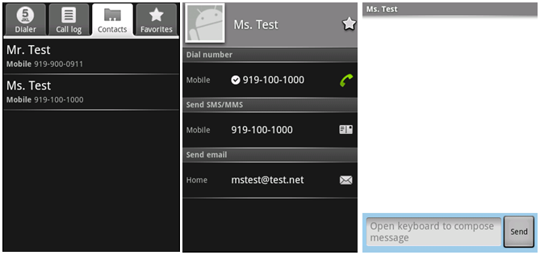
Components - Activity
An activity is usually a single screen:
Implemented as a class extending Activity.
Displays UI controls (views).
Reacts to user input/events.
An application typically consists of several screens:
Each screen is implemented by one activity.
Moving to the next screen means starting a new activity.
An activity may return a result to the previous activity.

Slide 50

Components - Activity (Cont)
One of the activities is marked as the first one that should be presented to the user when the application is launched.
Created “Activity” must be defined in the application’s manifest.xml

Slide 51
Components - Service
A service does not have a visual UI, but runs in the background for an indefinite period time.
Example: music player, network download, etc
Each service extends the Service base class.
It is possible to bind to a running service and start the service if it's not already running.
While connected, it is possible communicate with the service through an interface defined in an AIDL (Android Interface Definition Language).
Notification
Service
Communication
Pause/rewind
/stop/restart
Background running
for playback
Media Player
Activity
Binder

Slide 52
Components - Service (Cont)
Adding a “Service” with Android is similar to adding an "Activity".

Slide 53

Components - Broadcast Receivers
A broadcast receiver is a component that receives and reacts to broadcast announcements (Intents).
Broadcasts may originate from user code or OS code.
E.g. announcements that the time zone has changed, that the battery is low, etc.
Broadcast Receiver
Activity
Get incoming calls
Get incoming SMS
SMS

Slide 54
Components - Broadcast Receivers (Cont)
A broadcast receiver is a component that receives and reacts to broadcast announcements.
Applications can also initiate broadcasts.
e.g. to let other applications know that some data has been downloaded to the device and is available for them to use.
All receivers extend the BroadcastReceiver base class.

Slide 55
Components - Content Providers
Application
Activity
Activity
Application
Application
Activity
Content Resolver
Service
Content Resolver
Content Provider
Content Resolver
Data
XML
SQLite
Remote
Store
A content provider makes a specific set of the application's data available to other applications.
The data can be stored in the file system, in an SQLite database, or a remote store in the cloud

Slide 56
Components - Content Providers (Cont)
Content Provider extends the ContentProvider base class and implements a standard set of methods to allow access to a data store.
Querying
Delete, update, and insert data
Applications do not call these methods directly.
They use a ContentResolver object and call its methods instead.
A ContentResolver can talk to any content provider.
Content is represented by URI and MIME type.

Slide 57
Intents
Intents are simple message objects each of which consists of
Action to be performed (MAIN/VIEW/EDIT/PICK/DELETE/DIAL/etc)
Data to operate on (URI)
startActivity(new Intent(Intent.VIEW_ACTION, Uri.parse("http://www.fhnw.ch"));
startActivity(new Intent(Intent.VIEW_ACTION, Uri.parse("geo:47.480843,8.211293"));
startActivity(new Intent(Intent.EDIT_ACTION,Uri.parse("content://contacts/people/1"));

Slide 58
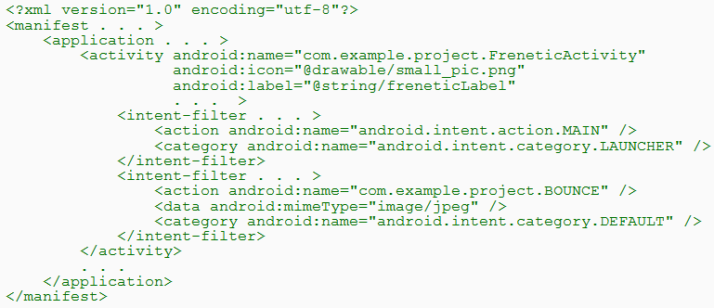
Intents (Cont)
Intent Filters
A component's intent filters in the manifest file inform Android of the kinds of intents the component is able to handle.
An example

Slide 59
Intents (Cont)
Intent Filters (Cont)
An example (Cont)
A component can have any number of intent filters, each one declaring a different set of capabilities.
The first filter in the example indicates that the activity is the entry point for the application.
The second filter declares an action that the activity can perform on a particular type of data.

Slide 60
Android Component Model
An Android application is packaged in a .apk file.
A .apk file is a collection of components.
Components share a Linux process: by default, one process per .apk file.
.apk files are isolated and communicate with each other via Intents or AIDL.
Every component has a managed lifecycle.
Application (.apk)
Process
Activity
Activity
Activity
Activity
Content Provider
Service
Service

Slide 61
Activities and Tasks
One activity can start another, including one defined in a different application.
②
Activity1
Activity2
Asynchronous Message (Intent)
①
Context.startActivity(Intent)
or
Activity.startActivityForResult
(Intent, Request_Code)
No return
To get some result
(e.g. to get a photo)

Slide 62
Activities and Tasks (Cont)
Tasks
A task is a collection of related Activities.
It is capable of spanning multiple processes.
Application (.apk)
Application (.apk)
Process
Process
Activity
Activity
Activity
Activity
Activity
Activity
Activity
Activity
Content Provider
Content Provider
Service
Service
Service
Service

Slide 63
Activities and Tasks (Cont)
Tasks (Cont)
All activities in a task are arranged in a stack.
If one activity starts another, the new activity is pushed on the stack and it becomes the running activity.
When the user presses the BACK key, the current activity is popped from the stack and the previous one resumes.
Instance of Activity B
The one that's currently running
Instance of Activity C
Instance of Activity B
Instance of Activity A
The one that began the task (typically, an activity the user selected in the application launcher)
A Stack

Slide 64
Activities and Tasks (Cont)
Affinities
An affinity means a preference for each activity to belong to a certain task.
An individual affinity can be set for each activity:
By default, a new activity is launched into the task of the activity that called startActivity().

Slide 65
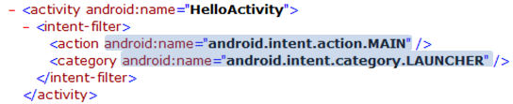
Activities and Tasks (Cont)
Starting Tasks
How to set up an activity as the entry point of a task

