Slide 1
Race Condition Vulnerability

Slide 2
Outline
What is Race Condition?
Race Condition Problem
Race Condition Vulnerability
How to exploit?
Countermeasures

Slide 3
Race Condition
Happens when:
Multiple processes access and manipulate the same data concurrently.
The outcome of execution depends on a particular order.
If a privileged program has a race condition, the attackers may be able to affect the output of the privileged program by putting influences on the uncontrollable events.

Slide 4
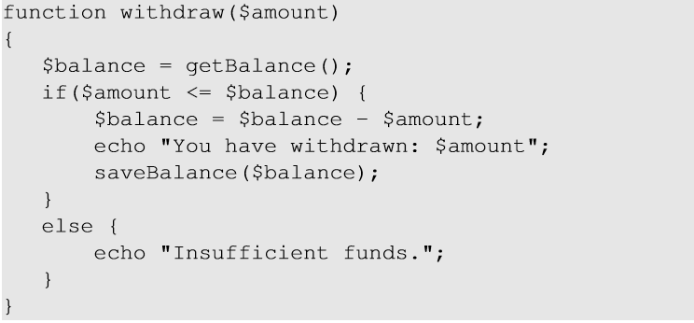
Race Condition Problem
When two concurrent threads of execution access a shared resource in a way that unintentionally produces different results depending on the timing of the threads or processes.
Race Condition can occur here if there are two simultaneous withdraw requests.
Notes:
The above php code performs withdrawal transaction from a bank. The function checks if the amount to be withdrawn is less than the balance. If yes, it authorizes the withdraw and updates the balance.If there are two simultaneous withdraw requests, a race condition may occur. Example, Current balance = $100. Request 1 to withdraw $90. Before the server updates the balance, request 2 tries to withdraw $90 which will approved as cuurent balance is still $100. Hence, $180 will be winthdrawn with $10 in the account as balance

Slide 5
A Special Type of Race Condition
Time-Of-Check To Time-Of-Use (TOCTTOU)
Occurs when checking for a condition before using a resource.

Slide 6
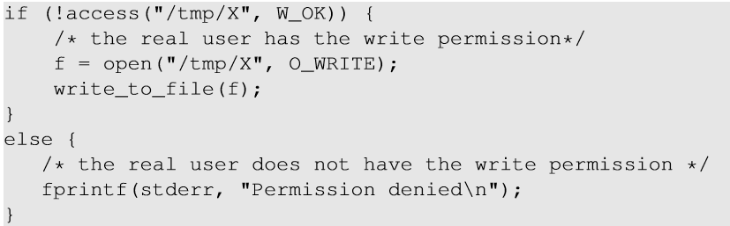
Race Condition Vulnerability
Root-owned Set-UID program.
Effective UID : root
Real User ID : seed
The above program writes to a file in the /tmp directory (world-writable)
As the root can write to any file, The program ensures that the real user has permissions to write to the target file.
access() system call checks if the Real User ID has write access to /tm/X.
After the check, the file is opened for writing.
open() checks the effective user id which is 0 and hence file will be opened.

Slide 7
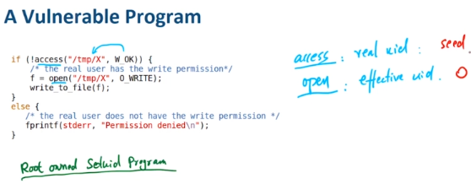
Race Condition Vulnerability
Goal : To write to a protected file like /etc/passwd.
To achieve this goal we need to make /etc/passwd as our target file without changing the file name in the program.
Symbolic link (soft link) helps us to achieve it.
It is a special kind of file that points to another file.

Slide 8
Race Condition Vulnerability
Create a regular file X inside /tmp directory
Pass the access() check
Issues :
As the program runs billions of instructions per second, the window between the time to check and time to use lasts for a very short period of time, making it impossible to change to a symbolic link
If the change is too early, access() will fail.
If the change is little late, the program will finish using the file.
Change “/tmp/X” to symbolic link, pointing to “/etc/passwd”
open() checks for the EID which is root.
Open password file for write.

Slide 9
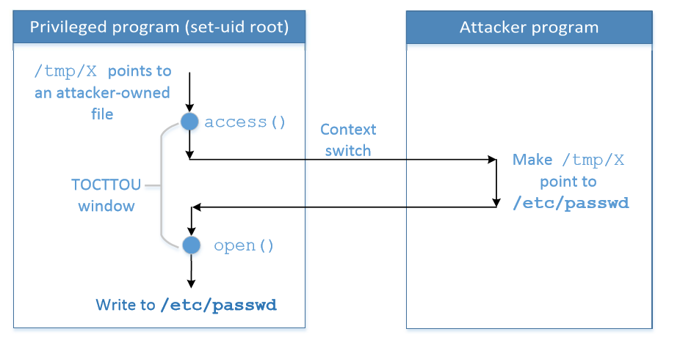
Race Condition Vulnerability
To win the race condition (TOCTTOU window), we need two processes :
Run vulnerable program in a loop
Run the attack program
Notes:
The above figure shows the TOCTOU window to change the link to /etc/passwd

Slide 10
Understanding the attack
Attack program runs: A1,A2,A1,A2…….
Vulnerable program runs : V1,V2,V1,V2…..
As the programs are running simultaneously on a multi-core machine, the instructions will be interleaved (mixture of two sequences)
A1, V1 , A2, V2 : vulnerable prog opens /etc/passwd for editing.
Let’s consider steps for two programs :
A1 : Make “/tmp/X” point to a file owned by us
A2 : Make “/tmp/X” point to /etc/passwd
V1 : Check user’s permission on “/tmp/X”
V2 : Open the file

Slide 11
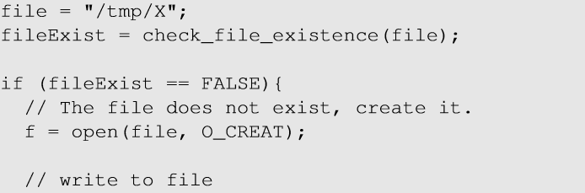
Another Race Condition Example
Set-UID program that runs with root privilege.
Checks if the file “/tmp/X” exists.
If not, open() system call is invoked. If the file doesn’t exist, new file is created with the provided name.
3. There is a window between the check and use (opening the file).
4. If the file already exists, the open() system call will not fail. It will open the file for writing.
5. So, we can use this window between the check and use and point the file to an existing file “/etc/passwd” and eventually write into it.

Slide 12
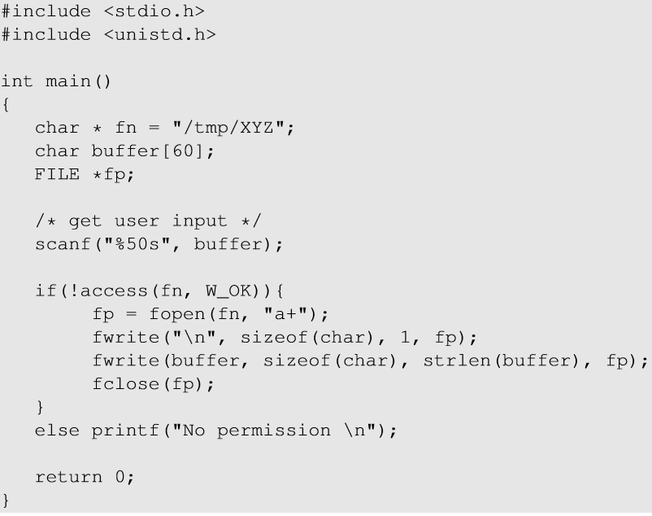

Experiment Setup
Make the vulnerable program Set-UID :
Race condition between access() and fopen(). Any protected file can be written.

Slide 13
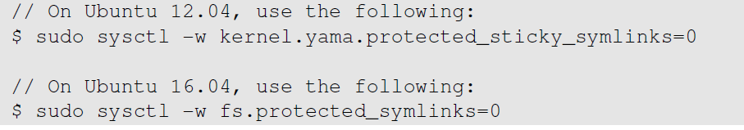
Experiment Setup
Disable countermeasure: It restricts the program to follow a symbolic link in world-writable directory like /tmp.

Slide 14
How to Exploit Race Condition?
Choose a target file
Launch Attack
Attack Process
Vulnerable Process
Monitor the result
Run the exploit

Slide 15
Attack: Choose a Target File
Add the following line to /etc/passwd to add a new user
test:U6aMy0wojraho:0:0:test:/root:/bin/bash
Username
UID (0 means root)
Hash value for empty password

Slide 16
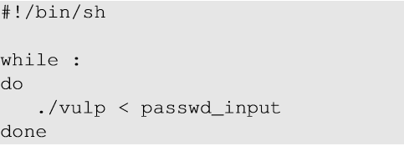
Attack: Run the Vulnerable Program
Two processes that race against each other: vulnerable process and attack process
Run the vulnerable process
Vulnerable program is run in an infinite loop (target_process.sh)
passwd_input contains the string to be inserted in /etc/passwd [in previous slide]

Slide 17
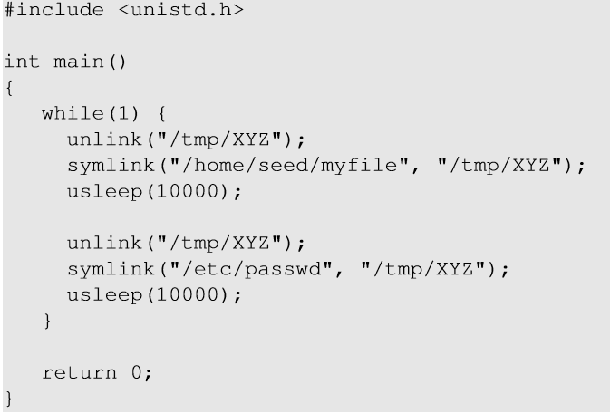
Attack: Run the Attack Program
Create a symlink to a file owned by us. (to pass the access() check)
Sleep for 10000 microseconds to let the vulnerable process run.
Unlink the symlink
Create a symlink to /etc/passwd (this is the file we want to open)

Slide 18
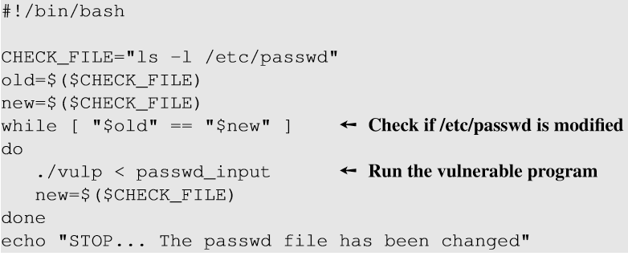
Monitor the Result
Check the timestamp of /etc/passwd to see whether it has been modified.
The ls -l command prints out the timestamp.

Slide 19
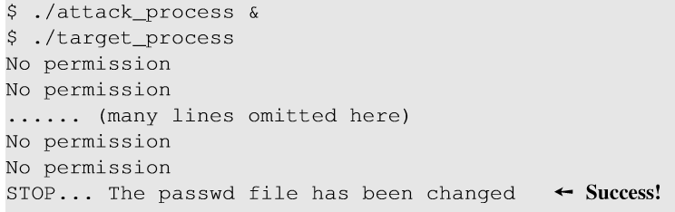
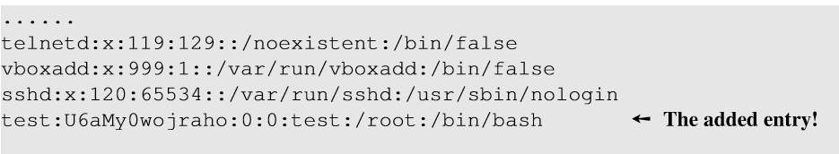
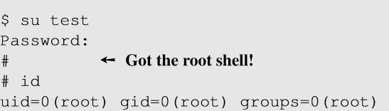

Running the Exploit
Run both attack and vulnerable programs to start the “race”.
Added an entry in /etc/passwd
We get a root shell as we log in using the created user.
Notes:
No permission : access() check failure
Success : Attack process wins the race and /etc/passwd is modified.

Slide 20
Countermeasures
Atomic Operations: To eliminate the window between check and use
Repeating Check and Use: To make it difficult to win the “race”.
Sticky Symlink Protection: To prevent creating symbolic links.
Principles of Least Privilege: To prevent the damages after the race is won by the attacker.

Slide 21
Atomic Operations
f = open(file, O_CREAT | O_EXCL)
f = open(file ,O_WRITE | O_REAL_USER_ID
These two options combined together will not open the specified file if the file already exists.
Guarantees the atomicity of the check and the use.
This is just an idea, not implemented in the real system.
With this option, open() will only check the real User ID
Therefore, open() achieves check and use on it’s own and the operations are atomic.

Slide 22
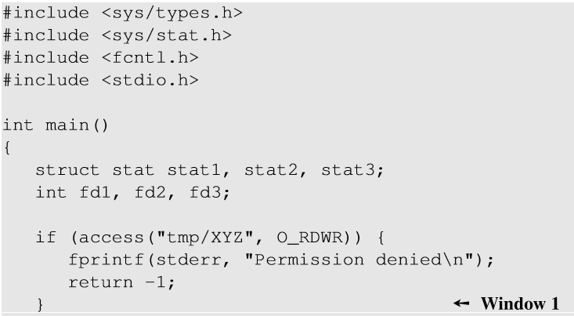
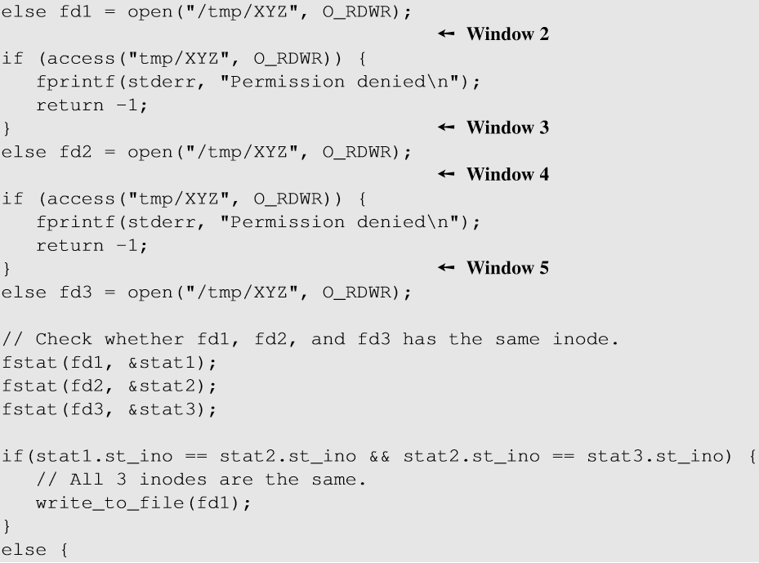
Repeating Check and Use
2
3
1
Check-and-use is done three times.
Check if the inodes are same.
For a successful attack, “/tmp/XYZ” needs to be changed 5 times.
The chance of winning the race 5 times is much lower than a code with one race condition.

Slide 23
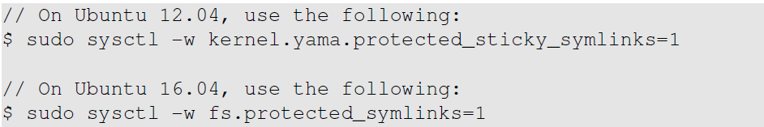
Sticky Symlink Protection
To enable the sticky symlink protection for world-writable sticky directories:
When the sticky symlink protection is enabled, symbolic links inside a sticky world-writable can only be followed when the owner of the symlink matches either the follower or the directory owner.
Notes:
Sticky Directory : In Linux filesystem, a directory has a special bit called sticky bit. When this bit is set, a file inside the directory can be renamed or deleted by the the file’s owner,the directory owner or root user.If the bit is not set, any user with write and execute permissions for the directory can rename or delete the file.To prevent normal users from renaming and deleting other users’ files inside, sticky bit is set.

Slide 24
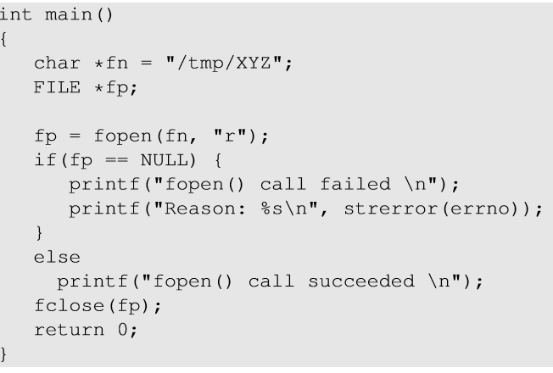
Experiment with Symlink Protection
Using the code and user IDs (seed and root), experiments were conducted to understand the protection.

Slide 25
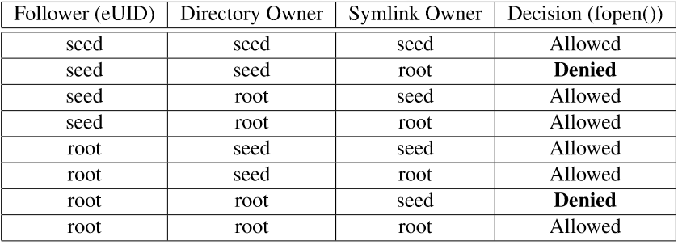
Sticky Symlink Protection
Symlink protection allows fopen() when the owner of the symlink match either the follower (EID of the process) or the directory owner.
In our vulnerable program (EID is root), /tmp directory is also owned by the root, the program will not allowed to follow the symbolic link unless the link is created by the root.

Slide 26
Principle of Least Privilege
Principle of Least Privilege:
A program should not use more privilege than what is needed by the task.
Our vulnerable program has more privileges than required while opening the file.
seteuid() and setuid() can be used to discard or temporarily disable privileges.

Slide 27
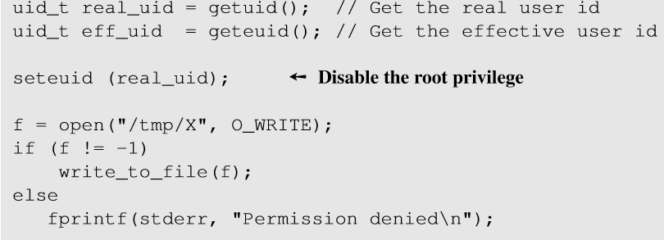
Principle of Least Privilege
Right before opening the file, the program should drop its privilege by setting EID = RID
After writing, privileges are restored by setting EUID = root

Slide 28
Quiz
Q: The least-privilege principle can be used to effectively defend against the race condition attacks discussed in this chapter. Can we use the same principle to defeat buffer-overflow attacks? Why or why not? Namely, before executing the vulnerable function (e.g., strcpy()), we disable the root privilege; after the vulnerable function returns, we enable the privilege back.
A: No. For buffer-overflow attack or other code injection attacks, attacker is running her own program, and can always turn back on root privilege. (It is useful to permanently drop the root privilege.) In contrast, for race condition attack, attacker does not run her own program, hence she cannot set privileges at all.

Slide 29
Summary
What is race condition
How to exploit the TOCTTOU type of race condition vulnerability
How to avoid having race condition problems

