Slide 1
A Case for NUMA-aware Contention Management on Multicore Systems Sergey Blagodurov et al. 2011
ZJU 2020
Notes:
This chapter provides an overview of computer security. We begin with a discussion
of what we mean by computer security. In essence, computer security deals
with computer-related assets that are subject to a variety of threats and for which
various measures are taken to protect those assets. Accordingly, the next section of
this chapter provides a brief overview of the categories of computer-related assets
that users and system managers wish to preserve and protect, and a look at the
various threats and attacks that can be made on those assets. Then, we survey the
measures that can be taken to deal with such threats and attacks. This we do from
three different viewpoints, in Sections 1.3 through 1.5. We then lay out in general
terms a computer security strategy.
The focus of this chapter, and indeed this book, is on three fundamental
questions:
1. What assets do we need to protect?
2. How are those assets threatened?
3. What can we do to counter those threats?

Slide 2
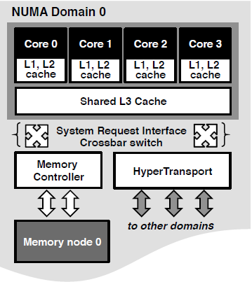
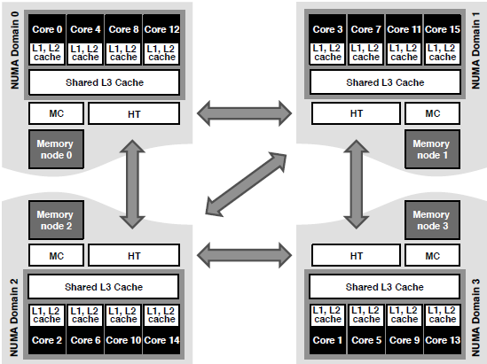
An AMD Opteron system with 4 domains

Slide 3
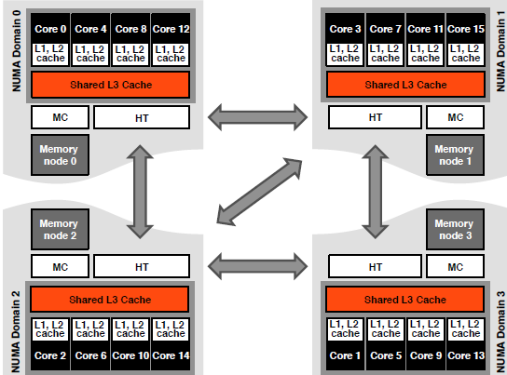

Slide 4
